Slide 1
Choosing a Tech Stack
2023 Hyland Hackathon

Slide 2

agenda
goals & considerations
technologies & frameworks
deployments
closing thoughts

Slide 3

goals for your hackathon experience
Win the competition?
Learn something new?
Expand existing knowledge?
Build something extraordinary?

Slide 4
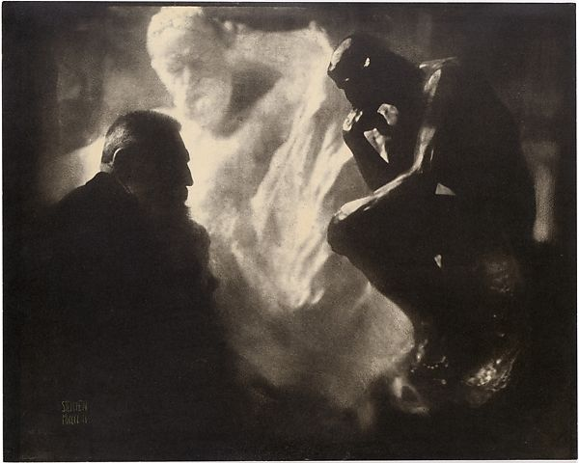
things to consider
Prior Knowledge
Industrial Usage
Mentor Experience
Ease of Onboarding

Slide 5
Technologies & Frameworks
platforms, languages, and more

Slide 6
web v. non-web
Non-Web
Web
Desktop applications
Mobile applications
Games, audio, deep back-end
Mentor experience in C#
Used for specific cases in industry
More difficult to begin
Recommended in specific cases
Static front-end websites
Full-stack websites
Progressive web apps
Mentor experience in many areas
Simple to start
The way of the future
Highly recommended

Slide 7
databases & the beauty of crud
SQL v. NoSQL
MongoDB
DynamoDB
Redis
MySQL
SQLite
PostgreSQL
Starting from a basic CRUD app, you can build something like Twitter or any number of useful software applications.

Slide 8
back-end web frameworks
JavaScript – NodeJS/Express, Deno
Python – Flask, Django
C# - ASP.NET
Java – Spring Boot
Ruby – Rails

Slide 9
front-end web frameworks
React
EJS
Ember
Angular
Vue
Svelte
Blazor

Slide 10
full web stacks
HTML, CSS, JS
MERN
MEAN
MEVN
Django
Ruby

Slide 11
deployments
Docker
AWS
I really don’t know

Slide 12
resources
Check the gitbook for this activity
Mentor shifts/skills

Slide 13
closing thoughts
No wrong choices

Slide 14
Questions?
now’s the time

Slide 15
Thank You
2023 Hyland Hackathon

