Slide 1

How To Make A Splash In The World Of Business
2023 Hyland Hackathon

Slide 2
Steps To Success
1999
Be Born Into a Cold and Callous World
2014
Descend into an Existential Crisis
2023
Dedicate Your Life to the Study of Business
The Future
Achieve Your Wildest Dreams

Slide 3
Follow The Three Rules of Business
Success is within reach

Slide 4



Rule #1: Make The Profits Go Up

Slide 5
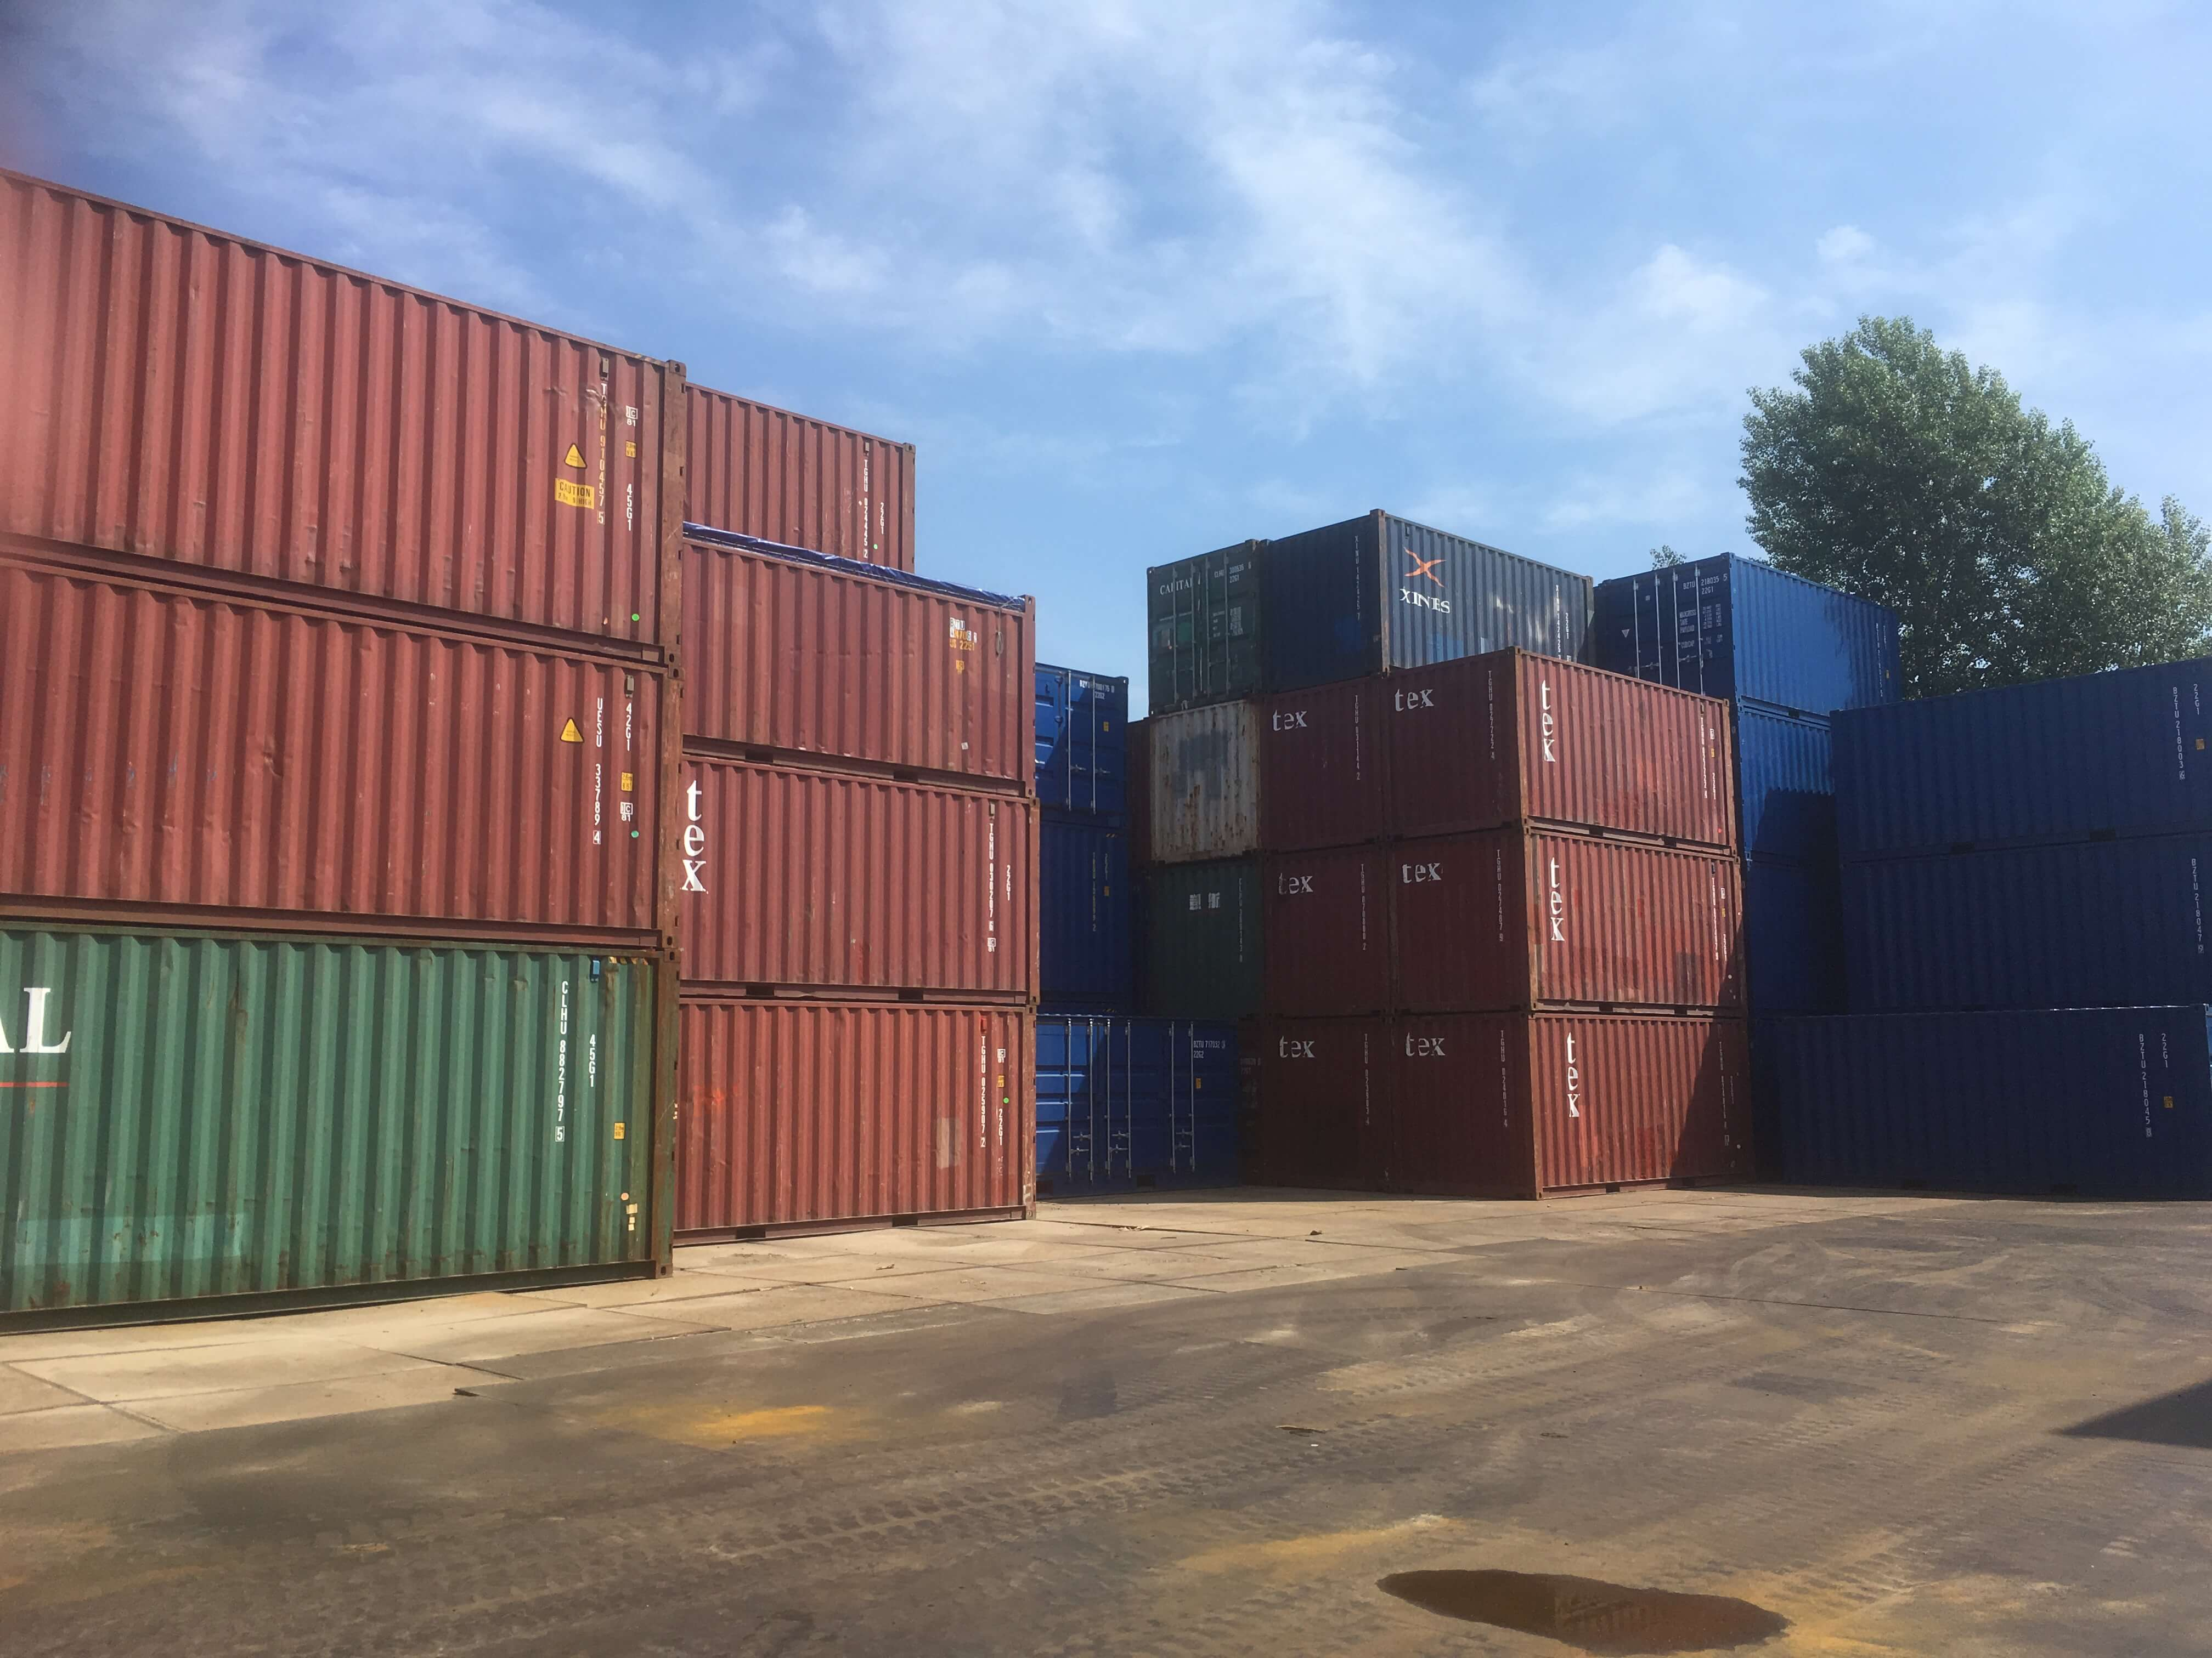


Rule #2: Containerize Deliverables

Slide 6



Rule #3: ABC (Always Be Closing)

Slide 7

Conclusion: You Will Make A Splash
Don’t Give Up On Your Dreams!

