Slide 1
Command Line
2023 Hyland Hackathon

Slide 2


Slide 3
Before The Gui
Command-Line Interfaces (CLI) were once the primary means of computer interaction
Graphical User Interfaces (GUI): the modern-day visual programs we all know and love
Now, the command line provides the ability to perform complex tasks that cannot be achieved with the available features provided by the operating system’s GUIs

Slide 4
Bash
Shell programs allow you to run a variety of commands on your computer
Bash is a Unix shell and command language, and is the default shell on Linux and OS X

Slide 5
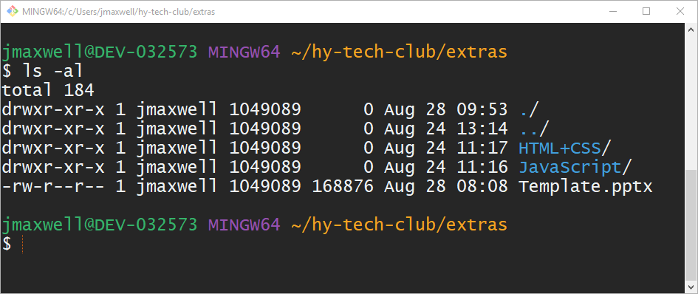
What does it look like?
System information
Command example
Command output
Command Prompt – where the user enters commands

Slide 6
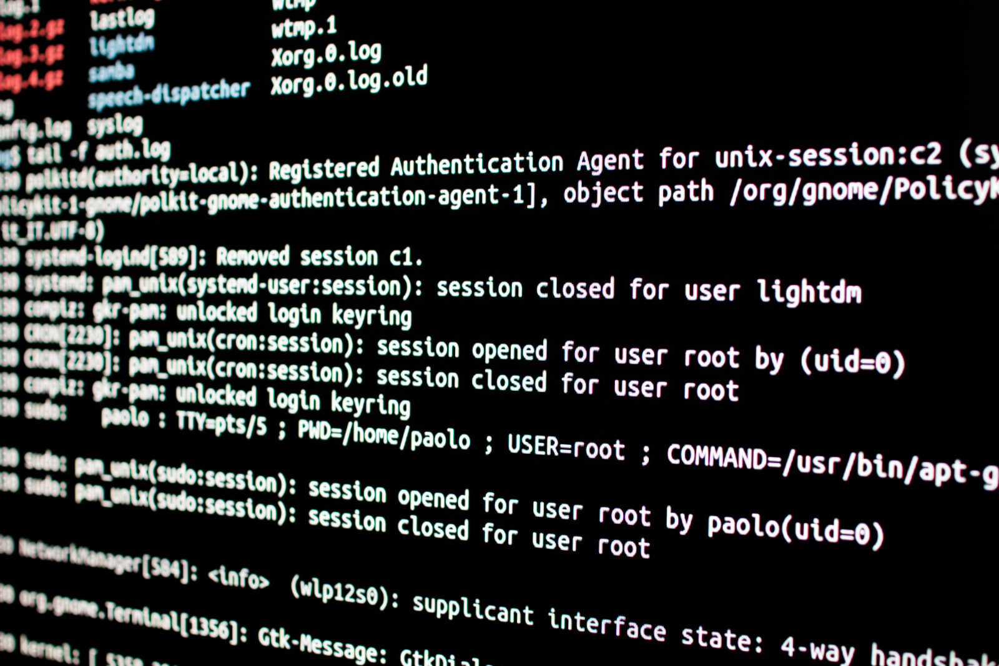
Bash Commands

Slide 7
Basic Bash commands
pwd – prints the working directory
A directory is a folder, just like in File Explorer
ls – lists the contents of the working directory
This will show both files and folders
cd – changes the working directory
This is the main way to move around in the file system
This command takes an argument to know where to go
Notes:
It will be helpful to show these commands in action in a Git Bash instance

Slide 8
The cd command
When you enter… | The directory changes to…
cd | Home directory
cd <path> | <path>
cd .. | One folder level up

Slide 9
Paths
A path specifies a unique location in a file system
It is the general form of the name of a file or directory
An absolute path is a full path, starting from the root
Ex: /c/Users/bburger/Downloads/file.txt (file)
Ex: /c/Users/bburger/Documents/ (directory)
A relative path is a partial path, starting from the current working directory
Ex: Downloads/file.txt (file – notice no starting slash)
Ex: Documents/ (directory – notice no starting slash)
Notes:
For these examples, if the user was in the /c/Users/bburger directory, the absolute and relative paths would go to the same place

Slide 10
Helpful Tips
TAB – When typing out a command, pressing the TAB key will attempt to auto-complete it
UP – Pressing the UP key will cycle through your command history
Ctrl+C – Pressing the key combination of Ctrl and C will kill the current process

Slide 11
DEMO: REPLIT Shell
Notes:
Click on the “Replit Shell” link: https://replit.com/@HylandOutreach/ShellCommands
Fork the project
Open the Shell (under Tools -> Shell button)
Try out some basic commands: pwd, ls, and cd
Show how to use TAB, UP, and Ctrl+C
An example for Ctrl+C could be running the “cmatrix” command and stopping it

Slide 12
Questions?

