Slide 1
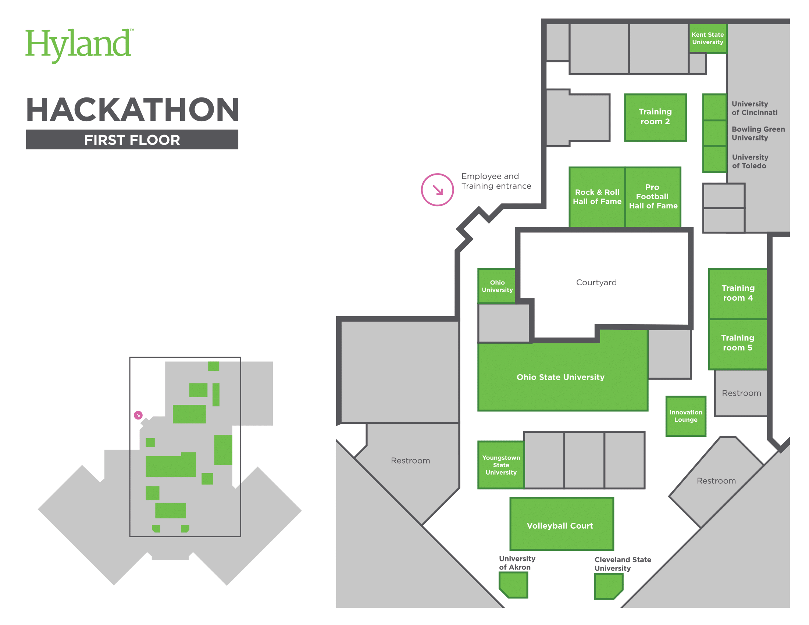

Slide 2
1
2
7
Employee &
Training Entrance
3
4
8
5
6
9
Workstations
10
11
14
15
Big Rooms
Customer Experience Lounge: 1, 2, 3, 4
Rock & Roll Hall of Fame: 10, 11, 12, 13
Pro Football Hall of Fame: 14, 15, 16, 17
12
13
16
17
18
19
20
21
Auditorium
22
23
Courtyard
Raffle Rooms
University of Cincinnati: 7
Bowling Green University: 8
University of Toledo: 9
Miami University: 10, 11
University of Akron: 32
Cleveland State University: 33
Auditorium
(Ohio State University)
Bathrooms
Hallway
Bathrooms
& Showers
R&D Training Room 2
Mentor Rooms
Ohio University
Youngstown State University
Bathrooms
24
25
30
26
Volleyball Court
27
31
28
29
Quiet Rooms
32
33
Break Room

Slide 3
Beach & Palms Newsletter
RETRO
Here is where your presentation begins

