Slide 1
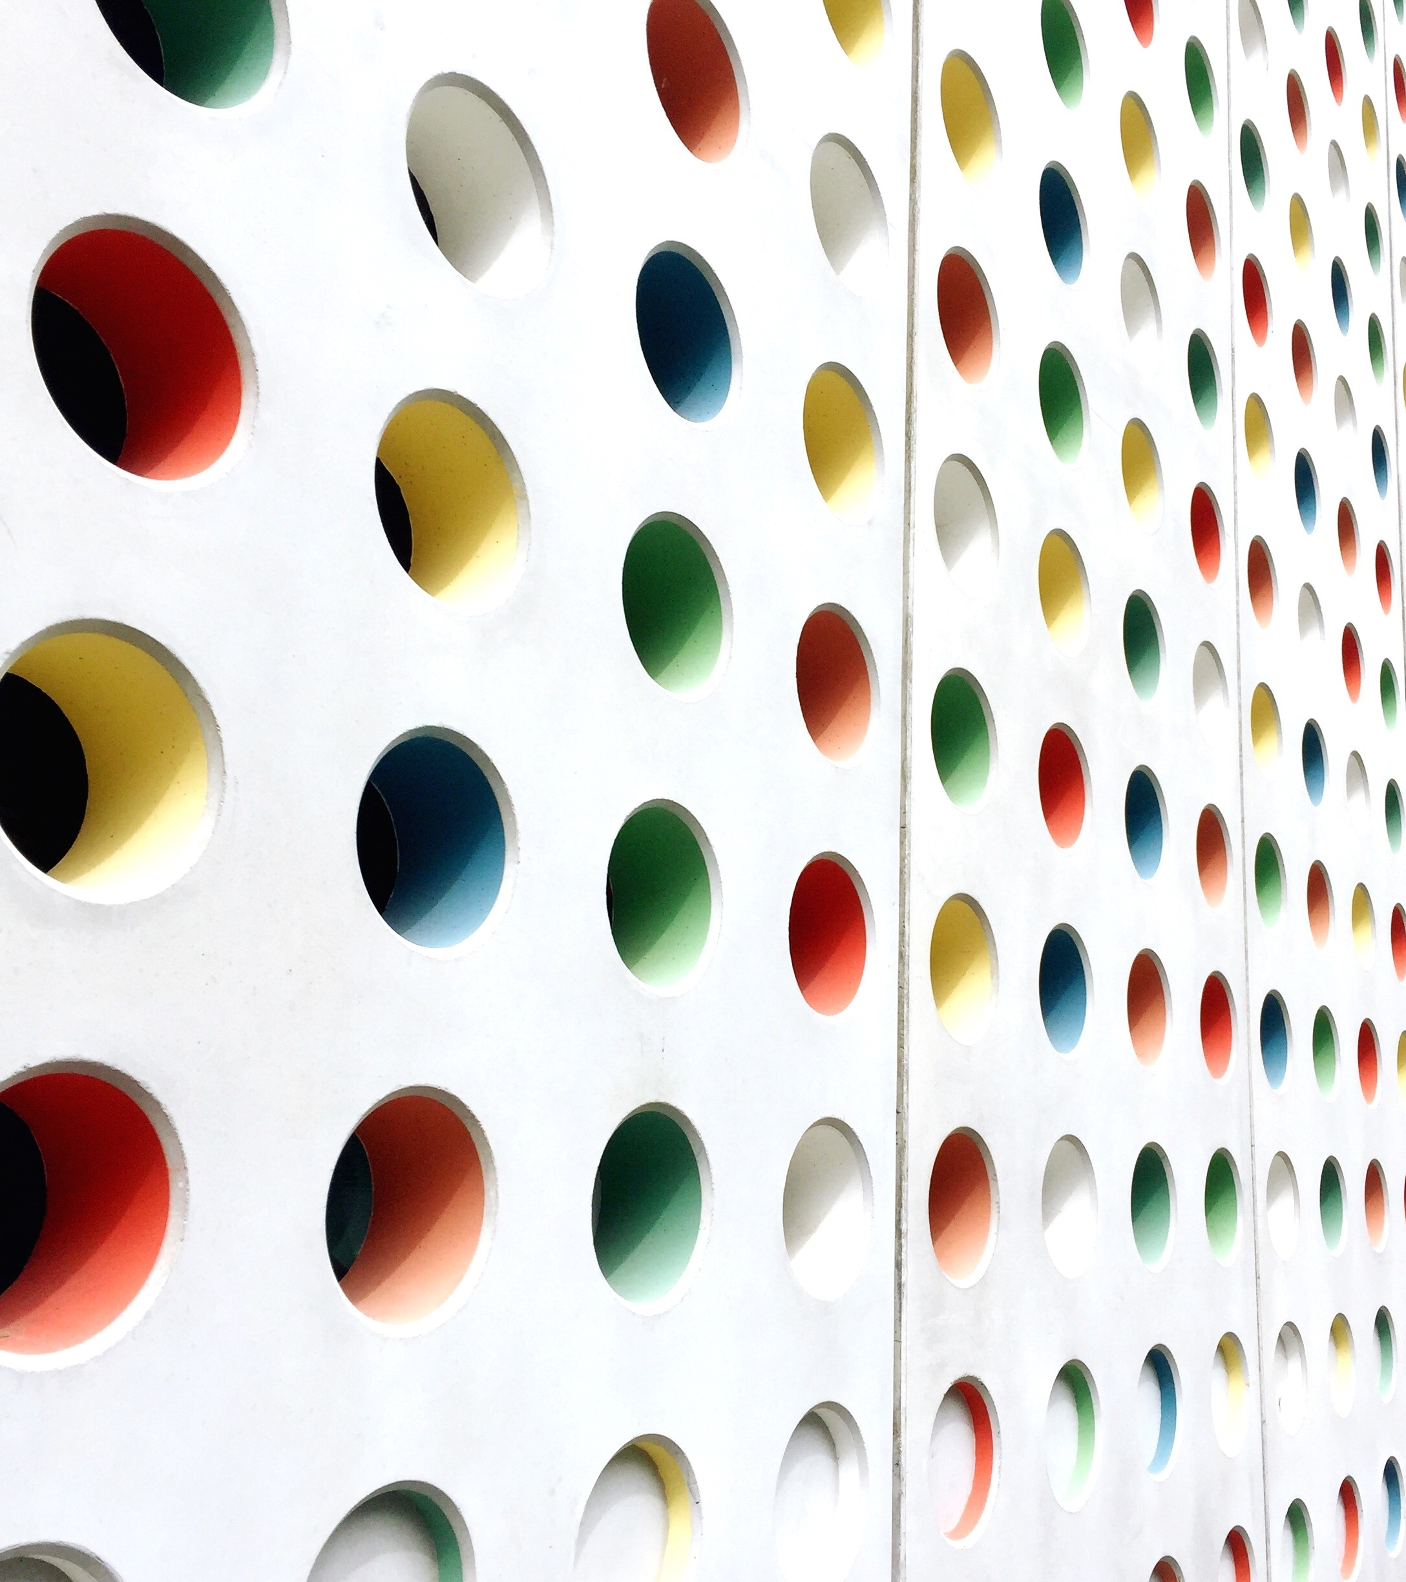
The Meaning of Art
2023 Hyland Hackathon

Slide 2
Process
Research: PRIMARY & SECONDARY DOCUMENTS
GOAL: EXPLAIN THE MEANING BEHIND THE WORKS
SELECTION: THREE PERPLEXING PIECES

Slide 3
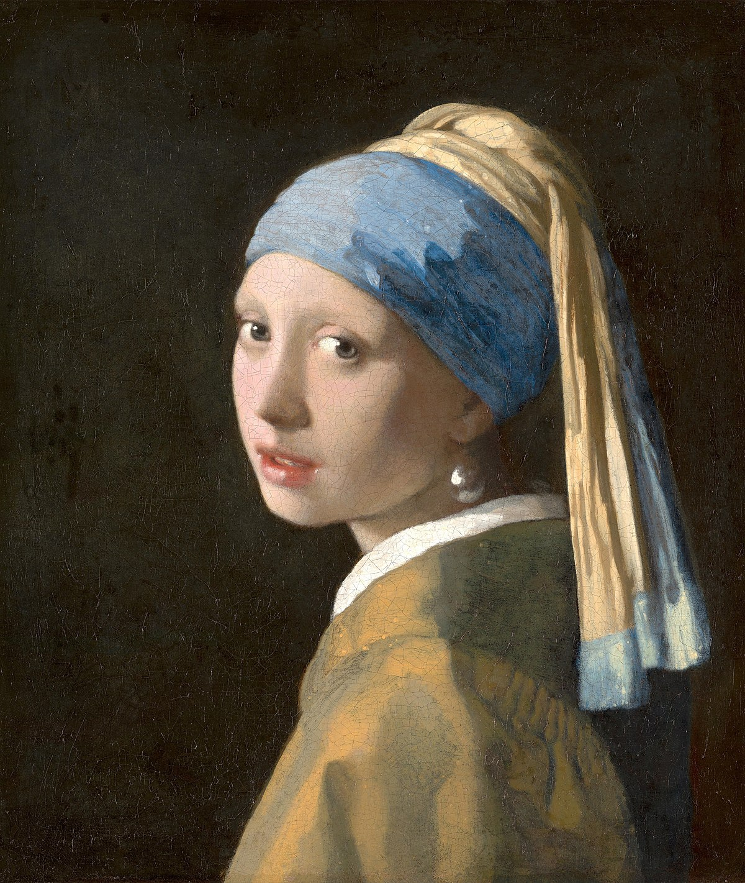
Girl with a Pearl Earring
This enigmatic piece raises many questions, but the answers have now become apparent…

Slide 4
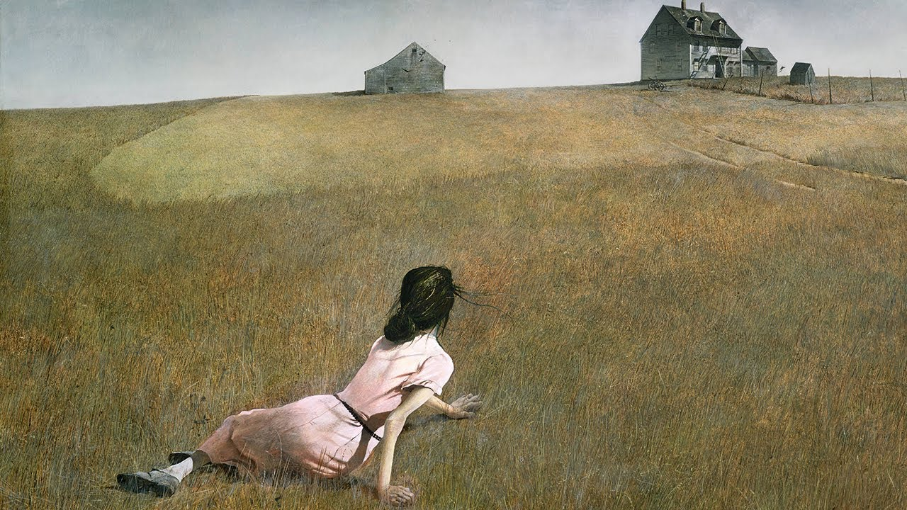
Scholars have debated the implications of this painting for decades, but now, finally, the true nature of the work can be revealed…
Christina’s World

Slide 5
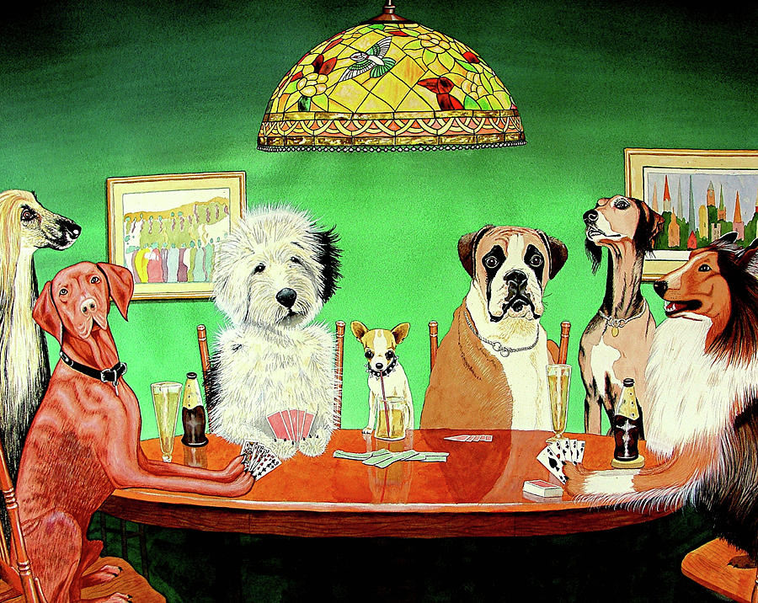
Dogs Playing Poker
This masterpiece strikes some as incomprehensible at first, but with a deeper look, the meaning is clear…

Slide 6
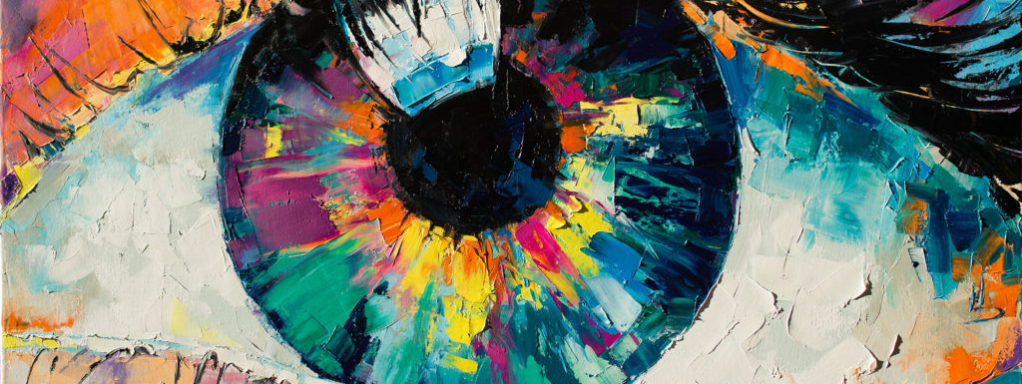
THANK YOU
The powerful messages behind these works will echo through the halls of the vast inconceivable future.

