Slide 1
Introduction to Git & GitHub
Hyland Hackathon

Slide 2
hylandtechoutreach.github.io/hackathon
Notes:
Show the students this site – it has a lot of helpful resources, including this presentation and links.

Slide 3

What is GitHub?
Notes:
Ask the students if they have heard of GitHub or have any idea what version control is

Slide 4
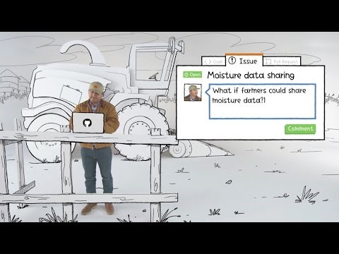
Notes:
This ~4min video introduces GitHub at a very high level, including issue tracking. The idea of the video is to give students an idea of who uses GitHub and how they use it, not introduce them to any technical concepts.

Slide 5
GitHub vs. Git
Git is a revision control system; a tool to manage your source code history.
GitHub is a hosting service for git repositories.
Git is the tool, GitHub is a service for projects that use git.
Notes:
Explain the difference between Git and GitHub. Students may confuse the two, which is understandable. The important thing to remember is that GitHub uses Git.

Slide 6
Essential concepts
A GitHub Repository is like a folder for a project. It contains all of the project files and stores the version history for each file.
A remote repository stores the project files on a server.
A Clone is a copy of a repository that lives on a local computer instead of on a remote server.
A Branch is one version of a repository. It allows developers to use/update files without affecting other versions.
A fork is similar to a branch, but it’s a copy of an existing repository.
Notes:
Go over some basic Git terminology. The most important part of Git is the Repository. A clone is also important – it’s a local copy.
Branches will be discussed more later.

Slide 7
Git
GitHub
an open-source program for tracking changes in text files
Clone
a provider of internet hosting for software development and project version control
a copy of a repository that lives on your computer instead of on a website
Repository
Branch
a parallel version of a repository
contains project files and stores each file's revision history
Notes:
Each boxed description corresponds with a term. Prompt the students to answer in the chat for each box, and whoever answers first gets a point.
Click on the boxes to reveal the answers.

Slide 8
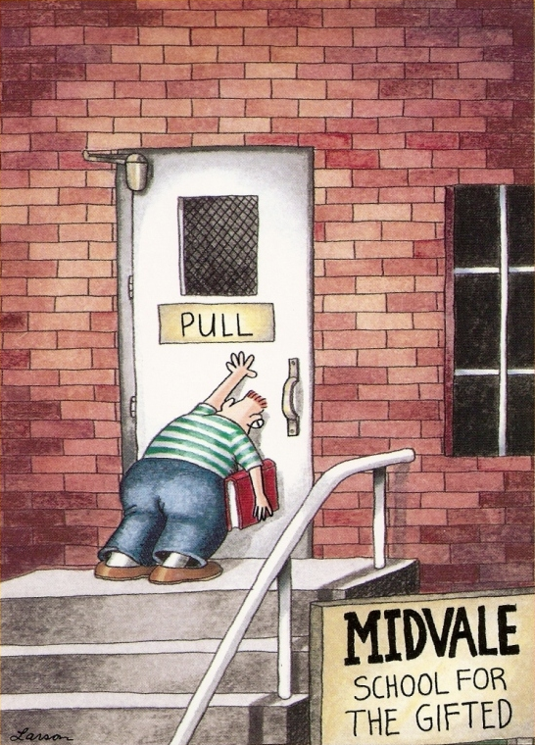
Pushing & Pulling
Notes:
So now that a repository exists, how do you actually work with it? How do you add/update files and make sure everything is up to date? Let’s find out.

Slide 9
More essential concepts
A Commit is an individual change to a file or set of files. Committing a change is like saving files, but with messages and tracking.
Pushing sends committed changes from a local repository to a remote repository, such as a repository on GitHub.
Pulling fetches changes from a remote repository and merges them into the local repository. (or – from branch to branch)
Notes:
A Commit is like a file save. It keeps track of every change to the file with a message. Commits are made locally but stored remotely after being pushed. They make it possible to revert back if necessary!
Pushing code sends it from the local to the remote, allowing the changes to be stored on the server repository. Remember, the local repository is the clone, and the remote repository is the server.
Pulling fetches changes from the remote and merges them into the clone repository. Again, remember the local repository is the clone, and the remote repository is the server.

Slide 10
git add && git commit && git push
In order to update the files in a repository, it is necessary to add, commit, and push the changes.
Follow these steps:
Make a change in the local repository
Add the change to the staged changes
Commit the change to the local repository
Push the change from the local repository to the remote repository
Notes:
Go over the necessary steps to make a change in the server repository from the clone repository.
Emphasize that local = clone and remote = server.
This applies for regularly-created repositories as well as forked repositories.

Slide 11
git pull
In order to update a local repository with the latest changes from a remote repository (or another branch), it is necessary to pull the changes.
Follow these steps:
Clean up the local repository as needed
Pull from the remote repository
Fix any merge conflicts that might arise
Notes:
Go over the purpose and procedure for pulling. It’s usually a good idea to pull before pushing – this can prevent merge issues.

Slide 12
Push
Commit
an individual change to a file (or set of files)
sending changes from a local repository to a remote repository
Pull
fetching and merging changes from another branch
Notes:
Each boxed description corresponds with a term. Prompt the students to answer in the chat for each box, and whoever answers first gets a point.
Click on the boxes to reveal the answers.

Slide 13
Collaboration
How can the whole team work on the same codebase simultaneously?

Slide 14
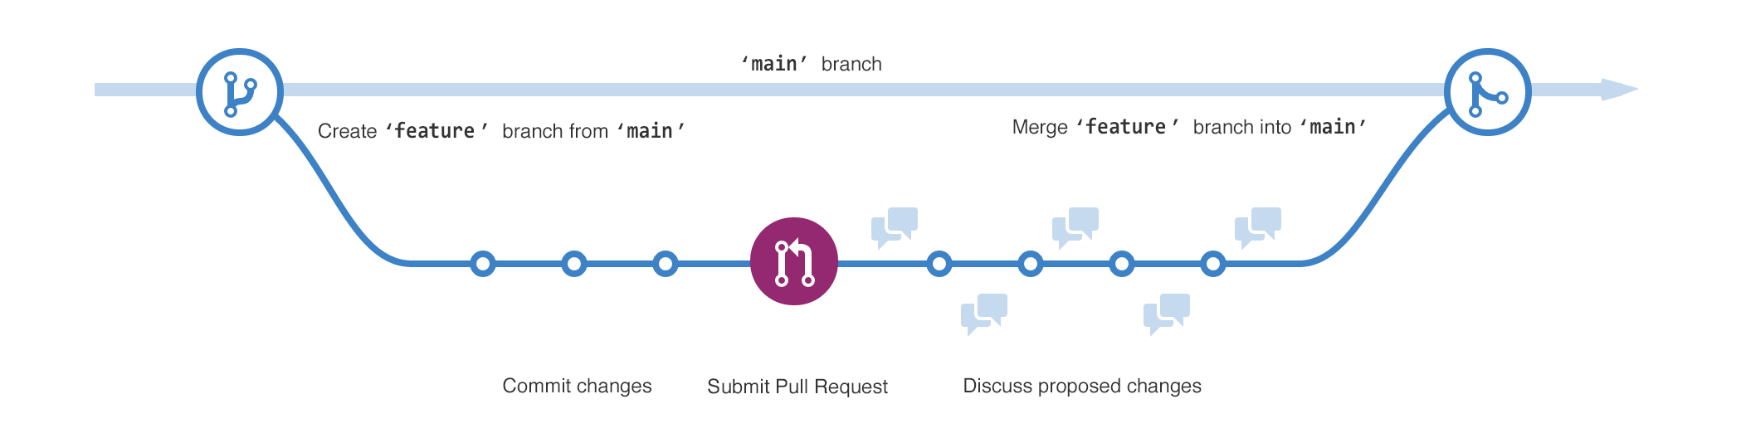
More on Branches
A branch is a parallel version of a repository
Branches allow developers to isolate development work, then merge it together
Two common types of branches are main and feature
Notes:
Introduce the idea of branching in Git.
The main branch holds all of the “real” code. It is usually the main branch, the one source of truth in a repository.
A feature branch is usually used for development work on features that are in progress. Once the work is complete, the feature branch merges into the main branch.

Slide 15

Merging takes the changes from one branch and applies them to another.
Notes:
Briefly explain merging. It basically means adding changes from one branch to another. Where have we seen the word “merge” before? For pulling!
Merging is often used to add new changes from a feature branch to the main branch, or pulling down the latest changes from the main branch into a feature branch.
So how does a merge take place? With a pull request!

Slide 16


Pull Requests
Pull requests are proposed changes to a repository
They are usually used to merge a feature branch into the main branch
Notes:
Merges are initiated with pull requests. This is basically someone saying, “I would like to add my changes to the repository.” Pull requests can include a number of commits, comments, and discussion. A pull request is complete when the owner of the repository merges it.

Slide 17
Typical Git Workflow
Developer wants to work on a new feature in the repository
Developer creates a new feature branch in the repository
Developer pushes changes to the feature branch
Team makes changes in the main branch
Developer merges the main branch into the feature branch
Developer submits a pull request to the main branch
Team merges the feature branch into the main branch
Notes:
Go over the full workflow of a typical developer.
The developer creates the feature branch and makes some changes in it. Note that this does not affect the main branch.
The blue part: the team makes separate changes in the repository. The developer merges these into the feature branch to make sure all the code is up-to-date.
This is important to avoid merge conflicts
Finally, the developer submits a pull request and the changes are merged into the code.

Slide 18
Typical Git Workflow
Notes:
View a graphic representation of the git workflow.
This graphic does not contain a depiction of changes from main merging into the feature branch, but that is also important.

Slide 19
Why?
If you break something, it’s possible to revive an old version of your code
Git makes it easier for team members to work at the same time
Git is a valuable skill if you want a career as a software developer
GitHub is a great place to showcase code you have written
Contributing to open-source projects can be extremely rewarding
Notes:
After the presentation, students may realize that using GitHub can be a lot of work. It would probably be easier to just use Repl.it Multiplayer/VS Live Share and keep all the code in one project, or send files back and forth. However, there are several reasons to start learning and using GitHub.

Slide 20
Questions?

