Slide 1
How To Make Friends
2023 Hyland Hackathon

Slide 2
Agenda
Places
People
Strategies
Inspiration

Slide 3
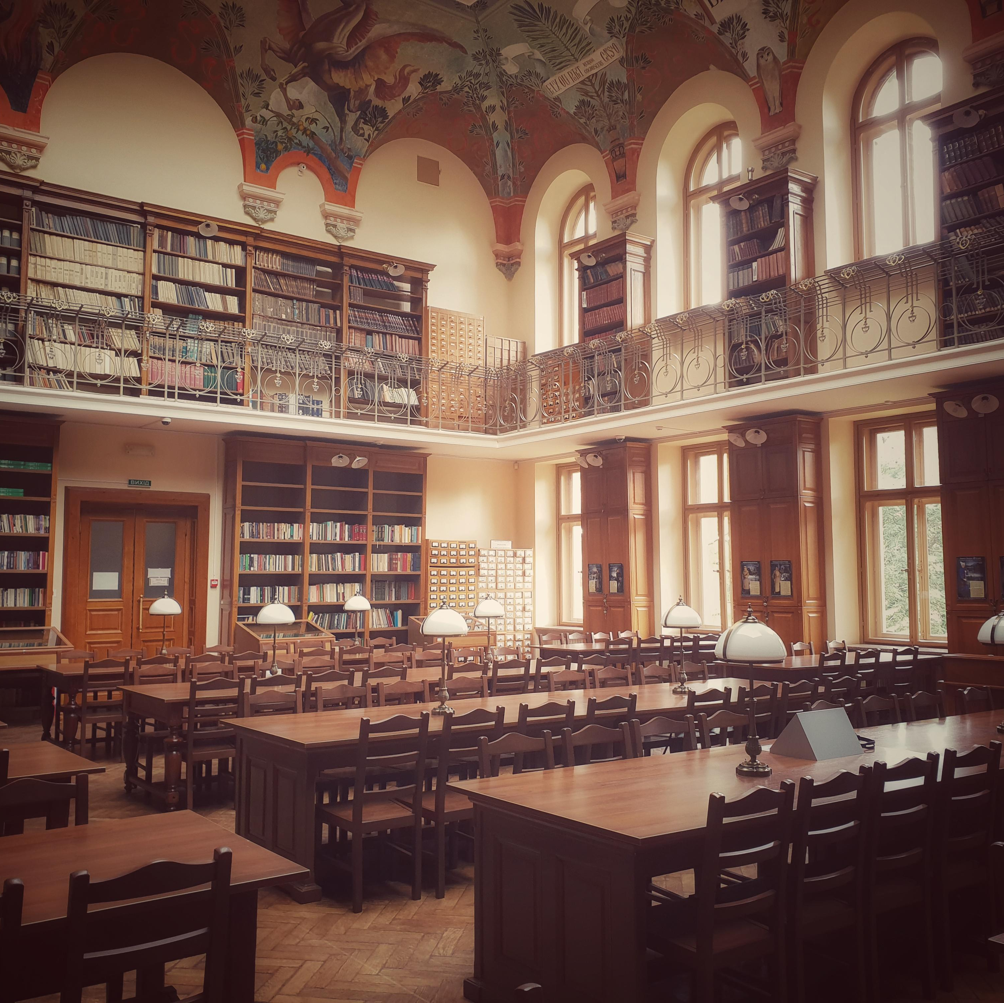

Places
The Public Library
The Beach
The Park
The Store
The Grocery Store
Best Buy
School
Your House

Slide 4

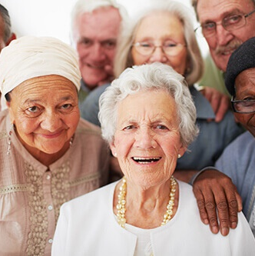
People
Be on the lookout for anyone who looks lonely… they might be a prime target for future friendship.
Senior citizens are usually very willing to talk, and their boring stories could be a gateway into companionship.
Remember that anyone can be a friend!

Slide 5
Strategies
Contact
Next Steps
Compliment Clothing
Ask For Book Recommendation
Discuss Temperature
Accidentally Spill Coffee
Tell Appropriate Joke
Ask To Be Friends
Exchange Numbers
Discuss Politics/Religion
Plan To Meet Again
Leave Awkwardly

Slide 6
Inspiration
Believe

