Slide 1
🏆
Prizes
2023 Hyland Hackathon

Slide 2
Raffle Prizes
Earn Raffle Tickets throughout the weekend by attending activities, helping others, asking great questions, and participating.
Each ticket you earn will give you one more chance to win!

Slide 3
Physical Prizes
🍭
Candy Bag
💧
Water Bottle
🦆
Rubber Ducks
👜
Grab Bag
🧸
Stuffed Animal
Yum!
Ahh!
Quack!
Assorted!
Cute!
IN-PERSON
Notes:
Candy – assorted candy bags
Rubber Ducks - https://www.amazon.com/SmartYeen-Toddlers-Assorted-bathtime-Birthday/dp/B0B4CDBDS9/
Stuffed animals - https://www.amazon.com/TeeTurtle-Reversible-Octopus-Mini-Plush/dp/B07H4HKDG7, https://www.amazon.com/dp/B09ZXTGRMY/, https://www.amazon.com/Aurora-World-Rolly-Prankster-Plush/dp/B01MZFBOVV/, https://www.amazon.com/Aurora-World-31290-Foxxie-Plush/dp/B004JRR5BM/, https://www.amazon.com/Melissa-Doug-Stuffed-Washable-Surface/dp/B004N7NFSK/
Squishmallow - https://www.amazon.com/dp/B09NB3QP1P/, https://www.amazon.com/dp/B09NB1QQWC/, https://www.amazon.com/Squishmallow-Official-Kellytoy-Ultrasoft-Stuffed/dp/B08G1W7G93
Water Bottle – hyland branded
Grab bag – USB sticks, extra swag, sunglasses

Slide 4
Digital Prizes
🎧
Audible Credit*
🎹
Bonus Track
🖼
A.I. Portraits
🖋
A.I. Poetry
🏫
Udemy Course*
Literary!
Musical!
Artistic!
Iambic!
Educational!
VIRTUAL
*international prize options may vary
Notes:
Audible credit - https://www.audible.com/ep/giftcenter
A.I. Portraits – Matt can generate through DALL-E
A.I. Poetry – Matt can generate through GPT-3
Bonus Track – Joseph can create a custom synthwave track
Udemy Course - https://support.udemy.com/hc/en-us/articles/229231187-How-to-Send-a-Udemy-Gift-
(note for udemy courses – the prices might go way up, so we should have a backup plan)

Slide 5
Grand Prizes
The judges will select the top two teams from each level. Each member will win one of these valuable prizes…

Slide 6

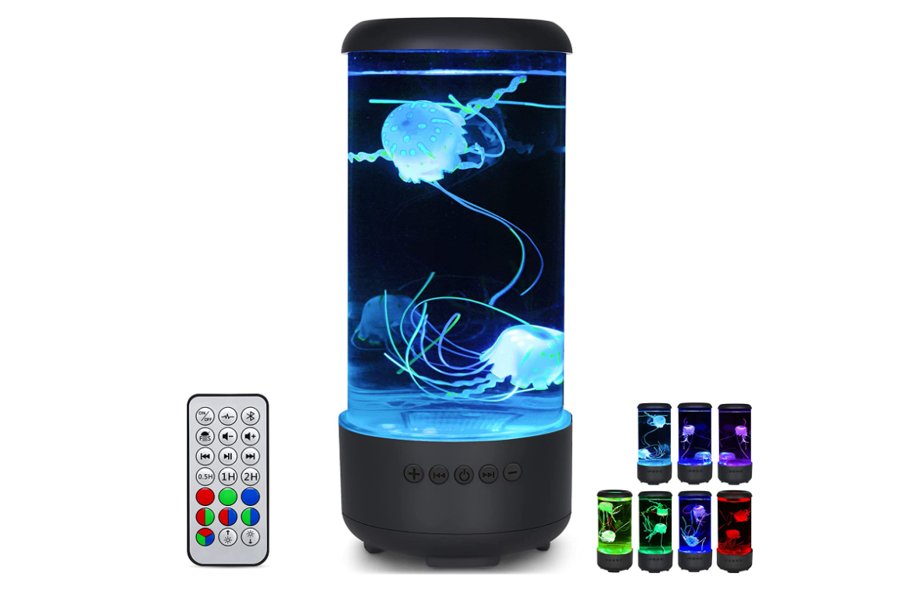
Second Place: Pick One
Pixel Art Bluetooth Speaker*
LED Jellyfish Lamp*
*international prize options may vary
Notes:
LED lamp: https://www.amazon.com/dp/B0B8R4T5HX/
Pixel Art Speaker: https://www.amazon.com/dp/B0811XB8VB/ref=cm_gf_acbr_iaac_d_p0_e0_qd0_NUOdAM3fFvGTmlUdfhxg

Slide 7
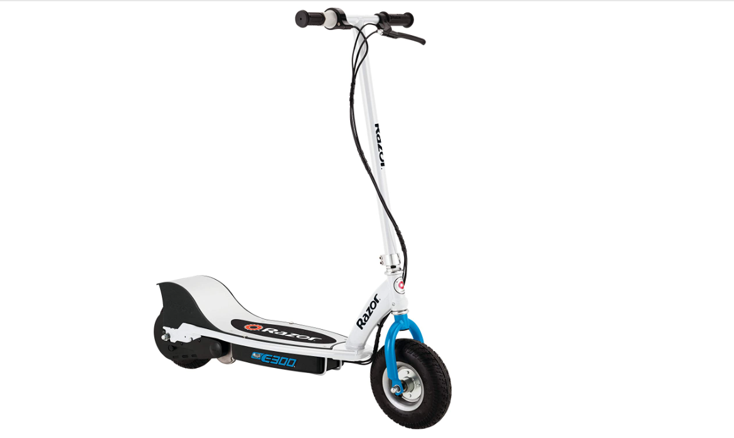
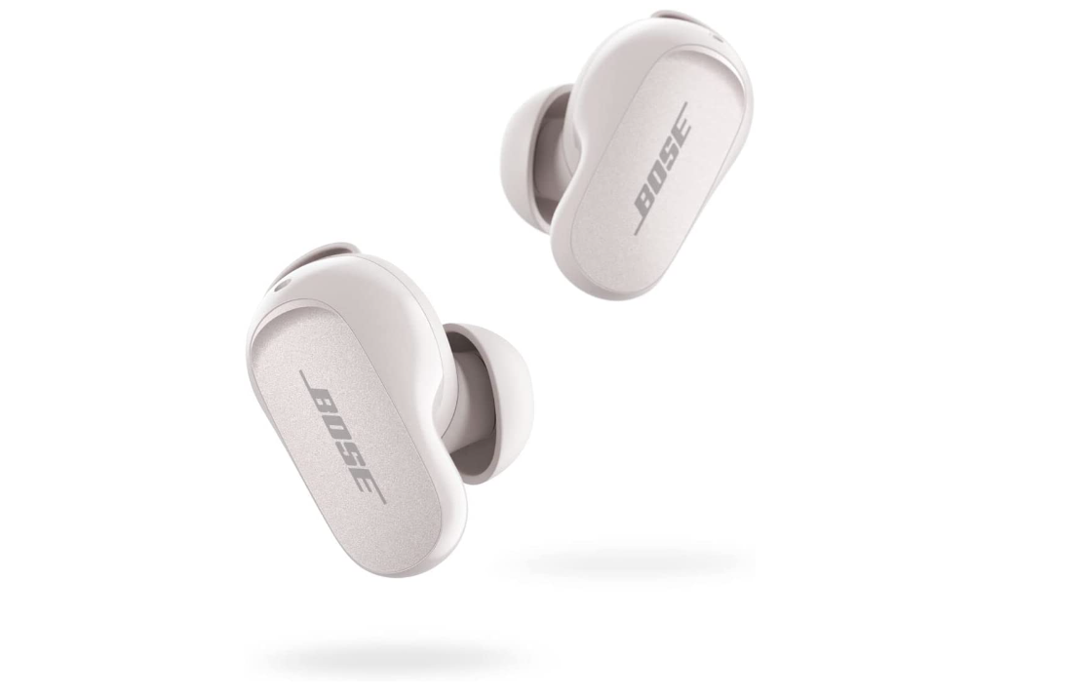
First Place: Pick One
Electric Scooter*
Bose Noise Cancelling Earbuds*
*international prize options may vary
Notes:
Bose Earbuds: https://www.amazon.com/dp/B0B7838HH6/
Electric Scooter: https://www.amazon.com/Razor-E300-Electric-Scooter-White/dp/B083G8KWCY

