Slide 1
User Experience
2023 Hyland Hackathon
Notes:
Hello, and welcome to this presentation about Software Development Teams and Processes!

Slide 2
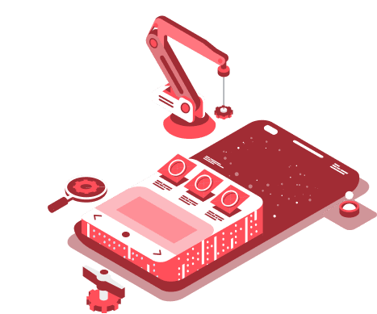
What is your favorite mobile app?
Notes:
What are some of your favorite mobile applications? I’m sure they all have good user experience! Positive user experience contributes to the quality of any app and must be considered. Apps that are favorites likely had a lot of thought put into their user experience.

Slide 3


User eXperience Team Goals
What does a User Experience team do?
Improve the software + customer relations
Make pleasant + productive products for end users
Software that does not frustrate or annoy them
Find innovative ideas in interaction technology
Attend conferences, learn from industry/research
Advocate for customer perspectives
Notes:
Does anyone have any idea what a user experience team does? Good guesses!
Probably the biggest thing is that they improve the software and customer relations for a product
They try to make pleasant and productive products – they want to avoid software that frustrates or annoys people. If you’ve ever used a product like that, you know why this team exists!
They are always looking for innovative ideas in interaction technology – they attend conferences and learn from industry and research. They might hear about something that’s working really well at Uber, and try to take those ideas and apply them to their work.
They are also always advocating for the customer. They try to see things as the customer does, and make sure they have a voice.

Slide 4



UX Stages
Research
Design
Test
Notes:
So what stages are there for UX on a project?
First, we have research
Next, we have design
And finally, we have test. These stages are often divided into different teams, where some people work on research and some work on design. They all work together to determine the experience!

Slide 5
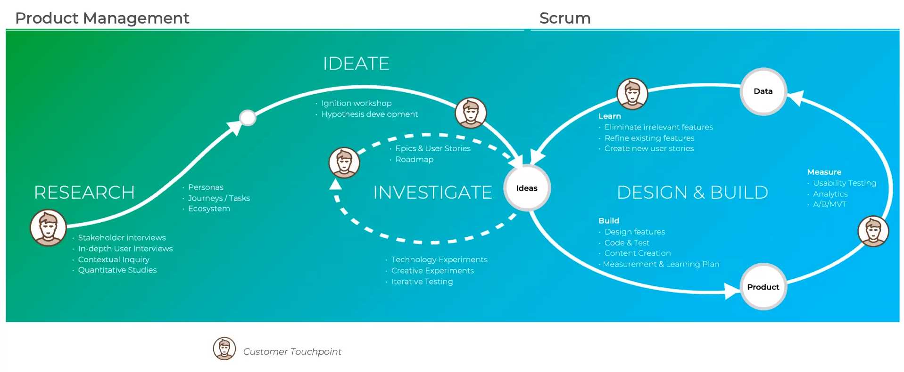
Notes:
Let’s take a look at this larger flow chart. Here we see how all of the user experience stages interact together. On the product management side (the left), we start things off with research. This is always the first part of a project. We then move into ideation, where the real planning begins. Those ideas are evaluated, and then enter into the design phase! The design is iterative, and has many customer touchpoints along the way. Once a product exists, it can be tested, and the test data is incorporated back into the idea phase. It’s a cycle that continues as long as a product is alive! Let’s break down a couple points from this graph.

Slide 6
UX Stages
Research
Design
Test
Notes:
Now let’s dive a little deeper into the stages of UX, starting with research.

Slide 7

Research
Surveys
Observations
Interviews
Specialized tests
Analytic data
Scientific publications
Notes:
This is always the first part of a UX team’s process. There are several ways to find a framework for the design of a product.
One way is surveys – they can put out wide-reaching surveys for potential customers, and see what they want.
They can also directly observe interactions customers have with software, and see what might help them.
They can also do interviews with individuals – this is a great way to get deep perspectives from reliable sources.
They can run specialized tests to assess current needs.
They can look at analytic data for existing products.
They can read up on scientific publications to see what’s new and what can improve people’s lives. There are a ton of ways to research!

Slide 8
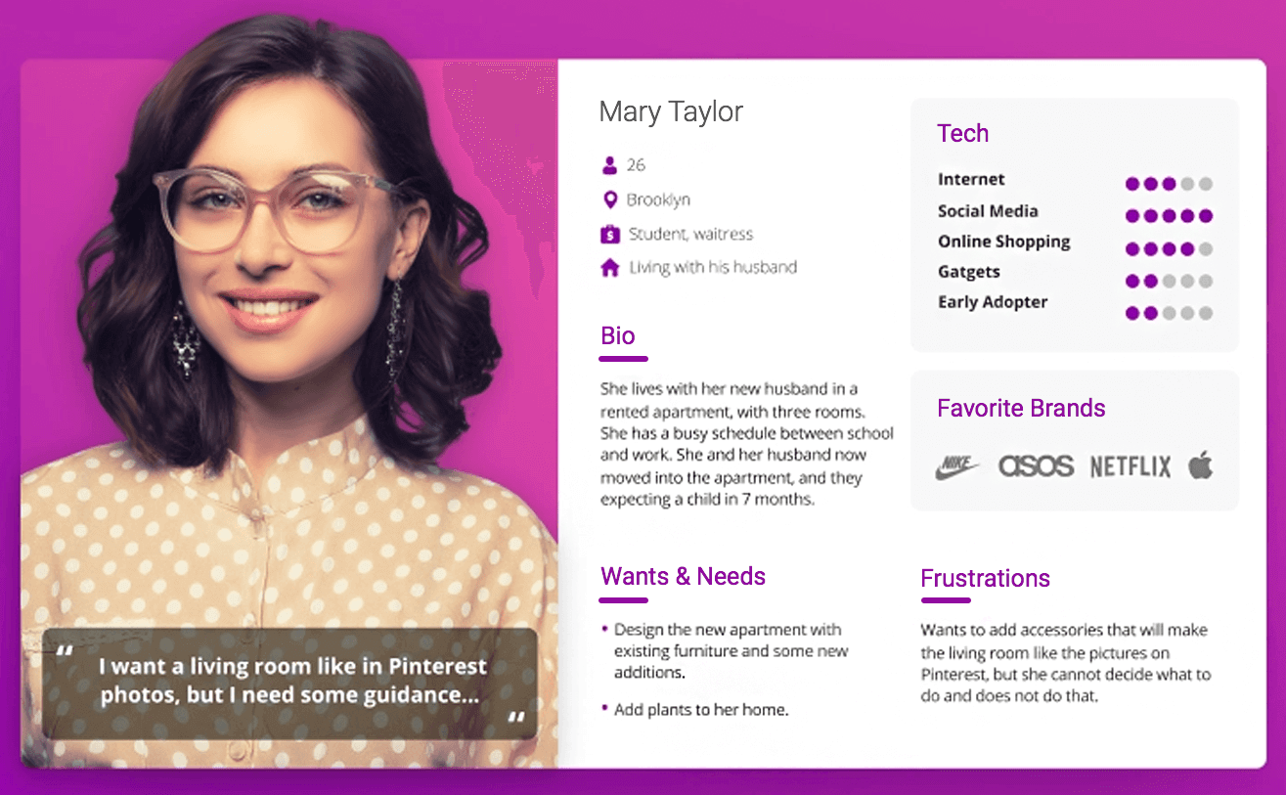
Personas
Research
User personas are archetypical users whose goals and characteristics represent the needs of a larger group of users.
Notes:
Another part of research is personas. Does anyone know what a persona is in UX?
User personas are archetypical users whose goals and characteristics represent the needs of a larger group of users. In the very early stages, it is super important to define some personas.
A persona might be like this one for Mary Taylor – they have an age, a location, a short bio, interest levels, favorite brands, frustrations, etc… this is just one example. It’s important to know who a product serves… are they good with technology? Do they care about flashy and engaging design? Do they want to get right to the point? Do they like customizing things, or do they want pre-fab configurations? There are a ton of questions to ask when designing a product, and these personas help guide the design immensely.

Slide 9
UX Stages
Research
Design
Test
Notes:
Now let’s get into the design phase.

Slide 10



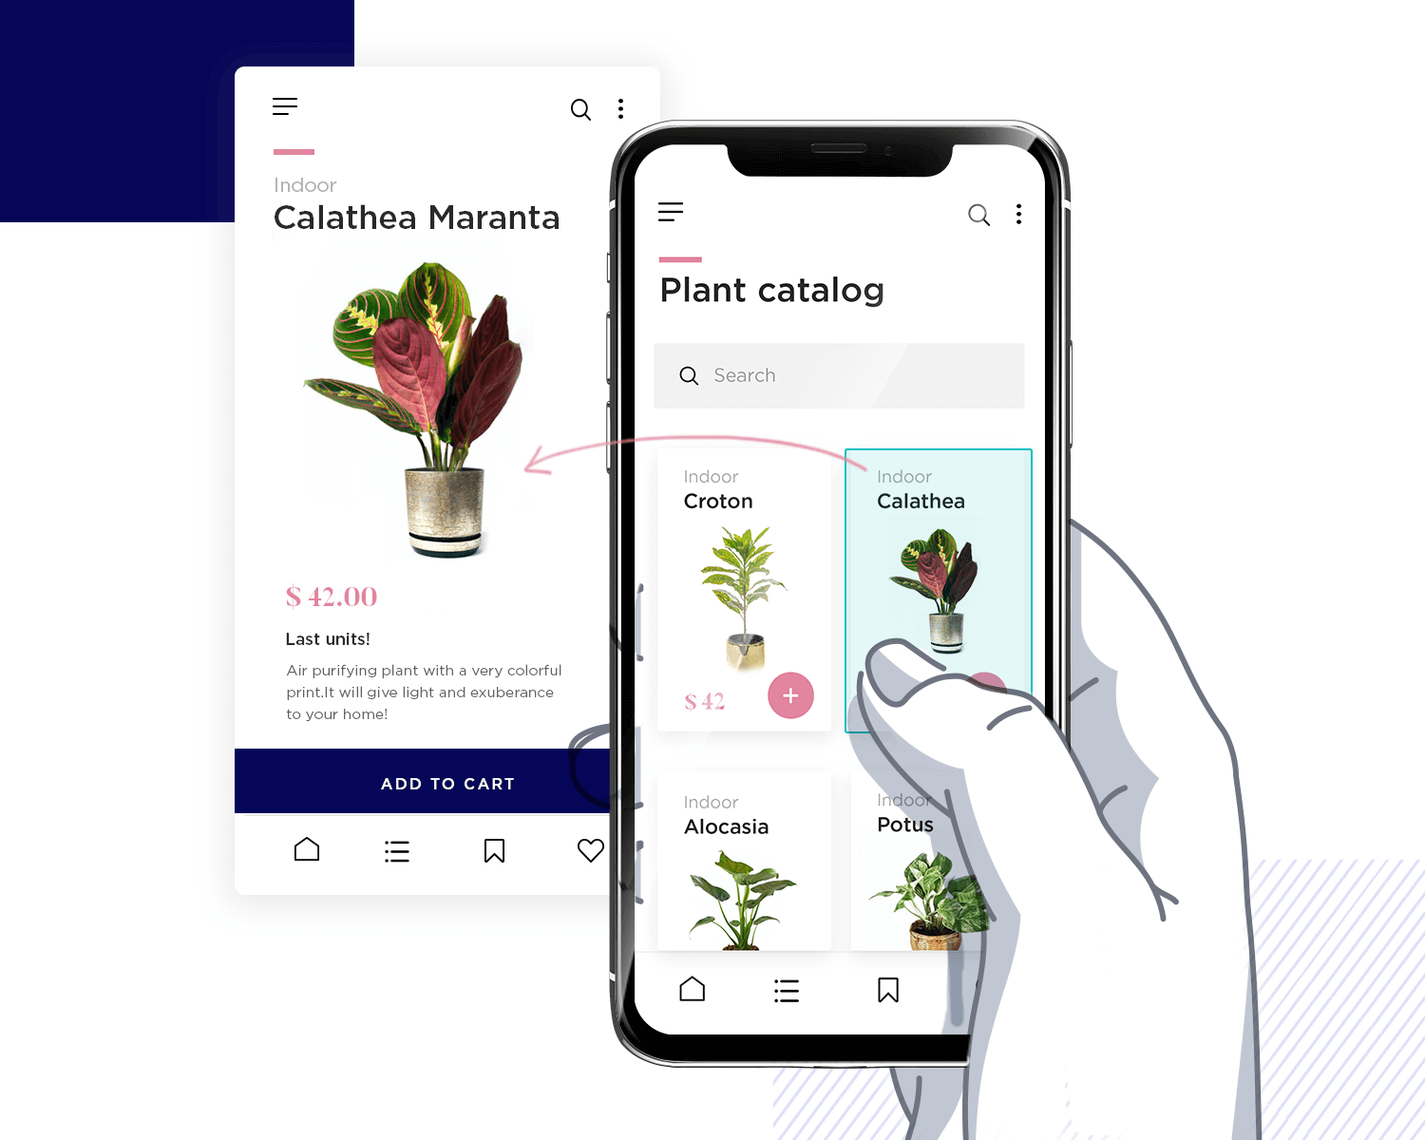
Design
Sketch sessions
Wire-framing
Interactive mockups
Coded prototypes
Applied research | Design guidelines | Best practices
Notes:
Many pieces go into the design of a product – it’s a lot more than just the colors and shapes!
Design usually starts with some sketch sessions. These help layout the placement of the features on paper.
Next, these features are made more solid through wireframing. A wireframe is a layout of a screen that demonstrates what interface elements will exist in key areas – this is where the actual layout starts to take shape.
After wireframes, the UX team can create interactive mockups – not fully functional, but visually functional.
Beyond that, they might even create coded prototypes – these probably won’t have actual data or features, but they can help a lot from a UX perspective.
During all this design, it is important for the UX team to keep a lot of things in mind, like applying research, following design guidelines, and employing best practices. These help make sure the team is doing their absolute best based on the latest knowledge and cohesive product treatment.

Slide 11
UX Stages
Research
Design
Test
Notes:
Once a product has been researched and designed, it’s actually out there in the wild! The next step is to test it.

Slide 12
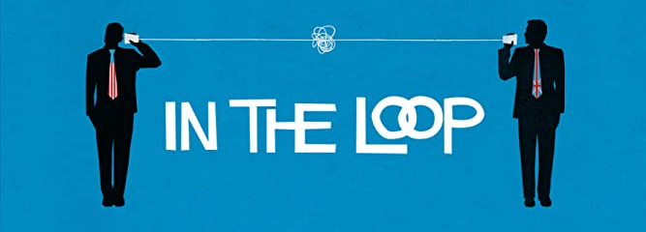
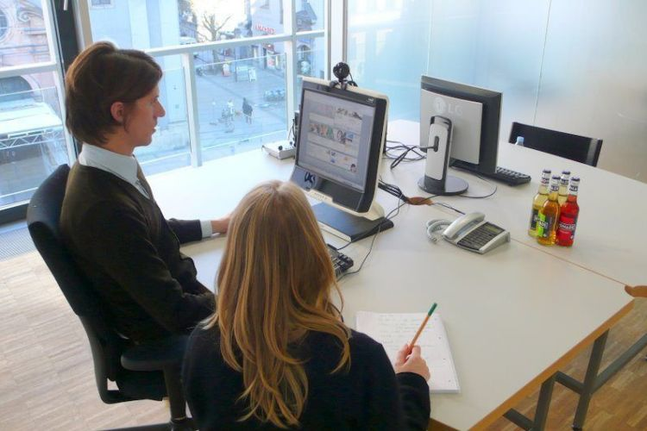
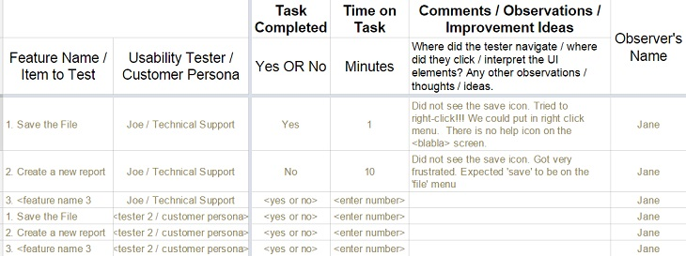
Test
Closing the Loop
Moderated and unmoderated online tests
In-lab or remote tests
Utilizing test data
Notes:
Testing a product is a way to close the loop – did all that research actually pay off? Do people actually use it as it is intended?
There are many different types of tests. Online tests are an easy way to get a lot of data – there can be value in moderated tests, or unmoderated tests. Moderated tests will provide more pointed observations, while unmoderated tests might help reveal unforeseen limitations or use cases.
There are also more specific tests that can take place in a lab or remotely. In-lab tests are great because it is possible to observe everything a user is doing – remote tests can do this as well.
Finally, what good is all this testing if the data is not applied? It’s important to utilize the test data to make changes to the product as needed. This is where it loops back around to the research and design stages – taking this data and incorporating it back into the product.

Slide 13
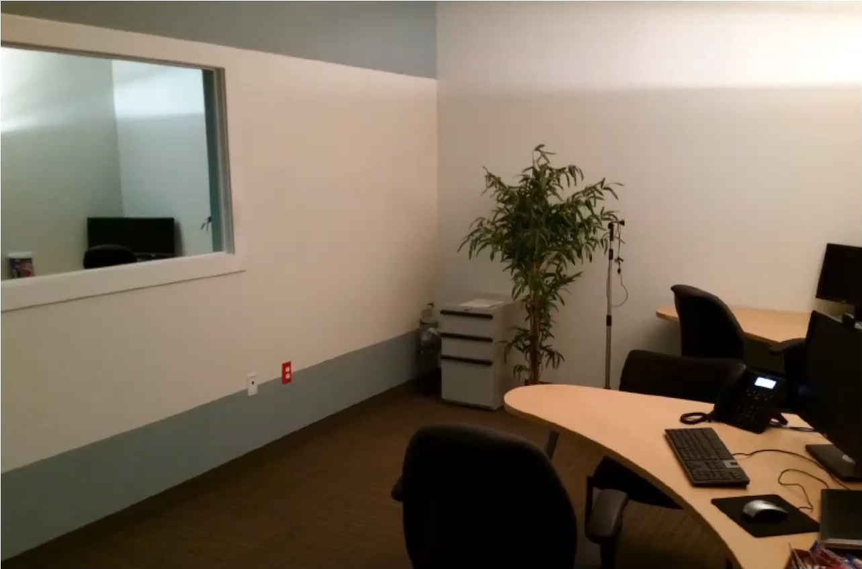
THE LAB
Test
Comfortable Good Lighting
One-way Mirror
Notes:
So where might this testing take place? Here’s a picture of the actual UX lab at Hyland!
Some key features are that it is comfortable, it has good lighting, and there’s a one-way mirror. This way, the team can observe test subjects without interfering. This helps a lot; sometimes, subjects will say they really like a feature, but not know how to use it very well. Some of the computers even have webcams equipped with eye-tracking technology – this can help the team determine where people look when they’re lost, how they view the screens, and what would be the best places to help them. All of this is designed to really hear from the customers and connect their perspectives to the design process.

Slide 14
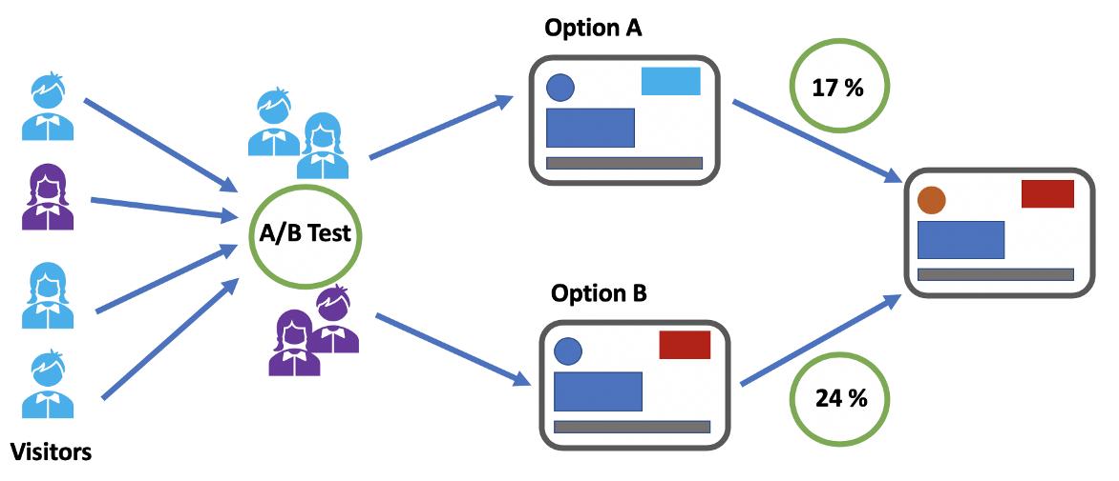
A/B Testing
Test
Notes:
One specific type of test that’s commonly used is called A/B Testing. This is a great way to compare two possible designs, and see which one works better. To do this, they’ll need a specific goal; they’ll want to drive engagement for a certain feature. If a team is considering two options, they can embed each of those options into different products: A and B. 50% of users will use product A, and the other half will use product B. Then, they can see which group had a higher conversion rate – did group A end up buying the product more often, or was it group B? That data can help inform the ultimate design decision for the product.

Slide 15
UX Stages
Research
Design
Test
Notes:
So that’s all of the stages! Each one of them is super important, and they all work together to create the ultimate experience for the user.

Slide 16


How to Pursue UX
College Degrees
Human Computer Interaction
Computer Science / CIS
Psychology
Design
UXPA (UX Professionals Association)
Apply for Internships
Notes:
Now you might be interested in doing this as a career – that’s great! It’s a very good profession for someone who works well with people and cares about ergonomics. How might you get involved in this type of career?
If you go to college, there are a few degrees that could help significantly…
Human Computer Interaction is a cool one
Computer Science or Information Science are also really good – they give a lot of technical background
Psychology can be a good path for the human side
Design works too – this will help from an actual graphical and ergonomic perspective!
That said, it’s not always necessary to go to college if you want to work in UX. One thing you can do is join UXPA – they have conferences and articles and whatnot that can help you enhance your UX skills significantly. It’s a great community!
Another great way is to apply for internships. You never know what you’ll end up learning! Hyland usually has some internships in UX, and it never hurts to apply.

Slide 17
THANK YOU!
WHAT QUESTIONS DO YOU HAVE?
Notes:
Alright, that’s it for the presentation. Hopefully you learned a lot. Anyone have any questions? Thank you!

