Slide 1
you should know by now how much i love to make powerpoints so here is another one
HyTOP Project Roadmap
Summer 2026

Slide 2
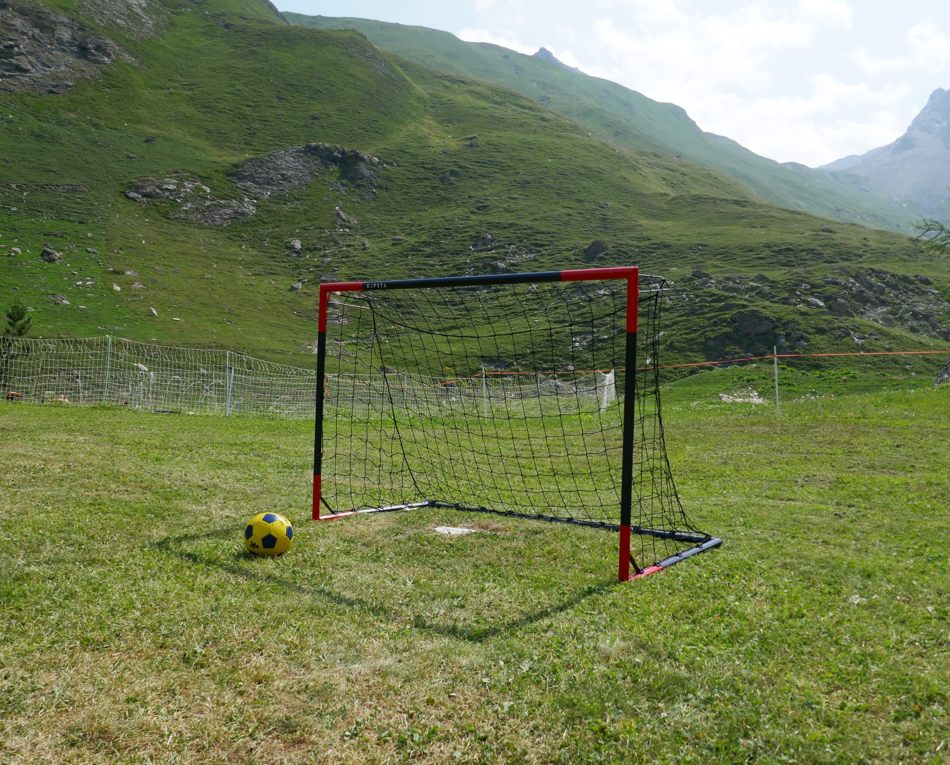
GOALS
What is good for HyTOP vs.
What is good for Tech Outreach vs.
What is good for you vs.
What is good for me

Slide 3
Good for HyTOP
Bug Fixes & Small Features
Security, Quality
Good for You
Learning
Positive experience
3
2
1
Good for Tech Outreach
Impressing Executives
HyTOP being good
Good for Me
All of the above ☺

Slide 4

ORIENTATION:
FINAL PRESENTATION
When you need to decide where to focus, you should always orient yourself toward the final presentation. This should be a cumulative, comprehensive picture of your entire experience, and it should reflect the quality and value of the internship as a whole. Everything you do in your work should ultimately be in service of this presentation.

Slide 5
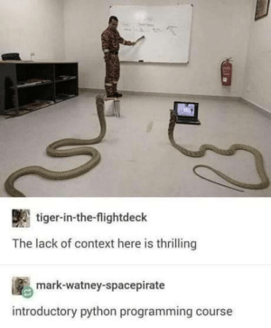
PRIORITY #1:
PYTHON SUPPORT
Looks like a complex value-add
Valuable for us, especially given the death of Trinket
Enables us to teach a technology heavily used in A.I.
Not actually too complicated

Slide 6

PRIORITY #2:
IMPACT FOR YOU
Speak about the quality of your internship experience
Share the impact it had on you personally
What you learned, your overall impression of Hyland
This will make me look good :)

Slide 7
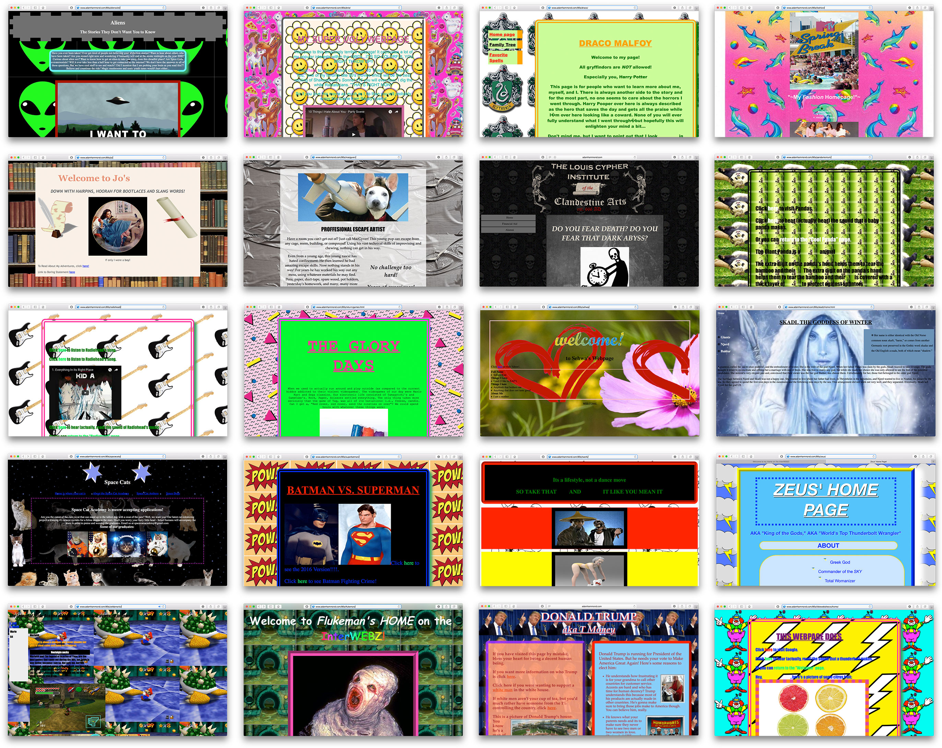
PRIORITY #3:
HOMEPAGE REVAMP
Visual changes are impressive
Doesn’t have to be super complicated

Slide 8
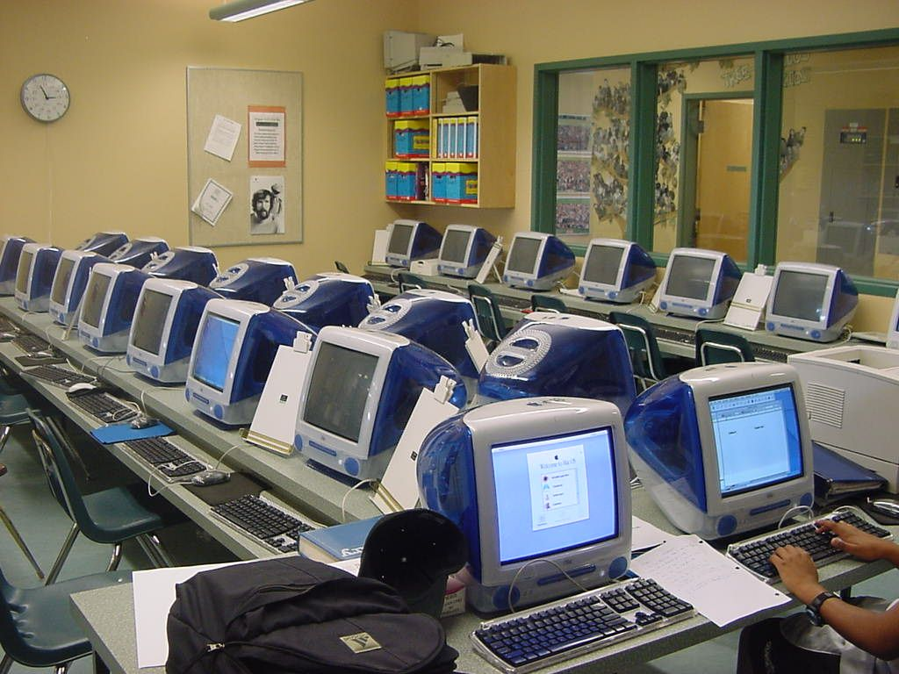
PRIORITY #4:
CLASSROOM MODE
Big Feature
Requested by our instructors based on actual use of HyTOP
Would be quite involved but worthwhile

Slide 9
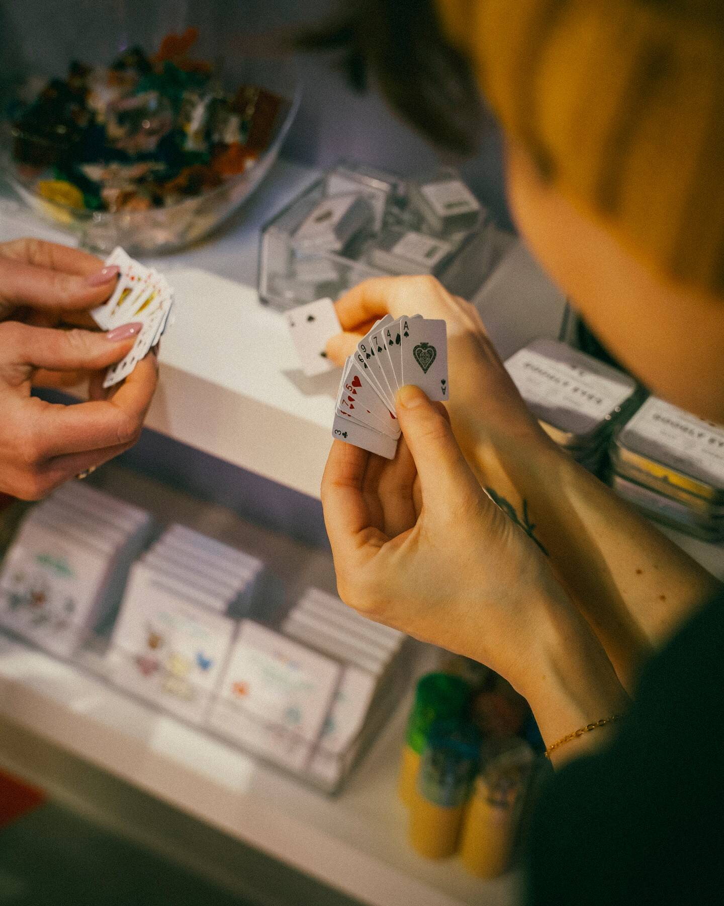
PRIORITY #5:
SMALL STUFF
Bug fixes and nice features
Not as impressive, but probably the most valuable to HyTOP
Real value for you to learn and contribute to the codebase
Sheer number of completed PRs could be impressive

Slide 10
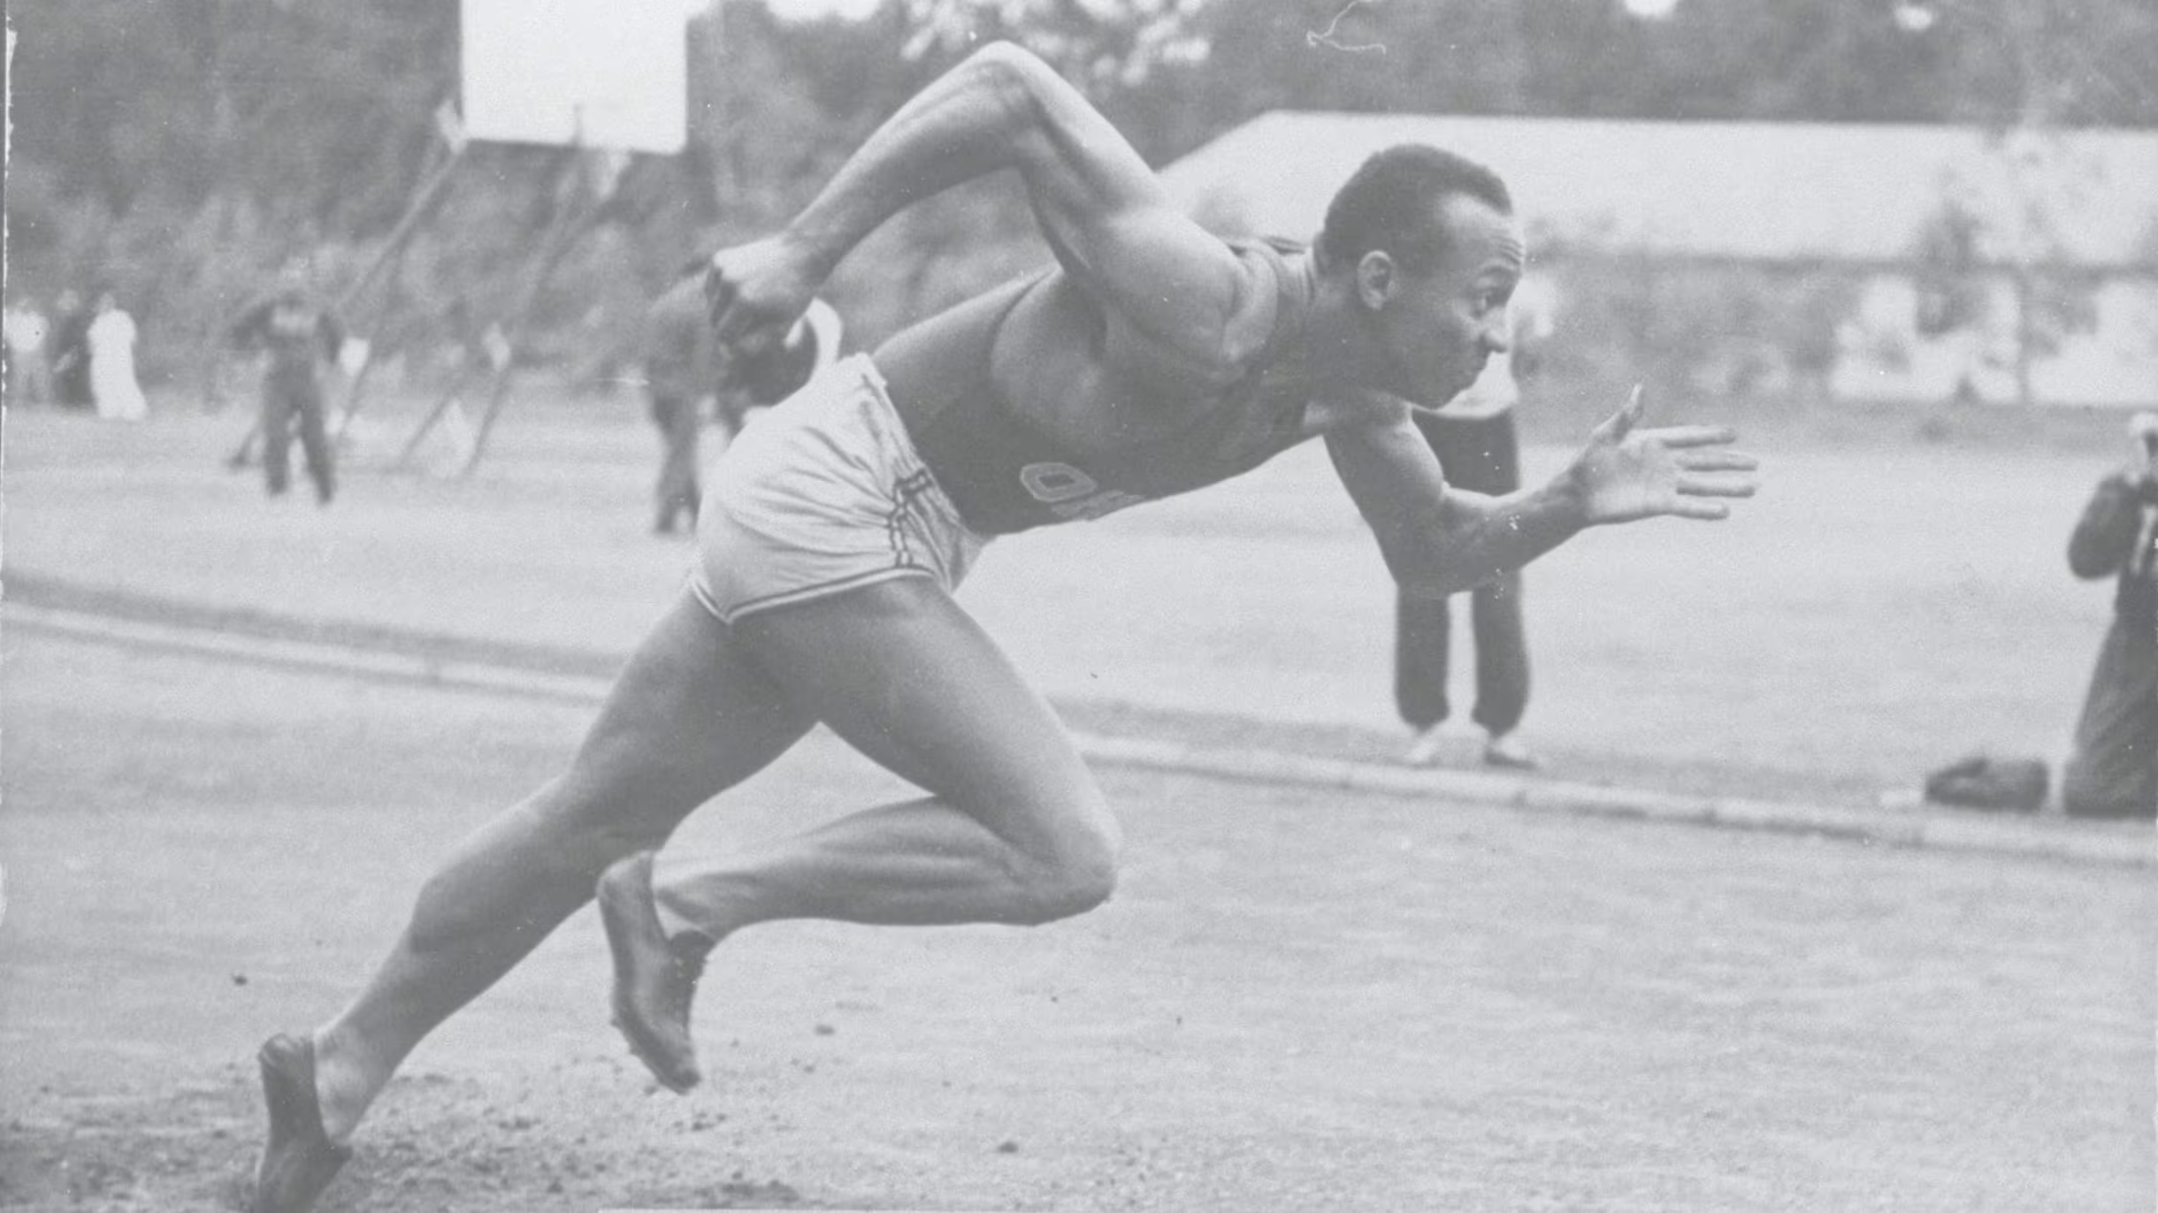
NEXT SPRINT
Python Support: UX, research (Figma, Skulpt)
Impact for You: Draft Presentation (Jul 9 Demo)
Homepage Revamp, Classroom Mode: Ideation
Small Stuff: Starting point

Slide 11
https://github.com/orgs/hto-projects/projects/10/views/2

