Slide 1
CRASH COURSE

Slide 2
HTML & CSS
short.hyland.com/www
https://hylandtechoutreach.github.io/coding-activities/BuildingWebsites/CodeAlong.html

Slide 3
JavaScript
https://hylandtechoutreach.github.io/coding-activities/InteractiveWebsites/QuizAboutMeCodeAlong.html

Slide 4



Full-Stack Web Architecture
Front-end
(client side)
HTML, CSS, JavaScript, React
User Interface
Back-end
(server side)
HTTP
Queries
REST
API
JSON Data
Node.js, Express
Server
Mongoose, MongoDB
Database

Slide 5
HTTP Request from JS
https://hytop.onrender.com/e/what-does-the-cat-say27

Slide 6
HTTP Response from Node.js
https://hytop-backend.onrender.com/up-check
Code:
https://github.com/hto-projects/hytop/blob/main/backend/server.ts

Slide 7
REST API
https://hytop-backend.onrender.com/api/fake-api/dogs?count=5
Code:
https://github.com/hto-projects/hytop/blob/main/backend/controllers/fakeApiController.ts
routes.ts for routing, server.ts for actual use

Slide 8
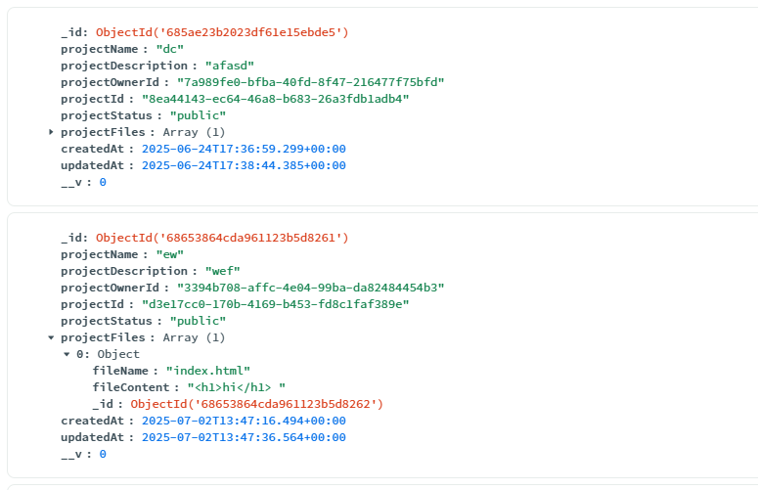
Database: MongoDB
https://cloud.mongodb.com/v2/6298b3f588a26f3f57a9dfb6#/explorer/6298b488ea69de59adbac92c/HYTOPLIVE/projects/find
.env file

Slide 9
React: Quick Start
react.dev/learn

Slide 10
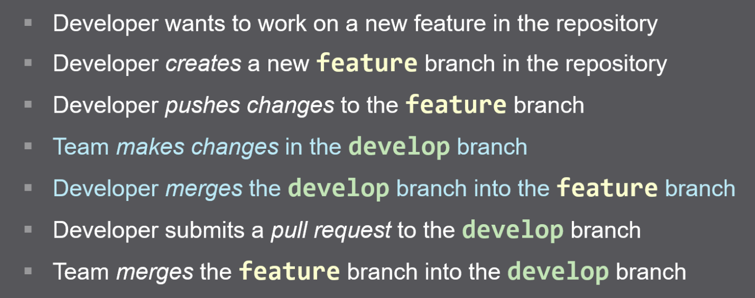
Collaboration: Git & GitHub
Code in GitHub …….. Pull Request Example

Slide 11
Deployment: Render
https://render.com/

Slide 12
Putting It All Together
Frontend
https://hytop.onrender.com/latest-updates/
<LatestUpdatesScreen> from LatestUpdatesScreen.tsx
useGetLatestProjectsQuery from projectsApiSlice.ts
routed through projectRoutes.ts and server.ts
getLatest defined in projectController.ts
projectModel.ts for schema
Database
Backend

