Slide 1
Hyland x PEEKE Internship 2026
Welcome!

Slide 2
Agenda
Introductions
Today’s Agenda
Things You Need To Know
Photos

Slide 3
Introductions

Slide 4
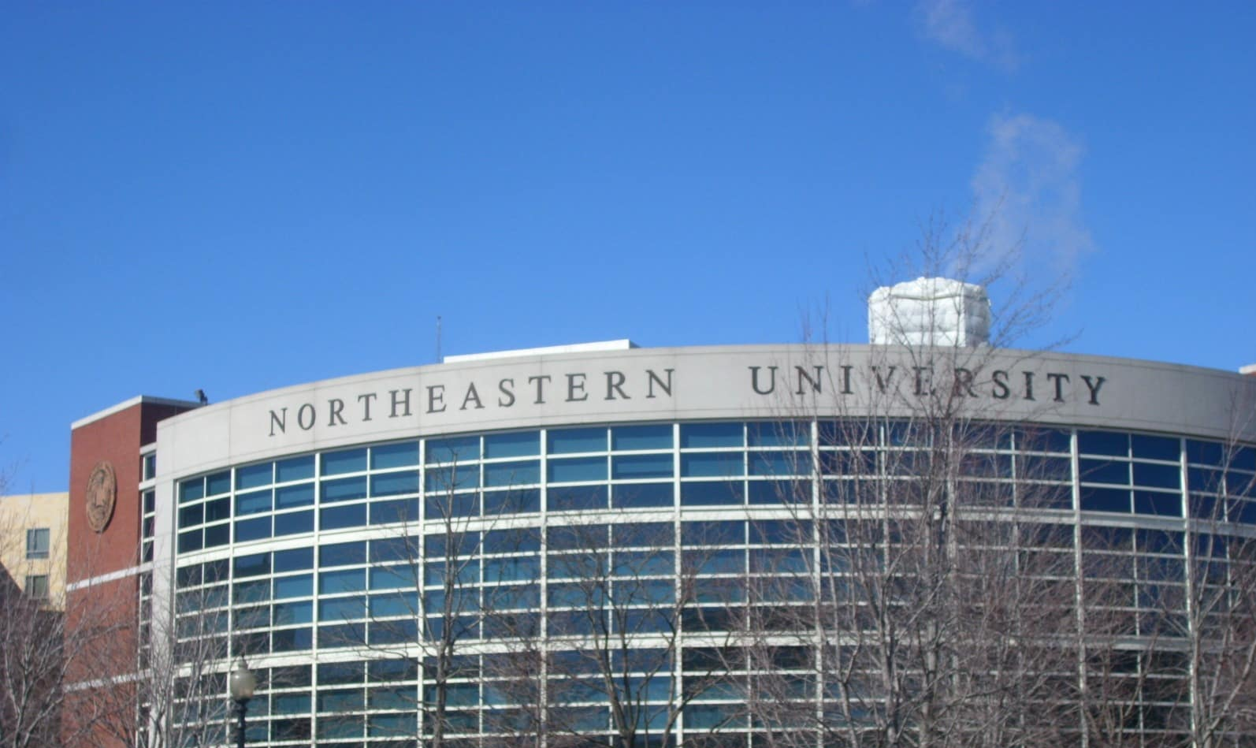
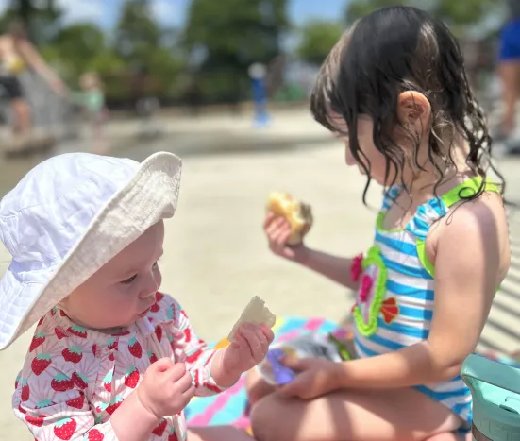
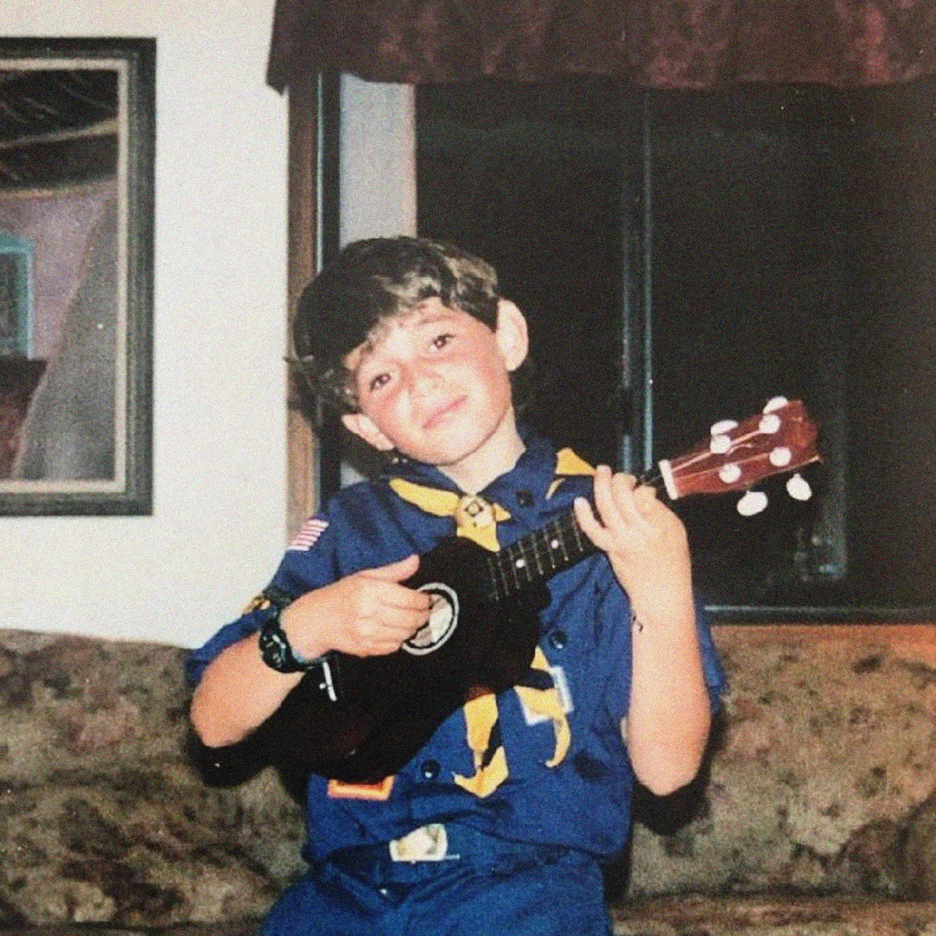
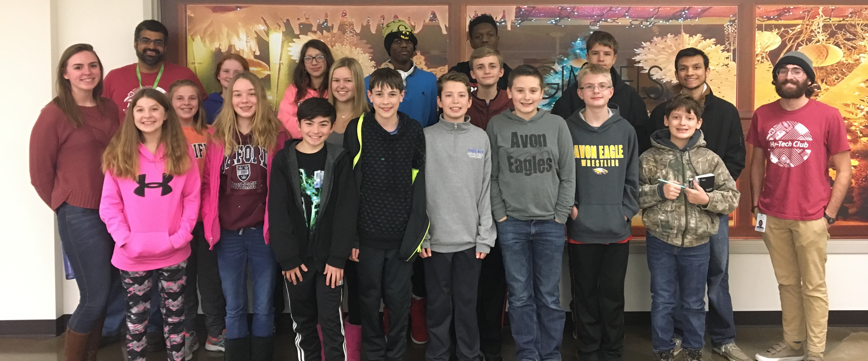
Joseph Maxwell – Instructional Designer
I grew up in Hawaii
I majored in Computer Science at Northeastern University
I started at Hyland in 2016​
(and transitioned from Software Developer to Tech Outreach Team Member in 2018)
I live in Lakewood with my wife Ali and our two daughters Rosemary (2) and Louise (0)

Slide 5
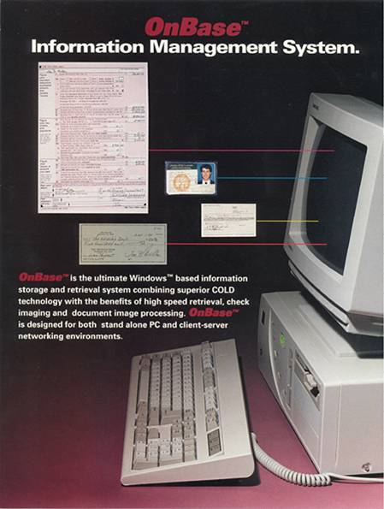
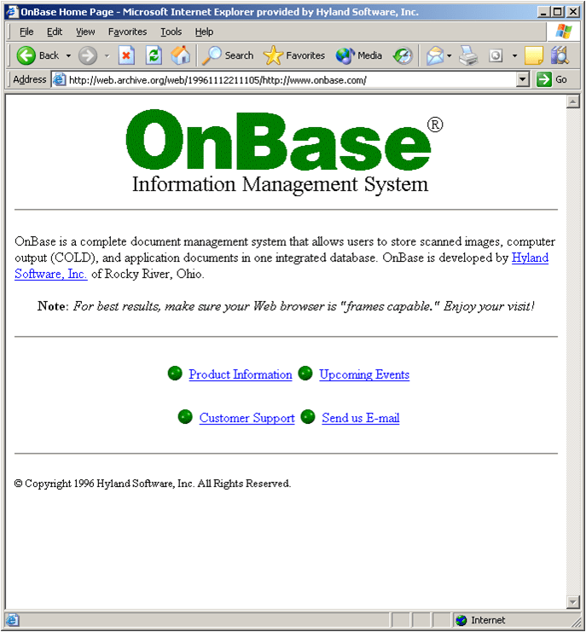
About Hyland
Hyland was founded in 1991.
OnBase is the flagship product of Hyland’s portfolio.
Hyland helps organizations manage all their content.
This is what the OnBase website looked like in the 90s.
Notes:
Hyland was founded in 1991.
Hyland has a lot of products, but OnBase is the flagship.
Hyland helps organizations manage their content.
These is what they OnBase website looked like in the 90s. It was a long time ago.

Slide 6
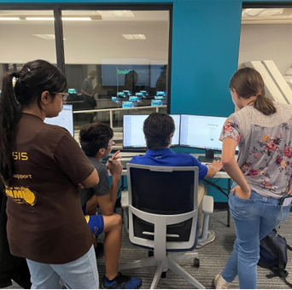
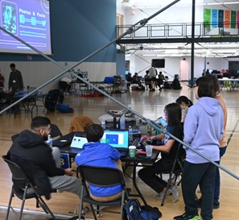
We offer a variety of free programs to teach kids about various tech topics. Such as: Field trips Workshops Classroom visits And… | Hackathons And other competitions |  | Hy-Tech Club Web 101 Web 102 Web 103 Capstone
 |  | Internships ⭐ you are here!
Our mission is to empower our communities through computer science education.
About Tech Outreach

Slide 7
Today’s Agenda

Slide 8
Today’s Agenda
Time | Activity
10-10:30a | Welcome : - )
10:30-11a | Mini Tour
11-11:30a | IS Setup
11:30-12:00p | Team Building Activity
12:00-12:30p | Lunch
1-2p | Project Introduction
2-4p | Desk Time

Slide 9
Things You Need To Know

Slide 10
THINGS TO REMEMBER
techoutreach@hyland.com
Your Email
First.Last@Hyland.com
Notes:
If you need anything during training or throughout the summer, please email techoutreach@hyland.com. This goes to all of us - we’ll get back to you as soon as we can.
Your email address will be your first name . Last name @hyland.com – we use Outlook (email and calendar) – you will be getting a lot of emails and calendar invites this week

Slide 11
WORK SCHEDULE
Lunches
30-minute lunch break – paid
Breaks
Two 20-minute breaks – paid
Notes:
We are flexible with hours - You can work out your start, end, lunch, and break times with your Internship Mentors
We can be flexible at times as needed (ex: doc appt, make up time next day to still get hours)

Slide 12
TIME OFF
All time off is unpaid (including holidays)
Planned Time Off
Notify Joseph (joseph.maxwell@hyland.com)
Unscheduled Time Off
Notify techoutreach@hyland.com
Notes:
You are allowed to take time off over the summer (ex: vacations, appointments, or need a day off), but it is unpaid – talk directly with your internship mentor for any time off you will need – block it on your calendar
Hyland is closed July 4th – you have the day off, but it is unpaid
Unscheduled Time Off – if you wake up not feeling well or have something come up and find out that morning you can’t work, you can email techoutreach@hyland.com

Slide 13
TIPS FOR SUCCESS
Check your email everyday!
Always have Outlook open Don’t miss important information we send about the internship program or companywide messages
Always be logged into Teams Internal messaging system
Professional Communication Be aware of the way you communicate to others
Notes:
It’s a best practice to always have your email open and check it throughout the day
Also, check your calendar regularly so you aren’t missing any meetings (respond to meeting invites)
You should also always be logged in to Teams our internal messaging system. Quick questions/less formal than email. Be mindful of when people are marked as busy/available (Intern Teams group – Anna to manage)
Keep professionalism in mind with all communications
CAMERA ON (people schedule meetings via Zoom OR Teams) - expectation

Slide 14
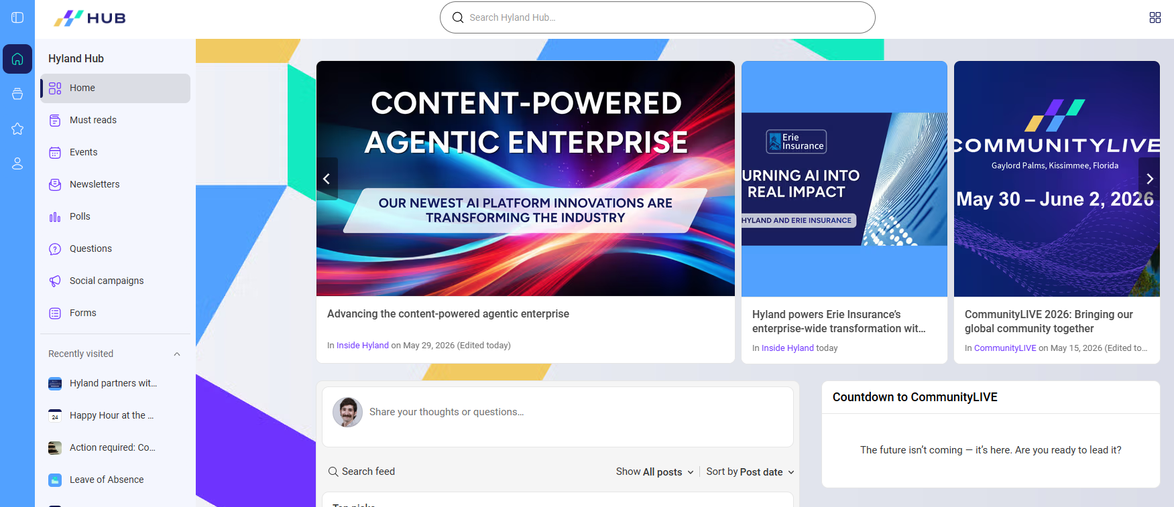
INTERNAL RESOURCES
https://myhub.hyland.com/
Notes:
There are internal resources to assist you during the summer. You will be able to go through the HR Portal and Hyland HUB in depth during your self-paced training. These are both great recourses to go to if you have questions.
HUB:
Landing pages with tiles (if you have time can show them yours)
HR Portal:
There’s a ton of information here on our company, events, policies, benefits, and much more (just for Hyland employees – need to be connected to Hyland’s network)
There is a page on the HR Portal created just for interns (you can see events, programs, resources, important information)
There are directions in Cornerstone training to show you how to navigate these

Slide 15
HEADS UP!
End Date: Aug 6
End of Summer Presentations
Notes:
End date - We will reach out to you to gather end dates later this summer.
We ask for all interns to do an end of summer presentation. You will schedule this yourself and can invite your Manager, Mentor, Team, leaders, and other interns. It’s a 5-10 presentation recapping your summer, talking about projects, what you learned, and the fun events you attended. You can be completely creative with this and can use a PowerPoint if you want. We will send you a reminder to schedule these.

Slide 16
QUESTIONS?
Financial Literacy Program
Socials
TechOutreach@Hyland.com
Cornerstone
Classes
Notes:
We will be sending you a ton of emails during your first week, please pay attention to all
Came at exciting time – new CEO next week
My Time Off

Slide 17
Photos

Slide 18
THANK YOU

