Slide 1
Pixel Art & Animation
Throwback
Notes:
Hello and welcome to the Animation for Games Hy-Tech Camp!

Slide 2
History of 2D animation
Notes:
Let’s go over some of the history of 2D animation.

Slide 3
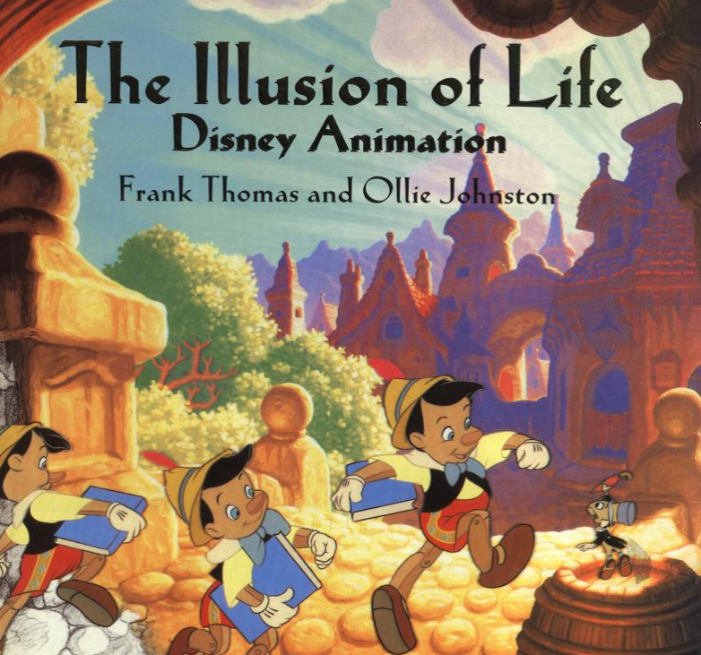
Animation (noun)
the state of being full of life or vigor; liveliness
OR
a method in which pictures are manipulated to appear as moving images… the illusion of life
Notes:
One definition of animation is: the state of being full of life or vigor; liveliness.
The one you probably know is the other one – a method in which pictures are manipulated to appear as moving images… the mere illusion of life.
There’s a very famous book on animation by some Disney animators that uses that as its title.
The idea is not to make things realistic; animators often exaggerate features or motion to make it appear more lively

Slide 4
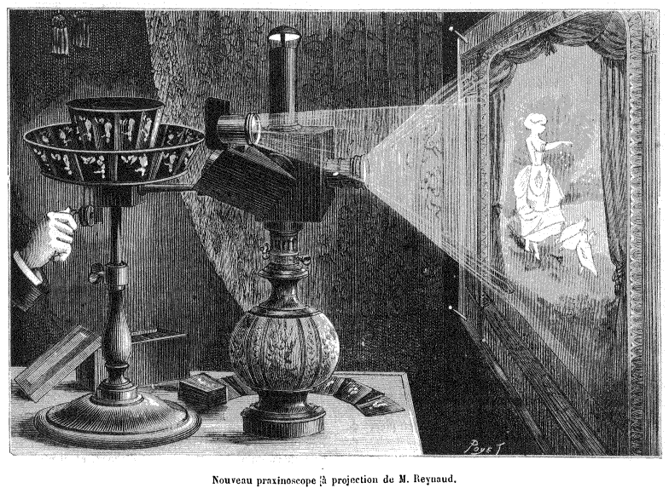
beginnings
Zoetrope (1834)
Praxinoscope (1877)
Notes:
Some of the early methods of animation were pretty rudimentary…
There was the Zoetrope in 1834 – sort of like a flip book
There was also the praxinoscope in 1877, that actually projected images onto a screen

Slide 5

The first animated film (1908)
https://youtu.be/7M5So1WFNzo?t=80
Notes:
Now let’s take a brief look at the first ever hand-animated film, from 1906
You could probably make something better than this now!

Slide 6
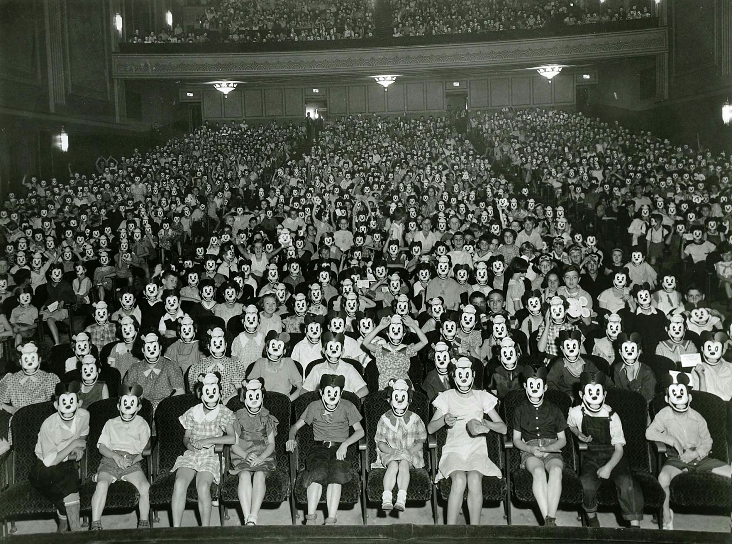
DISNEY
Steamboat Willie
Synchronized sound!
Mickey Mouse Craze
Notes:
Soon following the beginnings of animation, there was Disney.
Does anyone know who this is?
Disney revolutionized animation in a lot of ways, starting with Steamboat Willie and synchronized sound.
Steamboat willie would eventually become mickey mouse, and people really liked him. Maybe a little too much.

Slide 7
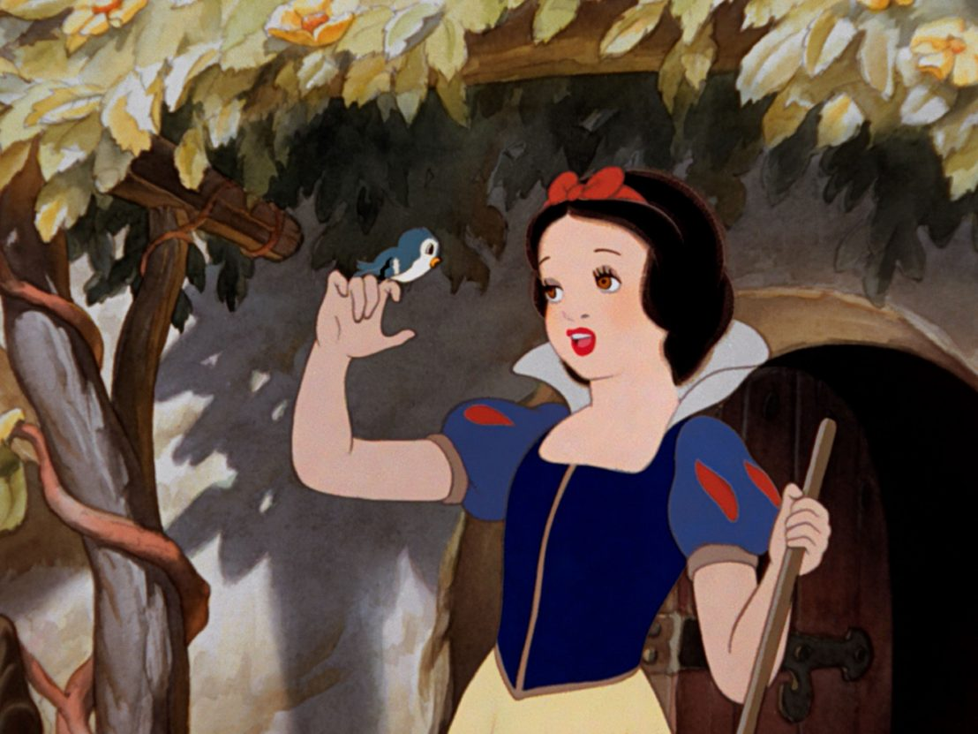
Feature-length animated films
Snow White was the first feature-length cel-animated film (1938)
Took a long time and cost a lot of money
Ultimately a huge success
Turned animation into an art form
Disney Innovations
Multiplane Camera
Rotoscoping
Interesting effects
Notes:
From those humble beginnings, Disney grew into the giant it is today.
Can anyone guess the first feature-length animated film from Disney?
Snow White was a groundbreaking film – the first feature length cel-animated film, from 1938!
Disney was responsible for several innovations throughout this era.

Slide 8
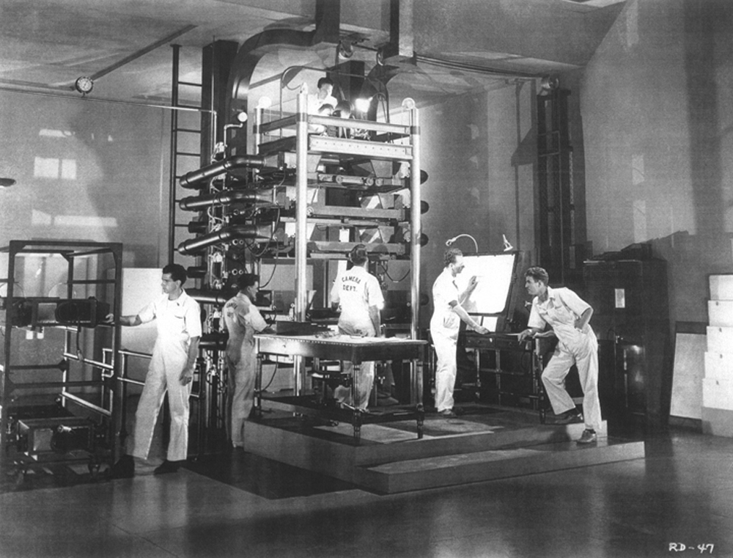
Multiplane camera
Multiple levels of cels allowed the artists to create the illusion of depth
Notes:
Everything was completely analog, done manually. They built this giant machine

Slide 9
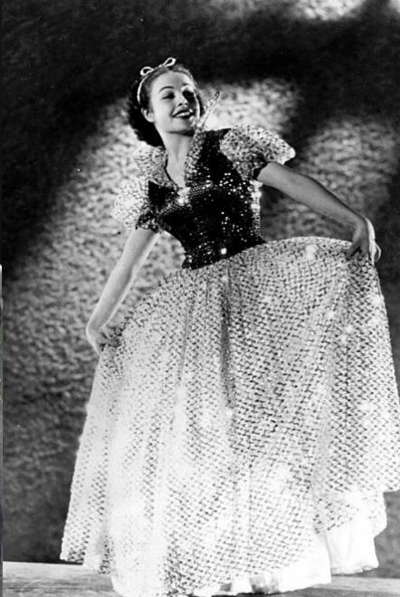
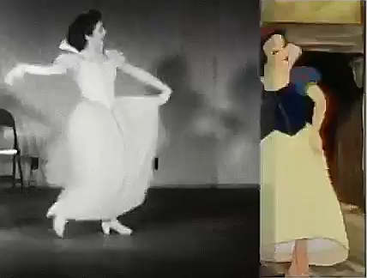
Rotoscoping
Disney would film the movements of real-life actors
Animators would trace the frames based on the movements

Slide 10
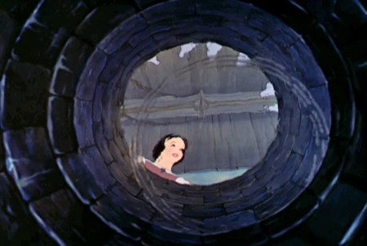
Interesting effects
Notes:
They used actual water to create a ripple effect, as if the camera were at the bottom of a well. Every frame had to be painted painstakingly

Slide 11
2D Video Game Animation
Notes:
Now let’s shift gears away from classic Disney cartoons and into classic video games!

Slide 12
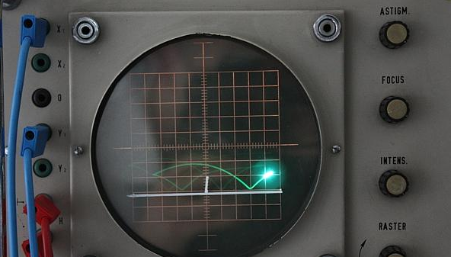
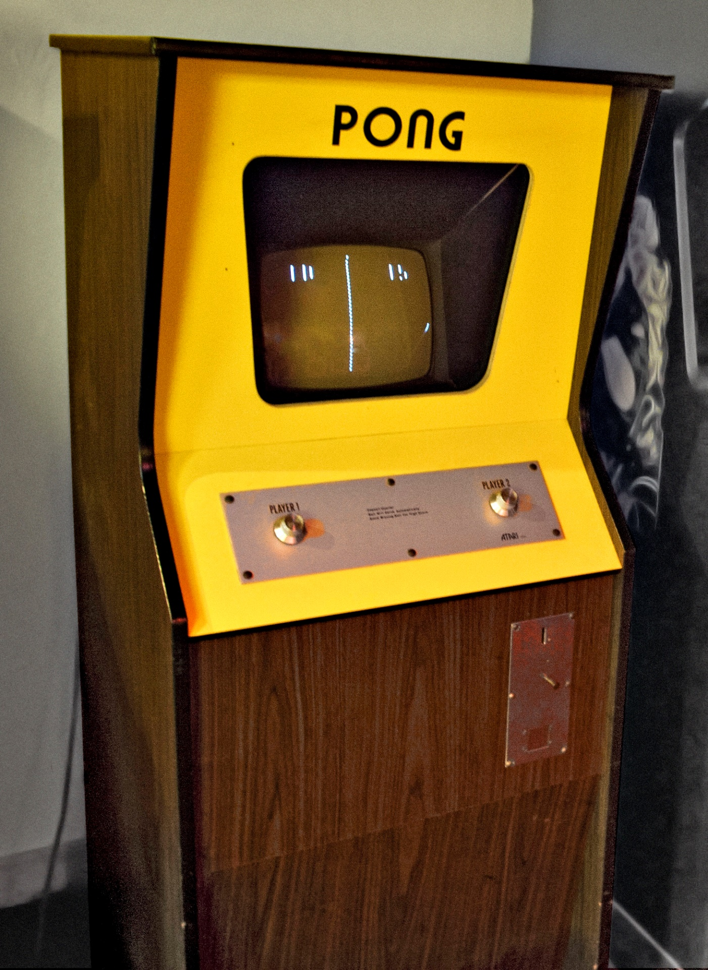
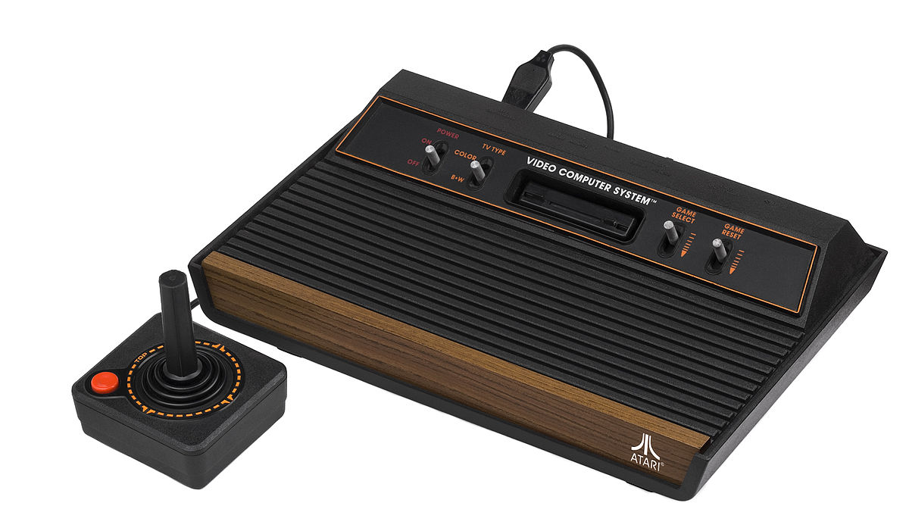
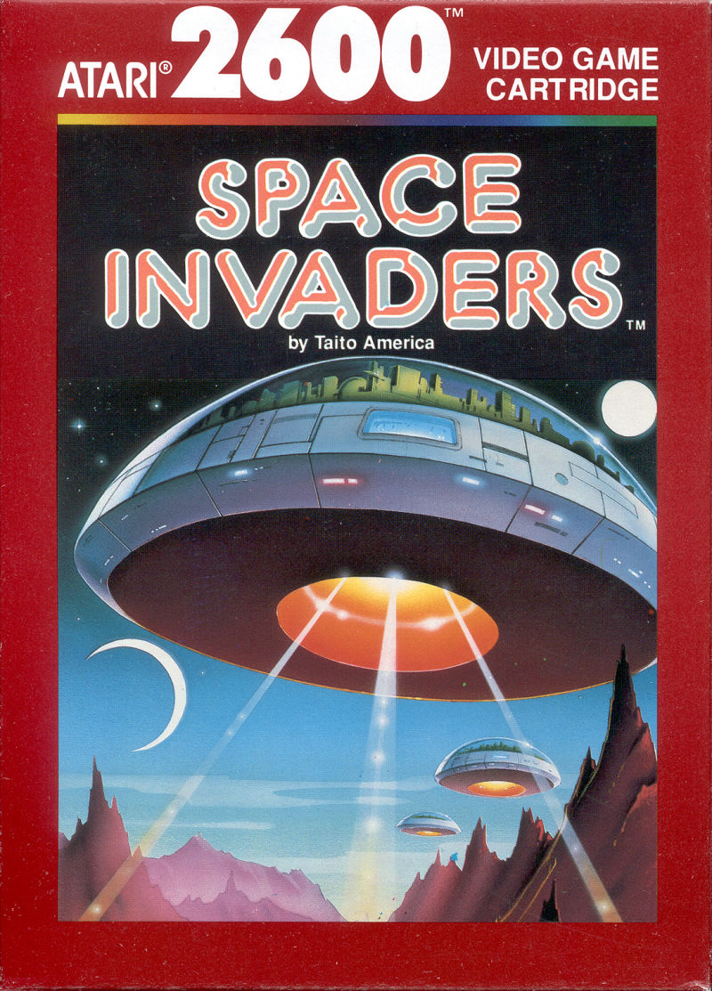
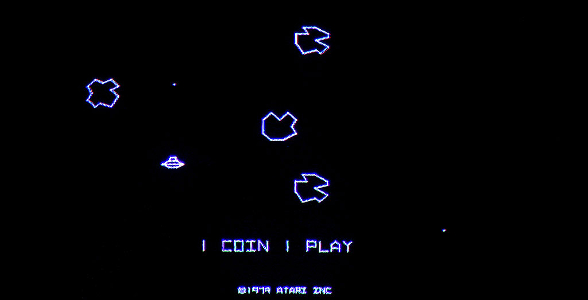
The first video games
Notes:
Can anyone name some of the first video games?
Upper left – Tennis For Two (1958) using something called an oscilloscope
Middle – PONG
Bottom left – Asteroids
Right – Atari / Space Invaders
Video games were very simple at first, and didn’t really involve much animation.

Slide 13
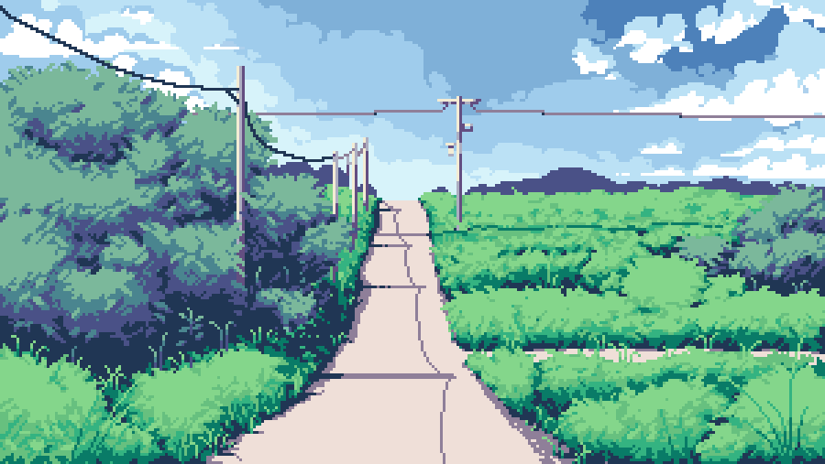
Pixel art
Though technology has evolved, many artists choose to copy this old style!
Notes:
Pixel art is popular these days because it has such a specific look and feel, it is nostalgic, and it is cheap

Slide 14

WALK cycles
2-frame (very simple)
“Ping-pong” reused frame
Classic 3-frame
Notes:
Walk cycles are simple in pixel art because of the limited number of pixels. These are some examples of walk cycles from video games
Does anyone know what game this is from? Super Mario World
Super Mario Bros
Super Mario 3
Castlevania III

Slide 15
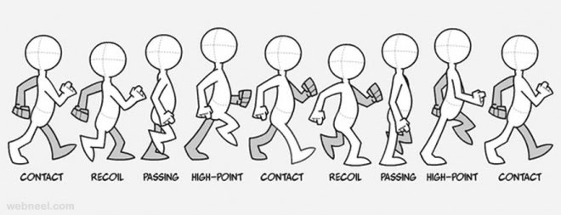
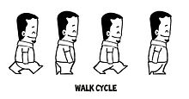
better walk cycles
More frames creates a smoother animation
Depending on the style of the game, it may be better to have fewer frames!
At least 3 frames is recommended
Notes:
It is possible to make smoother walk cycles, but sometimes simple is better

Slide 16
Questions?

