Slide 1
MUSIC
making
with
PROGRAMMING
MCCCC

Slide 2
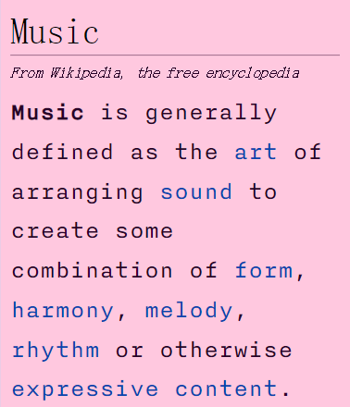
What Is Music?
How can you make music?
A.I. https://labs.google/fx/tools/music-fx-dj
Actual Creativity
short.hyland.com/piano
MCCCC

Slide 3
AGENDA
1. SCIENCE
2. THEORY
3. PRODUCTION
4. STRUDEL
SCIENCE

Slide 4
SCIENCE

Slide 5
SCIENCE

Slide 6
SCIENCE
Sound is a wave
https://musiclab.chromeexperiments.com/Sound-Waves/

Slide 7
SCIENCE
Faster waves make higher pitches
https://signalgenerator.sciencemusic.org/

Slide 8
SCIENCE
Some pitches include A2, B#5, Cb4, F#7
https://chromatone.center/practice/pitch/table/
Each pitch has a corresponding frequency, measured in Hertz (Hz)
THEORY

Slide 9
SCIENCE
THEORY

Slide 10
THEORY

Slide 11
Some pitches sound “good” together
https://musiclab.chromeexperiments.com/Harmonics/
THEORY

Slide 12
THEORY
You know music theory already even if you don’t know you know it https://www.youtube.com/watch?v=fjvR9UMQCrg

Slide 13
THEORY
https://www.onlinepianist.com/virtual-piano

Slide 14
THEORY
An octave is half or double a frequency, e.g., A3 and A4
Octaves are sometimes called the “basic miracle of music”

Slide 15
THEORY
Tempo = Speed

Slide 16
THEORY
Note =
Pitch + Time

Slide 17
THEORY
Interval =
Space between pitches

Slide 18
THEORY
Scale =
Series of notes

Slide 19
THEORY
Major Scale = ☺

Slide 20
THEORY
Minor Scale = ☹

Slide 21
THEORY
Chords =
Multiple pitches grouped together

Slide 22
THEORY
Major Chord = ☺

Slide 23
THEORY
Minor Chord = ☹

Slide 24
THEORY
Chord Progression =
A sequence of chords in order

Slide 25
THEORY
Arpeggio = Notes of a chord played in sequence
https://musiclab.chromeexperiments.com/Arpeggios/
PRODUCTION

Slide 26
PRODUCTION
You can make music electronically
THEORY

Slide 27
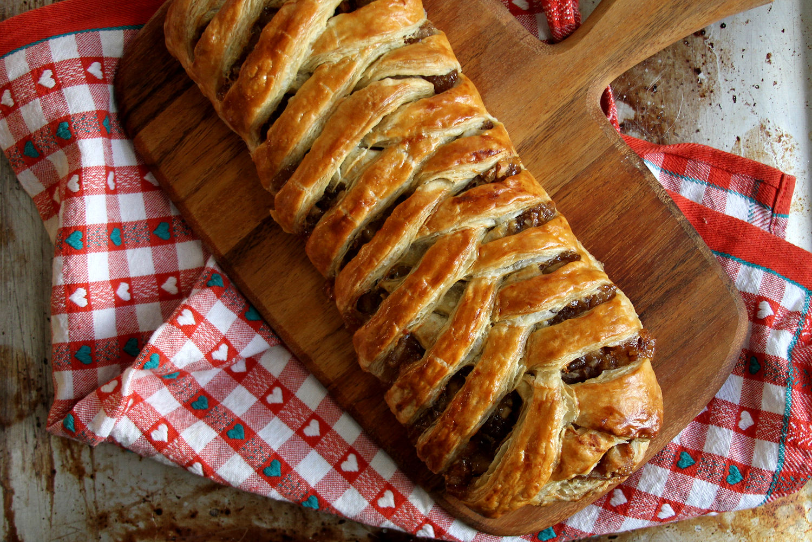


Strudel
a browser-based live-coding environment where you can make music with code
note("c a f e")

Slide 28
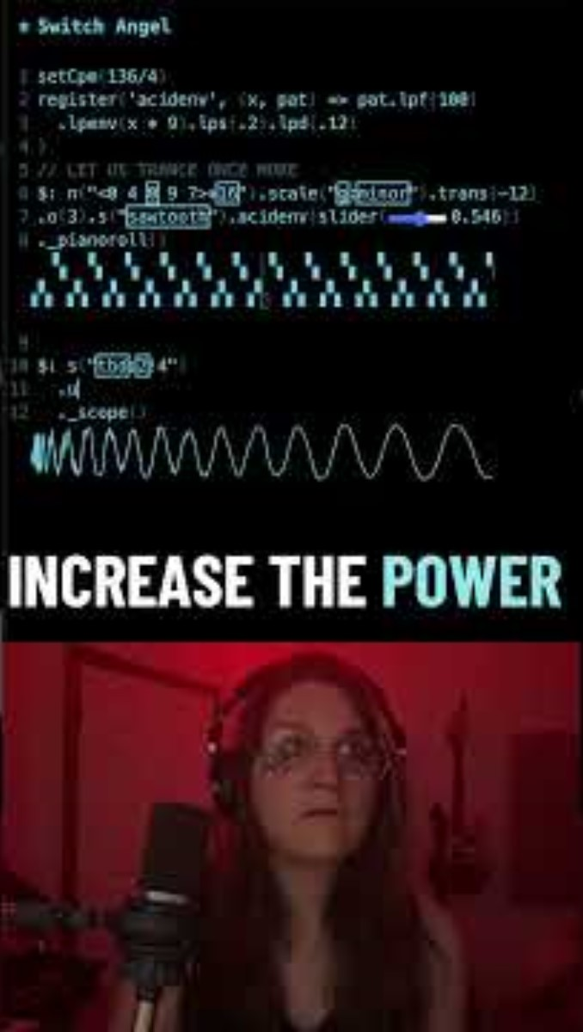
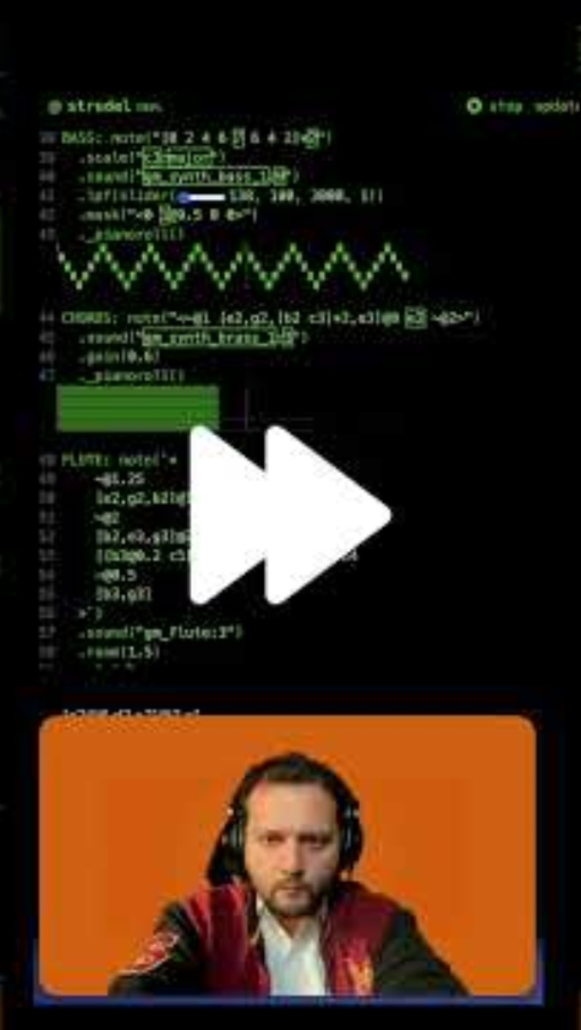

Slide 29
1. Tutorial Speedrun 2. Live Coding Playground

