Slide 1
WELCOME
Video Games
MCCCC
Notes:
Play some 8-bit music as students arrive

Slide 2
INSTRUCTOR INTRODUCTIONS
Notes:
Make sure all of the instructors introduce themselves!

Slide 3
AGENDA
Icebreaker
Presentation
Code-Along
Game Sharing
Blooket

Slide 4
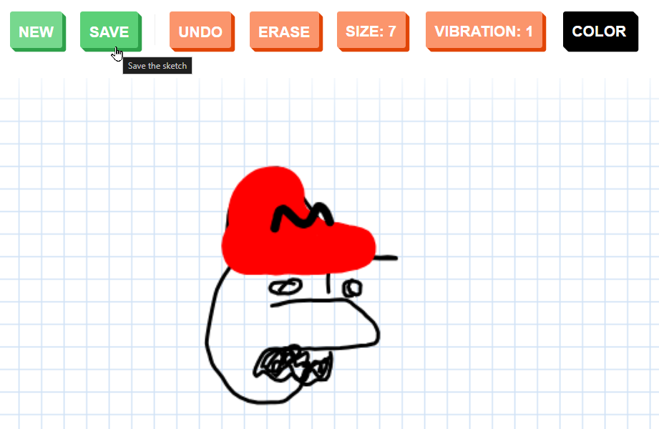
Microsoft Edge
1. Open Sketch Toy
2. Draw a video game character
3. Save the drawing
4. Copy the link
5. Submit your character
ICEBREAKER

Slide 5
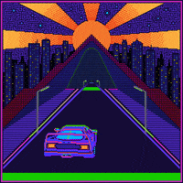
PRESENTATION

Slide 6
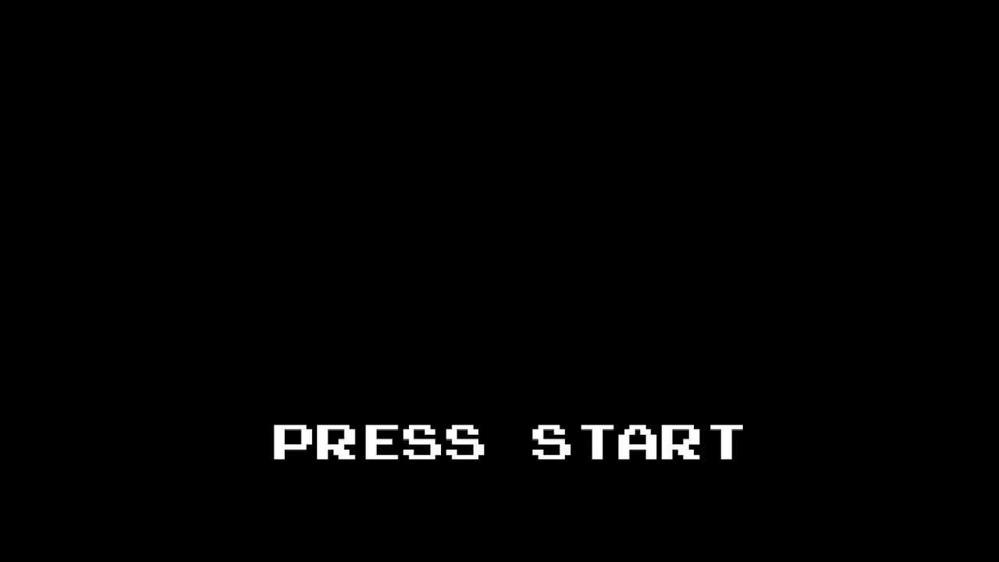


Slide 7


Slide 8
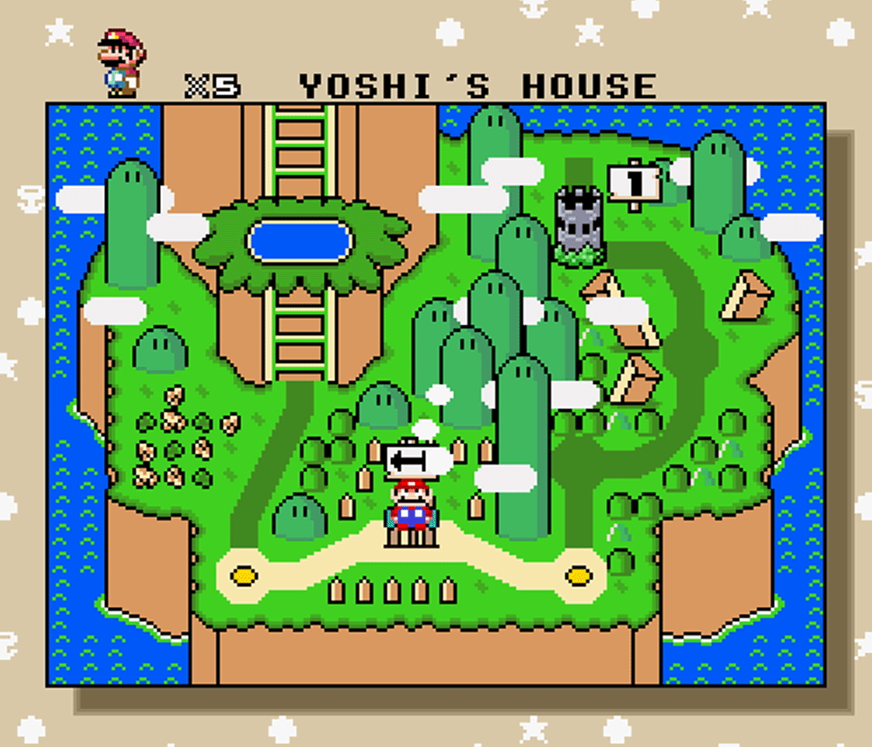
Notes:
Ask the students if they recognize this game (it is Super Mario World for the Super Nintendo).
Ask if they have played any other retro games (the old Sonic, Pokemon, Kirby, Legend of Zelda, Mega Man, etc). Lots of these were made by Nintendo.

Slide 9
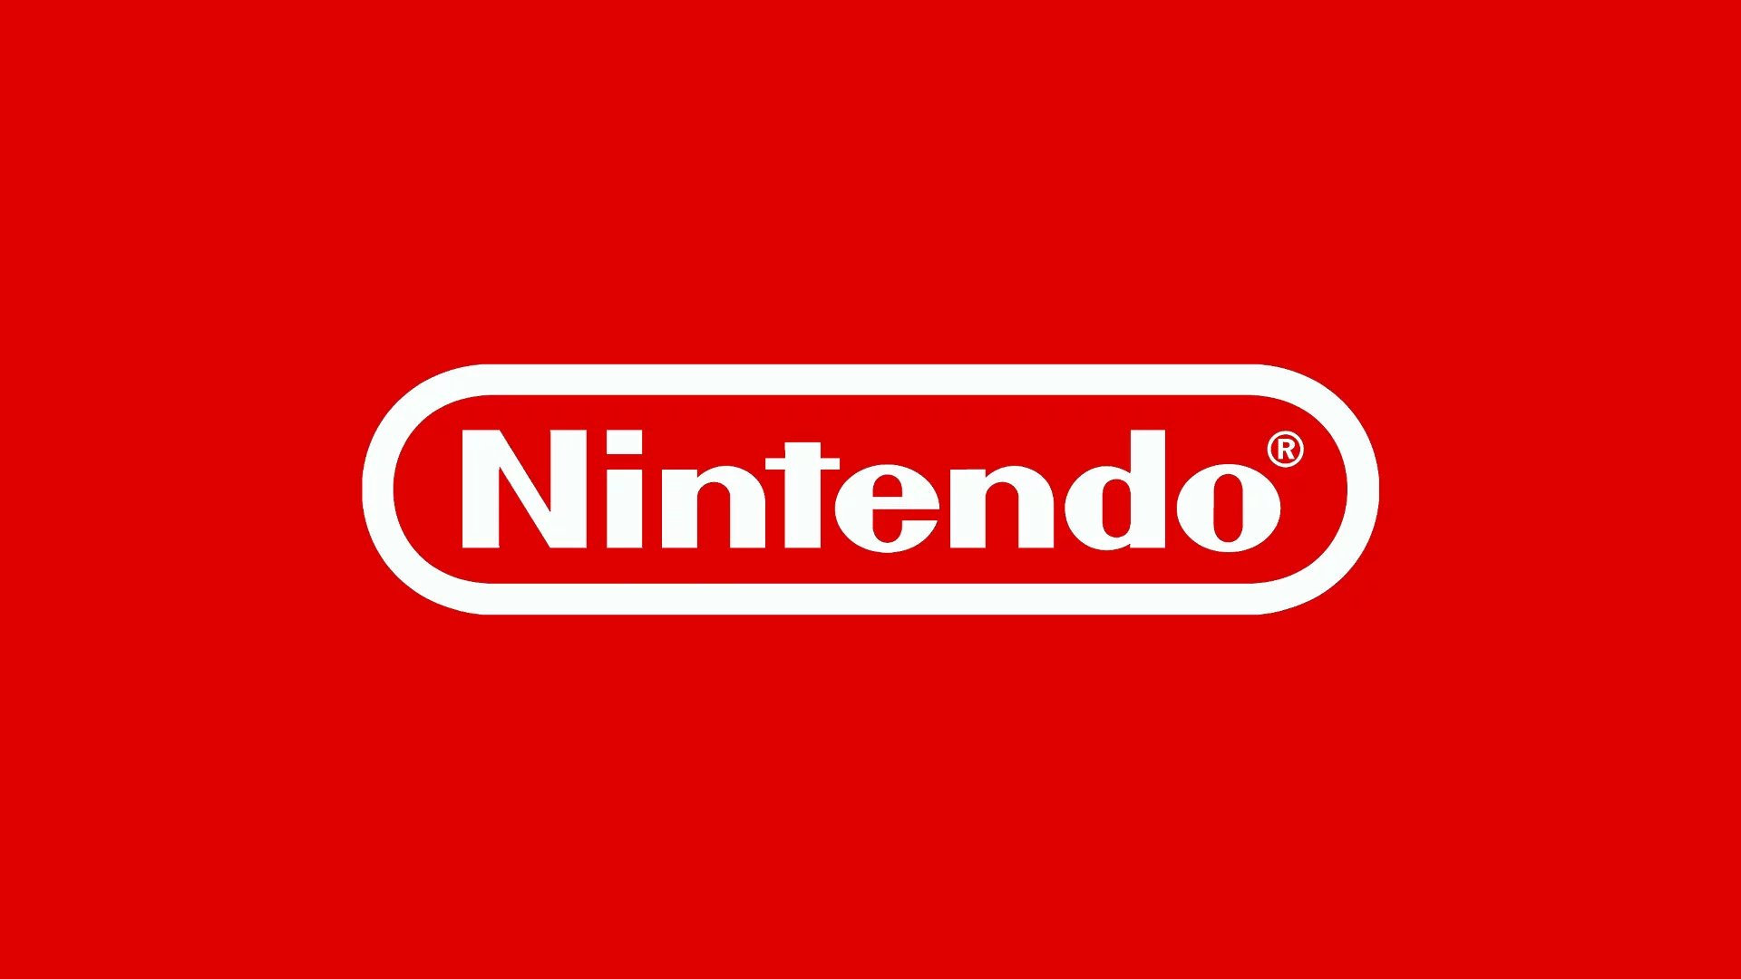
Notes:
Nintendo is one of the most important video game companies. Ask the students to name any of their favorite Nintendo games.
While this company is one of the most popular gaming companies in 2020, does anyone know when Nintendo was actually founded? Did Nintendo even exist before Mario?

Slide 10
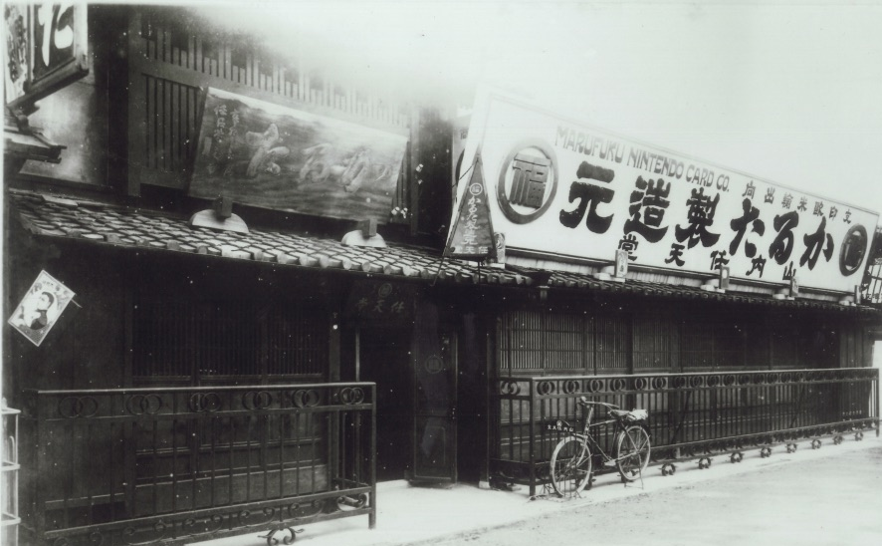
1889
Notes:
Nintendo was founded in 1889! This was the original Nintendo headquarters in Kyoto, Japan.
But was Nintendo making video games way back then? No! They actually started by making playing cards.

Slide 11
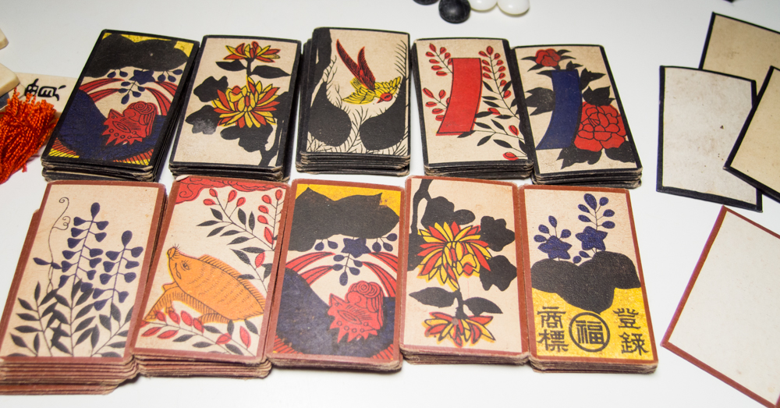
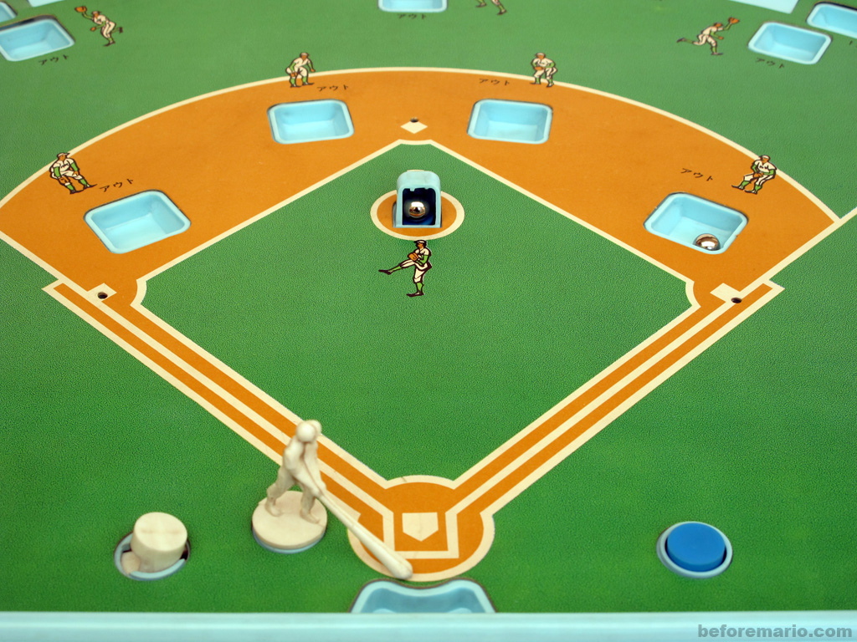
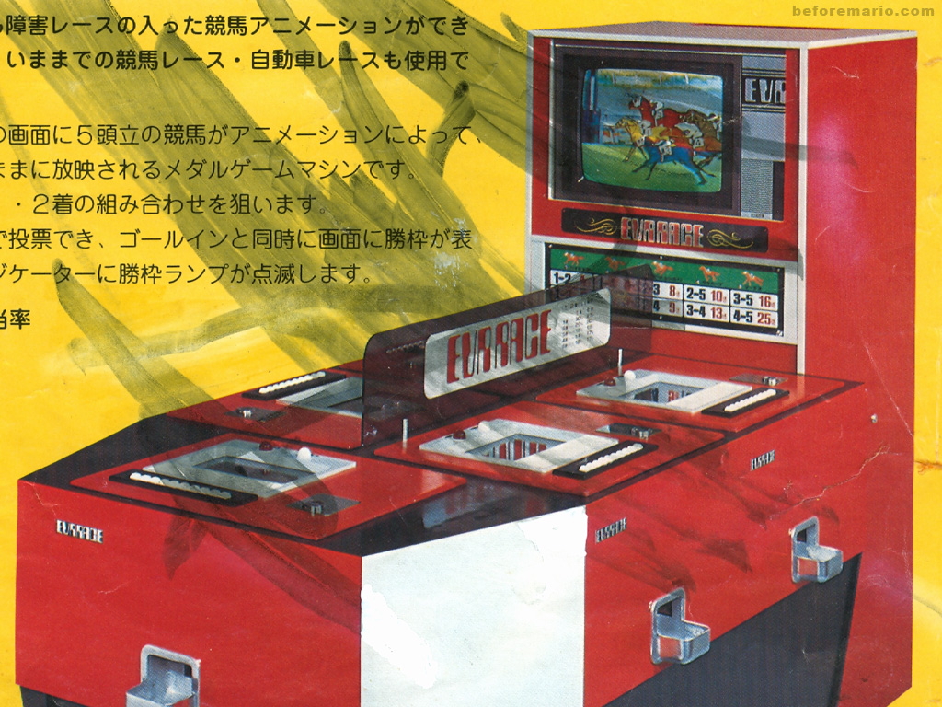
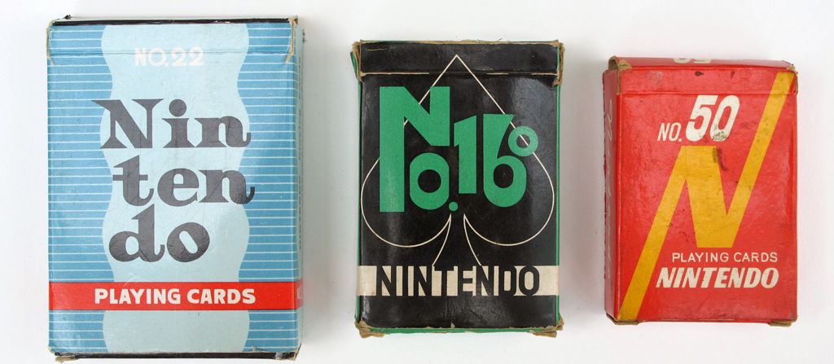
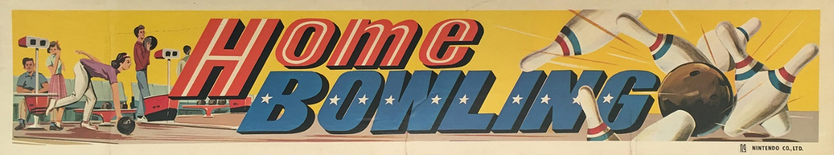
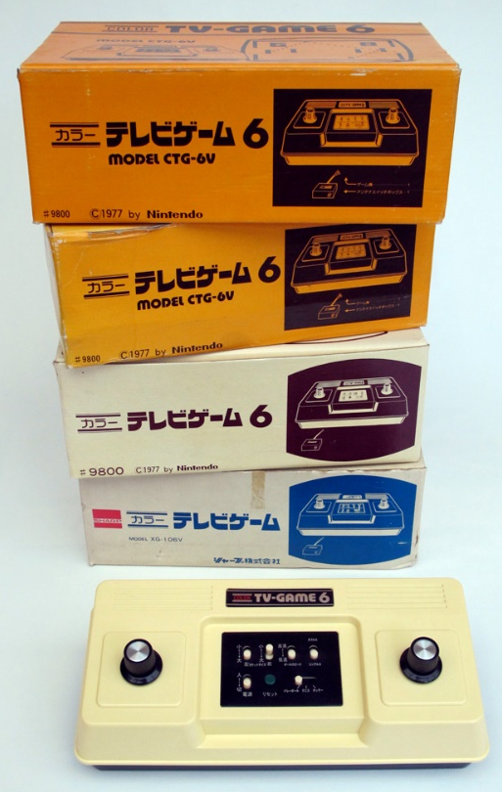
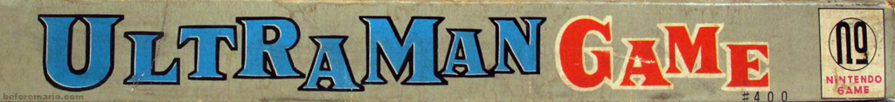
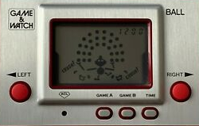
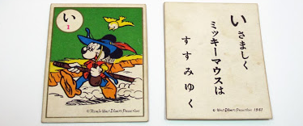
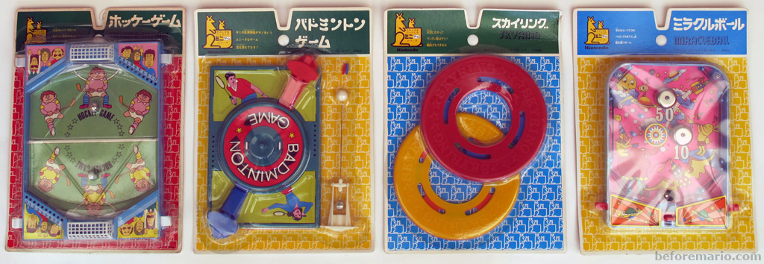
Nintendo before Mario
1889
Cards
1965
Toys
1975
Video Games
Notes:
So, what was Nintendo like before Mario?
From 1889 to 1964, Nintendo made Cards. They made playing cards, trading cards, and more. They even had licensing agreements with Disney!
In 1965, Nintendo started making all kinds of toys. Some examples were this baseball game, a home bowling game (possibly a predecessor to Wii Bowling), board games like Ultraman Game, and mini games.
In 1975, Nintendo released their first video game title: EVR Race. It was an arcade game where up to six players could bet on racing horses. They released their first video game console designed for home use in 1977: the Color TV-Game 6. In 1980, they released the Game & Watch – their first handheld console! Students might recognize Mr. Game & Watch, who appears in Super Smash Bros.
Students can check out beforemario.com for more pre-Mario Nintendo.

Slide 12
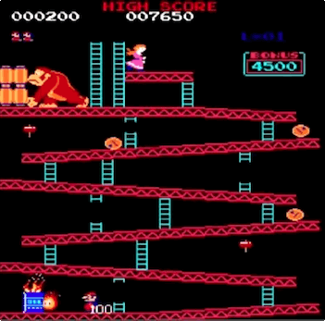
Donkey Kong (1981)
Arcade game
Shigeru Miyamoto & Gunpei Yokoi
First story-driven game ever!
Inspired by Popeye, King Kong
The first true platformer
Groundbreaking graphics
The hero was Mr. Video / Jumpman
Notes:
In 1981, almost one hundred years after Nintendo was founded, they released Donkey Kong. At this point, video games were really starting to take shape, and Donkey Kong was incredibly important in this developing industry.
Donkey Kong was an arcade game – it required a huge cabinet for all the hardware. Ask the students if they have ever played a physical arcade game
Shigeru Miyamoto & Gunpei Yokoi developed the game – Shigeru Miyamoto went on to be one of Nintendo’s most prolific developers
It was the first story driven game ever!
It was inspired by Popeye, King Kong, and Beauty & the Beast
It was one of the earliest examples of the platformer genre – the first “true” platformer because it was possible to jump
While the graphics look extremely outdated now, they were groundbreaking at the time
The main character was originally named Mr. Video, and then Jumpman, before finally becoming….

Slide 13
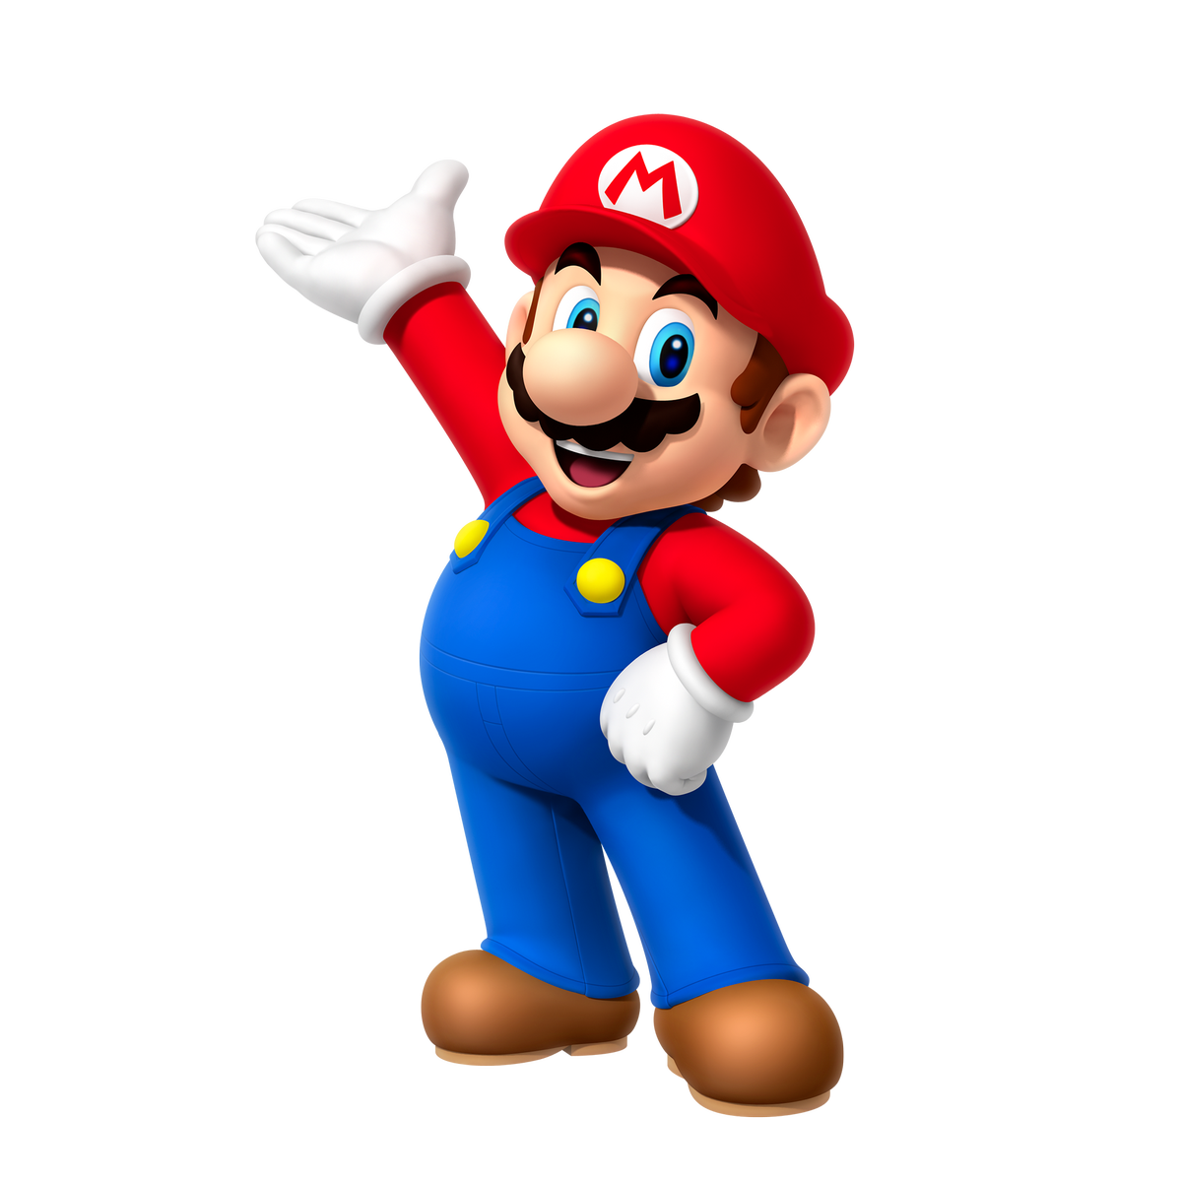
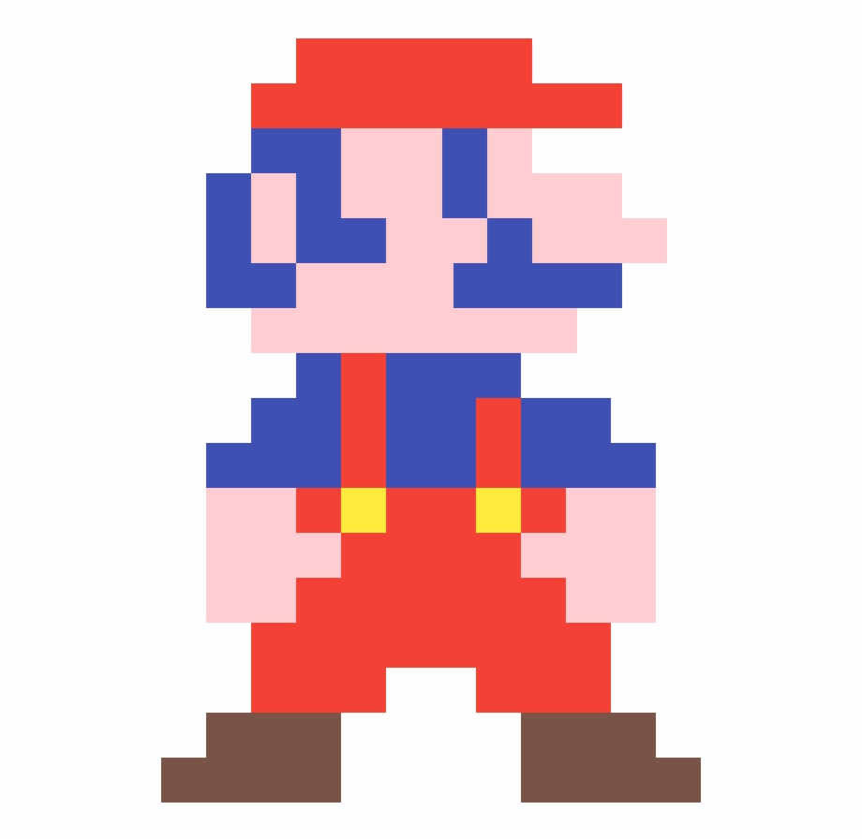
It's-a Me!
Mario Then
Mario Now
Notes:
That’s right, the main character from Donkey Kong would go on to become the beloved Mario.
Mario has since evolved into the much more high definition character we know today, but he started out as the pixelated protagonist of Donkey Kong. But why is Mario Mario?

Slide 14
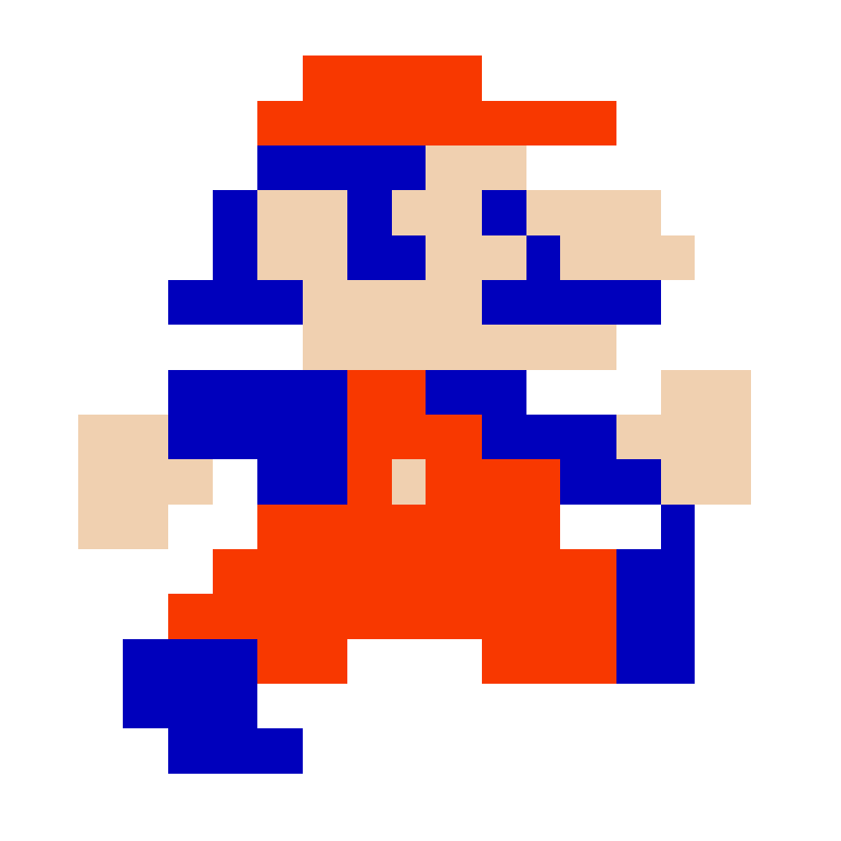
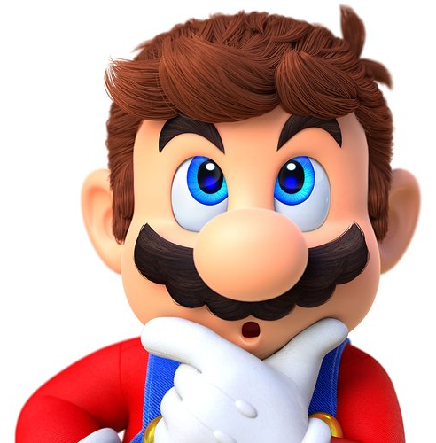
Why does Mario look the way he does?
Graphical limitations!
Hair was too hard to animate
Too few pixels for a mouth
Needed to show arm movements
Notes:
Ask the students if they have ever thought about why Mario looks the way he does.
Why does he have a hat? Why does he have a mustache? Why does he wear overalls?
Explain that the characteristics of the Italian plumber we all know and love were largely based on graphical limitations!
Drawing a mouth with so few pixels was infeasible, so the character was given a mustache
The programmers could not animate hair, so he got a cap
To make his arm movements visible, he needed colored overalls

Slide 15
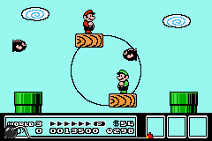
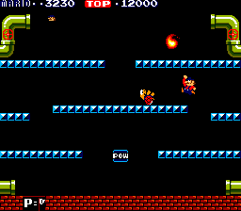
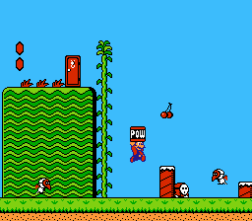
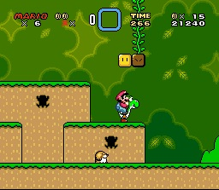
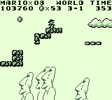
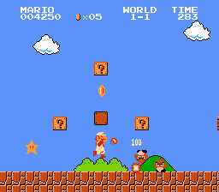
Mario's Early Games
NES
NES
Arcade
SNES
GAMEBOY
NES
Notes:
Mario would go on to appear in several video games. Most early Mario games were platformers.
Here we have:
Mario Bros (arcade game)
Super Mario Bros (NES)
Super Mario Bros 2 (NES)
Super Mario Bros 3 (NES)
Super Mario Land (Gameboy)
Super Mario World (Super Nintendo)
What do these games all have in common? They are all examples of platformers.

Slide 16
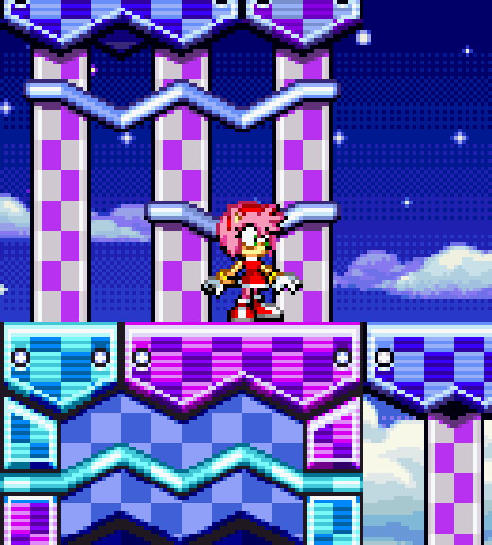
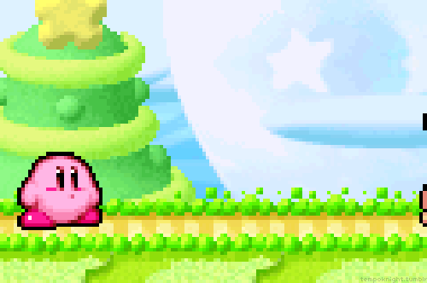
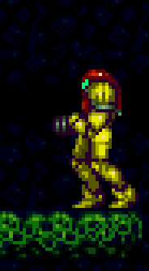
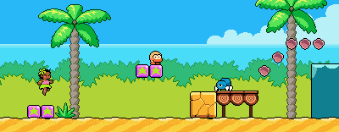
Platformers
Notes:
Back in the day, one of the most popular types of video game was a platformer. Ask the students to name any platformers they may have played.
These games are:
Sonic
Kirby
Metroid
Leilani’s Island (a modern indie game – using the retro style!)

Slide 17

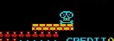
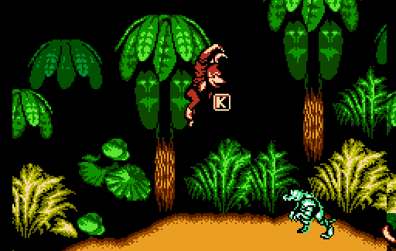
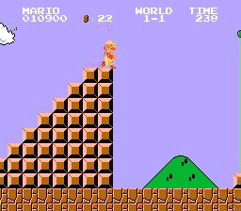
Traditional 2D Platformer Features
Motion from left to right
Jumping
Obstacles and Enemies
Win at map’s edge
Notes:
What makes a platformer a platformer? Ask the students if they know.
Another thing common in many platformer games is pixel graphics.

Slide 18
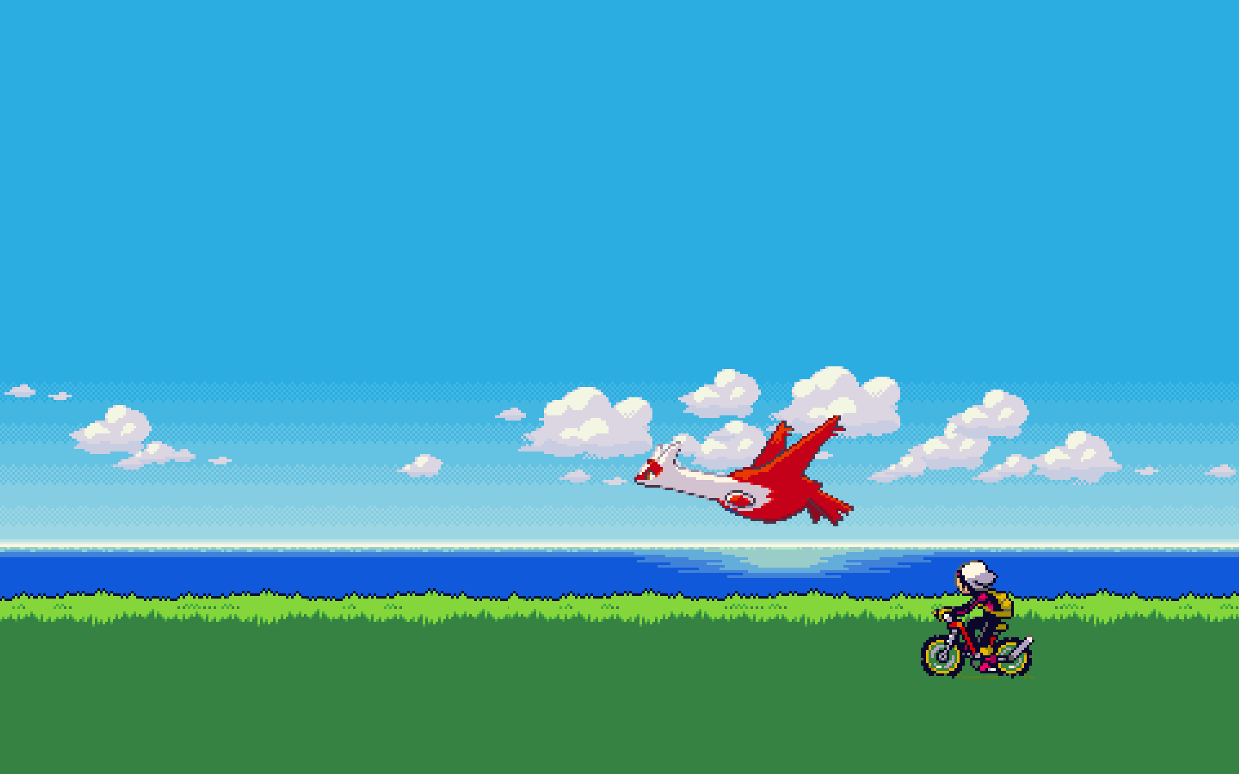
Notes:
Platformers from the past had limited graphical abilities, so they had to use pixel graphics. Many modern platformers use this retro style as well. It is often called “Pixel Art.”
So, what would you do if you want to make a game like this?

Slide 19
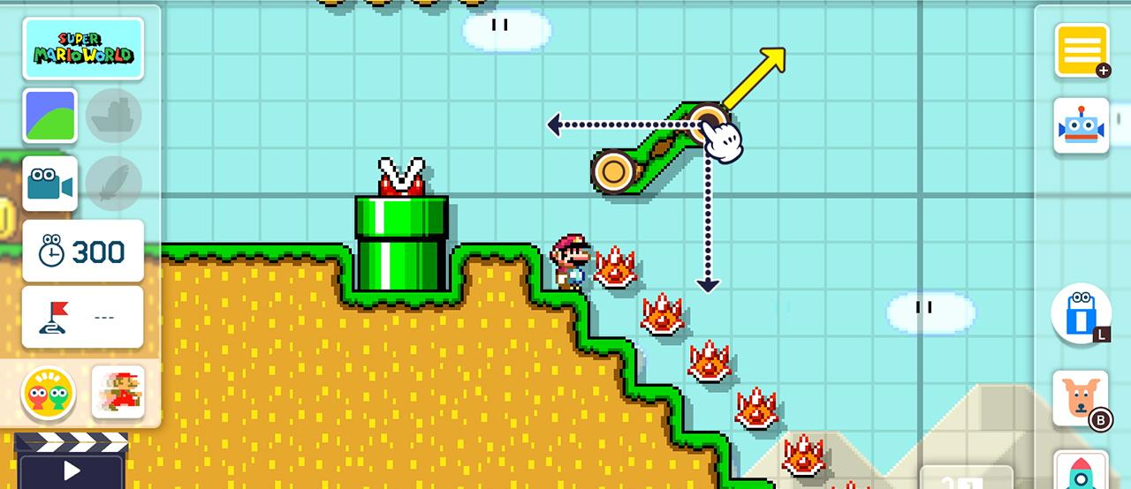
Making a Game – No Code
Notes:
Nowadays, it’s pretty easy to make a game using something like Super Mario Maker. There are other online tools for making platformer games.
However, to make a more customized game, it is necessary to use code.

Slide 20
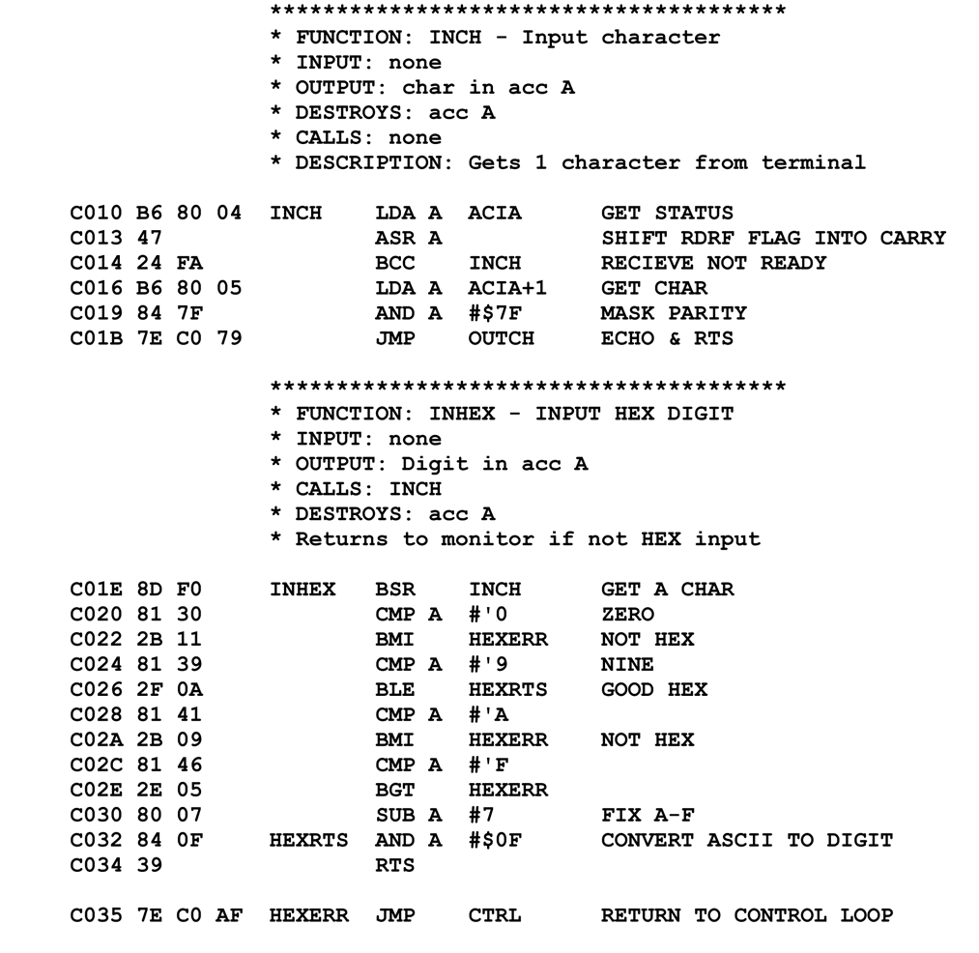
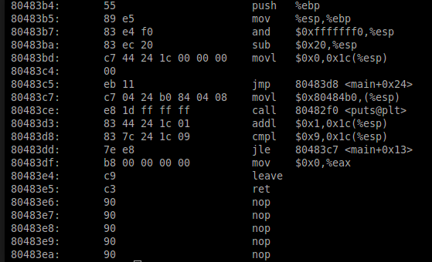
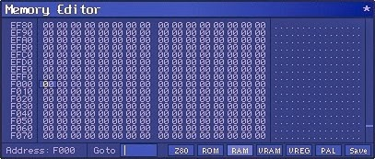
Making a Game – Assembly / Machine Code
Notes:
The original developers of platformer games had to write a whole lot of code to make the games they made! They used a lot of low-level assembly languages to program the game cartridges and arcade cabinets with entire games.
This code is almost completely indecipherable, but the developers knew what all of it meant!
In modern times, there are many options for creating games using a variety of programming languages.

Slide 21
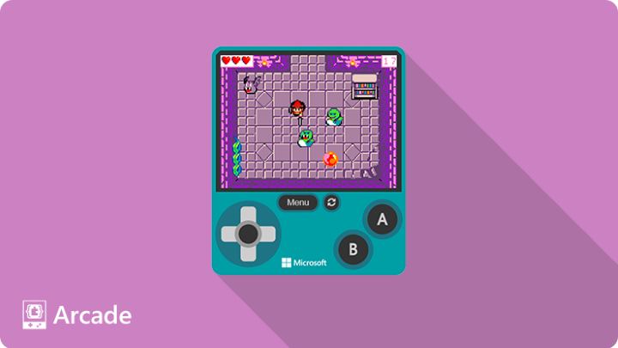
Microsoft MakeCode Arcade
Free
Open-source
Retro games
Block-based language
Handheld output
Tutorials available
Notes:
Microsoft’s MakeCode Arcade is a free game development platform used to make retro games with a block-based language. It’s a good way start learning how to code while making a game!

Slide 22
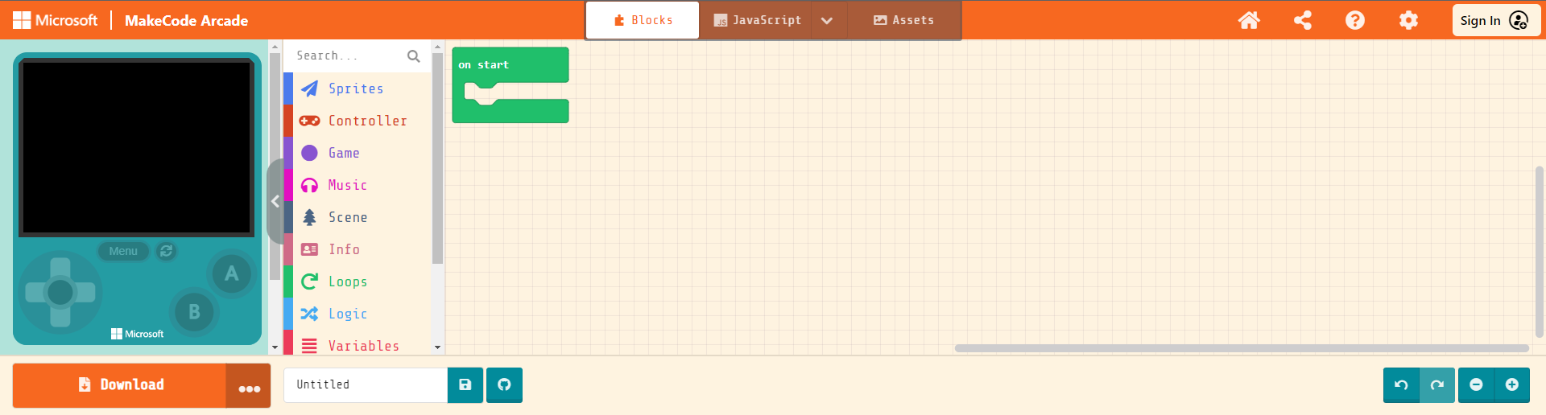
Back to Edge
Click the link under Code-Along
CODE-ALONG

Slide 23
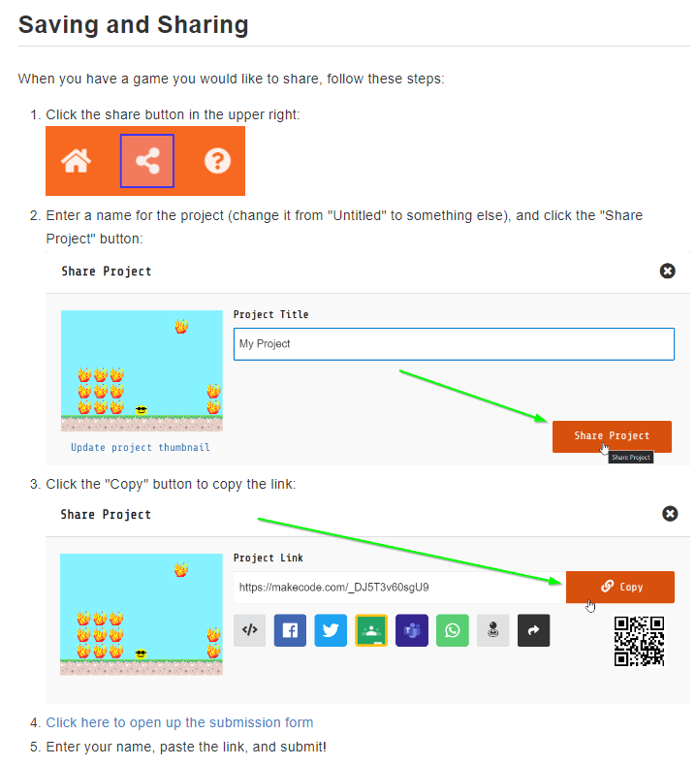
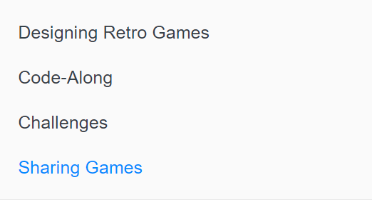
GAME SHARING

Slide 24
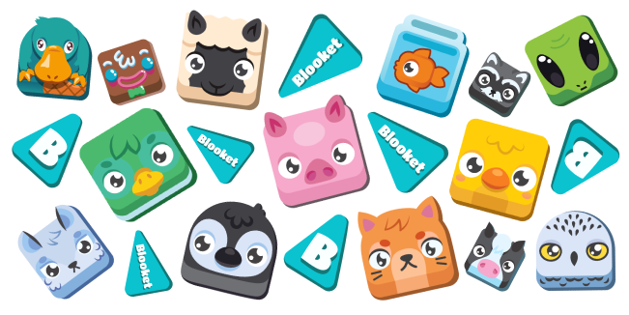
BLOOKET

Slide 25
Thank you!
CONCLUSION

