Slide 1
Unlocking the Power of the Command Line
Hyland Python Academy @ UCS
Notes:
Today we are going to show you how to unlock the power of the command line.

Slide 2

Notes:
Here’s a quick video showing how computers used to be for everyone back in the day.
Watch about a minute of this

Slide 3
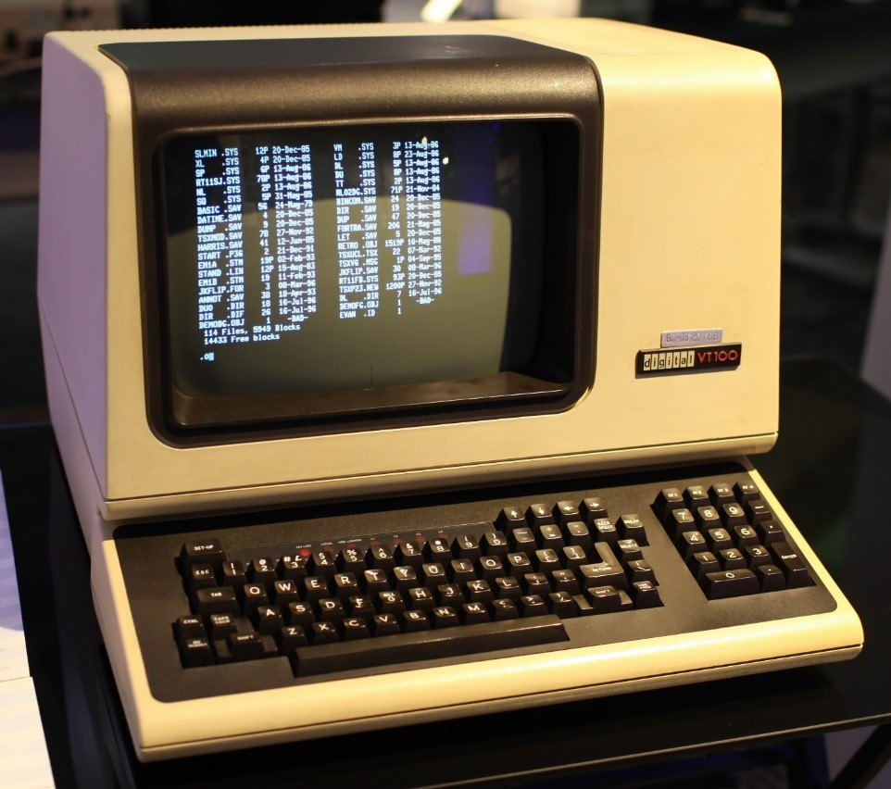
Before the GUI
Command-Line Interfaces (CLI) were once the primary means of computer interaction
Graphical User Interfaces (GUI): the modern-day visual programs we all know and love
Now, the command line provides the ability to perform complex tasks that cannot be achieved with the available features provided by the operating system’s GUIs
Notes:
How did people even survive back then? It was like pioneer times but for the world of computers.
Command-Line interfaces - programs based entirely on text – were all there really were! Anyone know what GUI stands for?
Graphical User Interfaces are used in almost every piece of software today. Things like websites, games, apps – all have GUIs (gooeys)
Today, while almost everything is GUI-based, there are still some use cases for the command line. Sometimes it’s just better, and sometimes it’s actually necessary!

Slide 4
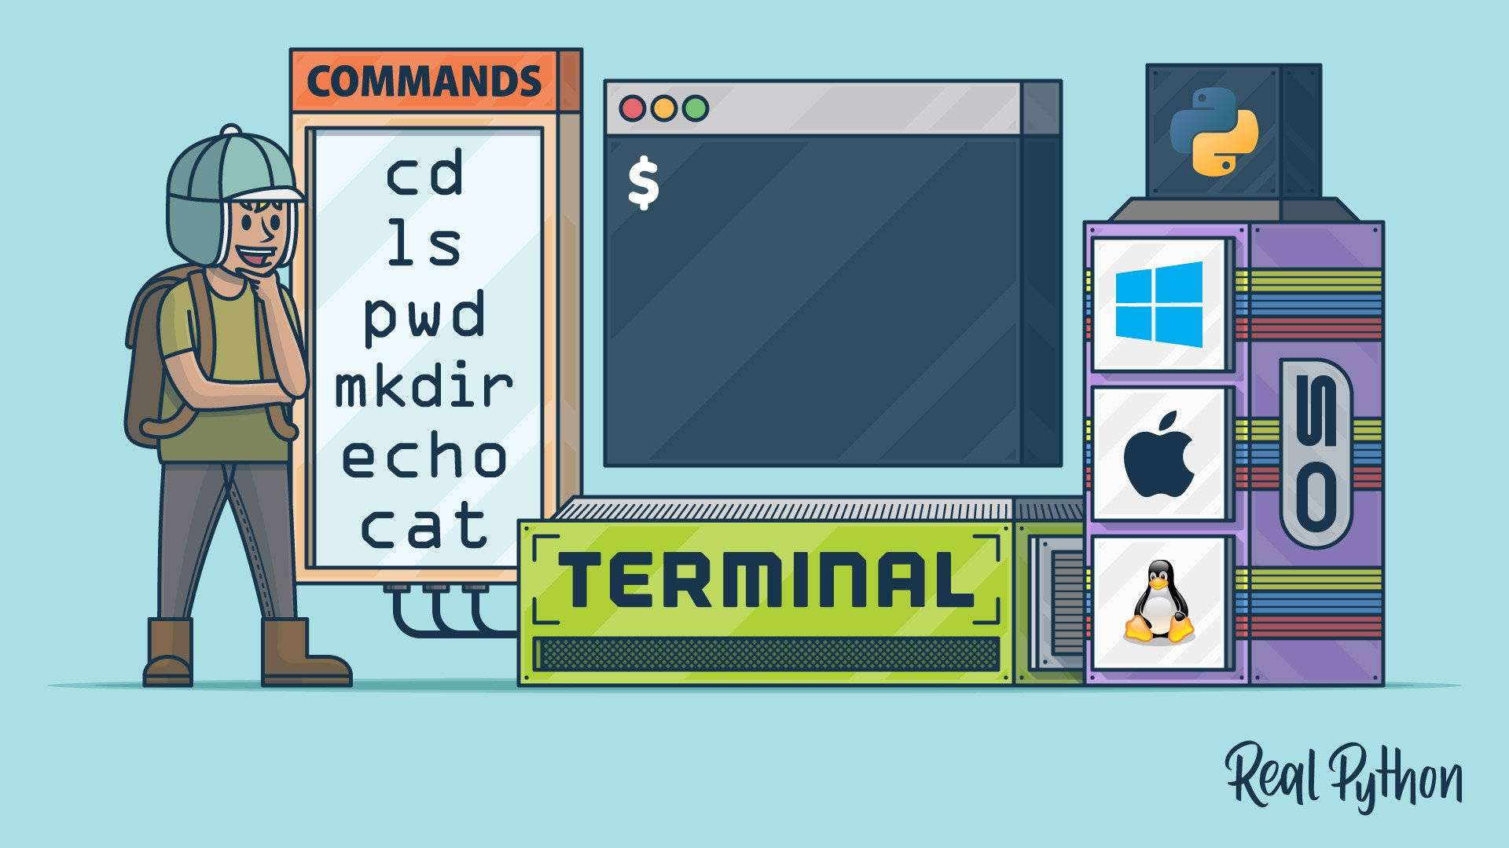
Python in the Command Line
The command line is the simplest way to see Python
Notes:
So, why are we learning about this? Well, Python is used extensively in the terminal (or console, or command line).
This is actually the simplest way to run Python scripts!

Slide 5
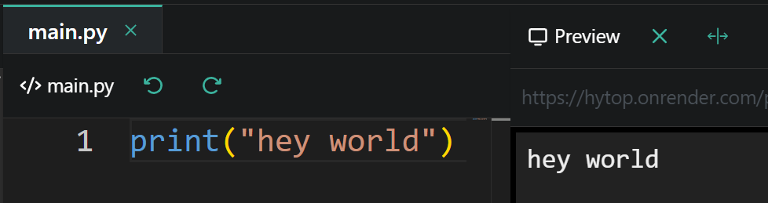
First Python Script
print("hey world")
Notes:
And now, for our first ever standalone script…
This print statement! That’s all we need for a command line application. Anyone know what this will do?
It prints what up world to the console. When Python reads, executes/runs this script (by running the `python main.py` command) – it shows up there in the command line.

Slide 6
Other Powers
from time import *
print("Welcome")
sleep(1)
your_name = input("What is your name? ")
print("Hi, " + your_name)
if your_name == "Joseph":
print("That's my name too!")
else:
print("Your name is different")
https://hytop.onrender.com/e/testing-py
Sleeping
Asking questions
Using answers
Dynamic execution
Notes:
And now, for our first ever standalone script…
This print statement! That’s all we need for a command line application. Anyone know what this will do?
It prints what up world to the console. When Python reads, executes/runs this script (by running the `python main.py` command) – it shows up there in the command line.

Slide 7
Questions?
Notes:
Anyone have any questions?

