Slide 1
Computer Hardware
MCCCC

Slide 2
Agenda
HARDWARE HISTORY
PARTS OF A COMPUTER
CIRCUITS
BINARY DATA
LOGIC GATES

Slide 3
HARDWARE HISTORY
2400BC–2026AD | Sporcle

Slide 4

Hardware History Gallery

Slide 5
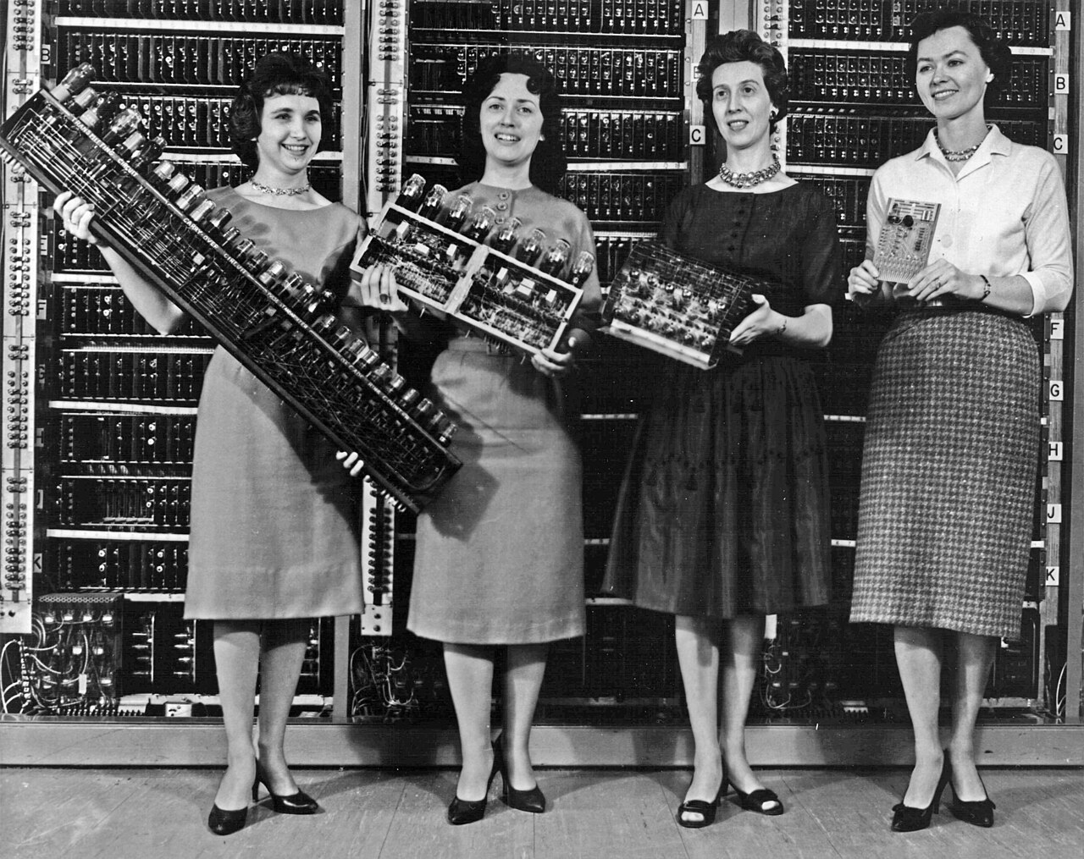

Slide 6
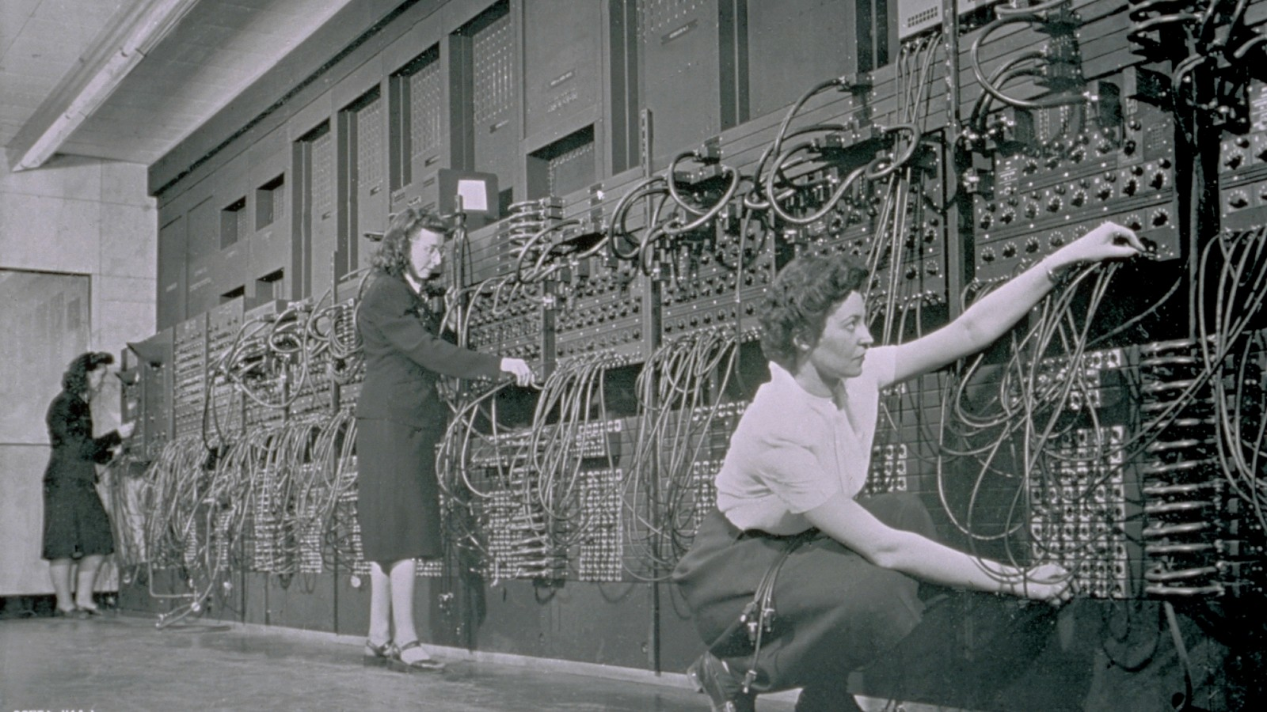

Slide 7
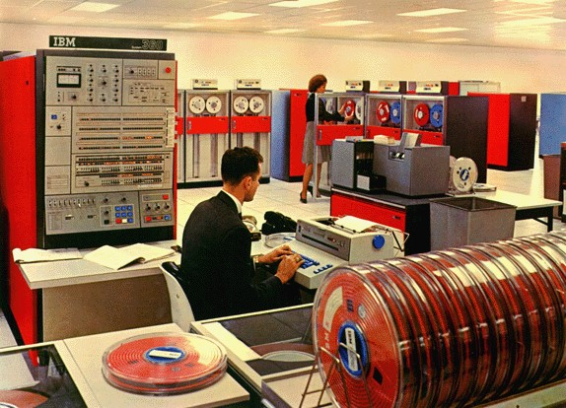

Slide 8
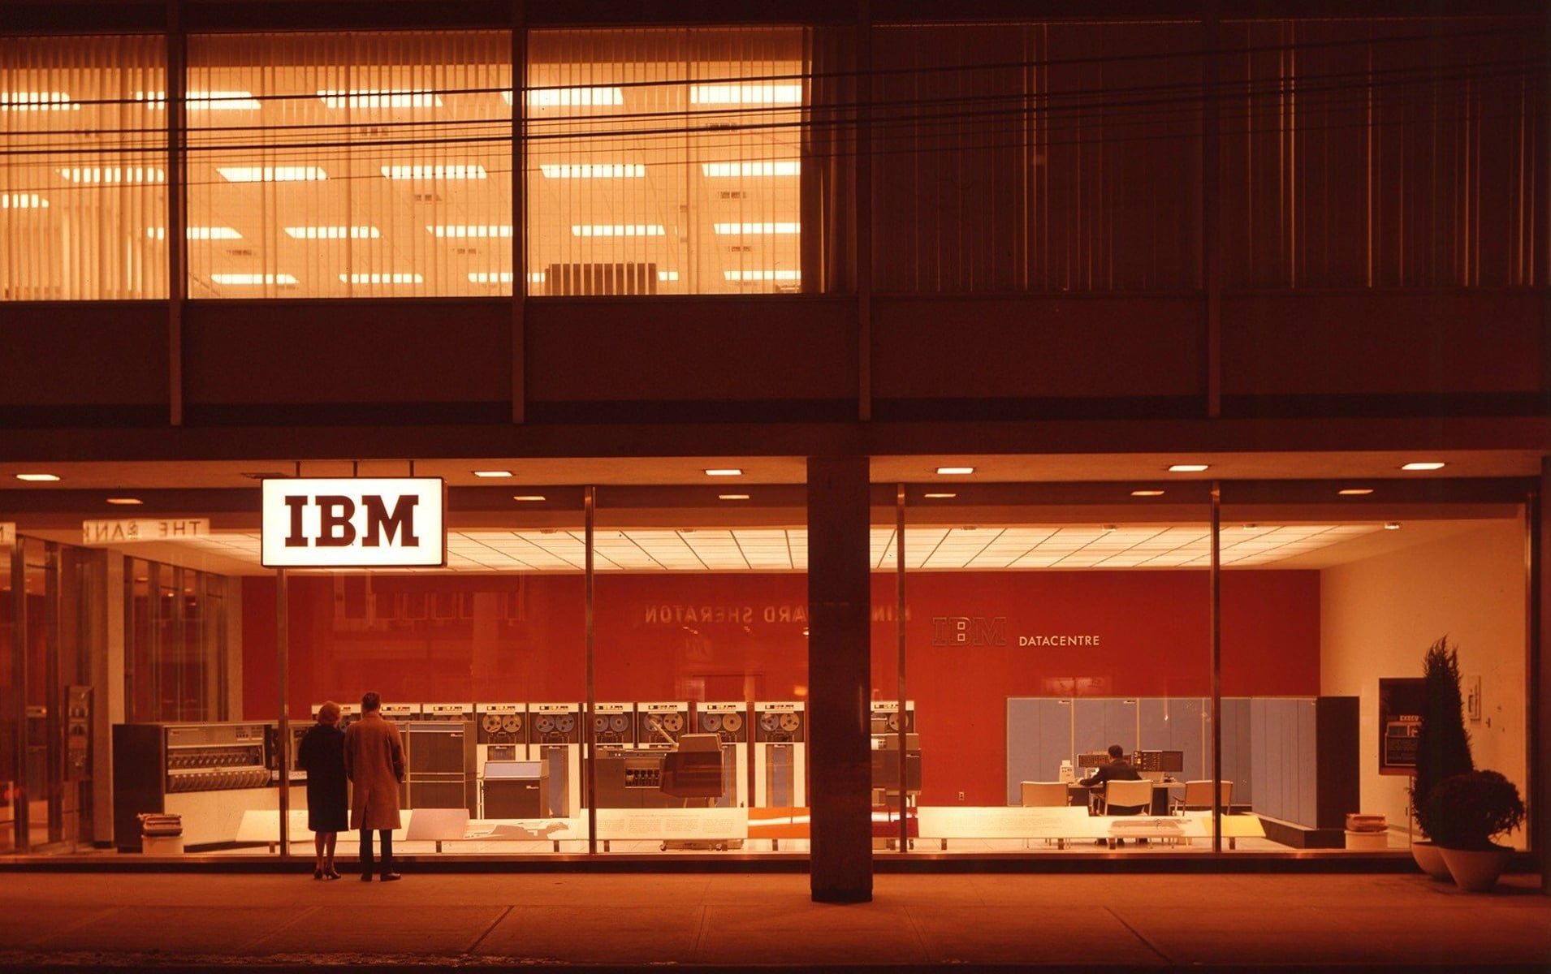

Slide 9
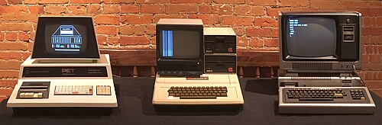

Slide 10
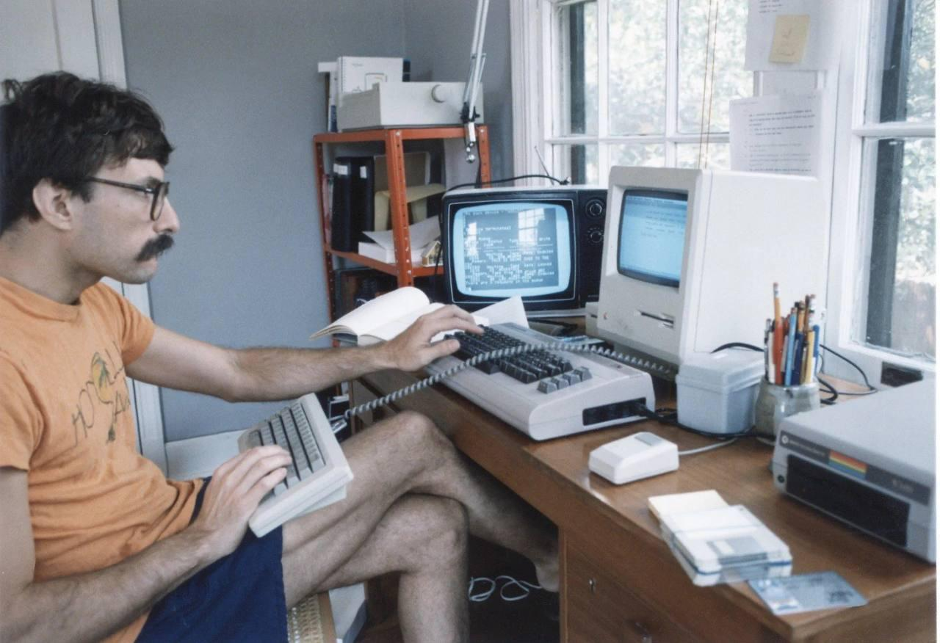

Slide 11
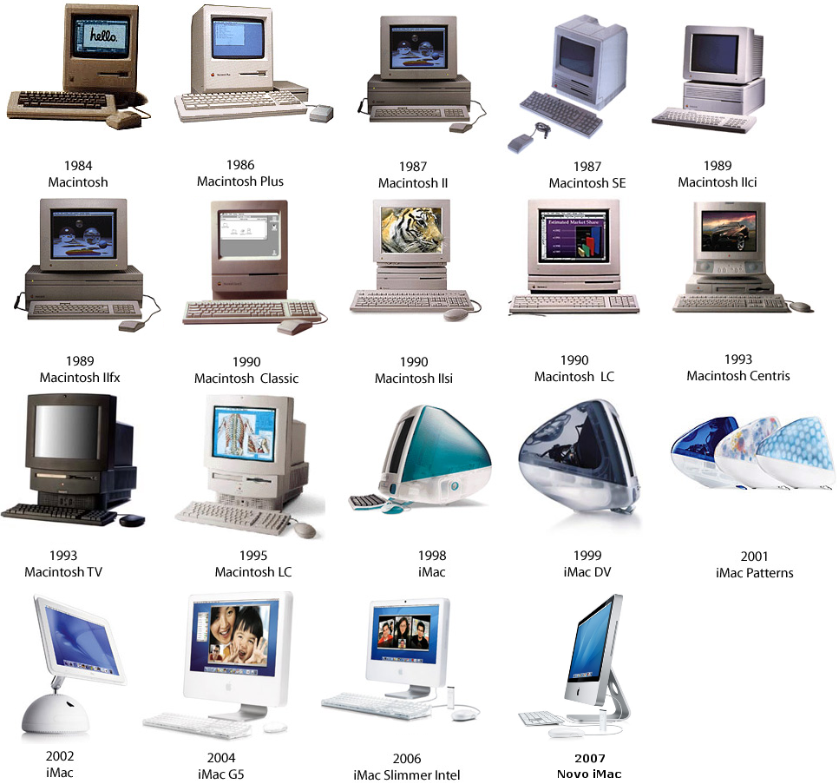

Slide 12
PARTS OF A COMPUTER
Simple | Complex | Connectors

Slide 13
ELECTRONIC CIRCUITS
Parts of parts of a computer

Slide 15
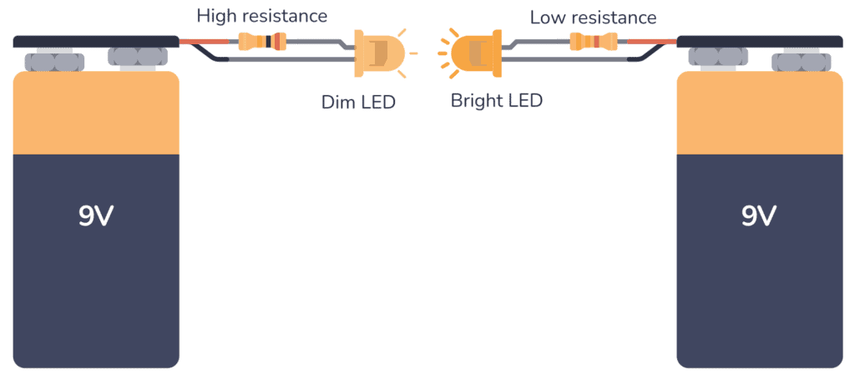
Electronic Components
Motors, controllers, boards, etc…
🔋Battery (+ and -)
🚨 Light
🔛📴 Switch
Resistors

Slide 16
ACTIVITY: Simulating Circuits with Tinkercad
Start Simulating

Slide 17
Break Time

Slide 18
BINARY DATA
Building blocks of all things

Slide 19
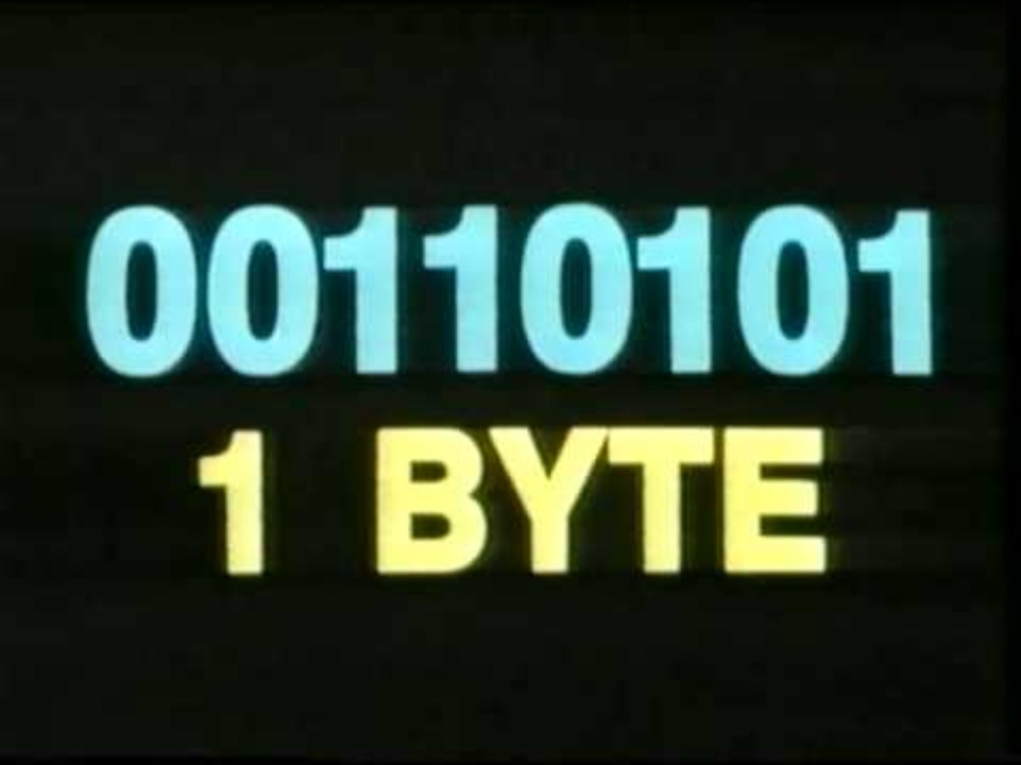

Slide 20
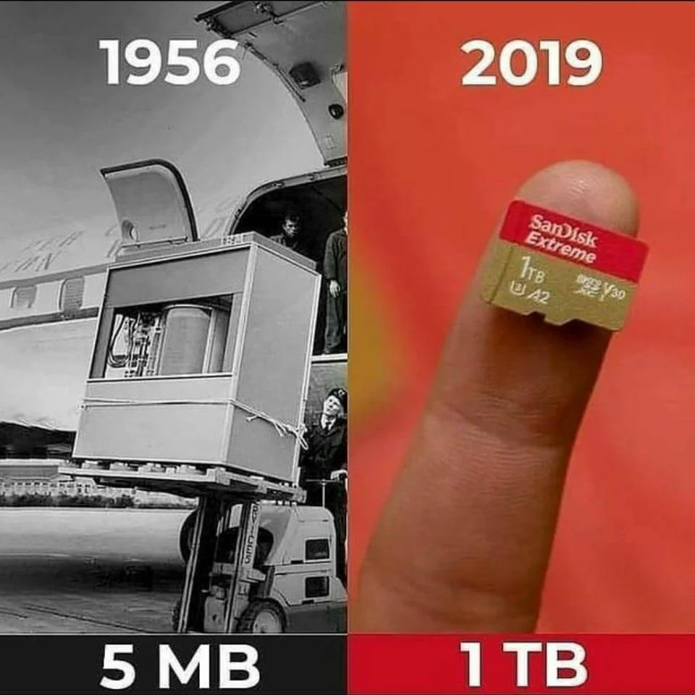
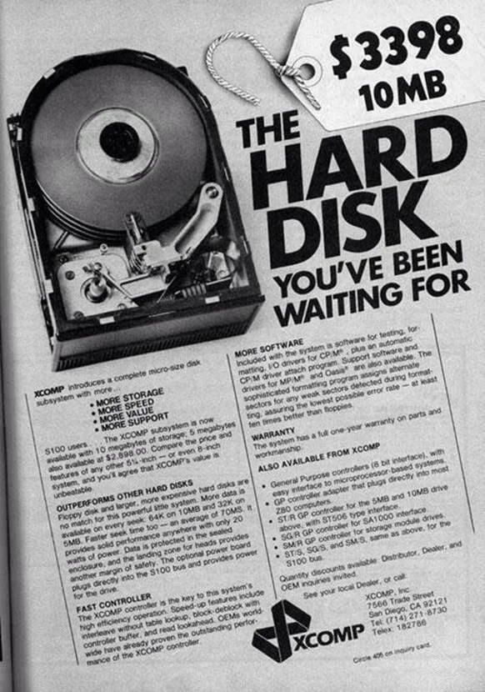

Slide 21
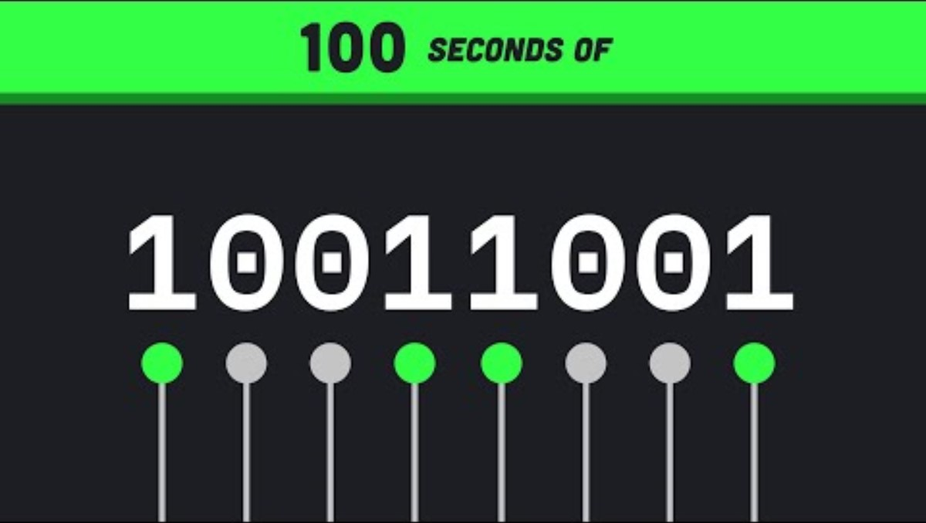

Slide 22
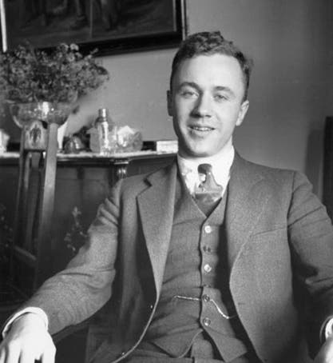
It from bit
John Archibald Wheeler
Quick Facts
Grew up in Youngstown, Ohio
Attended Johns Hopkins University
Coined the term black hole

Slide 23
It from bit
Every it—every particle, every field of force, even the space-time continuum itself—derives its function, its meaning, its very existence entirely—even if in some contexts indirectly—from the apparatus-elicited answers to yes-or-no questions, binary choices, bits. It from bit symbolizes the idea that every item of the physical world has at bottom—at a very deep bottom, in most instances—an immaterial source and explanation; that which we call reality arises in the last analysis from the posing of yes–no questions and the registering of equipment-evoked responses; in short, that all things physical are information-theoretic in origin.

Slide 24
ACTIVITY: Binary Conversion Game
Game

Slide 25
LOGIC GATES
Truth to CPU

Slide 26
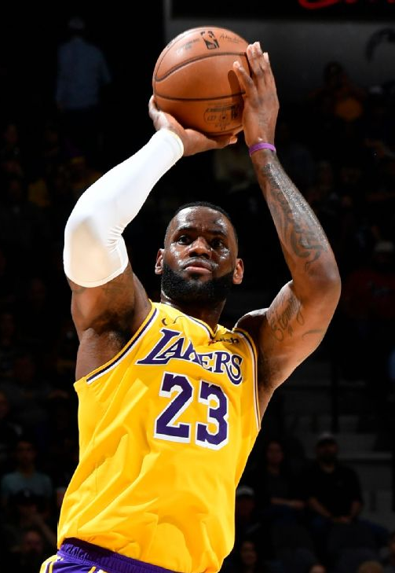
AND – a logical word
If I am unguarded AND
I am less than 10 feet from the hoop…

Slide 27
AND – a logical word
If the music is good AND
other people are dancing…

Slide 28
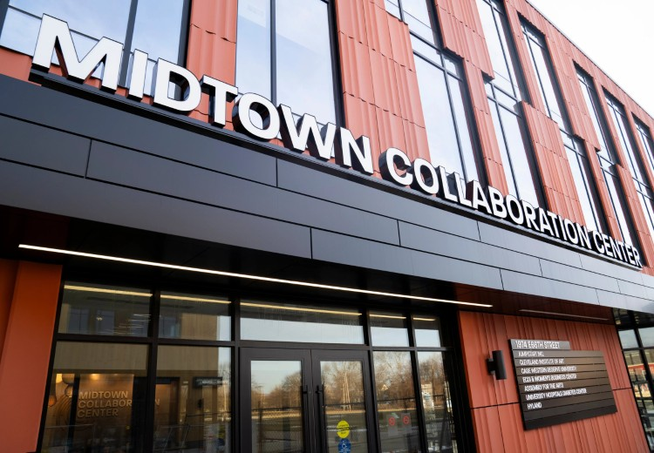
AND – a logical word
If it is Thursday AND
it is 4-7:30pm…

Slide 29
Truth Tables
Is It Thursday? | Is it 4-7:30pm? | Is MCCCC happening?
No | No | No ☹
No | Yes | No ☹
Yes | No | No ☹
Yes | Yes | YES ☺
If it is Thursday AND
it is 4-7:30pm…
Both the first thing AND the second thing have to be true for the third thing to be true!

Slide 30

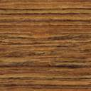


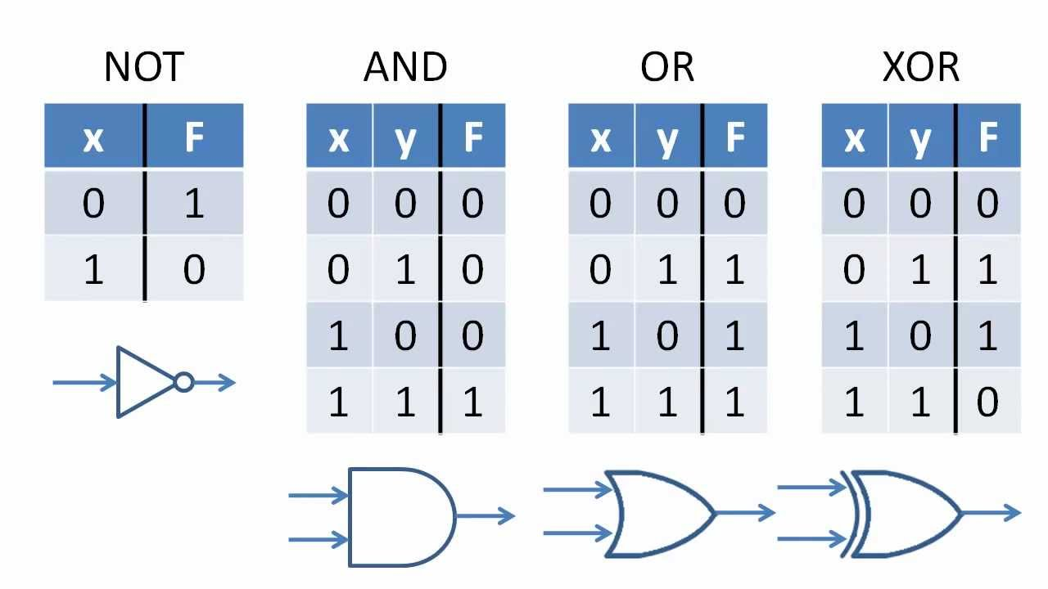
True / False … 1 / 0
Logic Gates take in input
And return output
As 0s and 1s (binary)

Slide 31
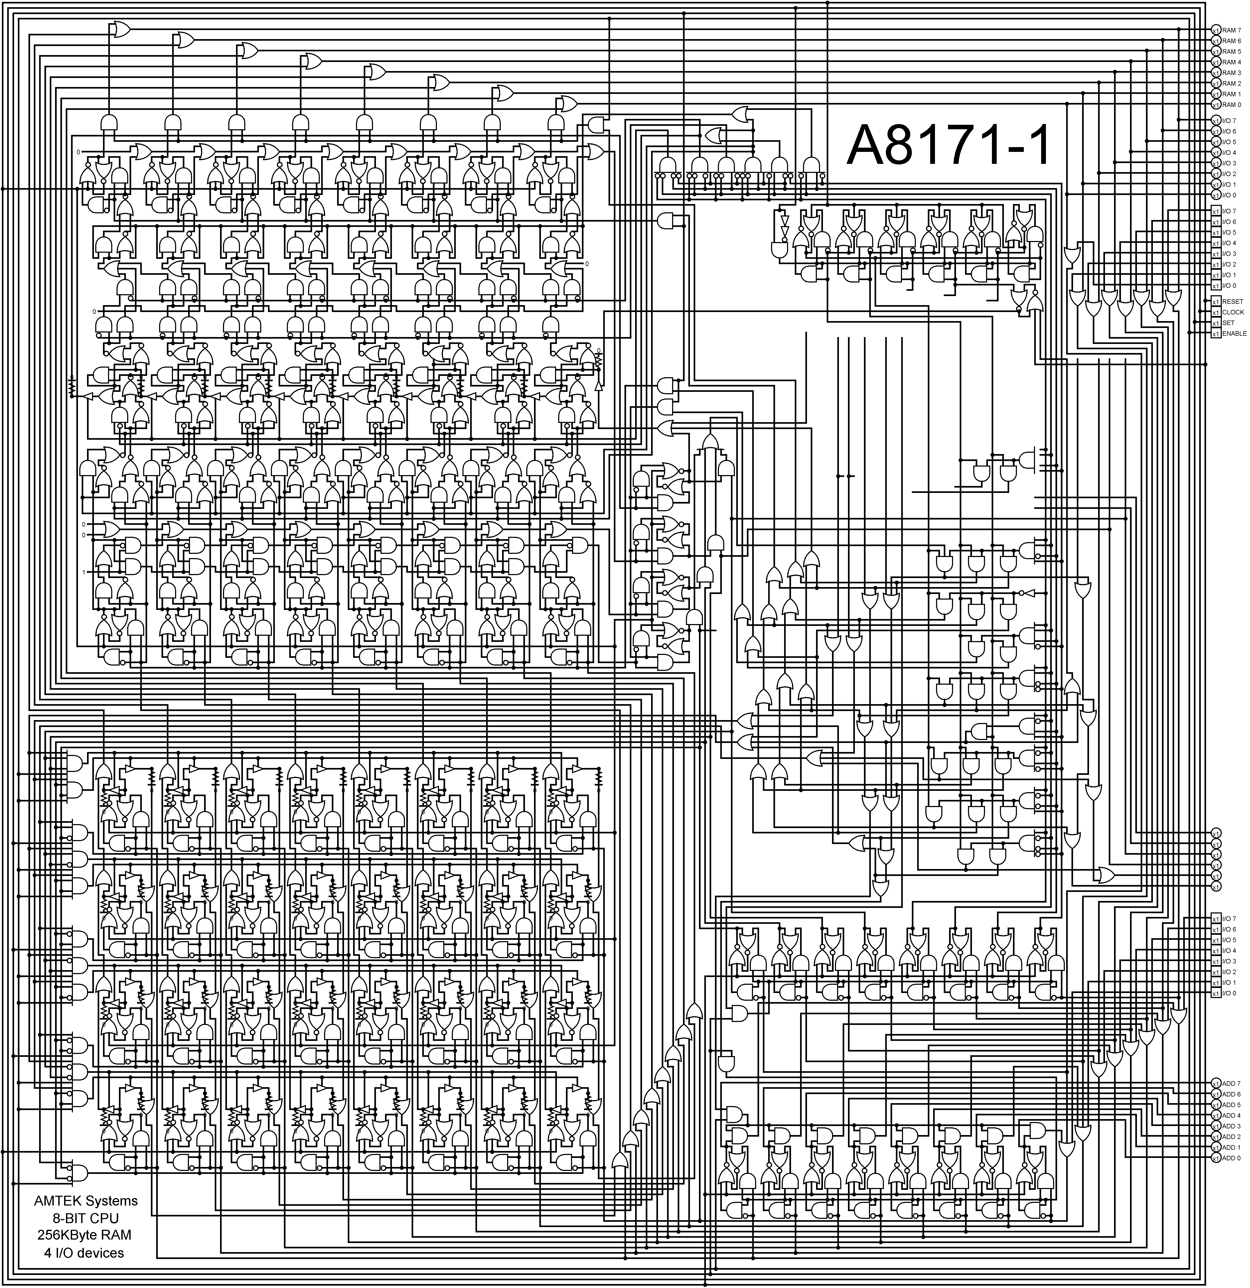
At the lowest level…
A CPU is built using these Boolean logic gates!
A lot of them!
Build a CPU from Scratch @ nandgame.com

Slide 32
Questions?

