Slide 1
Programming with Python
Hy-Tech Camp

Slide 2
Agenda
Icebreaker
Introduction to Python
Kahoot Quiz
Python Activities

Slide 3
ICEBREAKER
Write down a question that would help you get to know someone

Slide 4

Introduction to

Slide 5
What is python?
Python is named after “Monty Python’s Flying Circus”
It is a general-purpose language
Developers can use it for almost anything…
Creating websites
Analyzing large data sets
Controlling robots
Designing video games
Many other things!
Notes:
Ask students if they know anything about Python or programming. Ask them to guess how Python got its name

Slide 6
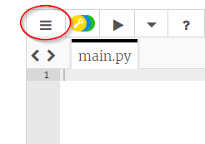
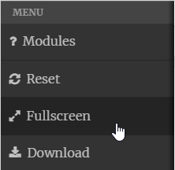
Trinket.io
Go to https://trinket.io/python/72ffa4b46a
Click the hamburger menu in the upper left, then click “Fullscreen”
Notes:
Direct the students to trinket, and have them follow along with the presentation

Slide 7
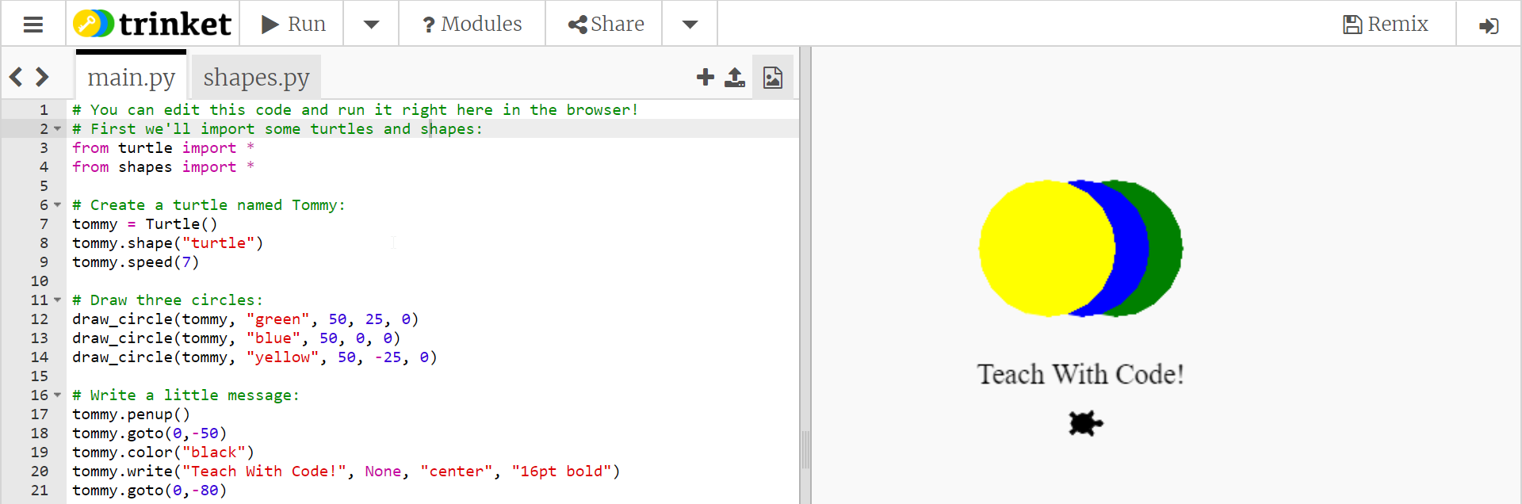
Trinket.io
Trinket is a tool that allows developers to write and run code online!
Click Run
Write Code
See Results

Slide 8
First Python Program – Hello World
A program that displays a message to the user saying “Hello World”
Usually the first program a developer writes when learning a new language
print("Hello, World")

Slide 9
Challenge – Display a different message
How could you display a message saying “Welcome” to the user?
print("Welcome")

Slide 10
Using quotation marks
Static string text values
Any messages to show the user must be within quotes ("")
This is how the program knows these are blocks of text
Text within quotes should be a red/orange color
"This is a message"
This is not a message!

Slide 11
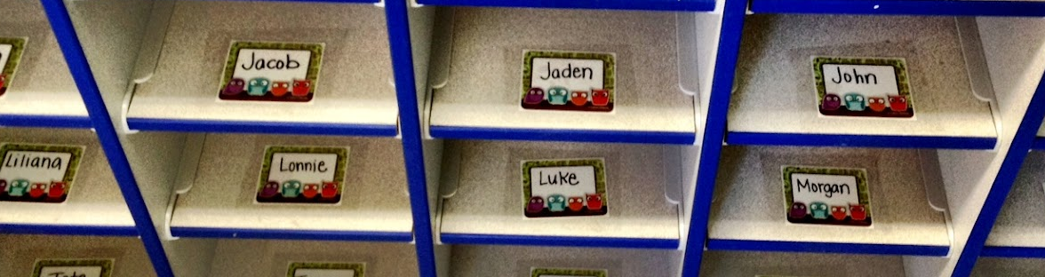
Variables
In computer science, variables are containers for data
Variables have names so developers can reference the data
They are kind of like mailboxes; they have a label so the developer always knows where to find them, and the contents can change
Notes:
Ask the students if they know what the mailbox/cubbyholes are

Slide 12
Variables – Python Example
my_name = "Sam"
print("Hello " + my_name)
What message will the user see?
Hello Sam
Notes:
Note that variables must have no spaces, no special characters

Slide 13
Variables – Python Example
my_name = "Sam"
print("Hello " + my_name)
The variable here is my_name. The code sets the value of the variable, and then references it

Slide 14
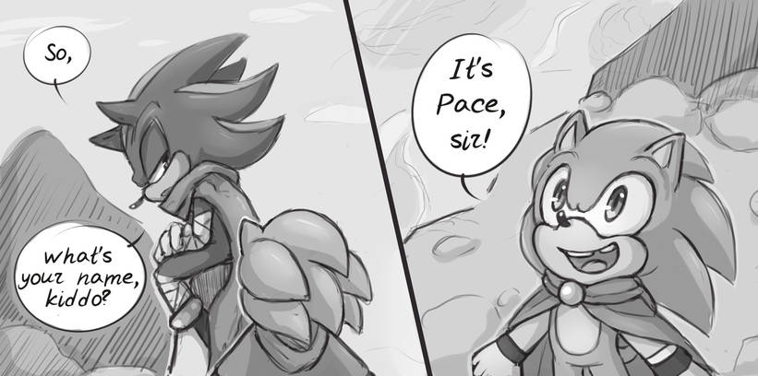
Interacting with the user
Real life conversation: Ask question, remember answer
Python program conversation: Ask question, remember answer
Answer is stored in a variable
Notes:
Explain that in a real life conversation, people ask questions and remember what the other person says. A computer program works in the same way; it asks questions to the user, and remembers their answers! In Python, the answers the user enters are stored within variables.

Slide 15
User Input – Python Example
name = input("What's your name?")
print("Hello " + name)
What will this code do?
Notes:
Ask the students what they think this will do

Slide 16
User Input – Python Example
name = input("Enter Name:")
The user sees the prompt and enters information
The text they enter is stored in the name variable
print("Hello " + name)
The name is remembered and used in the message
Notes:
Walk through the example line by line

Slide 17
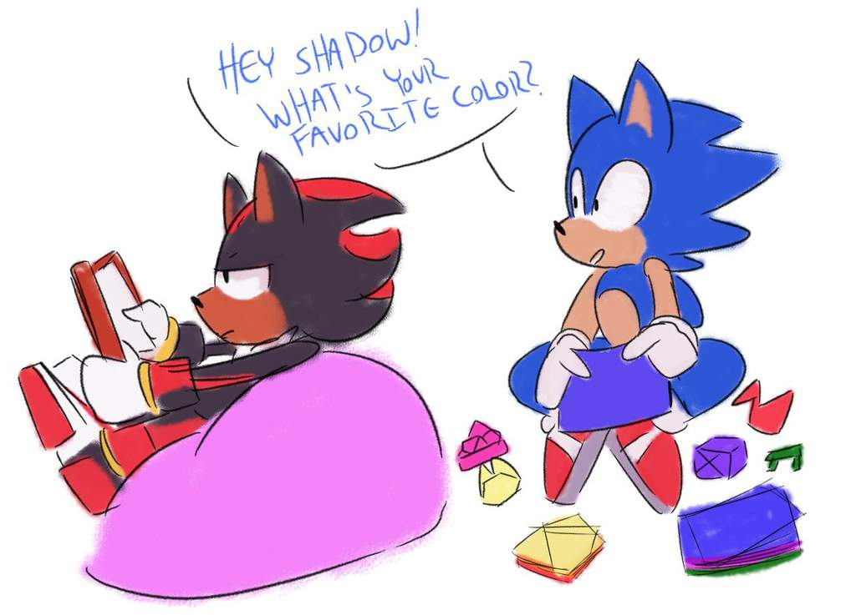
More User interactions – if/else
Real life conversation: Responses change based on what the other party says
If someone says their favorite color is blue, you might say “That’s my favorite too!”
If they say something else, you might say “That’s not my favorite”
Notes:
In a real conversation, one person would respond differently based on what the other person says.

Slide 18
if – Python Example
color = input("What is your favorite color?")
if color == "blue":
print("That's my favorite too!")
What will this code do?
Notes:
What will happen if the user enters blue? What will happen if the user enters something other than blue?
Indentation tells the program what to do if the condition is met.

Slide 19
if – Python Example
color = input("What is your favorite color?")
The color the user enters is stored in color
if color == "blue":
The program checks if the color is blue
print("That's my favorite too!")
If it is, the program prints out the message
Notes:
Walk through the example line by line

Slide 20
Setting variables vs. checking values
Setting variables (=)
Checking values (==)
Single equals sign
Stores some information in a variable
Used for user input
movie = "Minions"
Sets the movie variable to “Minions”
Double equals sign
Compares a variable to another value
Used in if statements
if movie == "Minions":
Checks if the movie variable contains “Minions”

Slide 21
If/else – Python Example
color = input("What is your favorite color?")
if color == "blue":
print("That's my favorite too!")
else:
print("That's not my favorite")
What will this code do?

Slide 22
Repeating code with Loops
Developers want to write as little code as possible!
Rather than copying and pasting code, developers use loops
Loops allow programs to repeat the same lines of code a number of times
This way, instead of writing 500 lines of code, only one line has to change
It is much easier to maintain!

Slide 23
Loops – Python Example
for x in range(10):
print("| || |")
What will this code do?

Slide 24
Loops – Python Example
print("| || |")
This line simply prints out a message
Note the indentation – this means it is within a loop
for x in range(10):
This line tells the program to repeat 10 times
Repeating the message makes a picture of a road!

Slide 25
Challenge – Make a longer road
How could you update the existing loop to make a longer road?
for x in range(20):
print("| || |")

Slide 26
Kahoot

Slide 27
Turtle Activities
https://github.com/hylandtechoutreach/python-camp

