Slide 1
Programming with Python
Virtual Hy-Tech Camp

Slide 2
Agenda
Introduction to Python
Kahoot Quiz
Python Activities

Slide 3

Introduction to

Slide 4
What is python?
Python is named after “Monty Python’s Flying Circus”
It is a general-purpose language
Developers can use it for almost anything…
Creating websites
Analyzing large data sets
Controlling robots
Designing video games
Many other things!
Notes:
Ask students if they know anything about Python or programming. Ask them to guess how Python got its name. Ask them if they know what a general-purpose language is.

Slide 5
First Python Program – Hello World
A program that displays a message to the user saying “Hello World”
Usually the first program a developer writes when learning a new language
print("Hello, World")
Notes:
This code will print a simple message to the user in Python.

Slide 6
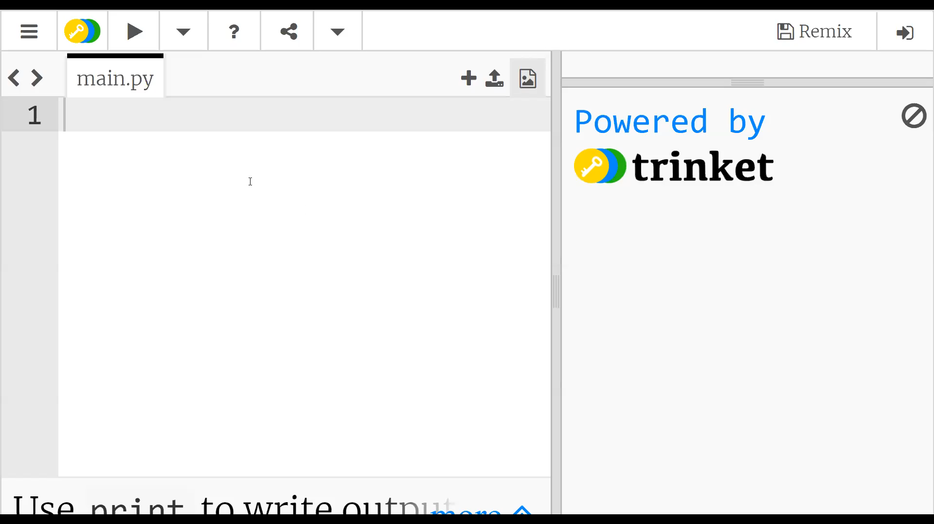
Notes:
Show an example of a print message

Slide 7
Challenge – Display a different message
How could you display a message saying “Welcome” to the user?
print("Welcome")
Notes:
Ask the students to type out a command that would print a message of “Welcome” instead. Then reveal the answer.

Slide 8
Using quotation marks
Static string text values
Any messages to show the user must be within quotes ("")
This is how the program knows these are blocks of text
Text within quotes should be a red/orange color
"This is a message"
This is not a message!
Notes:
This is a quick note to emphasize the need for double quotes, sometimes this syntax trips the students up.

Slide 9
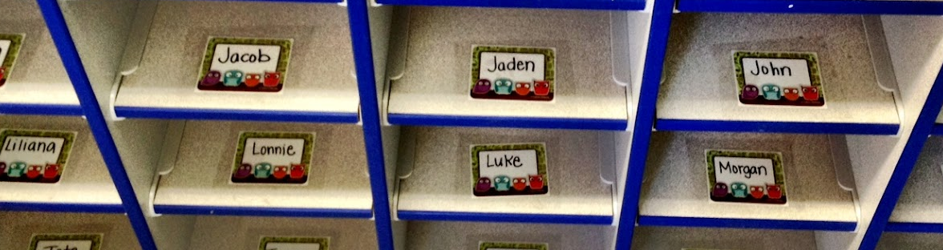
Variables
In computer science, variables are containers for data
Variables have names so developers can reference the data
They are kind of like mailboxes; they have a label so the developer always knows where to find them, and the contents can change
Notes:
Ask the students if they know what the image is – mailbox/cubbyholes.
Explain that variables in computer science are kind of like this – they are containers for data.
This may not make much sense yet, but this example can be used to make variables a little more tangible. Setting a variable is like putting something into a cubbyhole, and using its value is like looking into the cubbyhole.

Slide 10
Variables – Python Example
my_name = "Sam"
print("Hello " + my_name)
What message will the user see?
Hello Sam
Notes:
Ask the students if they can guess what this does. Then reveal the answer.
Note that variable names must have no spaces, no special characters

Slide 11
Variables – Python Example
my_name = "Sam"
print("Hello " + my_name)
The variable here is my_name. The code sets the value of the variable, and then references it
Notes:
Explain this example in terms of cubbyholes – my_name is like the name on the mailbox, and my_name = “Sam” is like putting some mail in the mailbox. Then, using the variable is like peeking into the mailbox to see what’s in there.

Slide 12

Interacting with the user
Real life conversation: Ask question, remember answer
Python program conversation: Ask question, remember answer
Answer is stored in a variable
Notes:
The short video clip shows Sonic the Hedgehog meeting Tails for the first time. Tails tells Sonic his name, and then Sonic remembers it (just like a computer).
Explain that in a real life conversation, people ask questions and remember what the other person says. A computer program works in the same way; it asks questions to the user, and remembers their answers! In Python, the answers the user enters are stored within variables.

Slide 13
User Input – Python Example
name = input("What's your name?")
print("Hello " + name)
What will this code do?
Notes:
Ask the students what they think this will do. Allow the students to enter this code in trinket to see what happens.

Slide 14
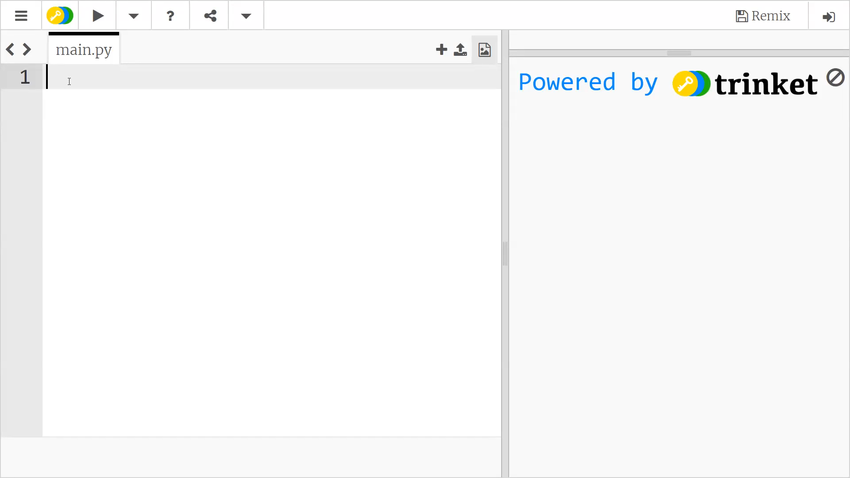
Notes:
Show an example of the program asking the user for input

Slide 15
User Input – Python Example
name = input("Enter Name:")
The user sees the prompt and enters information
The text they enter is stored in the name variable
print("Hello " + name)
The name is remembered and used in the message
Notes:
Walk through the example line by line. Explain that whatever the user enters will be stored in the name variable.

Slide 16
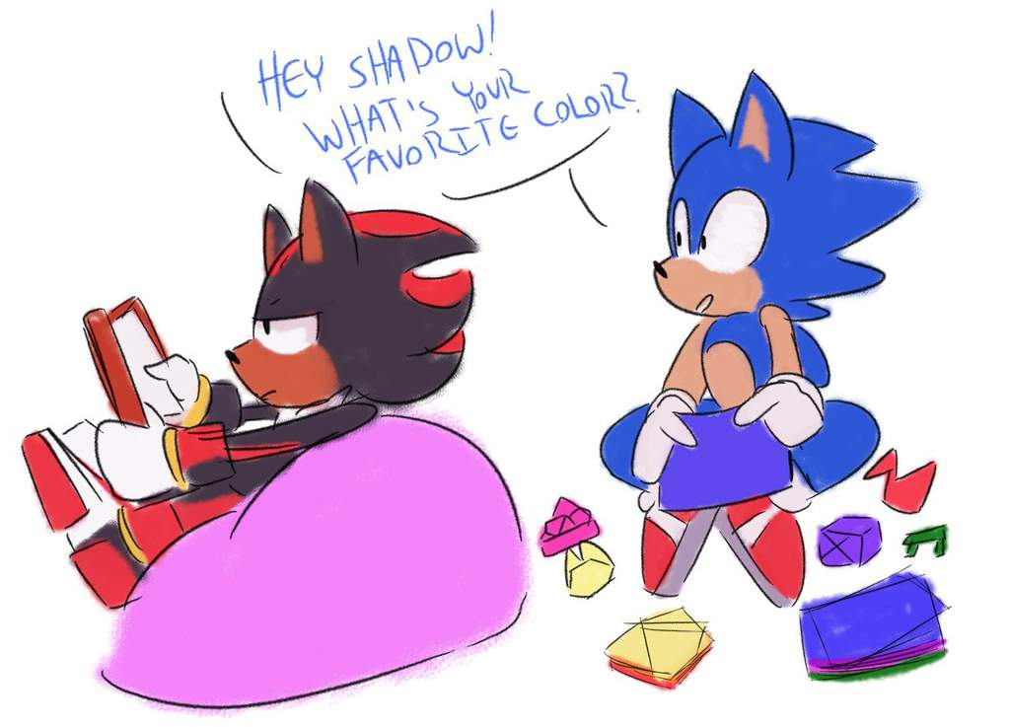
More User interactions – if/else
Real life conversation: Responses change based on what the other party says
If someone says their favorite color is blue, you might say “That’s my favorite too!”
If they say something else, you might say “That’s not my favorite”
Notes:
In a real conversation, one person would respond differently based on what the other person says. A computer also has to respond to user input! Like when searching for something on Google, the results will change based on what the user enters.

Slide 17
if – Python Example
color = input("What is your favorite color?")
if color == "blue":
print("That's my favorite too!")
What will this code do?
Notes:
What will happen if the user enters blue? What will happen if the user enters something other than blue? Explain that this is the same as the example from a real-life conversation.
Indentation tells the program what to do if the condition is met.

Slide 18
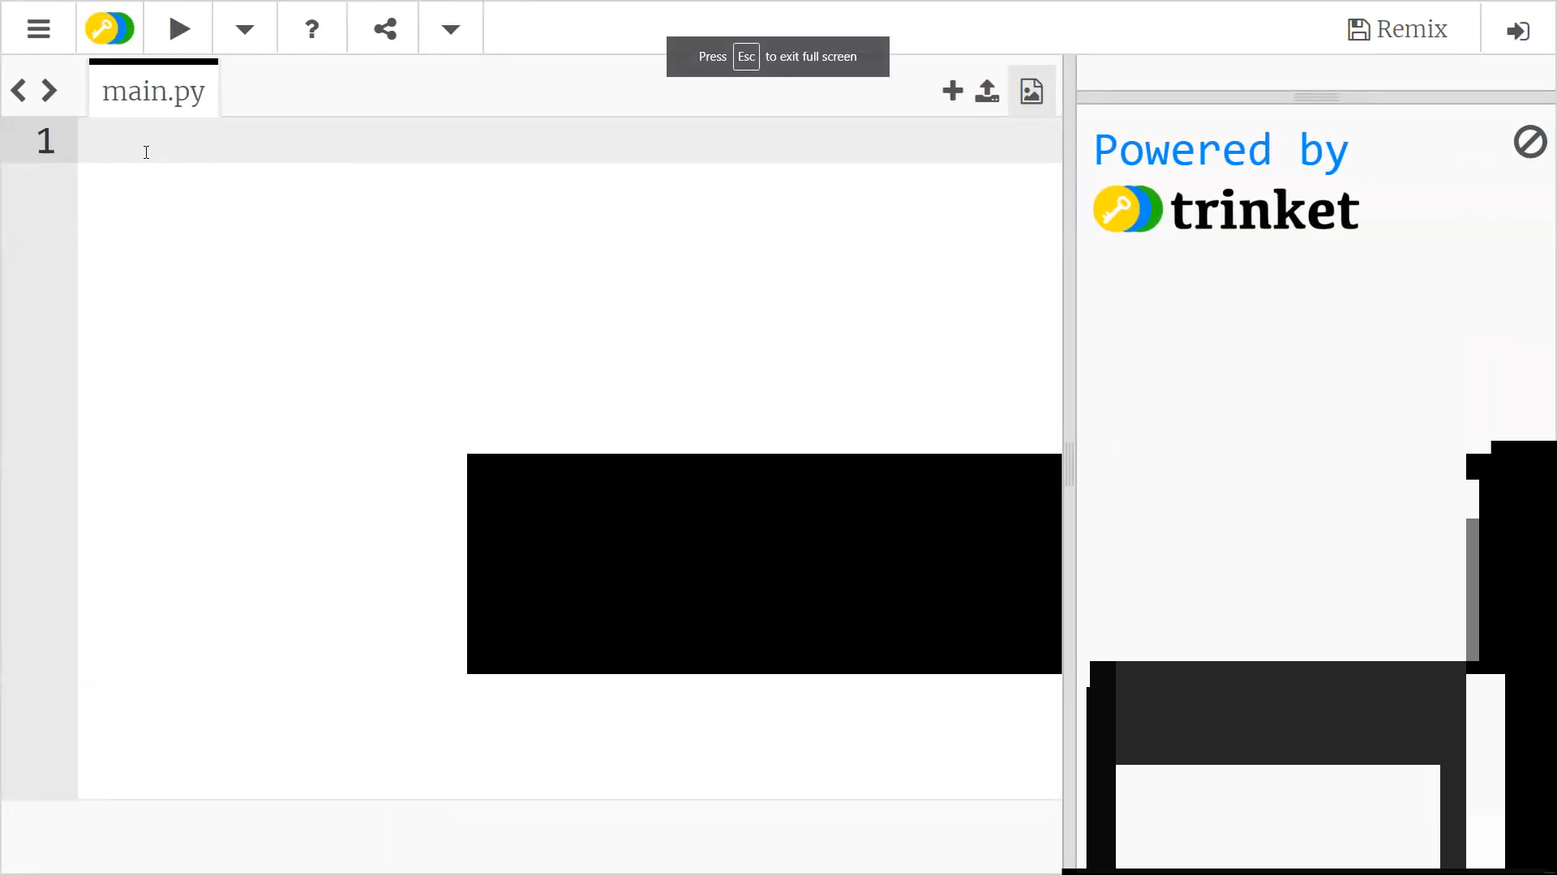

Slide 19
if – Python Example
color = input("What is your favorite color?")
The color the user enters is stored in color
if color == "blue":
The program checks if the color is blue
print("That's my favorite too!")
If it is, the program prints out the message
Notes:
Walk through the example line by line. Emphasize the need for indentation under the if.

Slide 20
Setting variables vs. checking values
Setting variables (=)
Checking values (==)
Single equals sign
Stores some information in a variable
Used for user input
movie = "Minions"
Sets the movie variable to “Minions”
Double equals sign
Compares a variable to another value
Used in if statements
if movie == "Minions":
Checks if the movie variable contains “Minions”
Notes:
Explain the distinction between single equals and double equals. This syntax can sometimes trip students up. They should remember, if they are using an if, they should use two equals signs. If they are setting a variable or looking for user input, they should use one equals sign.

Slide 21
If/else – Python Example
color = input("What is your favorite color?")
if color == "blue":
print("That's my favorite too!")
else:
print("That's not my favorite")
What will this code do?
Notes:
See if the students can guess what this code will do. else allows different code to execute if a condition is not true.

Slide 22
Repeating code with Loops
Developers want to write as little code as possible!
Rather than copying and pasting code, developers use loops
Loops allow programs to repeat the same lines of code a number of times
This way, instead of writing 500 lines of code, only one line has to change
It is much easier to maintain!
Notes:
This slide is mostly for informational purposes, and the students will likely be distracted by the looping gif, so it is not necessary to stay very long on this slide.
Explain loops in the context of the image; rather than having to hand-animate every single repeated frame, the gif will loop forever, which is much easier!

Slide 23
Loops – Python Example
for x in range(10):
print("| || |")
What will this code do?
Notes:
See if the students can figure out what this code does. The for loop syntax is not incredibly important, as it will be the same every time (other than the number of iterations). Allow the students to type this code into trinket to see what it does.

Slide 24
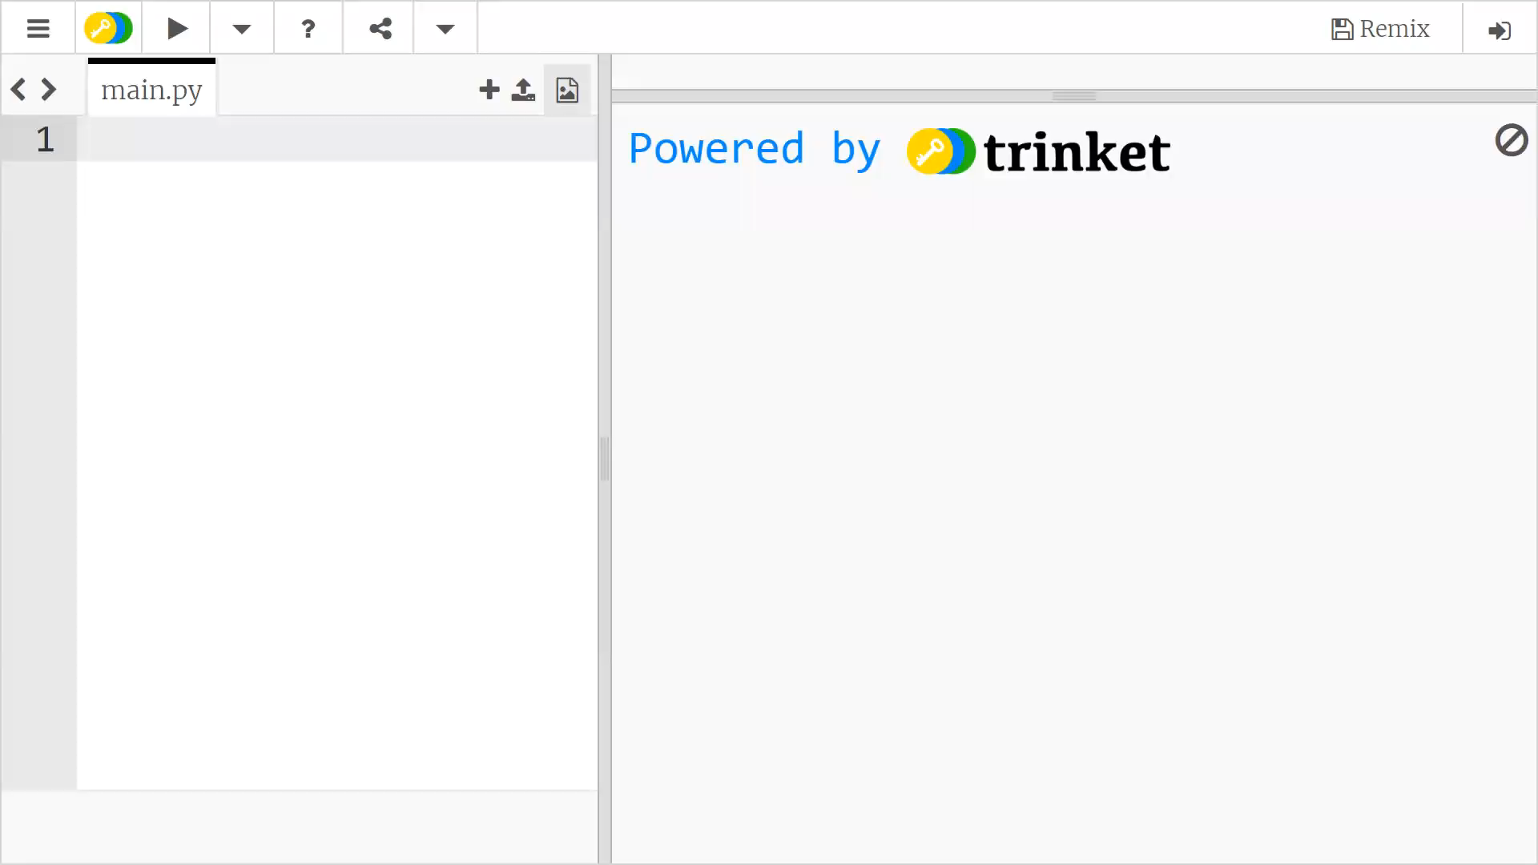

Slide 25
Loops – Python Example
print("| || |")
This line simply prints out a message
Note the indentation – this means it is within a loop
for x in range(10):
This line tells the program to repeat 10 times
Repeating the message makes a picture of a road!
Notes:
Explain what the example code does. Emphasize the need for indentation.
Printing a message is simple enough; it just prints the message to the screen.
The print code is within the for code (under it, and indented). The for x in range(): will always be the same for them, the only thing they’ll change is the number.

Slide 26
Challenge – Make a longer road
How could you update the existing loop to make a longer road?
for x in range(20):
print("| || |")
Notes:
Give students the opportunity to try and change the code so it prints more messages. All they have to do is change 10 to 20 (or another number higher than 10) so it prints more.

Slide 27
Kahoot
Notes:
Click the link to start the Kahoot quiz

Slide 28
Follow-Along Activity

Slide 29
Turtle Activities
bit.ly/PyChallenges
Notes:
Direct the students to visit the URL. This will contain the instructions for the challenge activities.

