Slide 1
Introduction to GitHub
Hy-Tech Club

Slide 2

What is GitHub?
Notes:
Ask the students if they have heard of GitHub or have any idea what version control is

Slide 3
What is GitHub?
GitHub provides hosting for software development version control using Git
It is a place where developers can store source code, collaborate on projects, track issues, and much more
Learning to use GitHub will be incredibly valuable
Most software companies use some form of version control – it is a useful skill
It is a good way to show off work you have completed!

Slide 4
GitHub vs. Git
Git is a revision control system; a tool to manage your source code history.
GitHub is a hosting service for git repositories.
Git is the tool, GitHub is a service for projects that use git.
Notes:
Explain the difference between Git and GitHub. Students may confuse the two, which is understandable. The important thing to remember is that GitHub uses Git.

Slide 5
Essential concepts
A GitHub Repository is like a folder for a project. It contains all of the project files and stores the version history for each file.
A remote repository stores the project files on a server.
A Clone is a copy of a repository that lives on a local computer instead of on a remote server.
Notes:
Go over some basic Git terminology. The most important part of Git is the Repository. A Clone is the local copy of a repository that exists elsewhere.

Slide 6
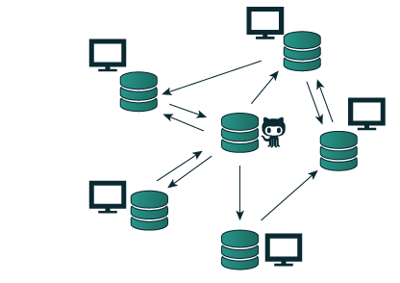
How will you use github?
Students will create an entirely new GitHub Repository
Students will create a local Clone of their repository.
Students will store their work in the server repository.
Notes:
Tailor this discussion to the specific needs of the course. Different courses may use GitHub in different ways.

Slide 7
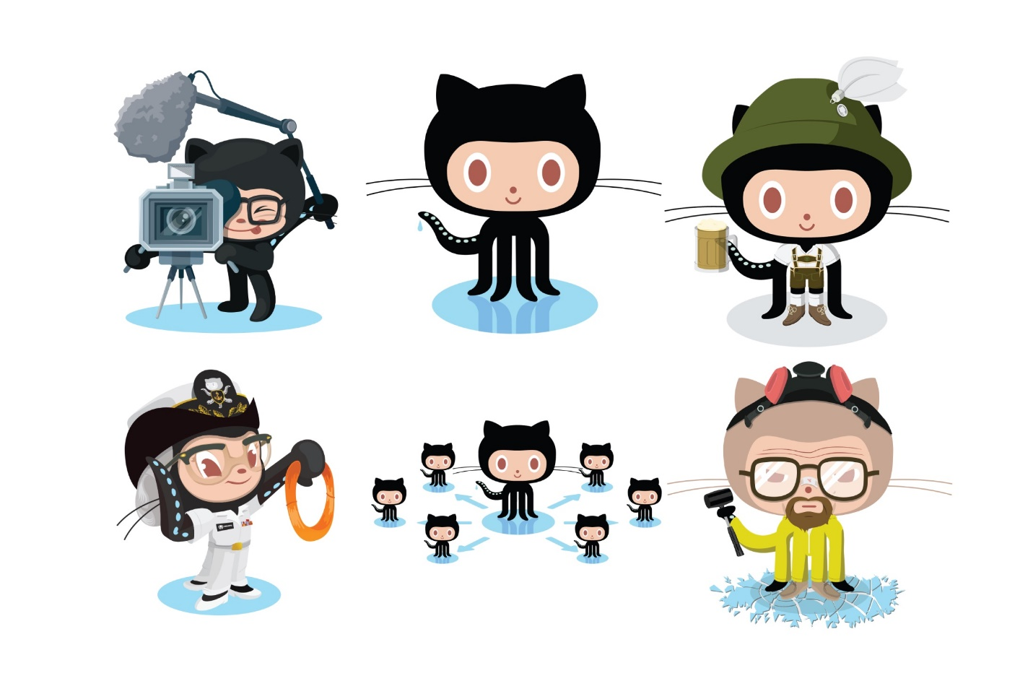
Practice
Make an account, then Create and Clone a repository!
Notes:
Give the students 5-10 minutes to get into GitHub. They should either fork the existing course repository or create a new one, then clone it to their computer. The instructions should be available online for them to follow.

Slide 8
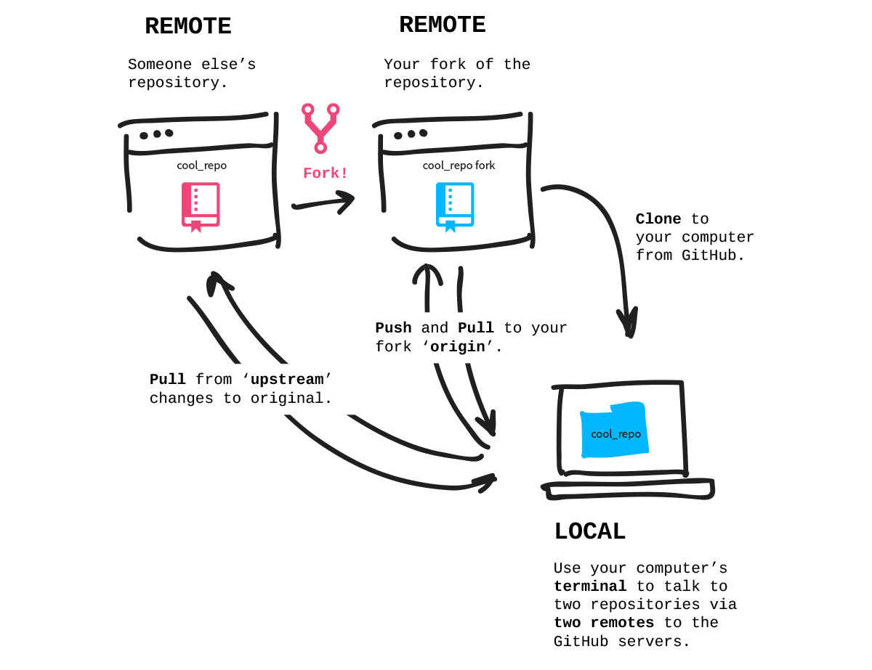
Pushing & pulling
Notes:
So now that a repository exists, how do you actually work with it? How do you add/update files and make sure everything is up to date? Let’s find out.

Slide 9
More essential concepts
A Commit is an individual change to a file or set of files. Committing a change is like saving files, but with messages and tracking.
Pushing sends committed changes from a local repository to a remote repository, such as a repository on GitHub.
Pulling fetches changes from a remote repository and merges them into the local repository.
Notes:
A Commit is like a file save. It keeps track of every change to the file with a message. Commits are made locally but stored remotely after being pushed. They make it possible to revert back if necessary!
Pushing code sends it from the local to the remote, allowing the changes to be stored on the server repository. Remember, the local repository is the clone, and the remote repository is the server.
Pulling fetches changes from the remote and merges them into the clone repository. Again, remember the local repository is the clone, and the remote repository is the server. Students will likely not need to do any pulling for the senior project.

Slide 10
git add && git commit && git push
In order to update the files in a repository, it is necessary to add, commit, and push the changes.
Follow these steps:
Make a change in the local repository
Add the change to the staged changes
Commit the change to the local repository
Push the change from the local repository to the remote repository
Notes:
Go over the necessary steps to make a change in the server repository from the clone repository.
Emphasize that local = clone and remote = server.
This applies for regularly-created repositories as well as forked repositories.

Slide 11
Practice
Push some changes!
Notes:
Give the students 5-10 minutes to pull some changes down and push changes up. They should either pull from upstream or from their server repository after making some changes online. The instructions should be available online for them to follow.

