Slide 1
Buttons

Slide 2
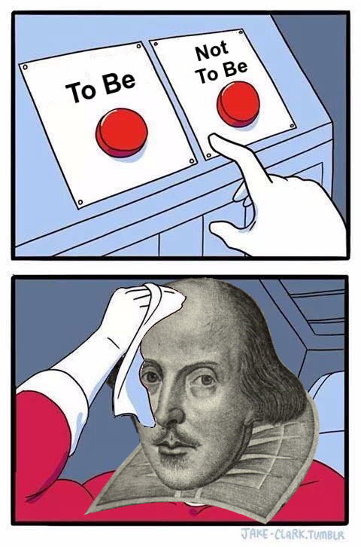
Buttons
Notes:
Now we are going to talk about buttons on webpages.

Slide 3

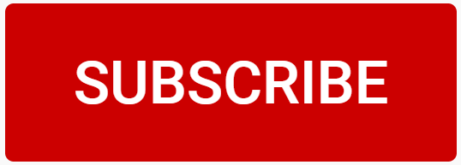

What can a button do on a webpage?
Buttons can execute JavaScript code when the user clicks them
This makes webpages more interactive
Instead of running all the JavaScript code when the page loads, it can run whenever the user wants it to run!
Notes:
Ask the students to think about what buttons they have seen on webpages.
Subscribe button
Like button
Others?

Slide 4
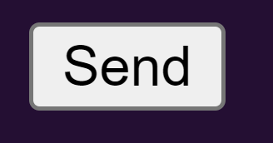
How to Add a button in html
<button onclick="doTheThing()">Send</button>
<button> opening tag
onclick attribute
doTheThing() function call
Send button text
</button> closing tag
Notes:
Show the syntax for creating a button in the HTML. Note each part of the syntax:
button tag (open/close)
onclick attribute
doTheThing() function call (we will explain this more later)
Actual text inside the button
All of this code will create a simple HTML button that says “Send”
But how does the button know what to do when it is clicked?

Slide 5
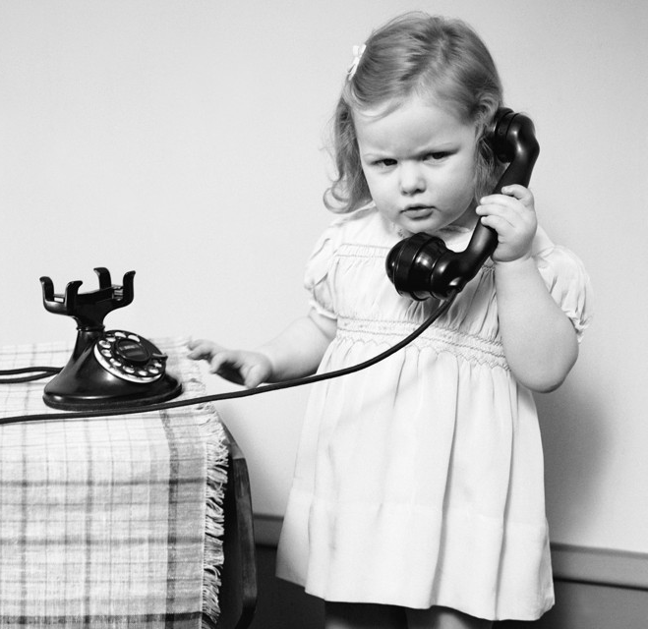
CALLING Functions
Notes:
Now we are going to show how buttons can call functions to run (execute) JavaScript code

Slide 6
How to tell the button what to do
In the script.js file:
function doTheThing() {
alert("You clicked!");
}
Must match the function call in the HTML button onclick:
<button onclick="doTheThing()">Send</button>
When the button is clicked, the code in the body of the function (e.g., the alert) will execute – that means it will run and do its thing!
Notes:
So we have a button in HTML, but how do we make it actually do something?
Add the code in the .js to make the button do something when clicked. All of the code within the square brackets will run whenever the user clicks the button. The “Send” button will display a message of “You clicked!” when clicked.
Note that the function name has to match the function call in the onclick.

Slide 7
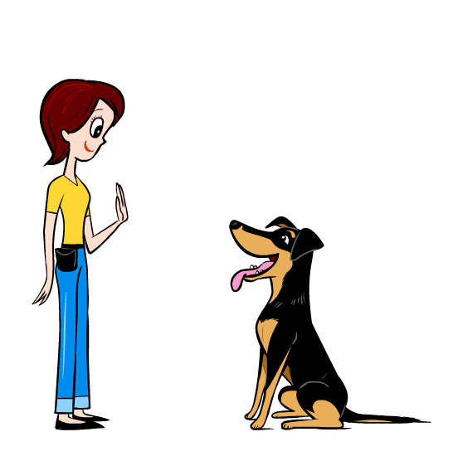
Defining a function
function speakTwice() {
alert("hello");
alert("hello again");
}
function (keyword)
Function name
Parentheses (left/right | open/close)
Curly brackets (left/right | open/close)
Body (JavaScript code)
Notes:
Go through all of the syntax needed to define a function. Students should remember these five parts of the function definition.
One analogy for defining a function is that it’s like teaching a dog a trick. You show the dog everything you want them to do when you say “speak.”

Slide 8

Calling a function
speakTwice()
hello again
hello
Function name
Parentheses (left/right | open/close)
Notes:
Now, to call a function, it looks like this: all that’s needed is the function name, and parentheses. Calling a function is like commanding the dog to do the trick you taught them!
Note: function arguments are also needed, but they are not covered at this point

Slide 9
Functions recap
When a button is clicked, it calls a function
Functions can be defined in a script.js file
The function name in the definition must match the function call
Notes:
Explain a little bit of background on functions.
Note that the goal here is not to make the students understand functions. They only need to understand enough to use functions for their webpages.

Slide 10
Button example
https://replit.com/@HylandOutreach/ButtonExample
Notes:
For the Repl, note the following in the index.html file:
The script tag has the proper src attribute pointing to script.js
The button tag has text of “Greet”
The button tag has the proper onclick attribute calling the sayHello function
Furthermore, note the following in the script.js file:
The function name is sayHello
There are two alert statements in the body of the function
Throughout, note the syntax of each piece of the code.

Slide 11
Questions?

