Slide 1
Conditionals
Hy-Tech Club: Web 102

Slide 2
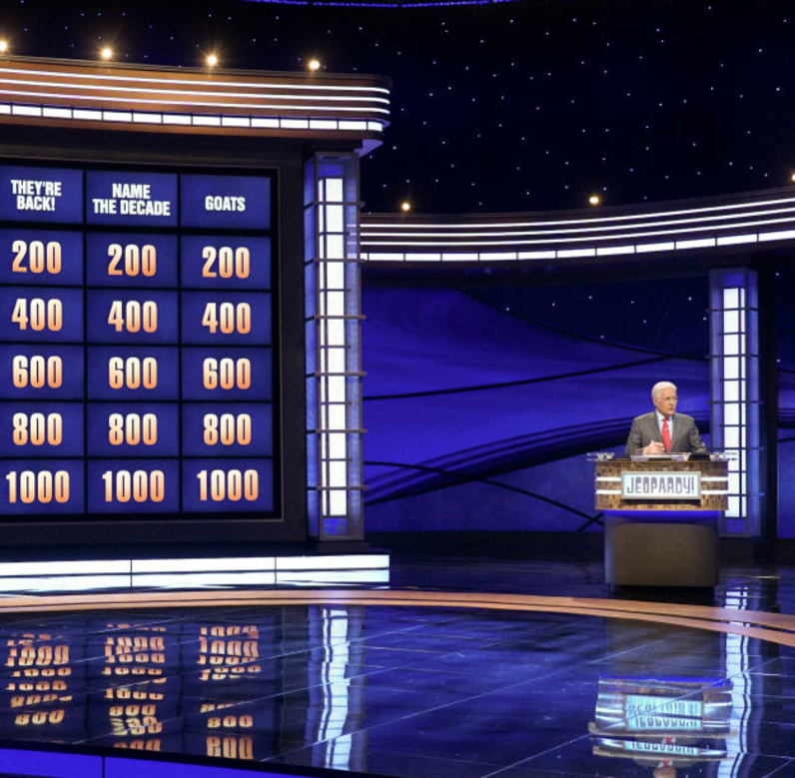
Warm-up Trivia

Slide 3




True or False
Actor Michael Keaton’s real name is Michael Douglas
True – he changed it because no two actors can share a name in SAG
McDonald’s is the largest restaurant chain in the world
False
It’s Subway
Notes:
Have students vote on if they think these statements are true or false.
If students do not know who Michael Keaton is – he played Batman.
If students do not know who Michael Douglas is – he was in Ant-Man (and a lot of classic 80s movies)

Slide 4
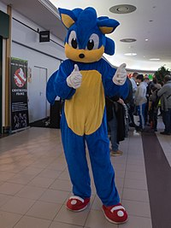
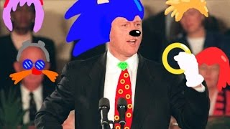
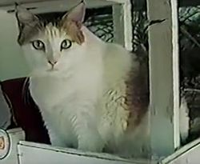
True or False
The oldest domestic cat on record lived for 38 years
True – her name was Crème Puff and she lived in Austin, TX
Sonic the Hedgehog’s personality is based on Bill Clinton
True – the developers wanted him to be “cool”
Notes:
Have students vote on if they think these statements are true or false.

Slide 5
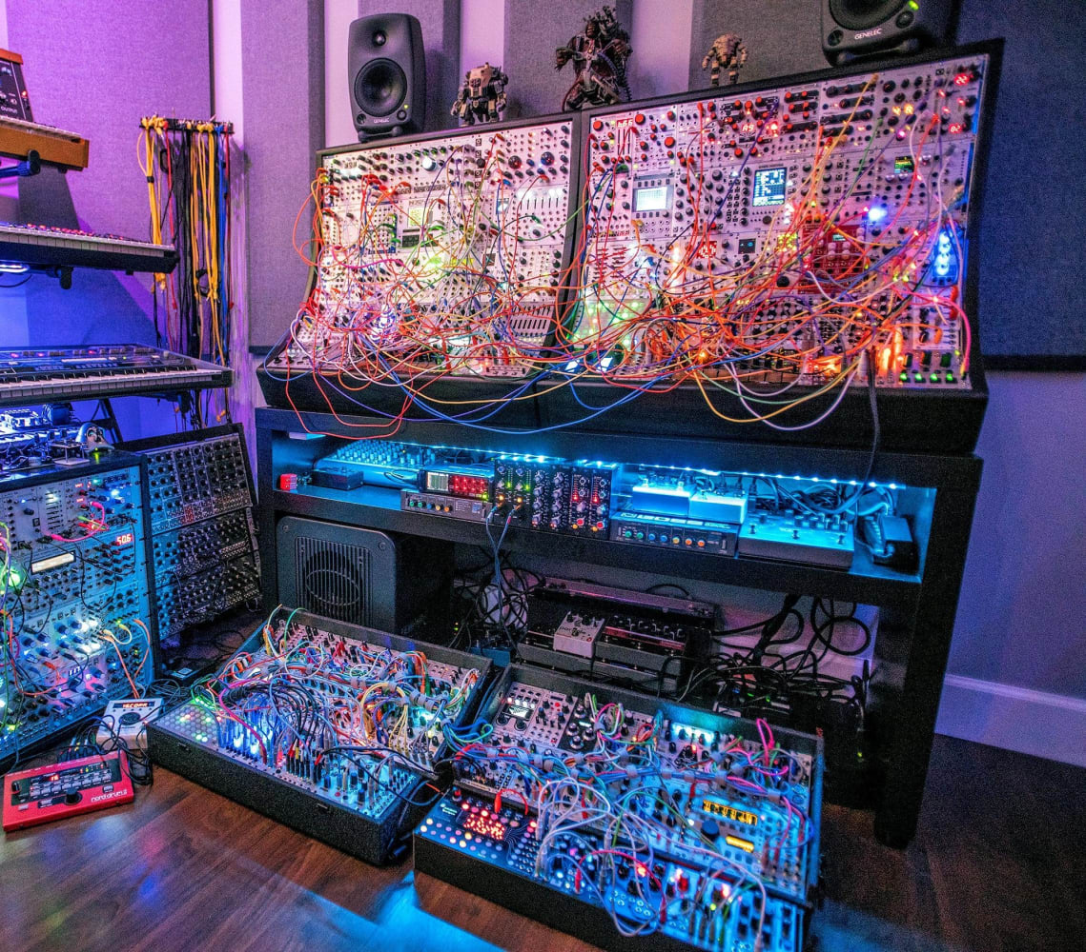
Data Types Review+New

Slide 6
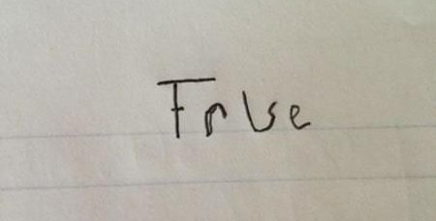
Data types
Number (any number)
let x = 8;
String (any block of text)
let x = "Apple";
Boolean (can only be true or false… no quotes)
let x = true;
let x = false;
Notes:
Ask the students to name the two data types we have seen so far (numbers and strings)
Ask the students to give examples of numbers
Ask the students to give examples of strings
Ask students if they can guess what type of data a boolean is.
Introduce a new data type: Boolean. A Boolean is a data type where values can be either true or false. A boolean is like the answer to a yes/no question. It’s either going to be yes, or no.

Slide 7
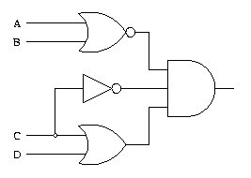
Boolean Expressions
A boolean expression will always evaluate to either true or false
Boolean expressions can be used to control program flow
Examples:
5 > 5 (false)
5 <= 6 (true)
"Hi" === "hi" (false)
7 === 7 (true)
2 === x + 1 (depends on x)
7 != x (depends on x)
Notes:
Explain that Booleans aren’t usually just the literal “true/false” and can be built from other values. This is especially useful if there is a variable within the boolean expression.
The image on this slide is an example of a circuit that uses boolean logic.

Slide 8
Comparing values for boolean expressions
There are several ways to build boolean expressions, including:
<= less than or equal to
< less than
>= greater than or equal to
> greater than
=== equal to (triple equals sign for equality)
!== not equal to
By making these comparisons, it is possible to change paths through the code with conditionals!
Notes:
Show the basic ways to compare data. Introduce the idea of conditionals.

Slide 9
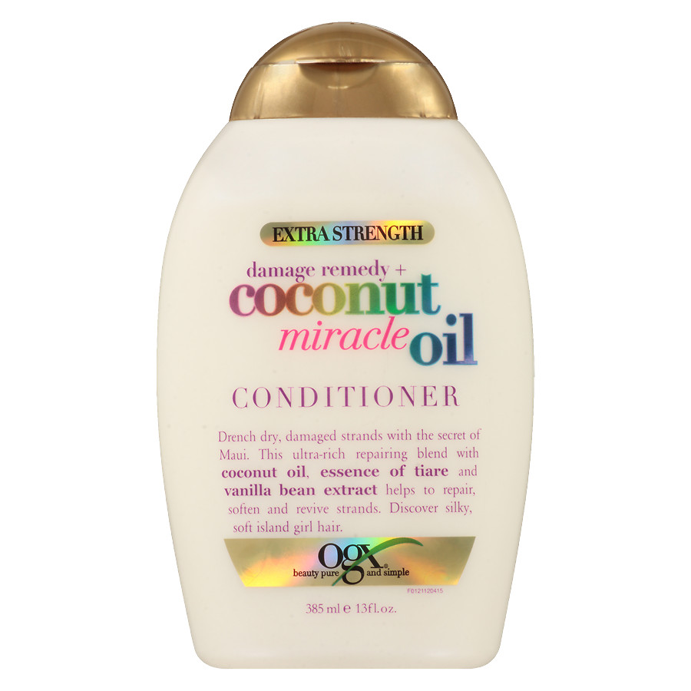
Conditionals
Notes:
This doesn’t actually have anything to do with moisturizing hair

Slide 10
if statements
if (myBalance < 5) {
alert("You do not have enough money!");
}
This code evaluates a boolean expression and executes the code in the body if the boolean is true
if, parentheses, boolean expression, curly brackets, body
Notes:
Ask the students what will happen based on the value of the myBalance variable. For example, what if the myBalance variable was set to 2?
Explain what an if statement does. Note each part of the if statement syntax: if, parentheses, boolean expression, curly brackets, body. Be sure to note where each part appears in the if statement.

Slide 11
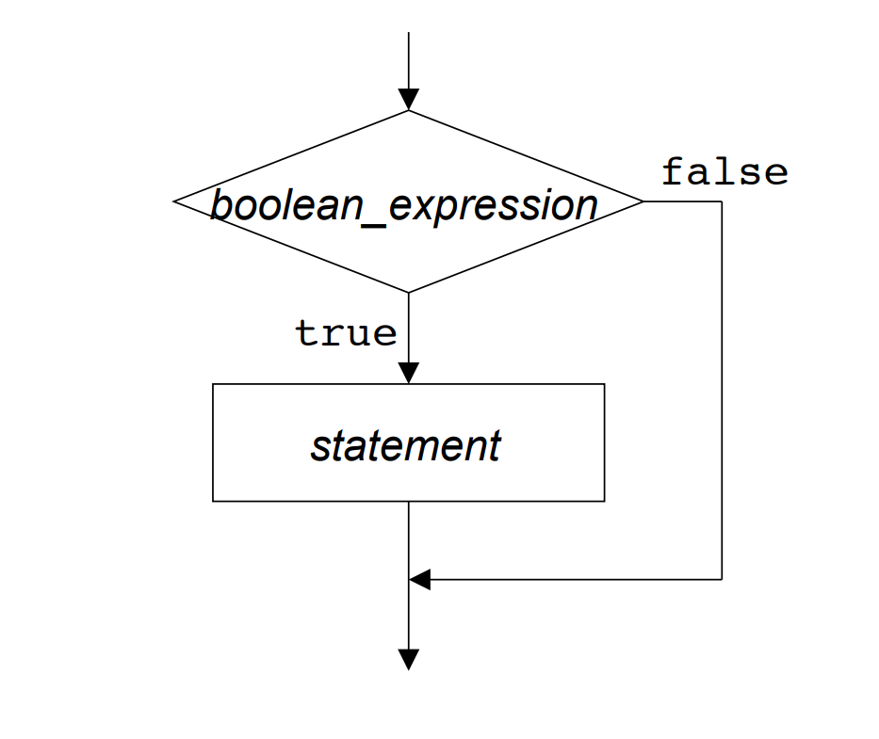
if statements – flowchart
Notes:
This image helps visualize the if statement process.
The execution of the code will reach the if statement, and it will check the value of the boolean_expression. If it is true, it will execute the statement from the body of the if statement. If it is false, it will skip the execution of the statement and move on.

Slide 12
conditional example
https://replit.com/@HylandOutreach/ConditionalExample2
Notes:
For the Repl, note how the if statement works. Change around the values, and setup the prompt as well. Possibly add some new code to see how it can affect the outcome.

Slide 13
TIP: Read it like English
if (yourFriends > 5) {
alert("wow, you are popular");
}
Try translating the code into an English sentence
Notes:
Ask the students to try and think of the code as English. For example: If you have more than five friends, say “wow, you are popular”

Slide 14

Mini-Quiz Time
????????????????????????????????????????????????????????????????????????????????????????????????????????????????????????????????????????????????????????????????????????????????????????????????????????????????????????????????????????????????

Slide 15
Mini-quiz: What’s the value?
5 > 5
Notes:
For this section, go around the room and ask the students to answer the questions
false

Slide 16
Mini-quiz: What’s the value?
"Hi" === "Hi"
Notes:
true

Slide 17
Mini-quiz: What’s the value?
"Apples" === "Oranges"
Notes:
false

Slide 18
Mini-quiz: What’s the value?
let myBalance = 5;
myBalance + 2 > 6;
Notes:
true

Slide 19
Mini-quiz: What message will show?
let you = 5;
if (you > 5) {
alert("you is over 5");
}
Notes:
No message

Slide 20
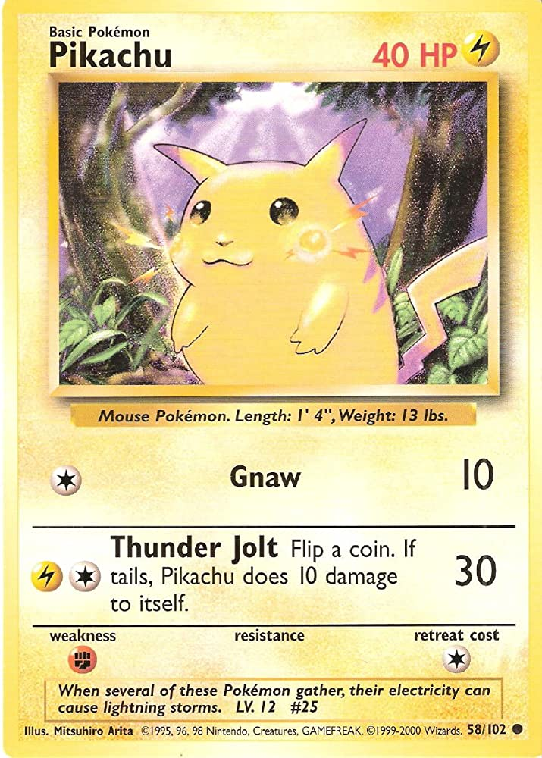
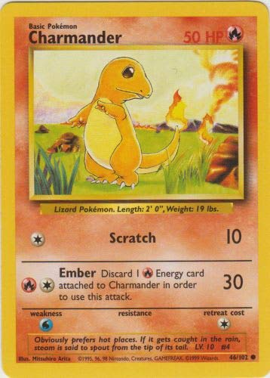
Mini-quiz: What message will show?
let name = "Pikachu";
if (name === "Pikachu") {
alert("Electric");
}
if (name === "Charmander") {
alert("Fire");
}
Notes:
Electric

Slide 21
Questions?

