Slide 1
⠀⠀⠀⠀⠀⠀⠀⠀⠀⠀⠀⠀⠀⠀⠀⠀⠀⠀⠀⠀⠀⠀⠀⠀⠀⠀⠀⠀⠀⠀⣠⣤⠶⢖⣚⣋⣭⣿⠍⠉⠙⠲⠶⣤⡀⠀⠀⠀⠀⠀⠀⠀⠀⠀⠀⠀⠀⠀⠀⠀⠀⠀⠀⠀⠀ ⠀⠀⠀⠀⠀⠀⠀⠀⠀⠀⠀⠀⠀⠀⠀⠀⠀⠀⠀⠀⠀⠀⠀⠀⠀⠀⢀⣰⠾⠋⠁⢀⡾⢋⡼⠛⠁⠀⣀⡤⠤⠤⢤⣀⠙⢷⡀⠀⠀⠀⠀⠀⠀⠀⠀⠀⠀⠀⠀⠀⠀⠀⠀⠀⠀ ⠀⠀⠀⠀⠀⠀⠀⠀⠀⠀⠀⠀⠀⠀⠀⠀⠀⠀⠀⠀⠀⠀⠀⠀⣠⢖⣿⣵⠀⠀⢀⣾⠞⠋⠀⢀⡴⠋⢁⣠⣤⠤⠤⣬⣷⡄⢿⡄⠀⠀⠀⠀⠀⠀⠀⠀⠀⠀⠀⠀⠀⠀⠀⠀⠀ ⠀⠀⠀⠀⠀⠀⠀⠀⠀⠀⠀⠀⠀⠀⠀⠀⠀⠀⠀⠀⠀⠀⣴⠞⣿⠋⢰⡇⠀⠀⠈⠉⠀⠀⢰⣿⠖⠋⠉⠁⠀⠀⠀⠀⠉⠳⠬⣷⠀⠀⠀⠀⠀⠀⠀⠀⠀⠀⠀⠀⠀⠀⠀⠀⠀ ⠀⠀⠀⠀⠀⠀⠀⠀⠀⠀⠀⠀⠀⠀⠀⠀⠀⠀⠀⠀⢠⢾⣡⡆⠘⢧⡸⡇⠀⠀⠀⠀⠀⠀⠉⠀⠀⠀⣀⣀⡤⢤⣀⠀⠀⠀⠀⢸⡆⠀⠀⠀⠀⠀⠀⠀⠀⠀⠀⠀⠀⠀⠀⠀⠀ ⠀⠀⠀⠀⠀⠀⠀⠀⠀⠀⠀⠀⠀⠀⠀⠀⠀⠀⠀⣴⣯⡾⣿⡇⠀⠀⠙⠿⠄⠀⠀⠀⠀⢲⡄⢀⡴⠚⠉⠀⠀⠀⠈⠓⢤⠀⠀⢸⡇⠀⠀⠀⠀⠀⠀⠀⠀⠀⠀⠀⠀⠀⠀⠀⠀ ⠀⠀⠀⠀⠀⠀⠀⠀⠀⠀⠀⠀⠀⠀⠀⠀⠀⢠⣾⣷⠋⠀⠹⣷⡄⠀⠀⠀⢀⣴⢖⣛⣿⣿⣷⠈⠉⠉⠉⠉⠉⠉⠙⠒⠻⠧⠀⢸⡇⠀⠀⠀⠀⠀⠀⠀⠀⠀⠀⠀⠀⠀⠀⠀⠀ ⠀⠀⠀⠀⠀⠀⠀⠀⠀⠀⠀⠀⠀⠀⠀⠀⢀⣾⡃⠙⠳⢦⣄⣹⣿⣄⠀⢐⣯⡟⠋⠀⢀⡿⠃⠀⢀⣀⣀⣀⠀⠀⠀⠀⠀⠀⠀⣸⠁⠀⠀⠀⠀⠀⠀⠀⠀⠀⠀⠀⠀⠀⠀⠀⠀ ⠀⠀⠀⠀⠀⠀⠀⠀⠀⠀⠀⠀⠀⠀⠀⠀⡿⣻⢿⡀⠀⠀⠈⠉⠉⠁⡴⠋⠀⠙⢒⣴⢛⡤⠖⠛⠉⠉⠉⠉⠛⠲⣤⠀⠀⠀⢠⡇⠀⠀⠀⠀⠀⠀⠀⠀⠀⠀⠀⠀⠀⠀⠀⠀⠀ ⠀⠀⠀⠀⠀⠀⠀⠀⠀⠀⠀⠀⠀⠀⠀⣼⢣⡏⠈⢷⣄⠀⠀⠀⢠⣾⡁⠀⢀⣴⠟⠷⠟⠓⠒⠲⢦⣤⠶⠶⠒⠒⠾⠇⠀⠀⣾⠁⠀⠀⠀⠀⠀⠀⠀⠀⠀⠀⠀⠀⠀⠀⠀⠀⠀ ⠀⠀⠀⠀⠀⠀⠀⠀⠀⠀⠀⠀⠀⠀⠀⣿⢸⣇⣀⣀⣘⣷⠄⢀⡞⠀⠉⣻⣿⡀⠀⠀⠀⠀⠀⠀⠀⠀⠀⠀⠀⣀⣀⠀⢀⣼⠁⠀⠀⠀⠀⠀⠀⠀⠀⠀⠀⠀⠀⠀⠀⠀⠀⠀⠀ ⠀⠀⠀⠀⠀⠀⠀⠀⠀⠀⠀⠀⠀⠀⢀⡇⣄⡀⠀⠀⠀⠀⠀⣸⠁⣰⡟⠋⠛⠛⢿⣟⠛⠛⠻⠟⠛⠛⢛⣷⠟⠛⠙⢻⣾⠃⠀⠀⠀⠀⠀⠀⠀⠀⠀⠀⠀⠀⠀⠀⠀⠀⠀⠀⠀ ⠀⠀⠀⠀⠀⠀⠀⠀⠀⠀⠀⠀⠀⠀⢸⡗⡏⠙⢷⣀⠀⠀⠀⡇⠀⣿⣄⣇⢀⡔⠀⢻⠒⠲⠆⠀⠐⠲⣾⠉⠲⣄⢀⣧⣿⡄⠀⠀⠀⠀⠀⠀⠀⠀⠀⠀⠀⠀⠀⠀⠀⠀⠀⠀⠀ ⠀⠀⠀⠀⠀⠀⠀⠀⠀⠀⠀⠀⠀⠀⢸⡇⣷⣀⣠⠬⠟⠁⢠⣧⡾⠛⠻⣿⠙⣦⡤⠜⠳⣄⠀⠀⢠⡴⠯⢤⣴⠟⢻⡟⠚⢿⣄⠀⠀⠀⠀⠀⠀⠀⠀⠀⠀⠀⠀⠀⠀⠀⠀⠀⠀ ⠀⠀⠀⠀⠀⠀⠀⠀⠀⠀⠀⠀⠀⠀⠀⣧⠈⠉⠁⠀⠀⠀⢨⣿⣟⢀⣼⣿⢶⣿⣧⣤⣤⡏⠀⠀⠸⣷⣤⣀⣿⣶⣿⢿⡀⢹⣿⡇⠀⠀⠀⠀⠀⠀⠀⠀⠀⠀⠀⠀⠀⠀⠀⠀⠀ ⠀⠀⠀⠀⠀⠀⠀⠀⠀⠀⠀⠀⠀⠀⠀⣿⢺⡟⠶⢤⣄⡀⢸⡿⢰⢘⠀⠞⠛⠿⣿⣿⠅⣭⠶⠴⣬⡩⣿⣿⡿⠛⠛⠆⠙⣾⢸⡟⠀⠀⠀⠀⠀⠀⠀⠀⠀⠀⠀⠀⠀⠀⠀⠀⠀ ⠀⠀⠀⠀⠀⠀⠀⠀⠀⠀⠀⠀⠀⠀⠀⢹⡟⢷⣤⠞⠋⠀⠘⢿⣼⣜⣇⠀⠀⠤⠿⠛⠋⠙⠃⠐⠛⠙⠛⠻⠧⠄⠀⢸⣏⣿⣾⠇⠀⠀⠀⠀⠀⠀⠀⠀⠀⠀⠀⠀⠀⠀⠀⠀⠀ ⠀⠀⠀⠀⠀⠀⠀⠀⠀⠀⠀⠀⠀⠀⠀⠈⣿⡌⠁⠀⠀⠀⠀⠀⠉⢿⣟⠦⣤⣀⣀⣀⠀⣂⣰⣶⣒⡀⢀⣀⣀⣠⣴⣻⡿⠋⠁⠀⠀⠀⠀⠀⠀⠀⠀⠀⠀⠀⠀⠀⠀⠀⠀⠀⠀ ⠀⠀⠀⠀⠀⠀⠀⠀⠀⠀⠀⠀⠀⠀⠀⠀⠙⣿⣶⡶⠶⠶⠿⣿⠏⠀⢻⣷⣶⡵⠿⣿⣭⣿⣿⣿⣮⣽⣿⠶⢾⣷⣾⡿⠁⠀⠀⠀⠀⠀⠀⠀⠀⠀⠀⠀⠀⠀⠀⠀⠀⠀⠀⠀⠀ ⠀⠀⠀⠀⠀⠀⠀⠀⠀⠀⠀⠀⠀⠀⠀⠀⠀⠸⣧⢷⡀⠀⡴⠋⠀⠀⠀⢿⣇⢿⡀⣿⣿⣿⡟⠻⣿⣿⣿⡇⣸⢳⣿⠁⠀⠀⠀⠀⠀⠀⠀⠀⠀⠀⠀⠀⠀⠀⠀⠀⠀⠀⠀⠀⠀ ⠀⠀⠀⠀⠀⠀⠀⠀⠀⠀⠀⠀⠀⠀⠀⠀⠀⠀⠙⣿⡻⠟⠁⠀⠀⠀⠀⠘⣿⡌⢷⣿⣿⣿⡟⣿⣿⣿⣿⣷⢇⣾⠃⠀⠀⠀⠀⠀⠀⠀⠀⠀⠀⠀⠀⠀⠀⠀⠀⠀⠀⠀⠀⠀⠀ ⠀⠀⠀⠀⠀⠀⠀⠀⠀⠀⠀⠀⠀⠀⠀⠀⠀⠀⠀⠘⢿⣶⣿⠞⠛⠛⣻⠏⠈⣿⣼⣿⣿⣿⡗⢿⣿⣿⣿⣃⣸⡟⠿⣄⡀⠀⠀⠀⠀⠀⠀⠀⠀⠀⠀⠀⠀⠀⠀⠀⠀⠀⠀⠀⠀ ⠀⠀⠀⠀⠀⠀⠀⠀⠀⠀⠀⠀⠀⠀⠀⠀⠀⠀⠀⠀⠈⠻⣮⠳⣤⡴⠃⠀⠀⢹⣟⠛⠛⠛⢳⡈⣿⣻⡟⣹⡟⠀⠀⠈⠙⢦⡀⠀⠀⠀⠀⠀⠀⠀⠀⠀⠀⠀⠀⠀⠀⠀⠀⠀⠀ ⠀⠀⠀⠀⠀⠀⠀⠀⠀⠀⠀⠀⠀⠀⠀⠀⠀⠀⠀⠀⠀⠀⠈⢳⣌⢳⣖⠒⢚⣿⠛⠓⠶⠒⠺⣗⣸⡿⠟⠋⠁⠀⠀⠀⠀⠀⠻⣦⡀⠀⠀⠀⠀⠀⠀⠀⠀⠀⠀⠀⠀⠀⠀⠀⠀ ⠀⠀⠀⠀⠀⠀⠀⠀⠀⠀⠀⠀⠀⠀⠀⠀⠀⠀⠀⠀⠀⠀⠀⠀⠙⢷⣌⢻⠟⠘⣷⣤⣀⠀⣰⢯⣟⣴⣿⠟⠁⠀⣠⡴⠚⠋⠀⠀⠹⣦⡀⠀⠀⠀⠀⠀⠀⠀⠀⠀⠀⠀⠀⠀⠀ ⠀⠀⠀⠀⠀⠀⠀⠀⠀⠀⠀⠀⠀⠀⠀⠀⠀⠀⠀⠀⠀⠀⠀⠀⠀⠀⠙⢳⣤⠀⠈⠛⠪⣟⢧⣼⢫⣿⡅⢀⡤⠞⠁⠀⠀⠀⠀⠀⠀⠈⠻⣦⡀⠀⠀⠀⠀⠀⠀⠀⠀⠀⠀⠀⠀ ⠀⠀⠀⣀⡀⠀⠀⠀⠀⠀⠀⠀⠀⠀⠀⠀⠀⠀⠀⠀⠀⠀⠀⠀⠀⠀⠀⠀⠉⠳⣤⡀⠀⠹⡆⠀⡿⠁⠻⡍⠀⠀⠀⠀⠀⠀⢀⡴⠖⠀⠀⠈⠻⣆⠀⠀⠀⠀⠀⠀⠀⠀⠀⠀⠀ ⠀⠀⡿⠟⠻⣤⣤⡀⠀⠀⠀⠀⠀⠀⠀⠀⠀⠀⠀⠀⠀⠀⠀⠀⠀⠀⠀⠀⠀⠀⠈⠛⢦⡀⠛⠛⠁⠀⠀⠙⣦⡀⠀⢀⡤⠚⠉⠀⠀⠀⠀⠀⠀⠈⢷⡄⠀⠀⠀⠀⠀⠀⠀⠀⠀ ⠀⣴⡇⠓⢦⡍⠉⢻⣶⣄⠀⠀⠀⠀⠀⠀⠀⠀⠀⠀⠀⠀⠀⠀⠀⠀⠀⠀⠀⠀⠀⠀⠀⠙⠳⣤⠀⣶⣦⣤⣬⡿⣶⠋⠁⠀⠀⠀⠀⠀⠀⠀⠀⠀⠀⠙⣦⡀⠀⠀⠀⠀⠀⠀⠀ ⠀⠻⣿⣶⡗⠉⣠⣾⡁⠘⢿⢷⣄⠀⠀⠀⠀⠀⠀⠀⠀⠀⠀⠀⠀⠀⠀⠀⠀⠀⠀⠀⠀⠀⠀⠈⠻⢮⣳⣤⣼⠀⠘⢷⡀⠀⠀⠀⠀⢀⡠⠖⠋⠀⠀⠀⠈⠻⣆⠀⠀⠀⠀⠀⠀ ⠀⠀⠀⠻⣿⣶⡇⠈⡳⣾⡃⠀⢹⣷⣤⠀⠀⠀⠀⠀⠀⠀⠀⠀⠀⠀⠀⠀⠀⠀⠀⠀⠀⠀⠀⠀⠀⠀⠙⢶⣄⠀⠀⠀⠹⣦⠀⣠⠴⠋⠀⠀⠀⠀⠀⠀⠀⠀⠹⣧⠀⠀⠀⠀⠀ ⠀⠀⠀⠀⠈⢿⣧⣠⠏⠈⠙⣦⡈⢀⡸⠟⢶⣄⠀⠀⠀⠀⠀⠀⠀⠀⠀⠀⠀⠀⠀⠀⠀⠀⠀⠀⠀⠀⠀⠀⠙⢷⡲⣖⣶⠊⢻⣅⠀⠀⠀⠀⠀⠀⠀⠀⢀⡄⠀⠈⢷⡄⠀⠀⠀ ⠀⠀⠀⠀⠀⠀⠉⢻⣷⣤⡞⠈⠻⢮⡀⠀⠤⠿⢷⣄⠀⠀⠀⠀⠀⠀⠀⠀⠀⠀⠀⠀⠀⠀⠀⠀⠀⠀⠀⠀⠀⠀⠻⣄⣀⣀⣀⣙⢧⡀⠀⠀⠀⣀⡴⠞⠉⠀⠀⠀⠈⢷⡄⠀⠀ ⠀⠀⠀⠀⠀⠀⠀⠀⠛⢿⣷⣤⡞⠀⢘⠶⣤⣠⡤⠿⣤⡀⠀⠀⠀⠀⠀⠀⠀⠀⠀⠀⠀⠀⠀⠀⠀⠀⠀⠀⠀⠀⠀⠙⢷⣽⠾⠋⠈⠻⣦⠶⠛⠉⠀⠀⠀⠀⠀⠀⠀⠈⢿⡀⠀ ⠀⠀⠀⠀⠀⠀⠀⠀⠀⠀⠙⠻⣷⣤⣿⠀⡿⠁⠀⠀⠀⠙⢷⡄⠀⠀⠀⠀⠀⠀⠀⠀⠀⠀⠀⠀⠀⠀⠀⠀⠀⠀⠀⠀⠀⠙⣷⣠⣤⣤⣘⣧⡀⠀⠀⠀⠀⠀⠀⠀⠀⠀⠈⣷⠀ ⠀⠀⠀⠀⠀⠀⠀⠀⠀⠀⠀⠀⠉⠻⣿⣿⣇⠀⠀⣠⣄⠀⠀⠹⣆⠀⠀⠀⠀⠀⠀⠀⠀⠀⠀⠀⠀⠀⠀⠀⠀⠀⠀⠀⠀⠀⠈⢻⣹⠴⠃⠈⢿⣄⠀⠀⣀⣀⠠⠀⠀⠀⠀⢹⡇ ⠀⠀⠀⠀⠀⠀⠀⠀⠀⠀⠀⠀⠀⠀⠀⠉⠙⢷⡀⠙⢻⣆⠀⠀⢹⣆⠀⠀⠀⠀⠀⠀⠀⠀⠀⠀⠀⠀⠀⠀⠀⠀⠀⠀⠀⠀⠀⠈⢻⣆⣀⠀⠀⠹⡖⠚⠋⠀⠀⠀⠀⠀⠀⠀⣇ ⠀⠀⠀⠀⠀⠀⠀⠀⠀⠀⠀⠀⠀⠀⠀⠀⠀⠘⣷⠀⣠⡾⡆⠀⠈⣿⠀⠀⠀⠀⠀⠀⠀⠀⠀⠀⠀⠀⠀⠀⠀⠀⠀⠀⠀⠀⠀⠀⠘⢿⣿⡷⣶⠶⠹⣦⠀⠀⠀⠀⠀⠀⠀⠀⢹ ⠀⠀⠀⠀⠀⠀⠀⠀⠀⠀⠀⠀⠀⠀⠀⣀⣀⣤⣿⠘⠛⠛⠟⠀⠀⢻⡷⢶⡶⠤⠤⣤⣄⣀⣀⣀⣀⡀⠀⠀⠀⠀⠀⠀⠀⠀⠀⠀⠀⠸⣟⠋⠉⠀⠀⠹⣆⠀⠀⠀⠀⡀⠀⠀⢸ ⠀⠀⠀⠀⠀⠀⠀⠀⠀⢀⣠⣤⡶⢾⣿⣛⡉⢉⣿⠀⢀⣤⠾⡇⠀⠘⡇⠘⢿⠓⢶⡤⠀⠉⢩⣭⣽⣿⣛⠓⠶⢦⣤⣤⣤⣀⠀⠀⠀⠀⣿⠀⠀⠀⠀⠀⠹⡦⠐⠒⠉⠀⠀⠀⢸ ⠀⠀⠀⠀⠀⢀⣠⡴⠾⢛⣍⣀⣀⠈⠻⣏⡿⢸⡇⠠⠿⠶⢦⡇⠀⠀⣿⡀⠈⠷⠟⠀⠀⠀⠀⠹⣄⢀⡽⠿⠃⠀⢰⡶⠬⢭⣹⡻⠶⣼⡏⣾⡄⠀⠀⠀⠀⢿⡄⠀⠀⠀⠀⠀⢸ ⠀⠀⠀⣀⣴⠟⢫⣴⣾⠯⢭⣍⣻⡄⠀⠘⠃⢸⡇⠀⠀⠀⢀⣤⣤⡀⠘⣧⡀⠀⠀⠀⠀⠀⠀⠀⢿⠏⠀⠀⠀⠀⠀⣧⣤⣤⠾⠁⢠⣿⣾⠁⠻⣤⡀⠀⠀⠸⡇⠀⠀⢀⡀⠀⢸ ⠀⢀⣾⠟⠁⠀⠈⠀⠀⠀⠀⠈⠹⠇⠀⠀⠀⠈⣿⠀⠀⢰⣿⠷⣬⣷⠀⠘⢷⣀⠀⠀⠀⠀⠀⠀⠀⠀⠀⠀⠀⠀⠀⠉⠁⠀⢀⣴⠟⠈⠙⠲⠶⣮⣿⡦⠀⠀⣇⠀⠉⠁⠀⠀⣾ ⢠⡿⠁⠀⠀⠀⠀⠀⣠⡤⣤⣘⣧⠀⠀⠀⢀⣀⣸⣆⠀⠀⠀⠀⠀⢼⣇⠀⠀⠙⢿⣛⠛⠻⠶⠶⠤⣤⣀⣀⠀⠀⠀⢀⣠⠾⢋⣡⢴⡄⠀⠀⠀⠀⠀⠀⠀⠀⢹⠀⠀⠀⠀⢠⡇ ⣾⠃⠀⠀⠀⠀⢀⣼⠃⣠⡤⠿⠛⢷⣴⣿⣋⣉⣤⡽⣧⣀⠀⢠⣴⣿⣿⣿⡦⠀⠀⠉⠛⢦⣤⣄⣀⣀⣠⣭⡿⠗⠚⠋⠡⣾⠋⠁⢸⣇⠀⠀⠀⠀⠀⠀⠀⠀⣼⠀⠀⠀⠀⣿⠃ ⣿⠀⠀⠀⠀⠀⢸⣷⠞⠉⠀⠀⣤⠾⠛⠻⣿⠉⠉⠉⢉⣿⣛⣒⣒⠒⠒⠒⢲⡒⠒⢒⡒⡒⠛⠉⢉⣉⣡⣤⠶⢷⡄⠀⠀⠹⣆⠀⠀⠹⣆⠀⠀⠀⠀⠀⠀⢰⣧⣤⡤⢄⣼⠃⠀ ⢸⣆⠀⠀⠀⠀⠙⠀⠀⠀⠀⠀⡇⠀⢀⡾⠃⠀⠀⢀⡾⠉⠉⣹⠟⠀⠀⠀⣼⠋⠉⠉⣹⡇⠀⠀⢸⡏⠀⠀⠀⢸⡇⠀⠀⠀⠉⠳⢤⣀⣙⣦⡀⠀⠀⠀⢀⡿⠁⠀⢀⣼⠋⠀⠀ ⠀⠙⣆⠀⠀⠀⠀⠀⠀⠀⠀⠀⡇⢠⡟⠀⠀⠀⠀⢸⡇⠀⣴⡏⠀⠀⠀⠀⢿⠀⠀⢰⠟⠀⠀⠀⠀⢷⠀⠀⠀⣸⠃⠀⠀⠀⠀⠀⠀⠀⠉⠛⠋⠀⠀⢀⡾⠁⠀⣠⣿⠃⠀⠀⠀ ⠀⠀⠈⢷⡀⠀⠀⠀⠀⠀⠀⠀⣷⡟⠀⠀⠀⠀⠀⢸⡇⣰⡏⠀⠀⠀⠀⠀⢸⡀⠀⣿⠀⠀⠀⠀⠀⠈⢷⡀⠀⡏⠀⠀⠀⠀⠀⠀⠀⠀⠀⠀⠀⠀⣰⠞⠒⣶⣾⠟⠁⠀⠀⠀⠀ ⠀⠀⠀⠀⠙⠦⣄⠀⠀⠀⠀⠀⠛⠁⠀⠀⠀⠀⠀⠀⠻⠿⠀⠀⠀⠀⠀⠀⠀⢷⣼⡏⠀⠀⠀⠀⠀⠀⠀⠻⣦⡇⠀⠀⠀⠀⠀⠀⠀⠀⠀⠀⣠⠾⣃⣠⡾⠟⠁⠀⠀⠀⠀⠀⠀ ⠀⠀⠀⠀⠀⠀⠈⠛⠦⣤⡀⠀⠀⠀⠀⠀⠀⠀⠀⠀⠀⠀⠀⠀⠀⠀⠀⠀⠀⠈⠿⠃⠀⠀⠀⠀⠀⠀⠀⠀⠈⠁⠀⠀⠀⠀⠀⠀⠀⣀⣴⣺⣥⠿⠟⠋⠀⠀⠀⠀⠀⠀⠀⠀⠀ ⠀⠀⠀⠀⠀⠀⠀⠀⠀⠀⠉⠛⠶⢦⣤⣀⣀⠀⠀⠀⠀⠀⠀⠀⠀⠀⠀⠀⠀⠀⠀⠀⠀⠀⠀⠀⠀⠀⠀⠀⠀⠀⠀⠀⠀⢀⣠⣴⣾⠿⠛⠉⠀⠀⠀⠀⠀⠀⠀⠀⠀⠀⠀⠀⠀ ⠀⠀⠀⠀⠀⠀⠀⠀⠀⠀⠀⠀⠀⠀⠀⠀⠉⠙⠛⠛⠷⠶⠶⠶⠤⠤⢤⣤⣤⣤⣤⣤⣤⣤⡤⠤⠴⠶⠶⠶⠶⠿⠟⡛⢛⠉⠉⢀⡀⠀⠀⠀⠀⠀⠀⠀⠀⠀⠀⠀⠀⠀⠀⠀⠀
Hello
, Python
Hyland Python Academy @ UCS
Notes:
Let’s say hello to Python! But first…

Slide 2
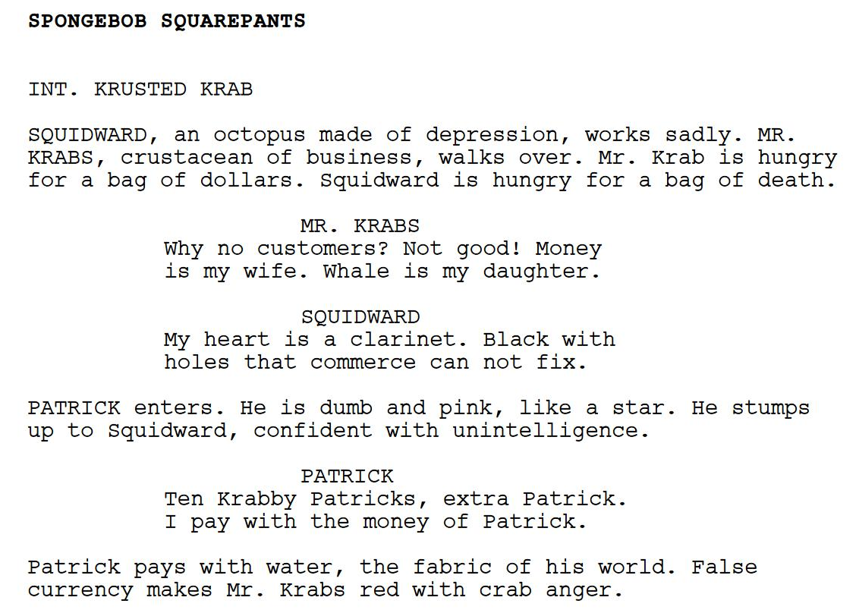
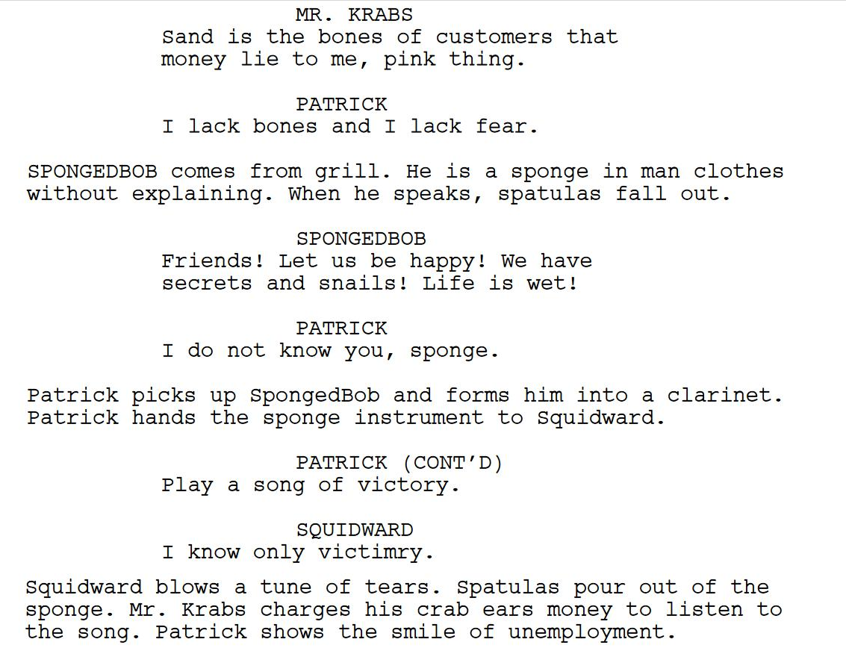
, Programming
Hello
Programming is a different type of coding than HTML/CSS
At its core, programming means writing instructions for a computer to follow
It is also called scripting – like writing a script for a play – and, like a play script, syntax matters
Notes:
Let’s say hello to programming. Does anyone know any programming languages?
Programming is different than writing HTML and CSS code. Those languages describe how to display a website, but they aren’t actually executing programs.
Programming means writing instructions for a computer to follow. These instructions have a very specific format, or what’s called syntax
This is a lot like writing a script for a play – and it’s super important that the script is the proper format. This script is not from a play, it’s from an AI-generated episode of spongebob. Still good. But we’re not ready to dispense with the theatrics just yet…

Slide 3
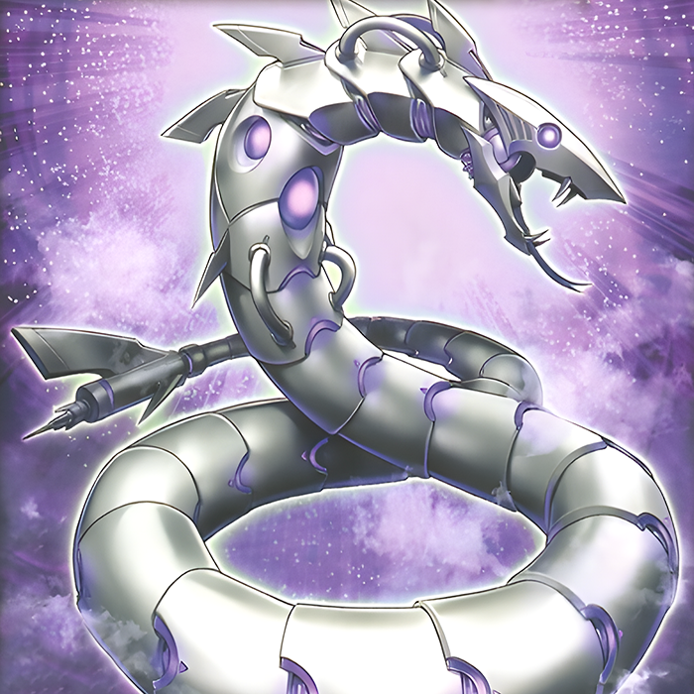
You Wield the Power
There is a magical robotic serpent named Python…
It will bend to your every will and whim…
All you must do is command it with flawless incantation…
Notes:
In the world of programming, you wield the power. Think of it like this –
There is a magical robotic serpent named Python
It will bend to your every will and whim
All you must do is command it with flawless incantation. Let’s see an example

Slide 4
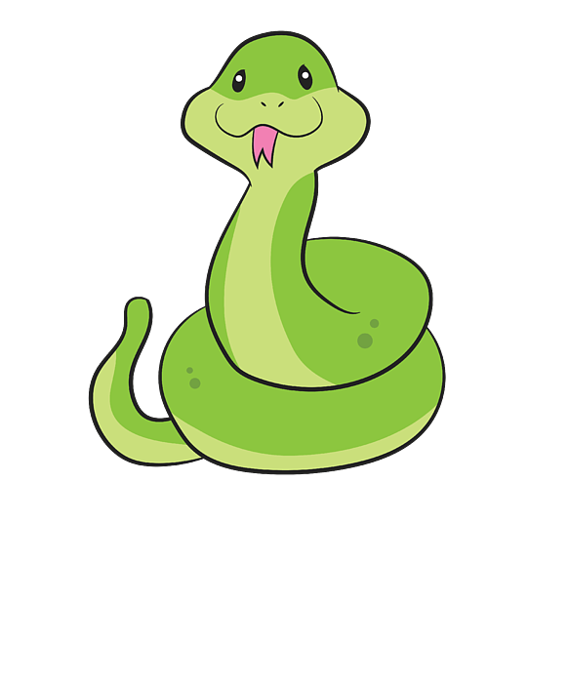
Python Executes Instructions
Hi!
Magical Scroll
Say “Hi”
Sleep for 5 seconds
Calculate 4+4
Do a flip
🐍
Notes:
Remember, Python (this snake guy) executes instructions. Python reads the instructions, and follows them – executing the commands.
Imagine there were a magical scroll that could control this snake. It has a set of instructions that MUST be followed.
The snake will read through these instructions ONE BY ONE. The first one happens first. Order matters.
The snake will execute the first instruction. Like this. It will say Hi!

Slide 5
Python Executes Instructions
z
z
Magical Scroll
Say “Hi”
Sleep for 5 seconds
Calculate 4+4
Do a flip
z
〰
〰
🐍
Notes:
After that, the snake will move on down to the next statement. It will read it, understand it, and then do it!
It looks like this.

Slide 6
Python Executes Instructions
8
Magical Scroll
Say “Hi”
Sleep for 5 seconds
Calculate 4+4
Do a flip
🐍
Notes:
The snake, being a super powerful computer, can also perform calculations. What’s four plus four?
It will spit out the answer.

Slide 7
Python Executes Instructions
Magical Scroll
Say “Hi”
Sleep for 5 seconds
Calculate 4+4
Do a flip
🐍
Notes:
Using some specific libraries (code other people wrote), it’s even possible to have graphical representations of the computer. If we tell Python to do a flip…
It will flip.

Slide 8
Python Executes Instructions
magical_scroll.py
print('Hi')
time.sleep(5)
print(4 + 4)
turtle.right(360)
Magical Scroll
Say “Hi”
Sleep for 5 seconds
Calculate 4+4
Do a flip
Each line of code is a statement or command
Each statement does something specific
Everything must be spelled correctly
Parentheses, quotation marks, periods - all important
Notes:
So, how does this actually translate into real Python code?
Really, it’s not too different from the text – but there are some specific format needs (or SYNTAX) that must be followed.
Each line here is a command or statement. Those are the same thing for our purposes.
Each statement does something very specific – the snake does exactly what you tell it, as long as it knows how!
It’s really important to spell everything correctly
Things like parentheses, quotation marks, and periods all need to be in the right place. They are super important! When in doubt, try to make sure everything you’re typing matches exactly.

Slide 9
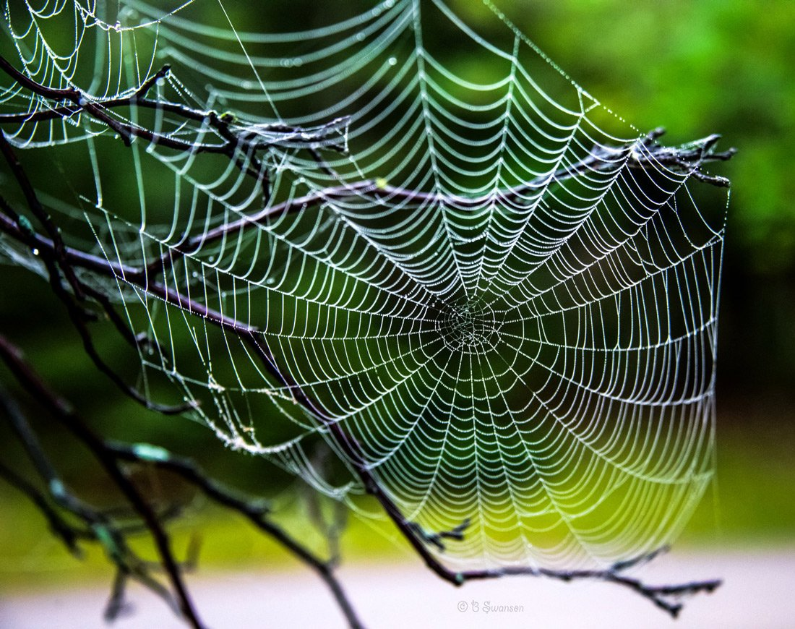
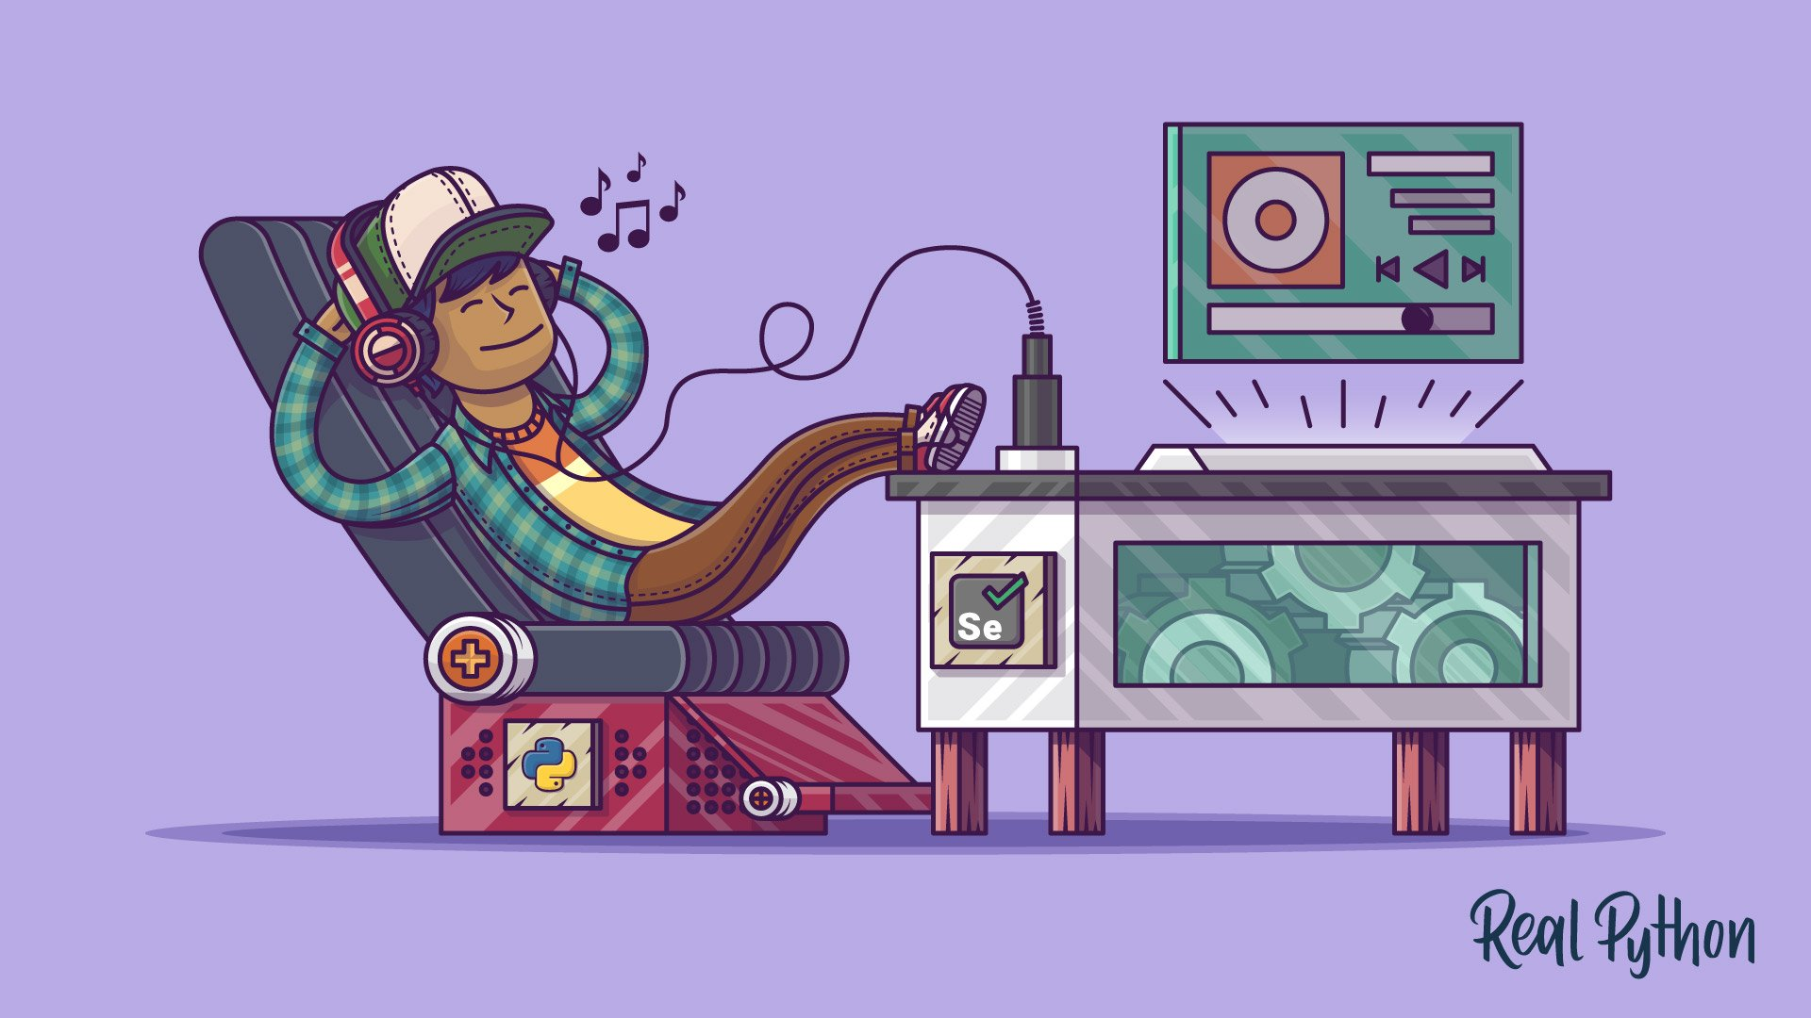
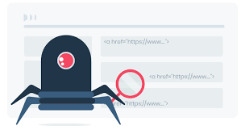
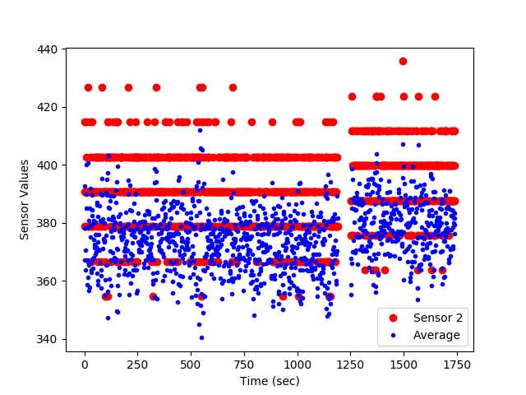
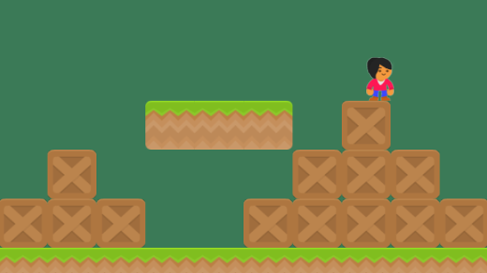
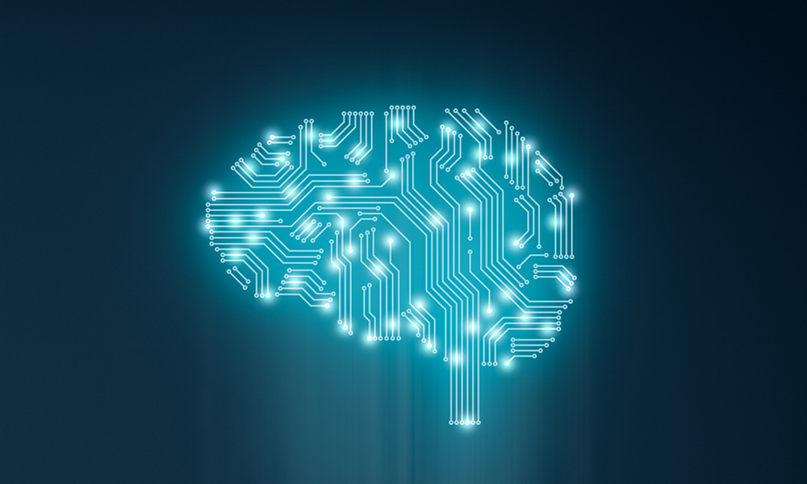
Things You Can Do
Make Websites
Automate Everything
Get Stuff from Websites
Analyze Data
Develop Games
Create A.I. Apps
Notes:
Python has a ton of uses. A few of them:
Game Development
Automation
Web Development
Data Analysis
Web Scraping
Machine Learning

Slide 10
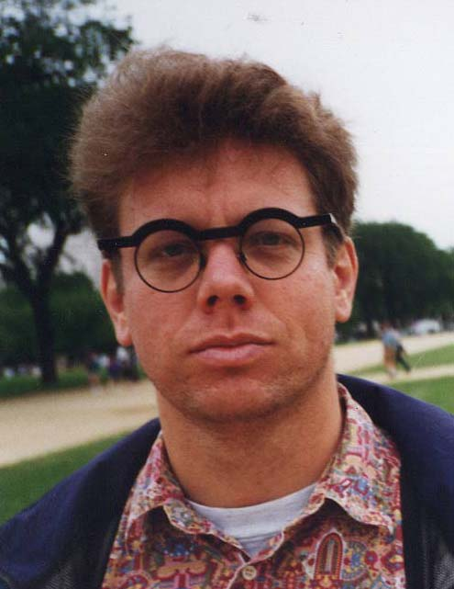
BONUS: Python Trivia
Some guiding principles include:
Beautiful is better than ugly.
Explicit is better than implicit.
Simple is better than complex.
Complex is better than complicated.
Readability counts.
Named after
Monty Python's Flying Circus
Released in 1991 by Dutch programmer Guido van Rossum
Notes:
None of this information is strictly necessary, but it’s fun to know!
Look at this cat – does anyone know Monty Python? That’s actually Python’s namesake.
The philosophy of Python has some key points. In comparison to other programming languages – these are some of the guiding principles.
Also, it was released in 1991 by this guy named Guido van Rossum. His glasses are cool as heck.

Slide 11
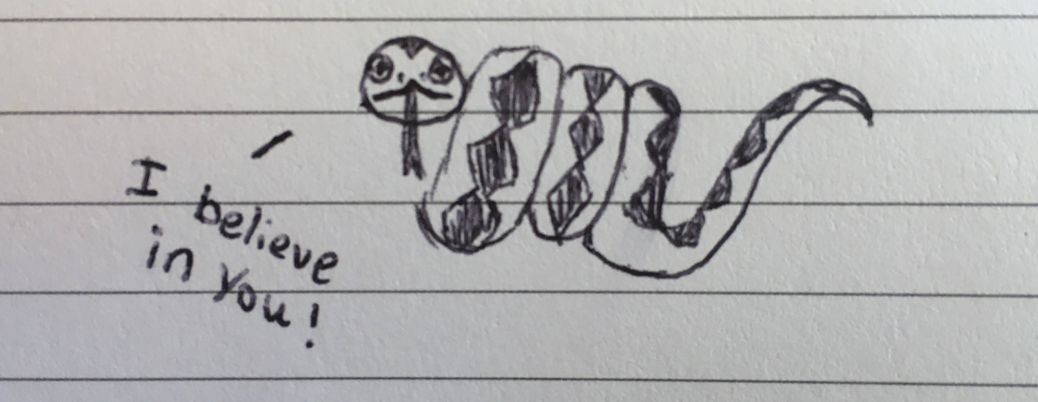
Final Thoughts
Notes:
This may feel like a lot of new information, a lot of new words, lots of different things – but that’s okay!
This snake believes in you, and I do too.

Slide 12
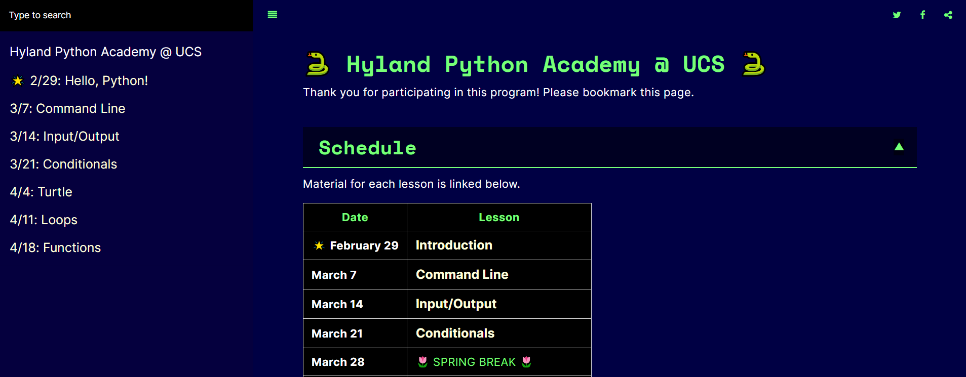
Go to tinyurl.com/ucspy
🔖 please bookmark the page 🔖

