Slide 1

Loops
Hyland Python Academy @ UCS

Slide 2
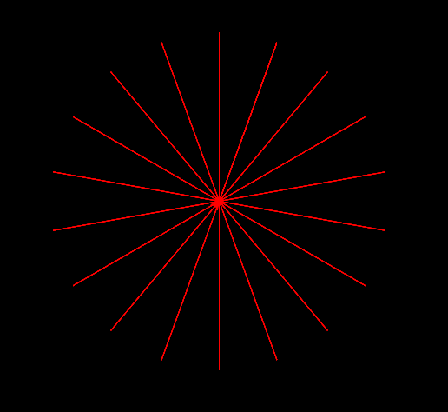
Code Without Loops
from turtle import *
sambi = Turtle()
paper = sambi.getscreen()
paper.bgcolor("black")
sambi.left(90)
sambi.color("red")
sambi.speed(10)
sambi.forward(100)
sambi.backward(100)
sambi.right(20)
sambi.forward(100)
sambi.backward(100)
sambi.right(20)
sambi.forward(100)
sambi.backward(100)
sambi.right(20)
sambi.forward(100)
sambi.backward(100)
sambi.right(20)
sambi.forward(100)
sambi.backward(100)
sambi.right(20)
sambi.forward(100)
sambi.backward(100)
sambi.right(20)
# and so on...

Slide 3
Code With Loops
from turtle import *
sambi = Turtle()
paper = sambi.getscreen()
paper.bgcolor("black")
sambi.left(90)
sambi.color("red")
sambi.speed(10)
sambi.forward(100)
sambi.backward(100)
sambi.right(20)
sambi.forward(100)
sambi.backward(100)
sambi.right(20)
sambi.forward(100)
sambi.backward(100)
sambi.right(20)
sambi.forward(100)
sambi.backward(100)
sambi.right(20)
sambi.forward(100)
sambi.backward(100)
sambi.right(20)
sambi.forward(100)
sambi.backward(100)
sambi.right(20)
# and so on...

Slide 4
Code With Loops
from turtle import *
sambi = Turtle()
paper = sambi.getscreen()
paper.bgcolor("black")
sambi.left(90)
sambi.color("red")
sambi.speed(10)
sambi.forward(100)
sambi.backward(100)
sambi.right(20)
sambi.forward(100)
sambi.backward(100)
sambi.right(20)
sambi.forward(100)
sambi.backward(100)
sambi.right(20)
sambi.forward(100)
sambi.backward(100)
sambi.right(20)
sambi.forward(100)
sambi.backward(100)
sambi.right(20)
sambi.forward(100)
sambi.backward(100)
sambi.right(20)
# and so on...
sambi.forward(100)
sambi.backward(100)
sambi.right(20)

Slide 5
Code With Loops
from turtle import *
sambi = Turtle()
paper = sambi.getscreen()
paper.bgcolor("black")
sambi.left(90)
sambi.color("red")
sambi.speed(10)
sambi.forward(100)
sambi.backward(100)
sambi.right(20)
sambi.forward(100)
sambi.backward(100)
sambi.right(20)

Slide 6
Code With Loops
from turtle import *
sambi = Turtle()
paper = sambi.getscreen()
paper.bgcolor("black")
sambi.left(90)
sambi.color("red")
sambi.speed(10)
sambi.forward(100)
sambi.backward(100)
sambi.right(20)
sambi.forward(100)
sambi.backward(100)
sambi.right(20)

Slide 7
Code With Loops
Number of times to repeat
from turtle import *
sambi = Turtle()
paper = sambi.getscreen()
paper.bgcolor("black")
sambi.left(90)
sambi.color("red")
sambi.speed(10)
sambi.forward(100)
sambi.backward(100)
sambi.right(20)
sambi.forward(100)
sambi.backward(100)
sambi.right(20)
for x in range(18):

Slide 8
Code With Loops
from turtle import *
sambi = Turtle()
paper = sambi.getscreen()
paper.bgcolor("black")
sambi.left(90)
sambi.color("red")
sambi.speed(10)
sambi.forward(100)
sambi.backward(100)
sambi.right(20)
sambi.forward(100)
sambi.backward(100)
sambi.right(20)
for x in range(18):
->
->
->
Indentation: shows Python which commands to repeat

Slide 9
Review
for x in range(5):
sambi.right(10)
for
x
in
range
parentheses ()
number 5
colon :
indentation ->
->
Question
How far will sambi turn in total?
Answer
50 degrees
(5 x 10)

Slide 10
Questions?
Hyland Python Academy @ UCS
Notes:
Anyone have any questions?

