Slide 1
Conditionals
---_ ......._-_--.
(|\ / / /| \ \
/ / .' -=-' `.
/ / .' )
_/ / .' _.) /
/ o o _.-' / .'
\ _.-' / .'*|
\______.-'// .'.' \*|
\| \ | // .'.' _ |*|
` \|// .'.'_ _ _|*|
. .// .'.' | _ _ \*|
\`-|\_/ / \ _ _ \*\
`/'\__/ \ _ _ \*\
/^| \ _ _ \*\
' ` \ _ _ \*\
\ _ _ \*\
\ _ _ \*\
\ _ _ \*\
Hyland Python Academy @ UCS

Slide 2
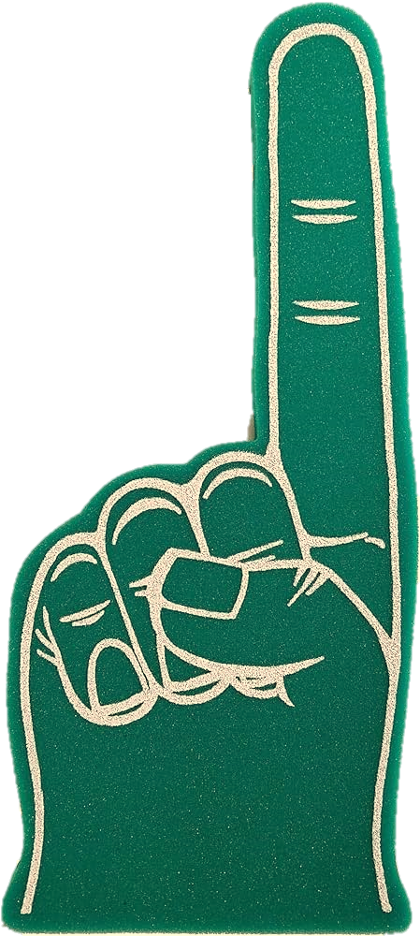

Intro: True/False Trivia
True
False

Slide 3
Each year has 15 months total
False

Slide 4
Sharks are mammals
False

Slide 5
The oldest domestic cat on record lived to be over 35 years old
True

Slide 6
There are more than 500 programming languages
True

Slide 7
Super Mario’s original name was Mr. Jumps
False

Slide 8
True/False: Boolean
In Python, a boolean can only be true or false
✅
✅
10 > 5
❌
"Hi" == "Hi"
20 < 5
❌
4 == 5
# name = "Mike"
name == "El"
✅
10 >= 5 + 5
❌

Slide 9
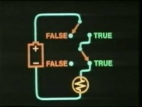

Slide 10
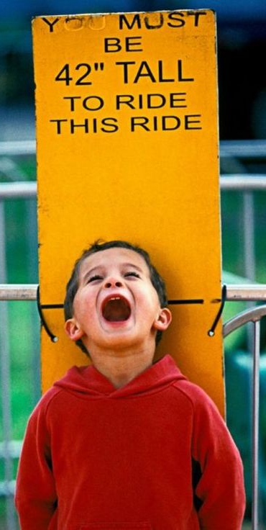
height = 19
if height > 42:
print("Allowed")
Will print nothing because
19 > 42 is false!
if statements
Doing things based on boolean values

Slide 11
height = 19
if height > 42:
print("Allowed")
if
condition (boolean)
: (colon)
indent
body statement(s)

Slide 12
color = input("Enter a color: ")
if color == "blue":
print("🥶")
if color == "red":
print("🥵")
Repl

Slide 13
Quiz Time
For each question:
🔎 Read the code
🔊 Say out loud whatever will be printed
It’s your turn to become Python

Slide 14
“FIVE”
x = 5
if x == 5:
print("FIVE")

Slide 15
Nothing!
if 9 < 4:
print("Hi")

Slide 16
if 4 == 4:
print("Math")
if 4 < 4:
print("Broke")
“Math”

Slide 17
if "Hi" == "Hi":
print("Hi")
if 5 == 10 - 5:
print("Equal")
“Hi,
Equal”

Slide 18
if "hey" == "Hey":
print("Hey")
if "hey" == "hey":
print("case matters")
“case
matters”

Slide 19
name = "Sam"
if name == "Samuel":
print("greetings")
if name == "Sam":
print("yo")
“yo”

Slide 20
Questions?
Hyland Python Academy @ UCS
Notes:
Anyone have any questions?

