Slide 1
Turtle Graphics
Hyland Python Academy @ UCS
___-------___
_-~~ ~~-_
_-~ /~-_
/^\__/^\ /~ \ / \
/| O|| O| / \_______________/ \
| |___||__| / / \ \
| \ / / \ \
| (_______) /______/ \_________ \
| / / \ / \
\ \^\\ \ / \ /
\ || \______________/ _-_ //\__//
\ ||------_-~~-_ ------------- \ --/~ ~\ || __/
~-----||====/~ |==================| |/~~~~~
(_(__/ ./ / \_\ \.
(_(___/ \_____)_)

Slide 2
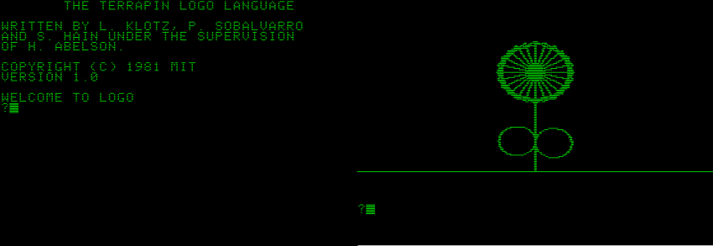
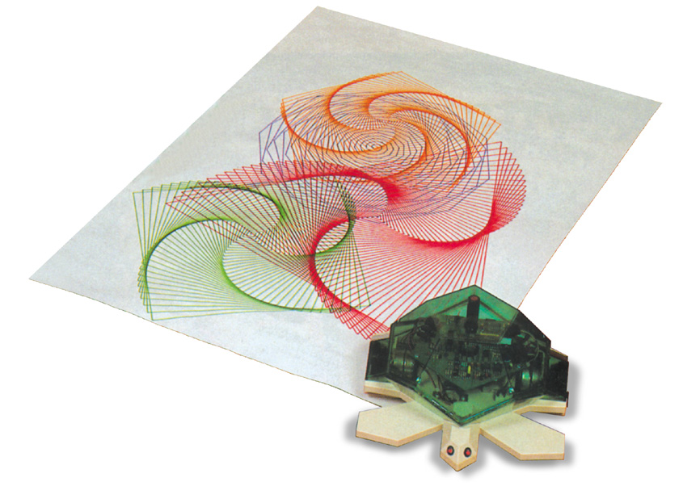
Examples: 1969-Today
Logo
Julia/Luxor
Python
Valiant

Slide 3
Turtles in Python
📚
from turtle import *
pulls in all the code from the turtle library
nothing else will work without this at the top

Slide 4
Creating a New Turtle
myrtle = Turtle()
Capital T in Turtle
Only letters (no spaces) in the turtle name
Parentheses ()
Equals sign =

Slide 5
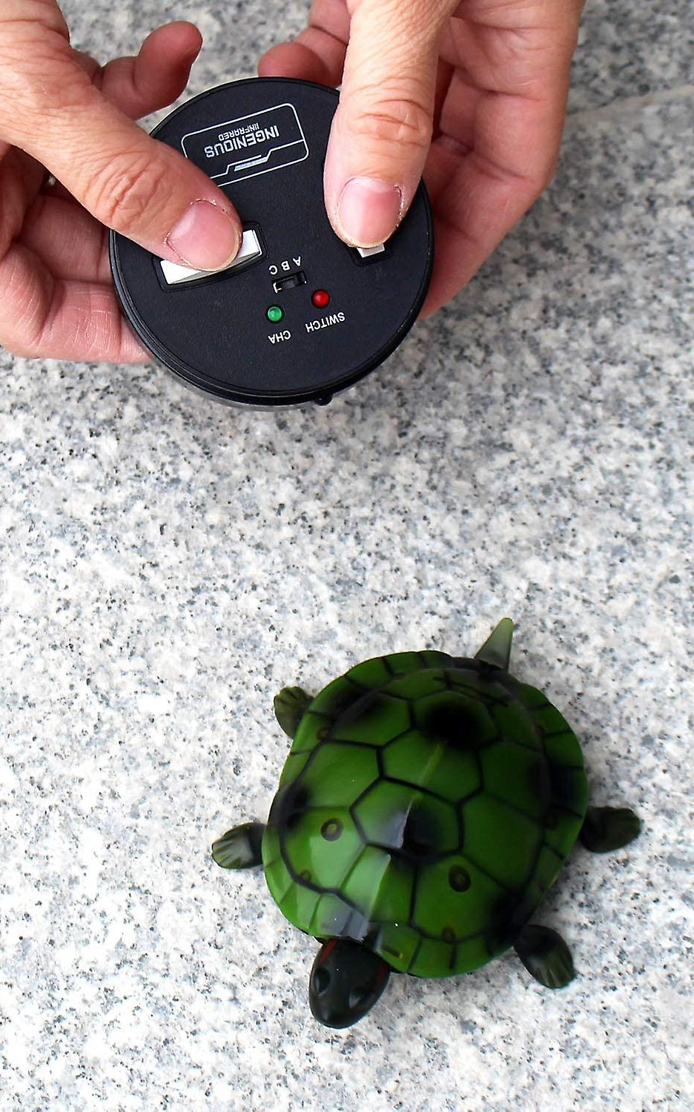
Controlling the Turtle
Call turtle functions with DOT .
example (not real):
myrtle.dance()

Slide 6

Turtle Features
myrtle.shape("arrow")
myrtle.color("green")
myrtle.turtlesize(1)
myrtle.speed(1)
myrtle.pensize(1)

Slide 7
Turtle Abilities
myrtle.forward(100)
myrtle.right(180)
myrtle.write("hi")

Slide 8
Turtle Abilities
Questions?
myrtle.forward(100)
myrtle.right(180)
myrtle.write("hi")

