Slide 1
Processing
\\XXXXXX//
XXXXXXXX OOOOOOOOOOOOOOOOOOOO
//XXXXXX\\ OOOOOOOOOOOOOOOOOOOO
////XXXX\\\\ OOOOOOOOOOOOOOOOOOOO
//////XX\\\\\\ |||||||||||||||OOOOOOOOOOOOOOOVVVVVVVVVVVVV
////////\\\\\\\\ |!!!|||||||||||OOOOOOOOOOOOOOOOVVVVVVVVVVV'
//////// \\\\\\\\ .d88888b|||||||||OOOOOOOOOOOOOOOOOVVVVVVVVV'
//////// \\\\\\\d888888888b|||||||||||| 'VVVVVVV'
/////// \\\\\\88888888888|||||||||||| 'VVVVV'
////// \\\\\Y888888888Y|||||||||||| 'VVV'
///// \\\\\\Y88888Y|||||||||||||| . 'V'
//// \\\\\\|iii|||||||||||||||!:::. '
/// \\\\\\||||||||||||||||!:::::::.
// \\\\\\\\ .:::::::::::.
/ \\\\\\\\ .:::::::::::::::.
\\\\\\\\ .:::::::::::::::::::.
\\\\\\\\
\\\\\\\\
Hyland Python Academy @ UCS

Slide 2
Processing is a software sketchbook
Students, artists, designers, and researchers use processing to create dynamic graphics in Java, JavaScript, and Python.

Slide 3

Processing has many features…

Slide 4

Processing has many features…
Shapes

Slide 5

Processing has many features…
Colors

Slide 6
Processing has many features…
Mouse Input

Slide 7
Processing has many features…
Keyboard Input

Slide 8
Processing has many features…
Image Loading

Slide 9
Processing has many features…
3D Graphics

Slide 10
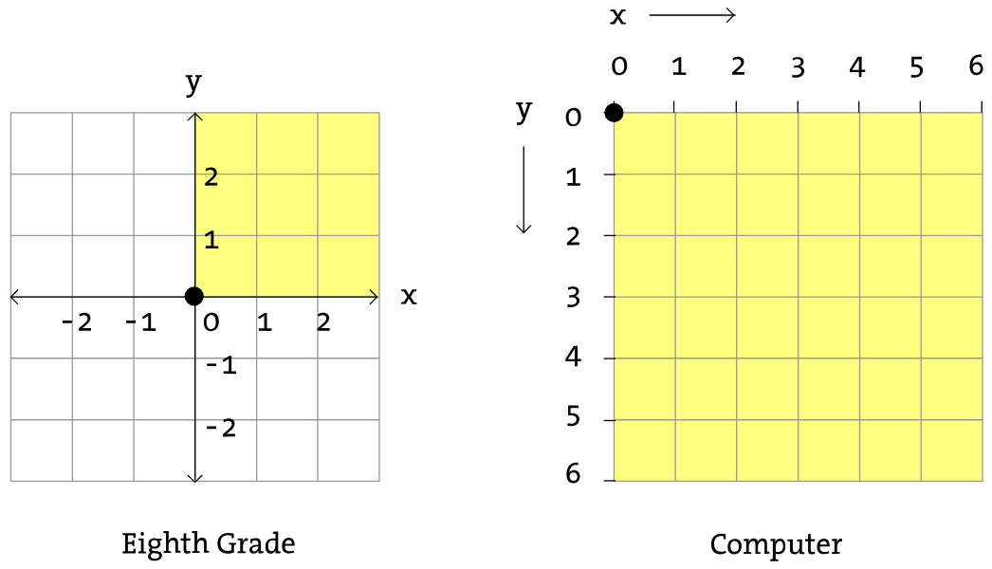
The Processing Canvas

Slide 11
The Processing Canvas
x: 2
y: 1
(2, 1)
(3, 2)
(1, 5)
(5, 4)

Slide 12
Into the Code: Lib Support
To use Processing, import everything from the processing library, and call the run function.

Slide 13
Drawing Shapes: Ellipse
Create an ellipse (aka oval or circle) by calling the ellipse function.

Slide 14
Drawing Shapes: Rectangle
Create a rectangle by calling the ellipse function.

Slide 15
Canvas Setup
Setup the canvas by defining the setup function.

Slide 16
New Canvas Frame
Update the canvas every frame by defining the draw function.

Slide 17
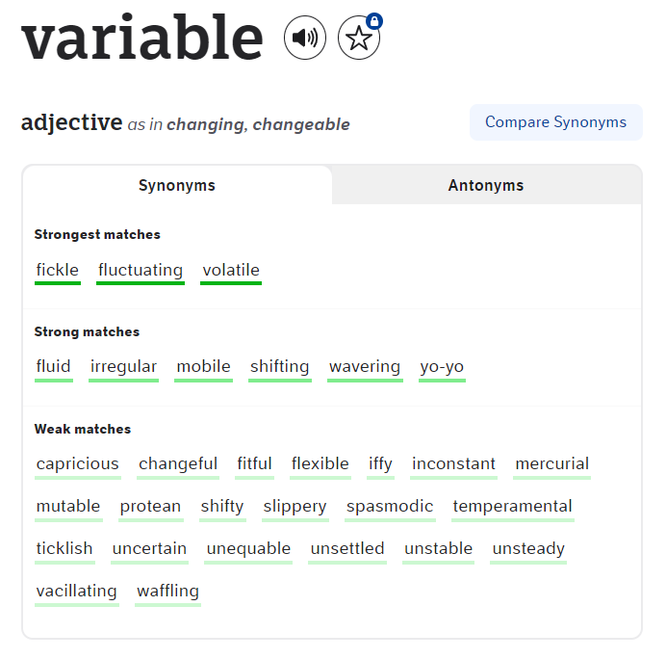
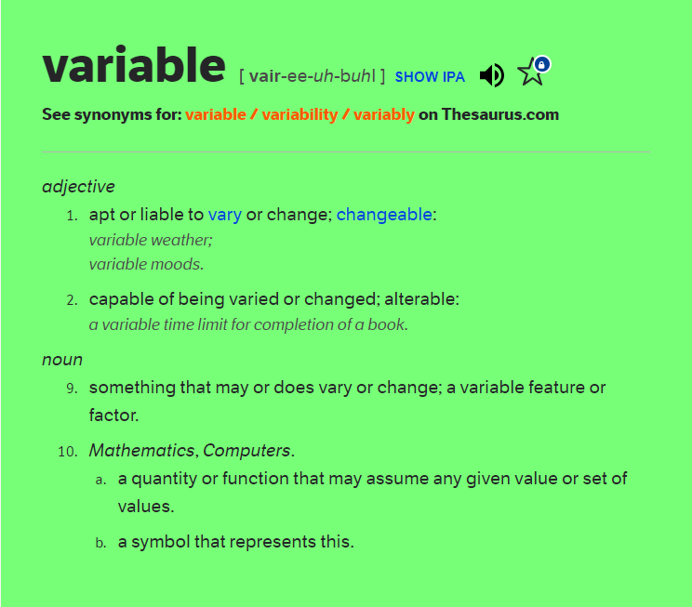

Slide 18
in computer science, variables are containers for data

Slide 19
In Python
speed = 7
color = "purple"
message = "hi"
loops = 4
Variable
Name
=
Variable
Value

Slide 20
Processing

Slide 21
Pygame

Slide 22
Questions?

