Slide 1
CSS Class Selector
Introduction to web development

Slide 2
Selectors recap
Selectors determine which HTML elements to style for a ruleset
Q: What is an example of a selector?
Example Answer: The p selector will style all p elements
p {
color: red;
}
Notes:
Review selectors. Ask the students for an example of a selector, and then show them a ruleset using a paragraph selector.

Slide 3
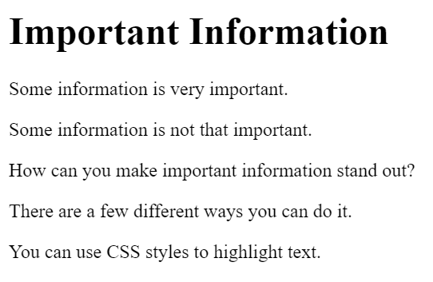
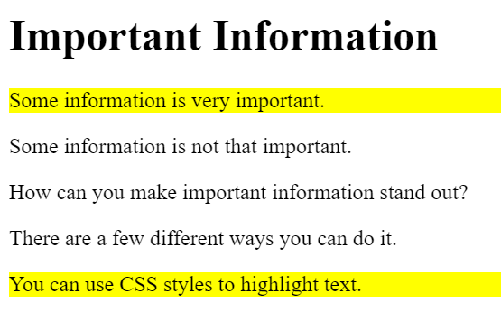
What if you want to select something else?
Example: you have five p elements, and you want to highlight some of them (but not all of them)
Notes:
Talk a little more about selectors. What if you didn’t want to select all paragraphs, just some of them? This is possible with Classes (on the next slide).

Slide 4
The class selector – example
CSS:
.important {
background: yellow;
}
HTML:
<p class="important">This is highlighted</p>
<h1 class="important">This header is highlighted too!</h1>
Notes:
Show the code for the class selector. Note the dot in front of the class name, and the class attribute value. Class names can be anything. Change “important” to anything else and it will still work the same.

Slide 5
Class Selector example
https://replit.com/@HylandOutreach/CssClassExample
Notes:
For the Repl, show the relationship between the class attribute and the class ruleset. Change the value of a class attribute and add another ruleset or change the selector to show how it works.

Slide 6
Questions?

