Slide 1
Hello CSS
Introduction to Web Development

Slide 2

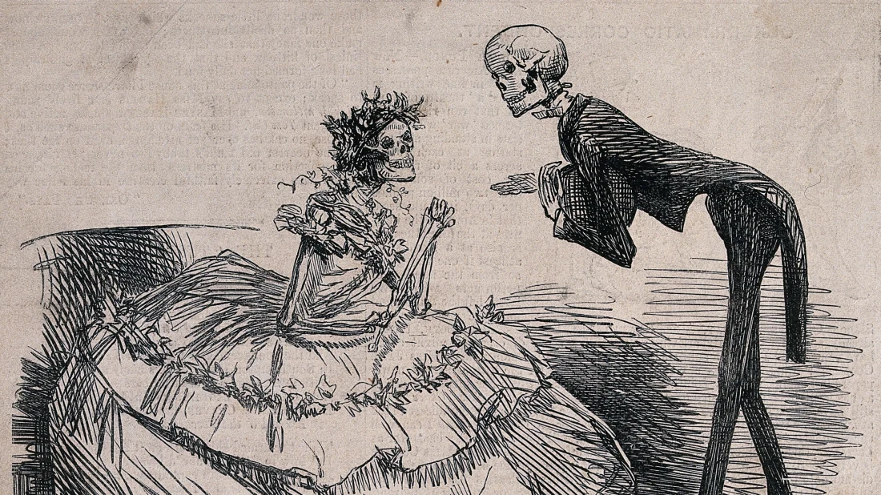
What is CSS?
CSS (Cascading Stylesheets) is a language that allows developers to change styles on a webpage
CSS can change fonts, colors, backgrounds, positioning, even animations!
If HTML is the skeleton of a page, CSS is the clothing that it wears
Notes:
Explain the purpose of CSS, and what it does.

Slide 3

CSS Files
CSS files are separate files that add style to HTML
They have a different language
They end with .css
They must be linked from the HTML element
Notes:
Explain what CSS files are

Slide 4

the link element
Different from the <a> hyperlink element
Links a variety of external files (CSS, fonts, icons)
It is a self-closing tag
It goes within the <head></head> element
Important attributes:
href: path to the file (either online or local)
rel: determines the relationship type (e.g., “stylesheet”)
type: specifies the content type of the file (e.g., “text/css”)
Notes:
Explain the link tag. Students should not have to worry about this for the most part – the starter code will usually start with a link tag already built in. If not, they can always copy it from somewhere else. It is important for them to be aware of its existence, but they do not need to memorize how it works.

Slide 5
CSS FILE example
https://replit.com/@HylandOutreach/CssFileExample
Notes:
Show the link tag in action. Make sure to note the filename, attributes, and CSS.

Slide 6
What does actual css code look like?
Ruleset
h1 {
font-size: 60px;
background-color: purple;
}
Declaration
Selector
Property
Value
Notes:
Go over the vocabulary around different parts of CSS. Make sure to note that each character is very important: every colon, every semi-colon, every curly bracket, dash, etc.

Slide 7
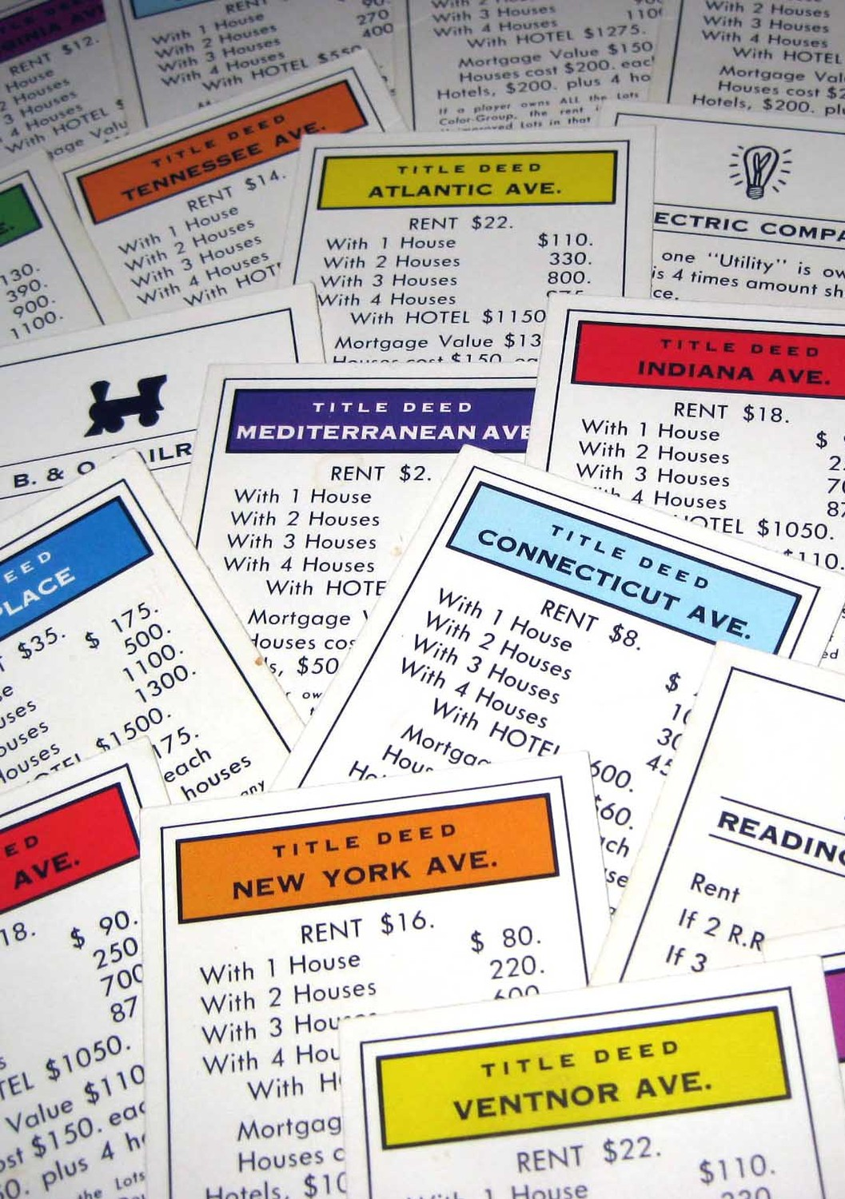
CSS Properties
color: controls the color of text in an HTML element
background: controls the background color of an HTML element
font-size: controls the size of text in an HTML element
font-family: controls the actual font of the text in an HTML element
Notes:
Explain how CSS properties determine the actual styles that are controlled by CSS

Slide 8

CSS Selectors
body: styles the entire page
h1: styles all h1 elements on the page
h2: styles all h2 elements on the page
p: styles all p elements on the page
… etc
Notes:
Go through a few of the selectors – actually just examples of the element selector. The main idea is that

Slide 9
Ruleset example
https://replit.com/@HylandOutreach/Ruleset
Notes:
For the Repl, show the whole ruleset in action. Make sure to switch to the CSS file to see the CSS. Change around the selector, properties, values etc to show how it affects the page.

Slide 10
Questions?

