Slide 1
Python in the Console
Workshop Sessions

Slide 2
Agenda
Console Applications
Python in the Console
Functions in Python
Team Quiz

Slide 3
Console Applications

Slide 4


Slide 5
Before The Gui
Command-Line Interfaces (CLI) were once the primary means of computer interaction
Graphical User Interfaces (GUI): the modern-day visual programs we all know and love
Now, there are still some programs that are console-based – these are often simpler to write, because they are totally text-driven and do not require a visual component

Slide 6
Python in the console

Slide 7
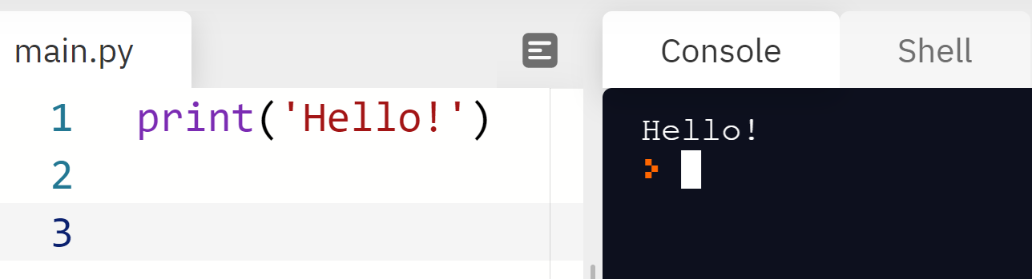
Printing
print('Hello!')
print, parentheses (), quotes '', message

Slide 8
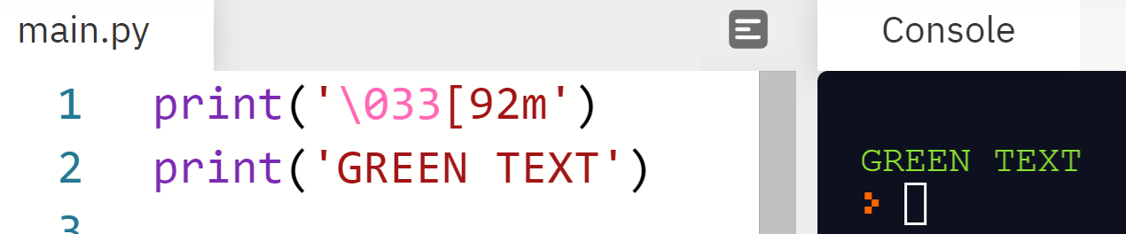
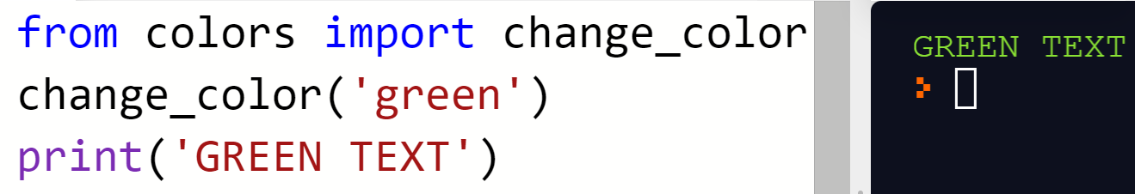
Changing Colors
There are special text codes that can change the color of the text
There are also libraries with commands that do similar things
Notes:
For the purposes of this lesson, we will use the change_color command to change the color of text. Students don’t really need to worry too much about this – it will be explained further in the code-along.

Slide 9
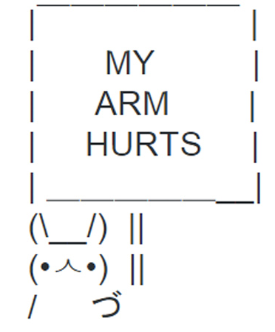
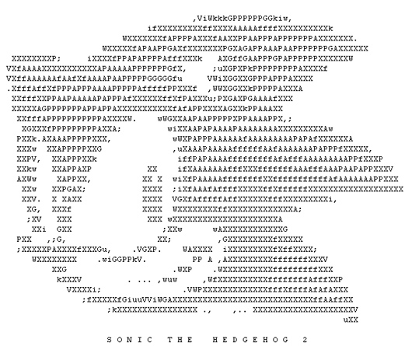

ASCII Art
ASCII art is text-based art that can be printed to the console. Examples:
Notes:
Theoretically, you could make anything using ASCII art.

Slide 10
Python Functions

Slide 11

What is a function?
A function is a "self contained" module of code that accomplishes a specific task
It has a name, and a body
It must be defined, and then it can be called
They work sort of like buttons on a toy – a set of things happens each time the function is triggered

Slide 12
Defining a Function
def do_something():
print('command')
print('command2')
def keyword
Function name
Parentheses
Indented body
Commands
Colon
Function definition
Notes:
There are several parts needed to define a function.

Slide 13
Calling a function
do_something()
Function name
Function call
Parentheses

Slide 14
Putting it together – what will be printed?
def do_something():
print('command')
print('command2')
do_something()
do_something()
Console
command
command2
command
command2
Notes:
Ask the students what will be printed when this code runs.

Slide 15
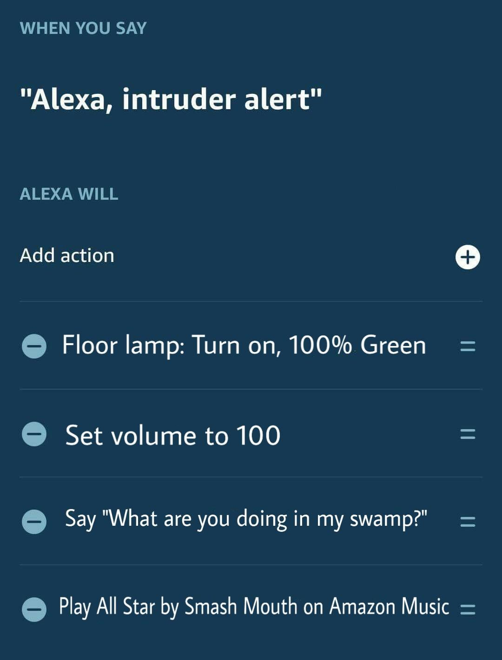
ALEXA CUSTOM COMMANDS
Defining a function is like building a custom command for Alexa…
WHEN YOU SAY <function_name>
ALEXA WILL <function_body>
__________________________________
Calling a function is like invoking a custom command for Alexa…
User says “<function_name>”
→ Execute <function_body>
Notes:
Let’s talk a little more about the difference between defining and calling function.
In this example, an Alexa owner has created a custom command. Presumably, this would be used in the case of a home invasion. When the person says “Alexa, intruder alert,” the green lamp will turn on, the volume will be set to 100, Alexa will say the phrase, and All Star will play.
This is actually a lot like defining a function in Python!
The command phrase is like the function name, and the action list is like the function body.
Calling a function will run all of the actions defined in the custom command.

Slide 16

Summary and Closing Remarks
Console applications print text to a console screen
It is possible to print to the console using print("")
Functions are code blocks that can be reused
They must be defined, and then they can be called
This is more advanced programming – it can be difficult
You can do it!
Notes:
The main point of this slide is to try encourage students. They may feel overwhelmed because this is a lot of information – but they should stick with it and know that they can learn if they put their mind to it!

