Slide 1
bit.ly/ucshyland
Code with Hyland Academy @ UCS

Slide 2
HELLO HTML!
Introduction to Web Development

Slide 3

WHAT IS A WEB BROWSER?
A web browser is an application that is used to view websites.
What are some examples of web browsers?
Notes:
Some students might already know all of this – but we want to make sure everybody is on the same page before we begin.

Slide 4
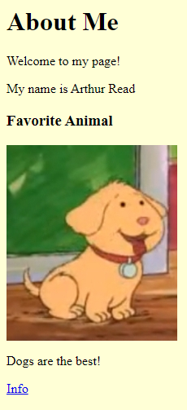
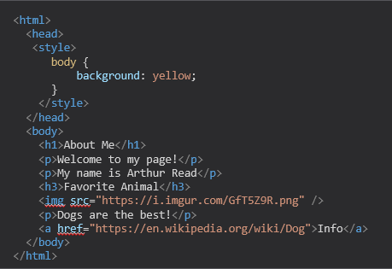
HOW DOES A BROSWER USE HTML?
SERVER
The browser reads the text from the server…
…interprets it…
…and shows it to the user!
Notes:
Browser reads the text, interprets it, and shows it to the user. HTML is behind every user interface on the web.
It can be helpful to view a popular Wikipedia page in the web, and then view the source to see how the web browser renders it into a viewable page.

Slide 5
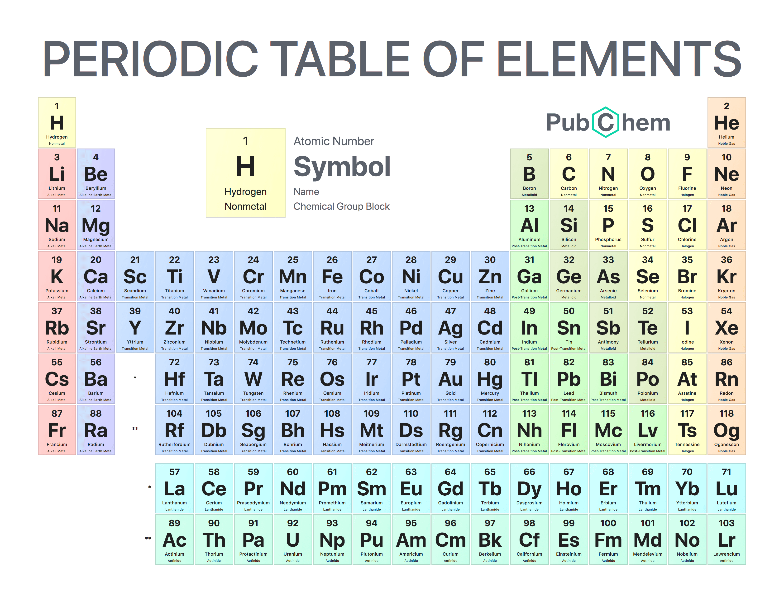
HTML INTRODUCTION
HTML stands for HyperText Markup Language
An HTML Document is a text file with a specific format
The file extension should be .html (e.g., index.html)
HTML has elements, each with a different purpose
E.g., images, text, tables, links, and so on!
Notes:
This may seem abstract, but it should make more sense after some examples

Slide 6
HTML INTRODUCTION
What are these?
Less-than Sign
Greater-than Sign
< >
Angle Brackets
Notes:
Ask the students if they recognize these symbols. They may have seen them in math – less than sign and greater than sign. In HTML, we also call these “angle brackets”. They will be necessary when writing the code for tags.

Slide 7
HTML TAGS
HTML Tags are the text that creates the start and end of HTML elements
Opening Tag:
<element-name>
Closing Tag:
</element-name>
Notes:
Go over the syntax for making a tag. It starts with a less-than sign, then the element name, then a greater-than sign.
A closing tag starts with a less-than sign and a slash, then the element name, then a greater-than sign.

Slide 8
HTML ELEMENT EXAMPLE- PARAGRAPH ELEMENT
<p> Hello World </p>
Opening Tag
Content
Closing Tag
HTML Element
Notes:
Note the < and > (greater than/less than, or angle brackets).

Slide 9
MORE HTML ELEMENTS
HTML – container for everything
body- container for visible elements
p- (paragraph) used for normal text
h1 – h6 – headers of different size
img - image
Notes:
These are the elements this lesson covers. There are so many elements out there, but this is a good place to start.

Slide 10
THANK YOU!
WHAT QUESTIONS DO YOU HAVE?

