Slide 1
Hello CSS
Introduction to Web Development

Slide 2

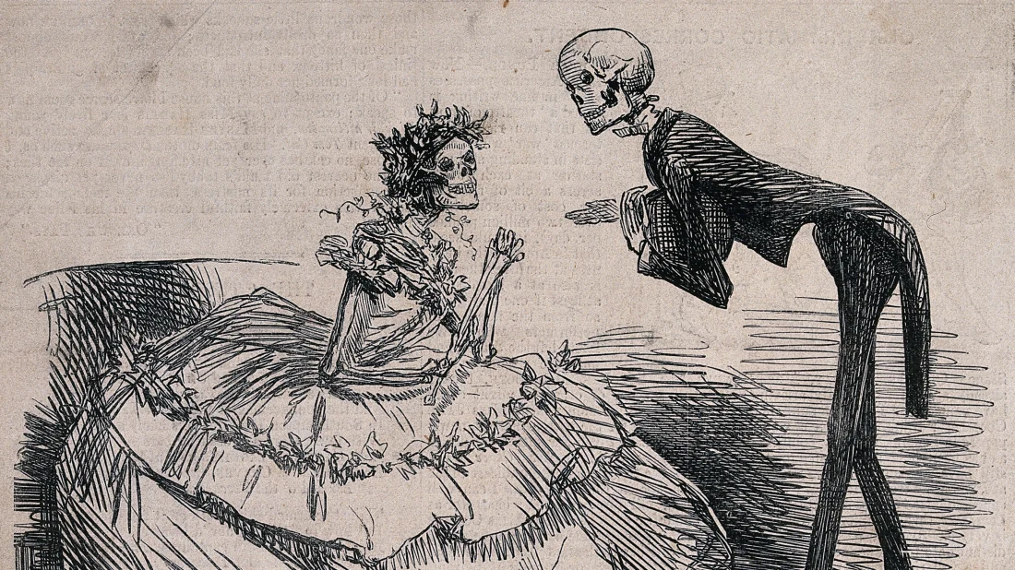
What is CSS?
CSS (Cascading Stylesheets) is a language that allows developers to change styles on a webpage
CSS can change fonts, colors, backgrounds, positioning, even animations!
If HTML is the skeleton of a page, CSS is the clothing that it wears
Notes:
Explain the purpose of CSS, and what it does.

Slide 3

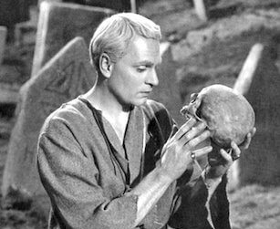
The <head> and <style> elements
<html>
<head>
<style>
/* CSS Goes Here */
</style>
</head>
<body>
<h1>My Site</h1>
</body>
</html>
The <head></head> element is a child of the <html></html> element, and a sibling of the <body></body> element
The <style></style> element is a child of the <head></head> element
Notes:
Explain what the head and style elements are

Slide 4
CSS FILE example
https://replit.com/@HylandOutreach/StyleElementExample
Notes:
Show the link tag in action. Make sure to note the filename, attributes, and CSS.

Slide 5
What does actual css code look like?
Ruleset
h1 {
font-size: 60px;
background-color: purple;
}
Declaration
Selector
Property
Value
Notes:
Go over the vocabulary around different parts of CSS. Make sure to note that each character is very important: every colon, every semi-colon, every curly bracket, dash, etc.

Slide 6
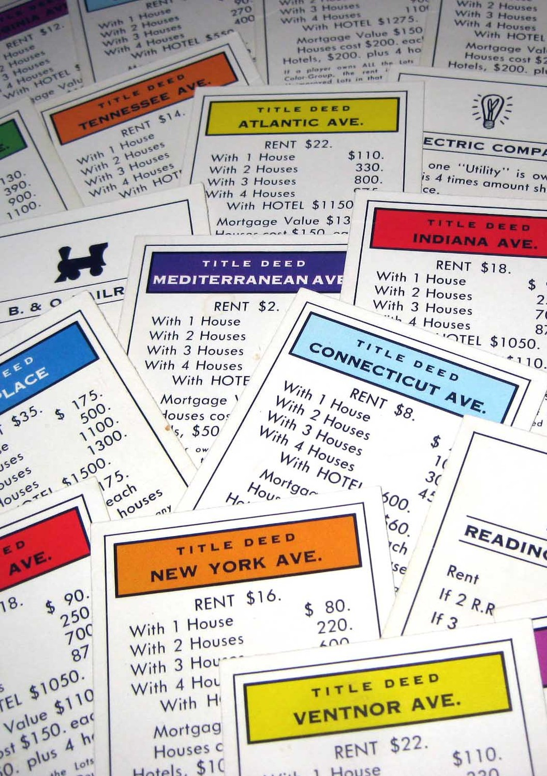
CSS Properties
color: controls the color of text in an HTML element
background: controls the background color of an HTML element
font-size: controls the size of text in an HTML element
font-family: controls the actual font of the text in an HTML element
Notes:
Explain how CSS properties determine the actual styles that are controlled by CSS

Slide 7

CSS Selectors
body: styles the entire page
h1: styles all h1 elements on the page
h2: styles all h2 elements on the page
p: styles all p elements on the page
… etc
Notes:
Go through a few of the selectors – actually just examples of the element selector. The main idea is that

Slide 8
Ruleset example
https://replit.com/@HylandOutreach/Ruleset2
Notes:
For the Repl, show the whole ruleset in action. Change around the selector, properties, values etc to show how it affects the page.

Slide 9
Questions?

