Slide 1
Hyland Academy @ Urban Community School
‘23-’24 School Year, Trimester 2

Slide 2
Intros
👋

Slide 3
THANK YOU!!!
🙏

Slide 4
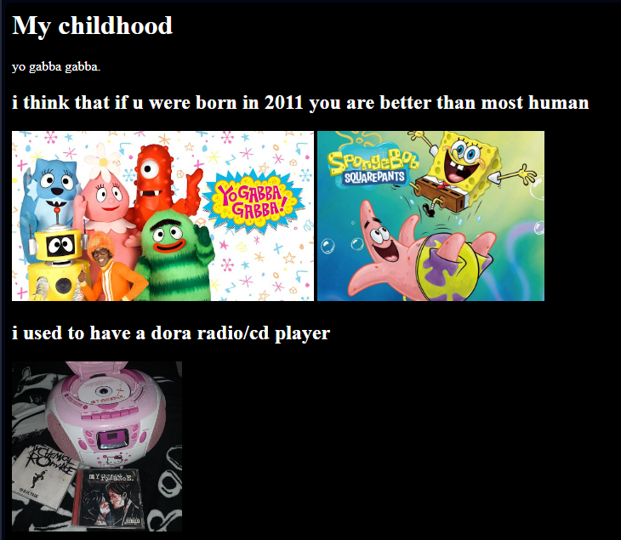
Course Overview: HTML/CSS
11/16 – Kick-off
11/30 – Introduction to HTML
12/7 – About Me Websites
12/14 – Restaurant Websites
1/4 – Practice & Review
1/11 – Introduction to CSS
1/18 – Rainbow Poem Websites
1/25 – New CSS Concepts
2/1 – Final Project Work
2/8 – Final Project Presentations
2/22 – Pixel Art (extra)

Slide 5
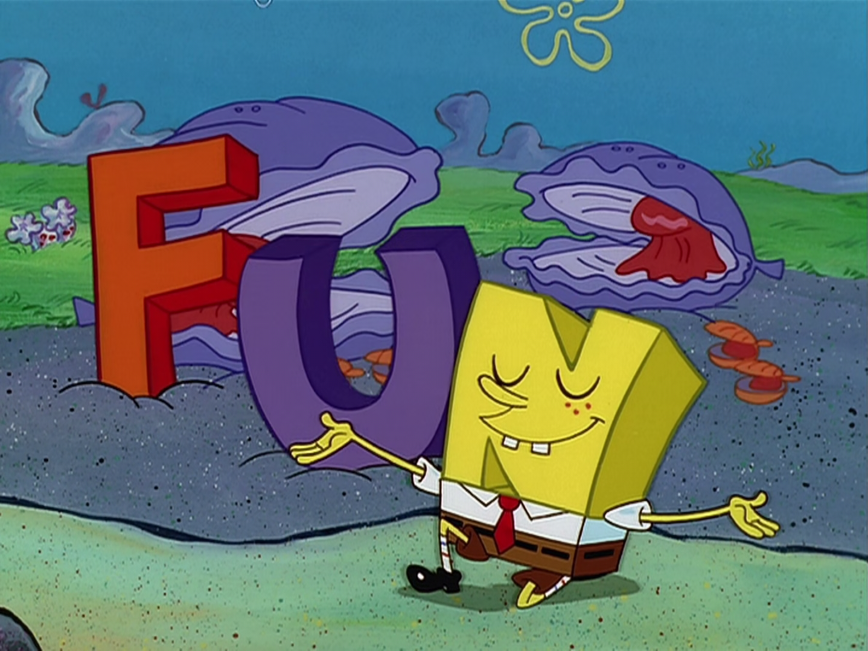
Course Goals
Build something like…
https://top-10-of-my-favorite-albums-of-all-time.oliverdodyk.repl.co/
https://restaurantwebsitefull.giancarlolegget.repl.co
https://red-lobster.ericpowell1.repl.co
Have a lot of fun
Spark an interest in coding
Experience > Retention

Slide 6
GitHub + Outlines + Forms
GitHub contains all the lesson plans for the course:
https://github.com/hylandtechoutreach/ucs
Outlines will have instructor responsibilities per week
(We will be moving these to Confluence or OneDrive)
Student forms will be moved to Microsoft Forms

Slide 7
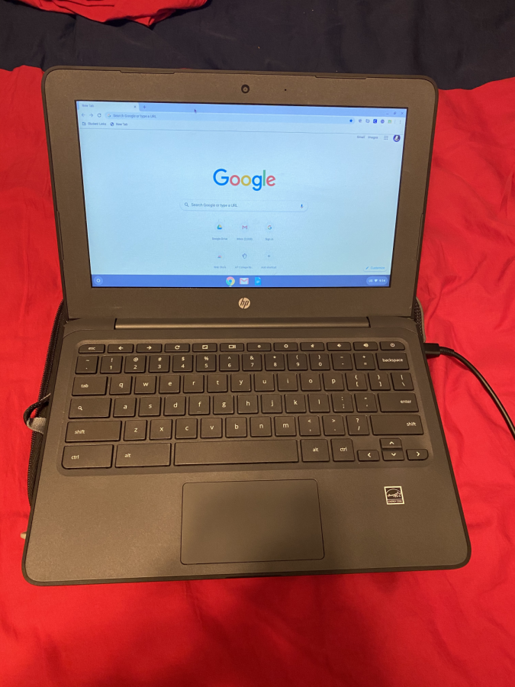
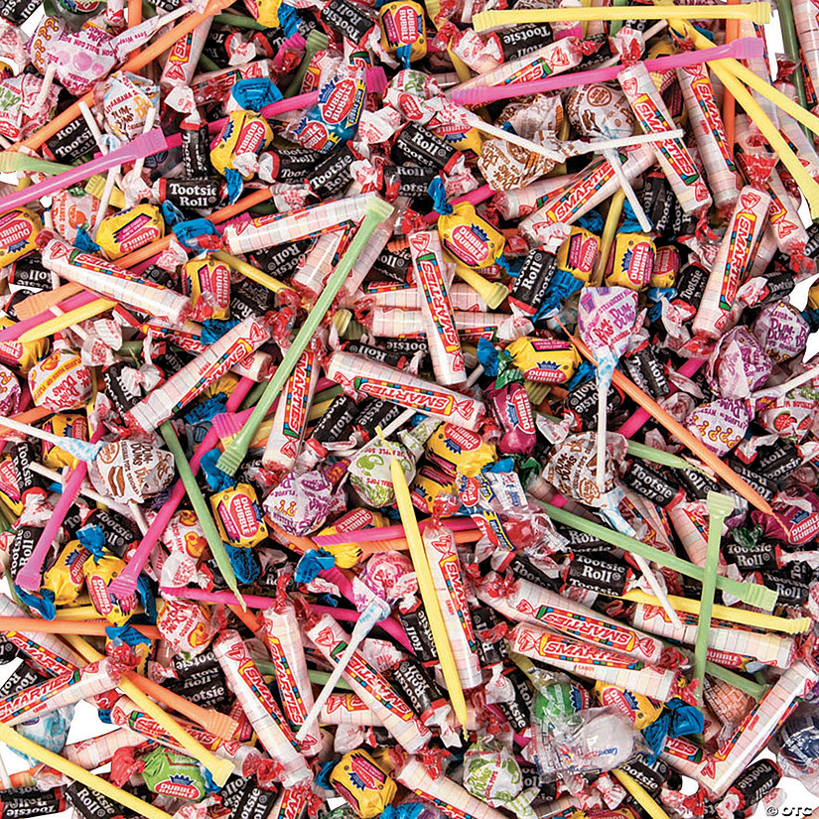
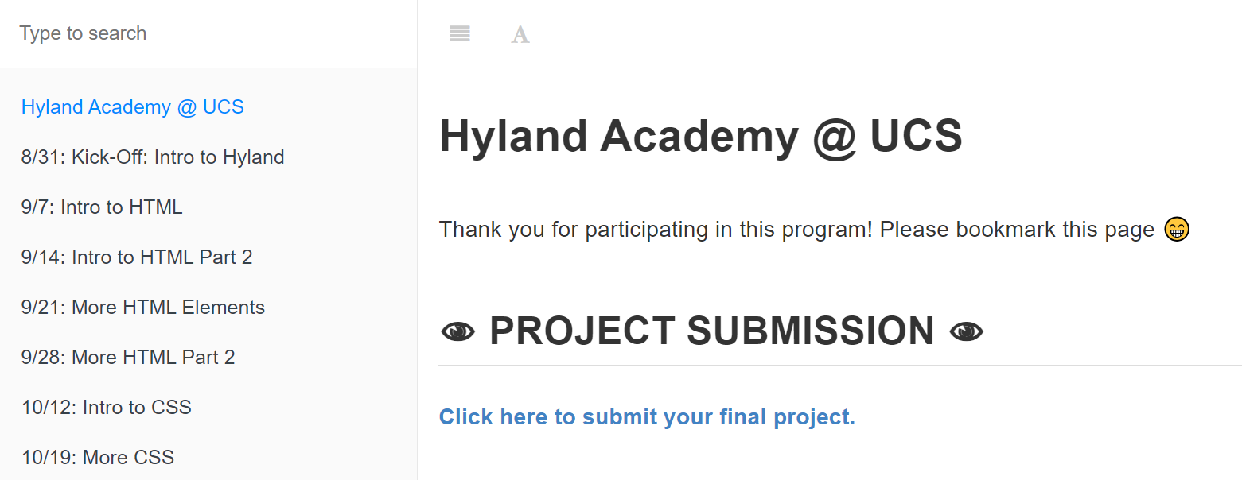
In the Classroom
Things can get a little chaotic…
Students in 6-8th grade
Somewhere between 4 and 14 total
Many of them need help with basic computer skills
Wide variation of interest and skill
bit.ly/ucshyland

Slide 8
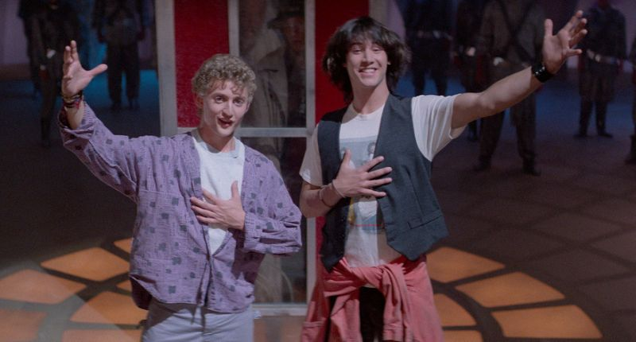
Student Expectations
DO
DON’T
STAY IN YOUR SEATS 🪑
HIT EACH OTHER 🤼‍♂️
BE EXCELLENT TO EACH OTHER (AND US)
PLAY SOUND FROM YOUR CHROMEBOOK 🔊
THROW AWAY CANDY WRAPPERS 🍬🚮
DISTRACT EACH OTHER 🗣
WRITE ON THE SCREEN 🖊📺
CHILL 😎
BE MEAN 😔
Notes:
Given those expectations, here are some specific rules that embody those ideas. We will start with the DON’Ts. Do not:
Play sound from your chromebook
Write on the big screen
Hit each other
Distract each other
Or be mean to each other! Now let’s take a look at some DOs. Do:
Stay in your seats (please)
Throw away your candy wrappers – or Ms Bids will get mad at us
Chill – don’t go nuts all the time
And finally, be excellent to each other – this one kind of sums it up. Be respectful of your fellow students, and be respectful of us – we are taking time to be here to help you learn, and we want everyone to get the most out of it that they can!

Slide 9
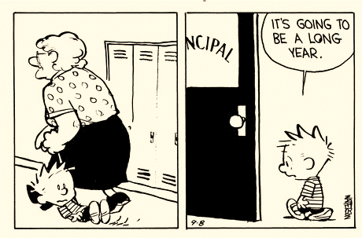
Escalation Plan
What can we do if they misbehave?
We may:
Withhold candy
Restate our instructions
Give them a chance to try again
Let them work in the hall
Call Mr. Taylor / Mr. K
Notes:
You might not care to respect these expectations, and still have some desire to disobey. So what happens then?
Well, we may…
Take away your chance to get candy
Tell you again what we want you to do
Let you retry something you did wrong
Send you out into the hall, or to another seat in the classroom
And lastly, we will not hesitate to call Mr. Taylor or Ms. Mac.
You probably don’t want us to do that – so please try to behave so we don’t have to get to that point ☺

Slide 10
Next Steps
I will send out a recurring calendar invitation
New instructors can observe for the first few weeks
We will check in on Teams before class each week
Questions?

