Slide 1
Hello HTML!
Introduction to web development
Notes:
Some students might already know all of this – but we want to make sure everybody is on the same page before we begin.

Slide 2
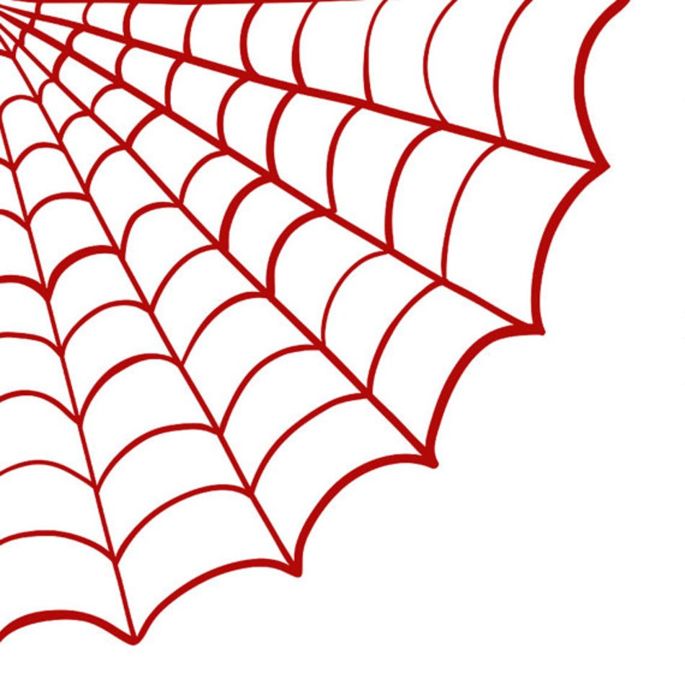
Web Overview

Slide 3
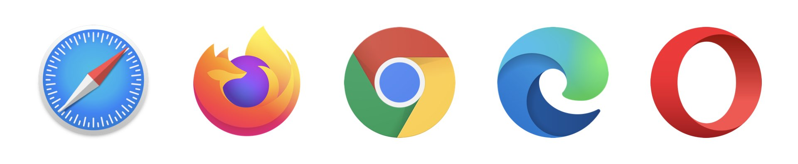
What is a web browser?
A web browser is an application that is used to view websites.
What are some examples of web browsers?
Notes:
Ask the students this question to see if they know the answer. Ask if they are familiar with any web browsers. Examples on the slide include apple safari, mozilla firefox, google chrome, Microsoft edge, and opera.

Slide 4
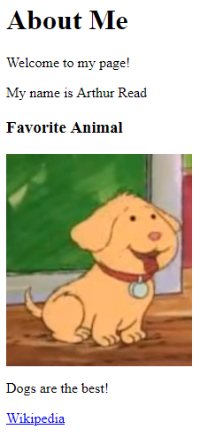
How does a browser use HTML?
The browser takes HTML and turns it into a webpage
<html>
<body>
<h1>About Me</h1>
<p>Welcome to my page!</p>
<p>My name is Arthur Read</p> <h3>Favorite Animal</h3>
<img src="pal.png">
<p>Dogs are the best!</p>
</body>
</html>
Notes:
Browser reads the text, interprets it, and shows it to the user. HTML is behind every user interface on the web.
It can be helpful to view a popular Wikipedia page in the web, and then view the source to see how the web browser renders it into a viewable page.

Slide 5
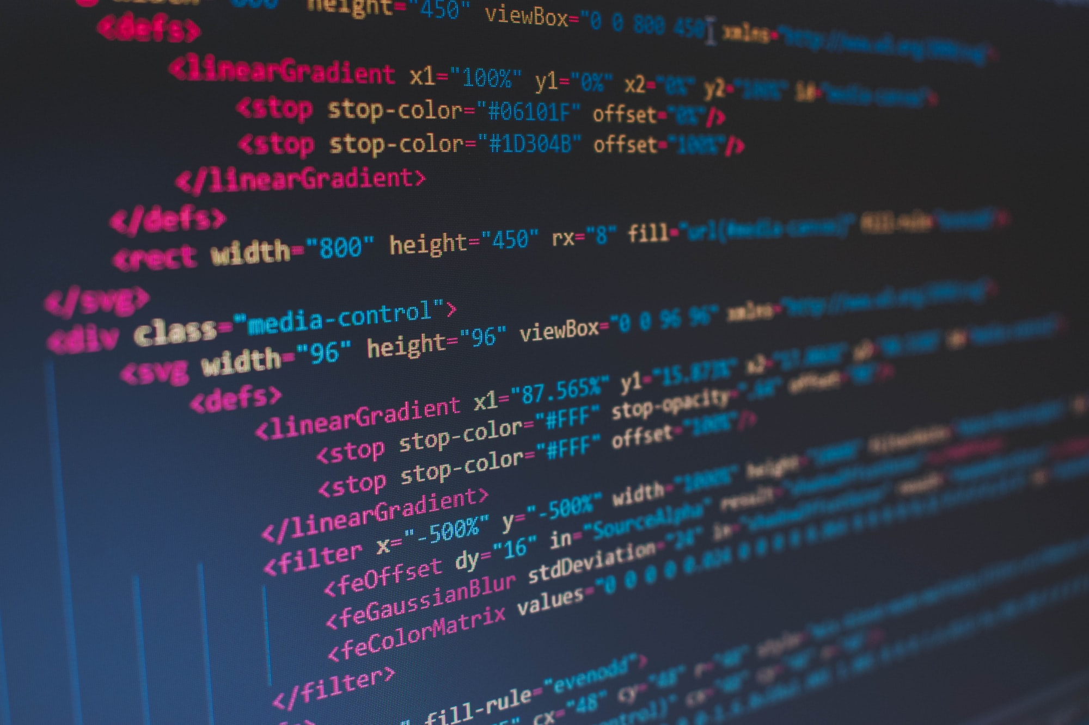
HTML Introduction

Slide 6
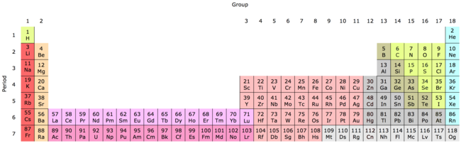
HTML Introduction
An HTML Document is a text file with a specific format
The file extension should be .html (e.g., index.html)
HTML has elements, each with a different purpose
E.g., images, text, tables, links, and so on!
Notes:
This may seem abstract, but it should make more sense after some examples

Slide 7
What are these?
< >
Angle Brackets
Less-than Sign
Greater-than Sign
Notes:
Ask the students if they recognize these symbols. They may have seen them in math – less than sign and greater than sign. In HTML, we also call these “angle brackets”. They will be necessary when writing the code for tags.

Slide 8
HTML TAGS
opening tag
<element-name>
closing tag
</element-name>
Notes:
Go over the syntax for making a tag. It starts with a less-than sign, then the element name, then a greater-than sign.
A closing tag starts with a less-than sign and a slash, then the element name, then a greater-than sign.

Slide 9
HTML Element Example – paragraph element
<p>Hello World</p>
Opening Tag
Closing Tag
Content
HTML Element
Notes:
Note the < and > (greater than/less than, or angle brackets).

Slide 10
More HTML ElementS
html – container for everything
body – container visible elements
p – (paragraph) used for normal text
h1-h6 – headers of different size
img – image
Notes:
These are the elements this lesson covers. There are so many elements out there, but this is a good place to start.

Slide 11
A Full Example
https://replit.com/@HylandOutreach/HtmlExample

Slide 12
Questions?

