Slide 1
URBAN COMMUNITY SCHOOL CLASSROOM EXPECTATIONS
What to expect for this Hyland Academy
Notes:
Classroom expectations are important! This will help you to know what’s expected of you and we create a fun and safe classroom culture for you all.
Through creating expectations, you all will be able to learn more effecicently and focus on tasks more easily.

Slide 2
OUR EXPECTATIONS OF YOU
BE
RESPECTFUL
BE
RESPONSIBLE
DO
YOUR BEST
BE
PREPARED
BE
POSITIVE
HAVE FUN!
Notes:
Here we have our expectations of you all as students. They are:
-Be Respectful
-Be Responsible
-Do Your Best
-Be Prepared
-Be Positive
-Have Fun!
Now we’re going to give you all a chance to get to know each other and collaborate. First, we’re going to put you all into groups *Put students into even groups, ~3 students per*
Now, we’re going to pass around Post-It Notes that coordinate with each expectation category. *Hand Out 1 of each color Post-It note to each group of students (6 post its per group)*
We’re going to give you all 5 minutes to talk as a group and come up with one example of each category.
*After 5 minutes, collect post-its and read them off and put them on the board on top of each category*
Examples if students are stumped:
Respectful:
-Follow directions
-Respect different differences/ideas
-Encourage yourself and others
Responsible:
-Use appropriate voice levels
-Be ready to learn at the start of class
-Use time Wiseley to complete tasks
-Wait to be dismissed
Do Your Best:
-If something is difficult, don’t give up!
-Ask for help if you need it
-Give every project 100% -- it’s the best way to learn!
Be Prepared:
-Come with your Chromebook and notes every day
-Have headphones if you want to listen to music when there’s time to work individually
-Come prepared with questions
Be Positive:
-Growth mindset – Don’t say “I can’t” say “I can’t do it yet”
-Encourage classmates
-Encourage yourself
-Find the good parts of every project you work on
Have Fun:
-Get to know your classmates
-Get to know your instructors
-Get creative with our projects

Slide 3
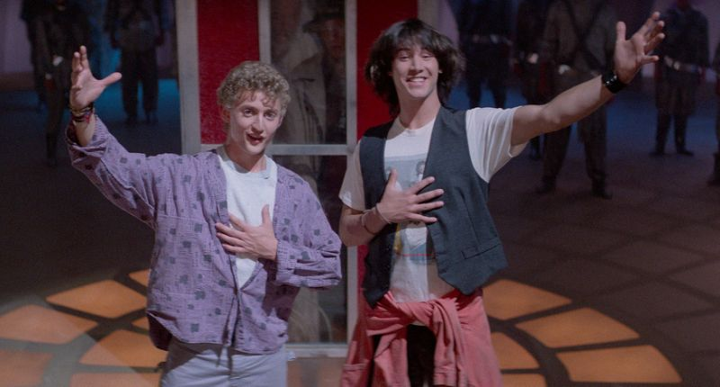
EXPECTATIONS -> RULES
DO
DON’T
STAY IN YOUR SEATS 🪑
HIT EACH OTHER 🤼‍♂️
BE EXCELLENT TO EACH OTHER (AND US)
PLAY SOUND FROM YOUR CHROMEBOOK 🔊
THROW AWAY CANDY WRAPPERS 🍬🚮
DISTRACT EACH OTHER 🗣
WRITE ON THE SCREEN 🖊📺
CHILL 😎
BE MEAN 😔
Notes:
Given those expectations, here are some specific rules that embody those ideas. We will start with the DON’Ts. Do not:
Play sound from your chromebook
Write on the big screen
Hit each other
Distract each other
Or be mean to each other! Now let’s take a look at some DOs. Do:
Stay in your seats (please)
Throw away your candy wrappers – or Ms Bids will get mad at us
Chill – don’t go nuts all the time
And finally, be excellent to each other – this one kind of sums it up. Be respectful of your fellow students, and be respectful of us – we are taking time to be here to help you learn, and we want everyone to get the most out of it that they can!

Slide 4
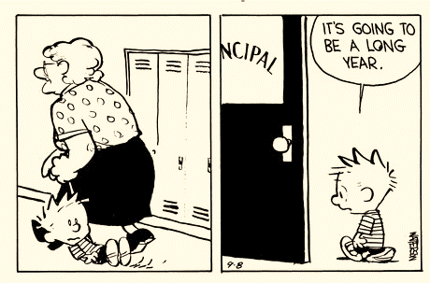
ESCALATION
What if I still want to misbehave?
We may:
Withhold candy
Restate our instructions
Give you a chance to try again
Let you work in the hall
Call Mr. Taylor / Ms. Mac
Notes:
You might not care to respect these expectations, and still have some desire to disobey. So what happens then?
Well, we may…
Take away your chance to get candy
Tell you again what we want you to do
Let you retry something you did wrong
Send you out into the hall, or to another seat in the classroom
And lastly, we will not hesitate to call Mr. Taylor or Ms. Mac.
You probably don’t want us to do that – so please try to behave so we don’t have to get to that point ☺

Slide 5
YOUR EXPECTATIONS OF US
GROUP 1
GROUP 2
Notes:
Now that we’ve set expectations for you all as students we’re going to give you all the time to create expectations for us as instructors!
*Split students into 2 groups, give 5 Post-It Notes to each group*
In your groups, come up with about 5 expectations of your Hyland instructors.
*After 5 minutes, collect Post-It Notes and read out loud, placing each on top of the board in the proper section*

