Slide 1
Full-stack Web Development
Hy-Tech Club: Web 201

Slide 2
Agenda
Front-end
Back-end
Full-stack

Slide 3
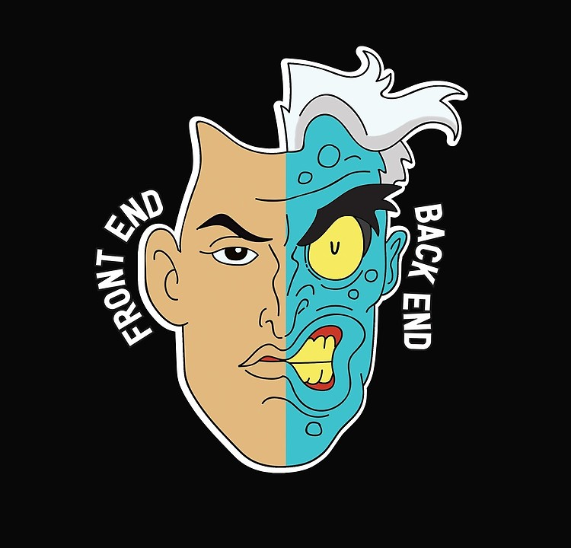

Slide 4
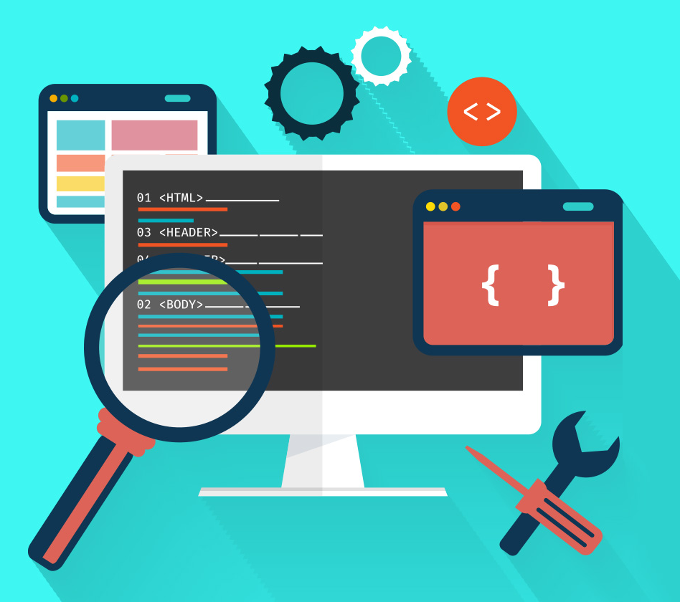
Front-end (client side)

Slide 5



Front-end – The user interface
The front-end of a web application is everything the user sees
Structure
Style
Interactivity
Notes:
HTML is used to create the structure and content of a webpage. Each element on the page is represented in HTML.
CSS is used to style a webpage.
JavaScript is used to add interactivity to a webpage. It is also used to communicate between the front-end and the back-end of a web application.

Slide 6
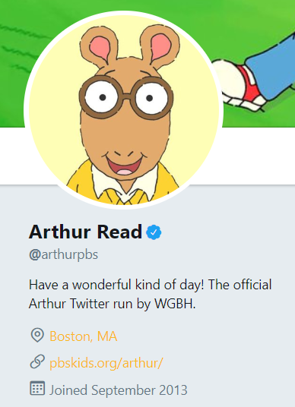
Front-end – Data Transfer
The front-end receives data from the back-end and uses it to show the information to the user
Example: https://twitter.com/arthurpbs
Name
Is Verified
Bio
Location, Website, Join Date
Notes:
Think about going to someone’s Twitter profile. This webpage is not created manually for every single twitter user; instead, the front-end has to look for the data belonging to a given user, and use that data to populate the page.
On Arthur’s Twitter profile, it lists his name, and it has a blue checkmark because he is verified. It displays his bio, and a lot of other information about him (location, website, join date). This information will be different for every user, but the front-end functionality will be the same!

Slide 7
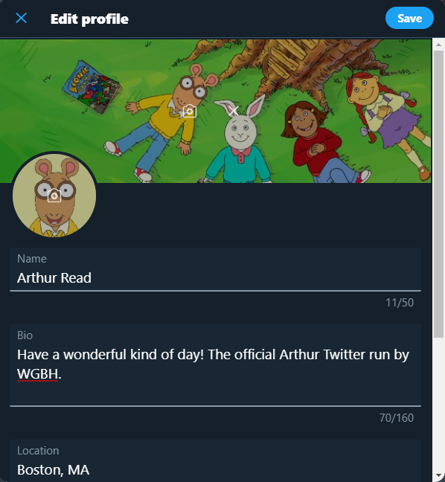
Front-end – Data Transfer
The front-end sends data from the user to the back-end to update it
Example: Editing Twitter Profile
Name
Bio
Location
Save Button
Notes:
On the other side, think about updating a Twitter profile. When Arthur wants to update his profile, or send a tweet, he does not have to update the HTML on his page… all he has to do is click “Edit Profile” and he can make changes!
When he fills out this form with his Name, Bio, and Location, the front-end will send the data after he clicks the Save button. Then, the data will update on the server, and his profile page will update too!

Slide 8
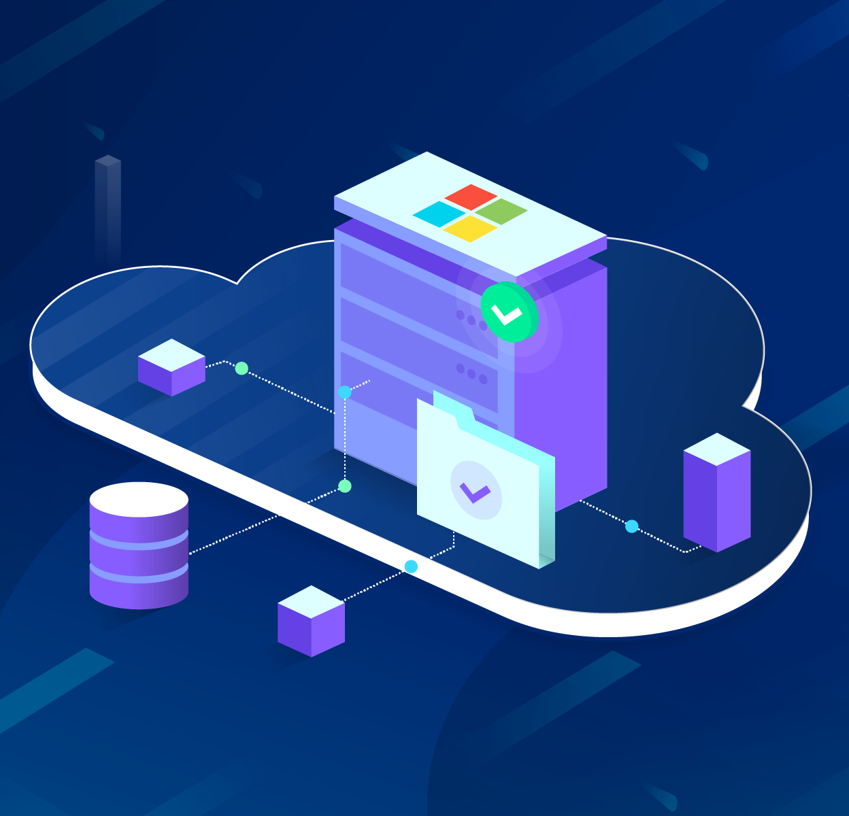
Back-end (Server Side)

Slide 9

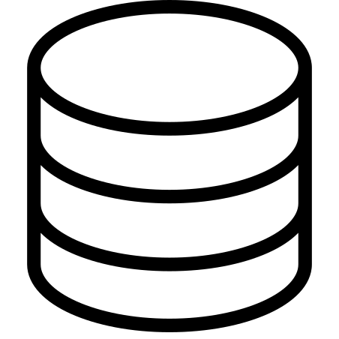



Back-end – behind the scenes
The back-end of a web application is the engine that runs the website
It processes requests from the front-end, and holds data for the app
Server
Database
Notes:
The backend consists of the Server and the Database.
The server stores, processes, and delivers webpages to clients.
The database stores data for the web application. The server communicates with the database to figure out which data to use for a certain page, or to update the data. There are several different databases!

Slide 10


MINI-QUIZ – What data could be in a database?
Name
Bio
Verification Status
Location
Website
Join Date

Slide 11
Back-end – Data Transfer
If the front-end requests data, the server will search the database to find the relevant information
If the front-end wants to update data, the server will update the database as needed

Slide 12

Full-stack

Slide 13
Full-stack – Everything
Full-stack developers need to understand the full picture of a web application
They work with all parts of the stack, including frameworks:
HTML
CSS
JavaScript
Server
Database
EJS (Templating Engine)
HTTP (Communication Protocol)
Node.js and Express (Web Server)
MySQL or Repl.it DB (Database)
SQL queries and JSON data

Slide 14


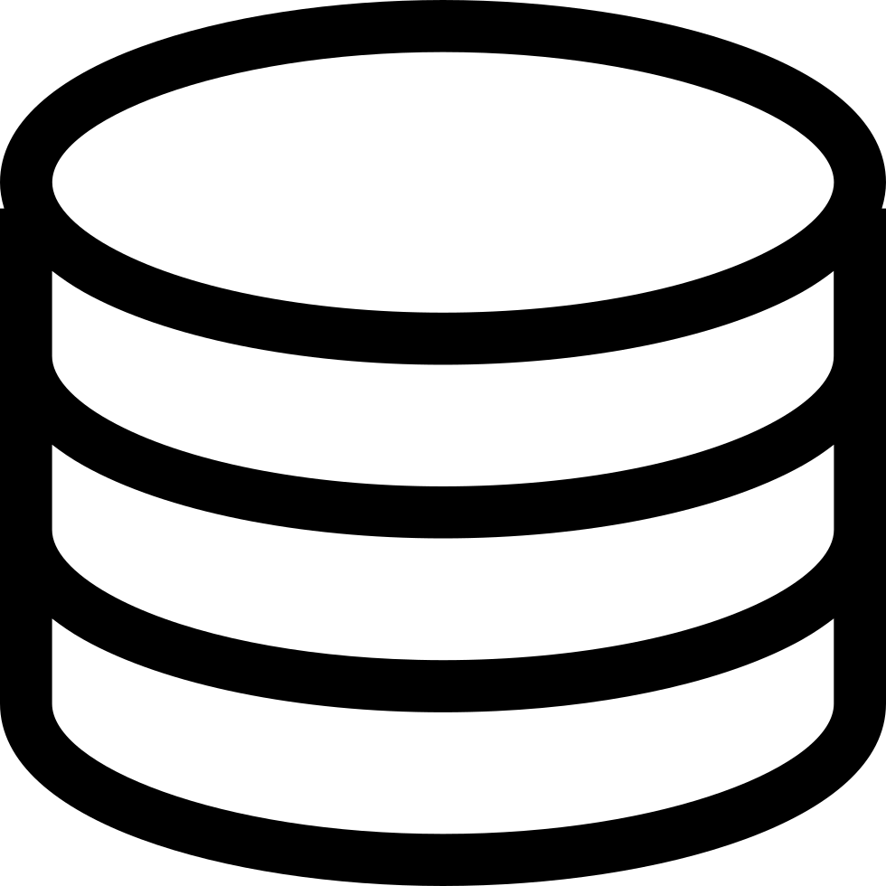
Full-Stack Web Architecture
Front-end
(client side)
HTML, CSS, JavaScript, EJS
User Interface
Back-end
(server side)
HTTP
SQL Queries
JSON Data
Node.js, Express
Server
MySQL or Repl.it DB
Database

