Slide 1
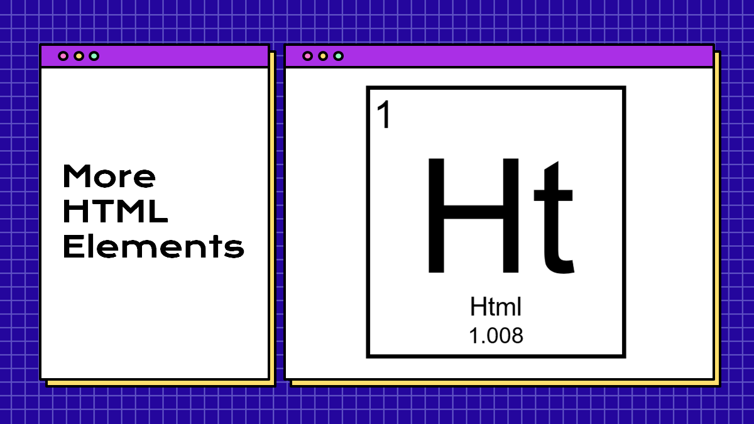
Tables & IFrames
Hy-Tech Club: Web 101

Slide 2
The List Elements
Lists are used to display groups of items
They can be unordered (bullet points) or ordered (numbered)
Each item is its own HTML element: <li>
The list items are children and the list elements are the parents
<ul>
<li>Eggs</li>
<li>Milk</li>
</ul>
<ol>
<li>Iron Man</li>
<li>The Hulk</li>
</ol>
Notes:
The bullet points on this slide are an unordered list!
An ordered list has numbers – for example, the MCU movies in release order

Slide 3
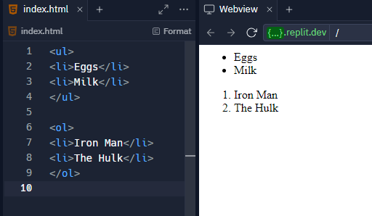
The List Elements
Notes:
The bullet points on this slide are an unordered list!
An ordered list has numbers – for example, the MCU movies in release order

Slide 4
List Example
https://jsfiddle.net/5fmw3dL8/
Notes:
Visit the Repl to show lists in action.
Here we really want to emphasize the hierarchical structure of HTML
Also show the difference between ol and ul

Slide 5
The <input> Element
inputs are interactive controls that accept data from the user
The type attribute determines how it appears
It is a self-closing tag
<input type="text" />
<input type="button" />
<input type="radio" />
<input type="checkbox" />
<input type="range" />
<input type="submit" />
Notes:
Ask the students to guess how each of these input types might appear

Slide 6
Special Inputs
<textarea></textarea> is used to create a multi-line text box
select and option are used to create a dropdown list
<select>
<option value="1">One</option>
<option value="2">Two</option>
</select>

Slide 7
Input Examples
https://jsfiddle.net/mz7gpx6c/
Notes:
Visit the Repl to show inputs in action

Slide 8
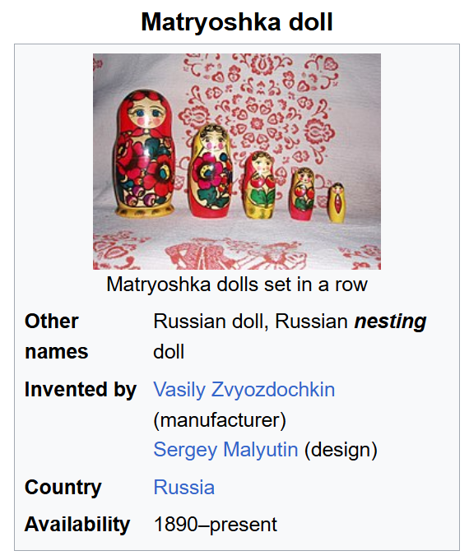
Nesting Activity
Things containing things
<county name="Cuyahoga">
</county>
Notes:
Explain nesting as a concept using geography.
Start by writing the following on the whiteboard (leave a lot of space around the tags):
<county name=“Cuyahoga”>
</county>
Ask what goes within a county – a city! Add that to the code:
<county name=“Cuyahoga”>
<city name=“Westlake”></city>
</county>
Ask what goes around a county – a state! Add that to the code:
<state name=“Ohio”>
<county name=“Cuyahoga”>
<city name=“Westlake”></city>
</county>
</state>
Use this concept to explain nesting. Explain parent/child relationships. The next slide has an example using lists.

Slide 9
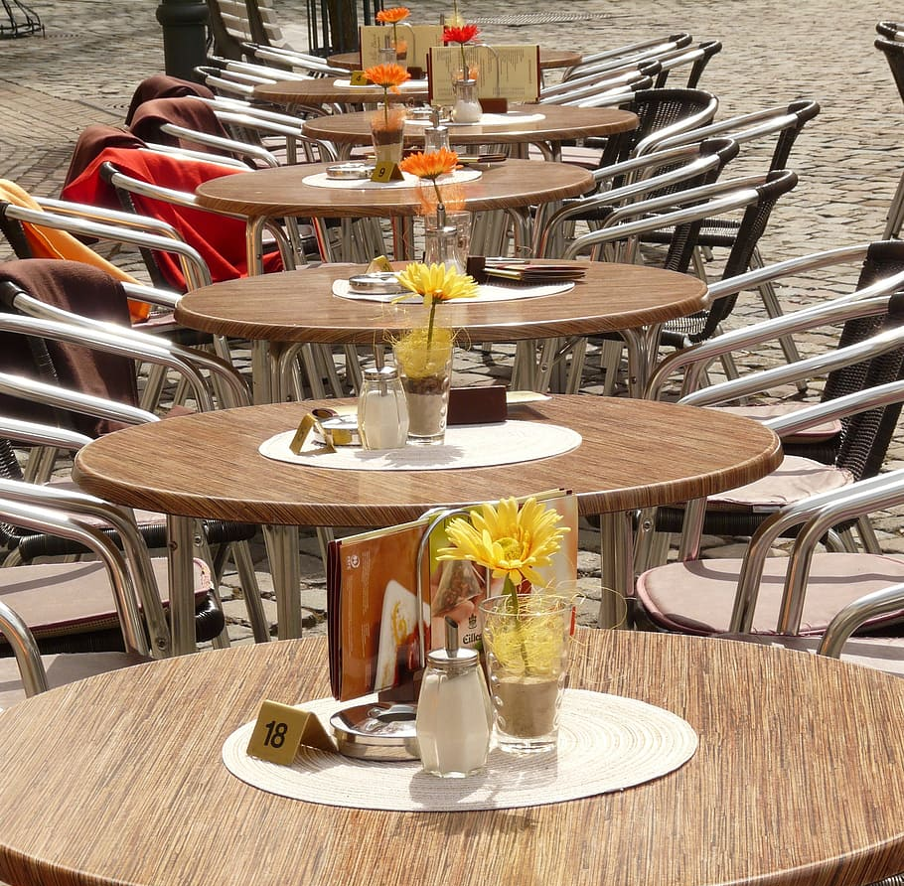
Tables

Slide 10
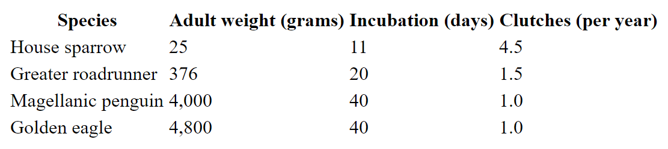
HTML Tables
What type of data could be displayed in a table?
Information about birds
Notes:
Ask the students for examples of tabular data. Lots of times there are things like stats (for sports, etc) or other information about people.
Show an example of this table, and ask the students what they think it is about.
It’s about birds.

Slide 11
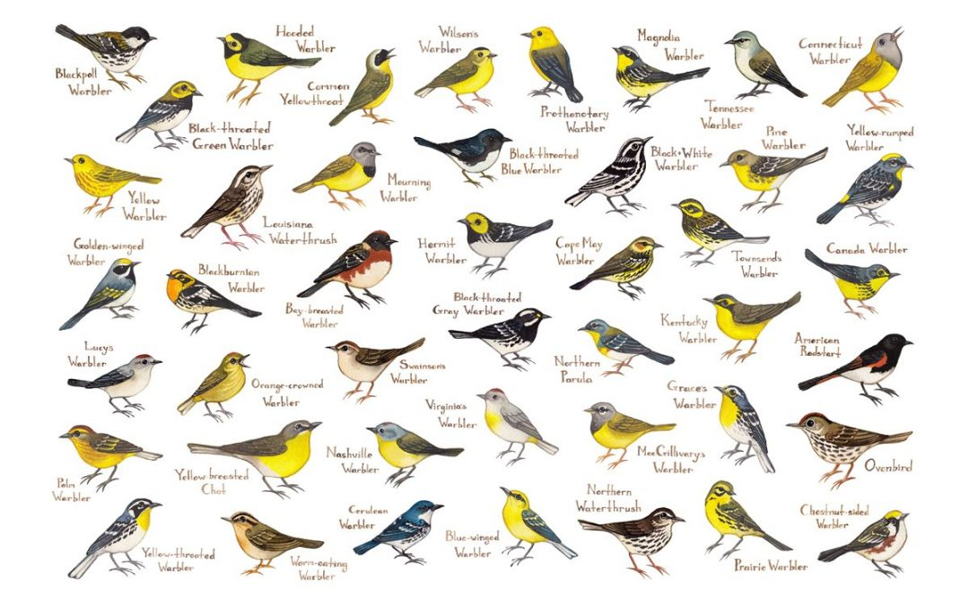
Table Elements
HTML Tables consist of several nested elements:
table: the primary element in a table, contains all other elements
tr: a row in the table
th: a header cell in the table
td: a normal cell in the table
Notes:
Explain each element that goes into a table. These will make more sense once we see the tables in action.
The Repl contains an actual full table in HTML.

Slide 12
Table Example
https://jsfiddle.net/70jat2m6/
Notes:
Start by forking the Repl project. Emphasize the relationships between each table element. Ask students which elements are parents/children/sibilings/etc.
Additionally, show the border attribute – it starts as 0, so change it to 1 to see the border.

Slide 13
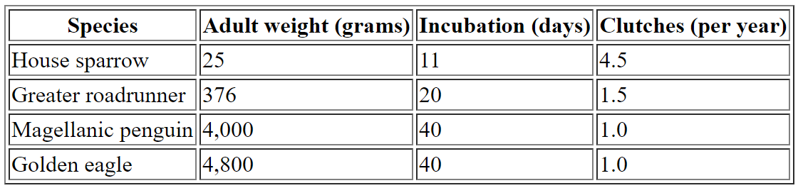
The border Attribute
<table border="1">
Set the border attribute to 1 to add a border

Slide 14

IFrames

Slide 15
The <iframe> Element
The Inline Frame element represents a nested browsing context, embedding another HTML page into the current one
Basically, you can display other webpages within your webpage
IFrames use the src element to determine which webpage to display
There are also height and width attributes
<iframe src="https://www.google.com"></iframe>
Notes:
Explain iframes

Slide 16
IFrame Example
https://jsfiddle.net/atg9vohw/
Notes:
For the Repl, emphasize the use of attributes. Add an attribute for width, change the height attribute. Also show embedding a YouTube video for fun

Slide 17
THANKS!
DO YOU HAVE ANY QUESTIONS?

