Slide 1
HTML Elements
HTO: Website Development

Slide 2
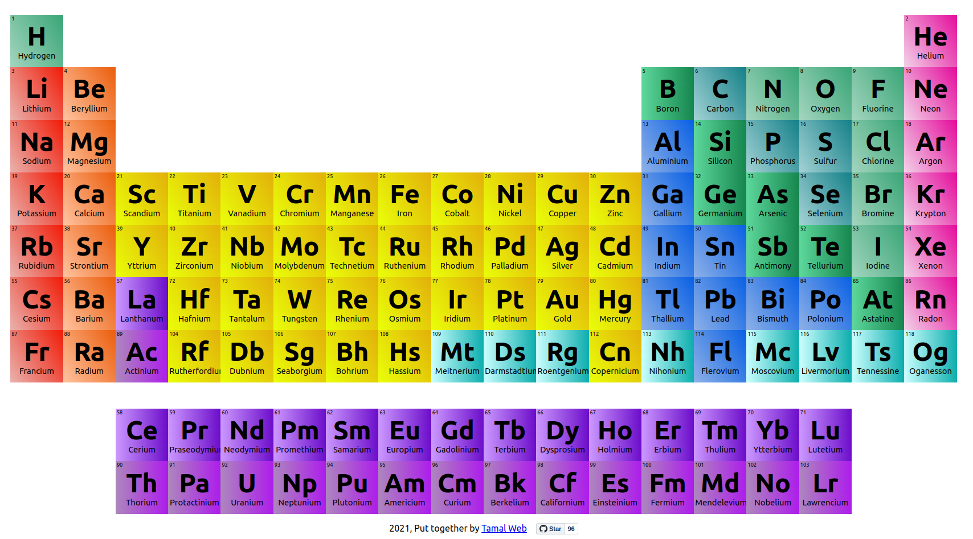
<p>Fire</p>
<p>Water</p>
<p>Earth</p>
<p>Air</p>
The chemical elements make up our entire universe
HTML elements make up a website

Slide 3
The Fundamental Elements
<html>
<body>
<..stuff..>
</body>
</html>
“Root” element - contains entire document
HTML content element
Everything that is visible!
The code will work without these… but you should add them anyway!

Slide 4
Header Elements
Used for page headings or titles
There are six header elements – h1 through h6
<h1>This is the biggest</h1>
<h6>This is the smallest</h6>

Slide 5
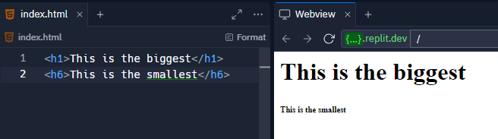
Header Elements

Slide 6
The Paragraph Element
Displays common text on the page
The content does not have to be multiple sentences
Each <p></p> creates a new line under it
<p>This will appear normal</p>

Slide 7
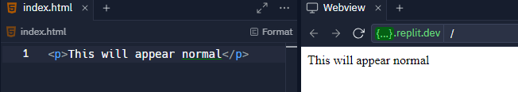
The Paragraph Element

Slide 8
The Hyperlink Element
Used to create a link to another page
Set the href to a URL
The text of the link goes in between the opening and closing tag
<a href="https://google.com">Google</a>

Slide 9
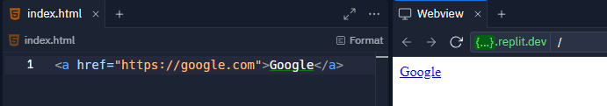
The Hyperlink Element

Slide 10
The Image Element
Used to display an image
Set the src to a URL
This element has no closing tag – it is self-closing
<img src="https://i.imgur.com/GfT5Z9R.png" />

Slide 11
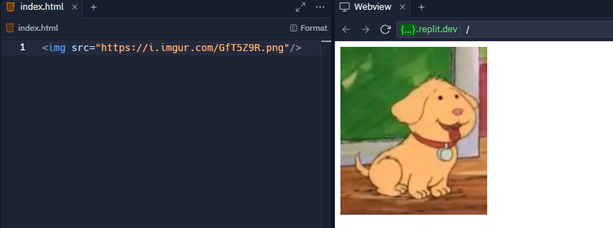
The Image Element

Slide 12
Example
https://jsfiddle.net/mxtdvL10/
Notes:
https://replit.com/@HylandOutreach/BasicElementsExample

Slide 13
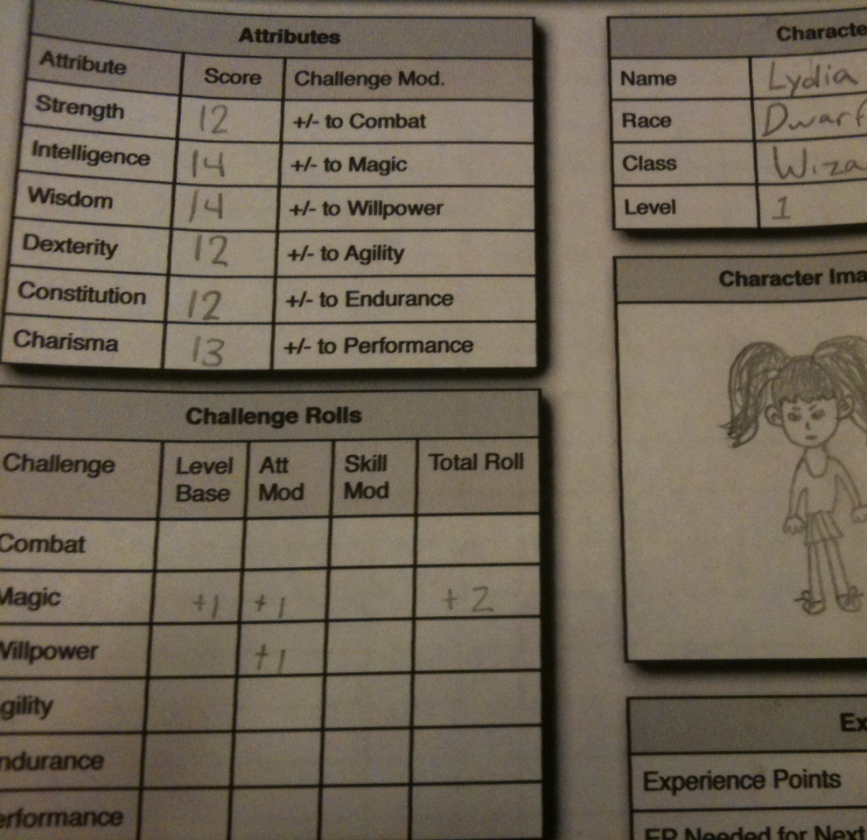
Attributes
Qualities or features regarded as a characteristic or inherent part of someone or something.

Slide 14
Attribute Example: <a>
<a href="http://wikipedia.org/">Wikipedia</a>
Q: What does the href do?
A: The href attribute specifies the destination URL for the link
Notes:
Ask the students what href does – it tells the link where to go when clicked!

Slide 15
What Are Attributes?
Attributes add extra information to HTML elements
They allow developers to customize the behavior of elements
Attributes go inside of the opening tag of an HTML element
<a href="file.html" >
Attribute name, equals sign, quotation marks, attribute value
Notes:
Point out each part of the attribute syntax

Slide 16
Mini-Quiz
<img src="dog.png" />
What is the attribute name?
src
What is the attribute value?
dog.png
Notes:
Ask the students these questions

Slide 17
Attributes Examples
https://jsfiddle.net/Lhodz460/
Notes:
Visit the Repl to show attributes in action. Uncomment the commented lines of code to display them. You should be able to use Ctrl+/ to comment and uncomment code in Repl

Slide 18
THANKS!
DO YOU HAVE ANY QUESTIONS?

