Slide 1
DOM MANIPULATION

Slide 2
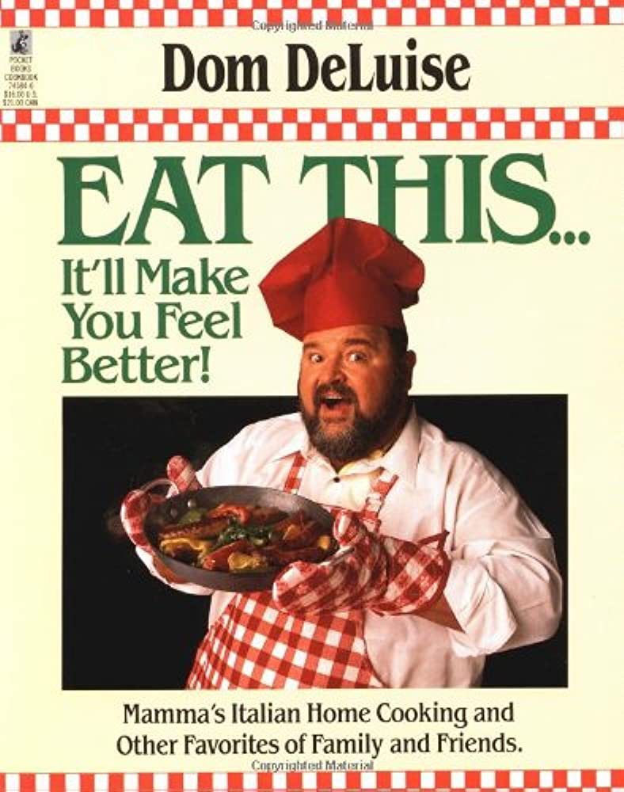
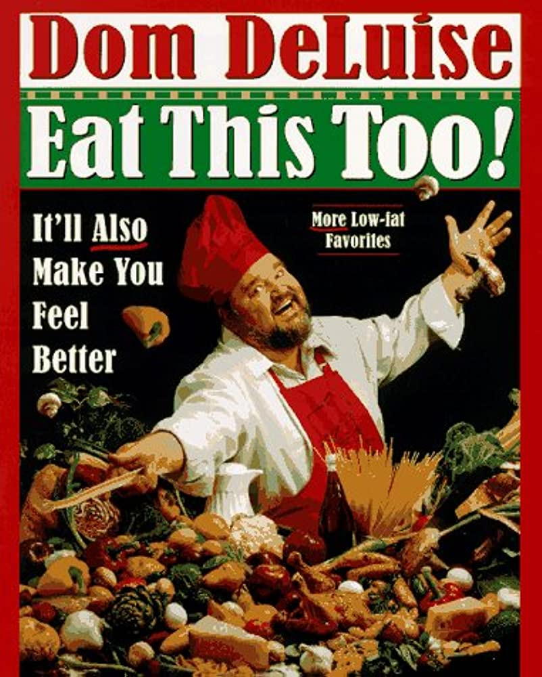
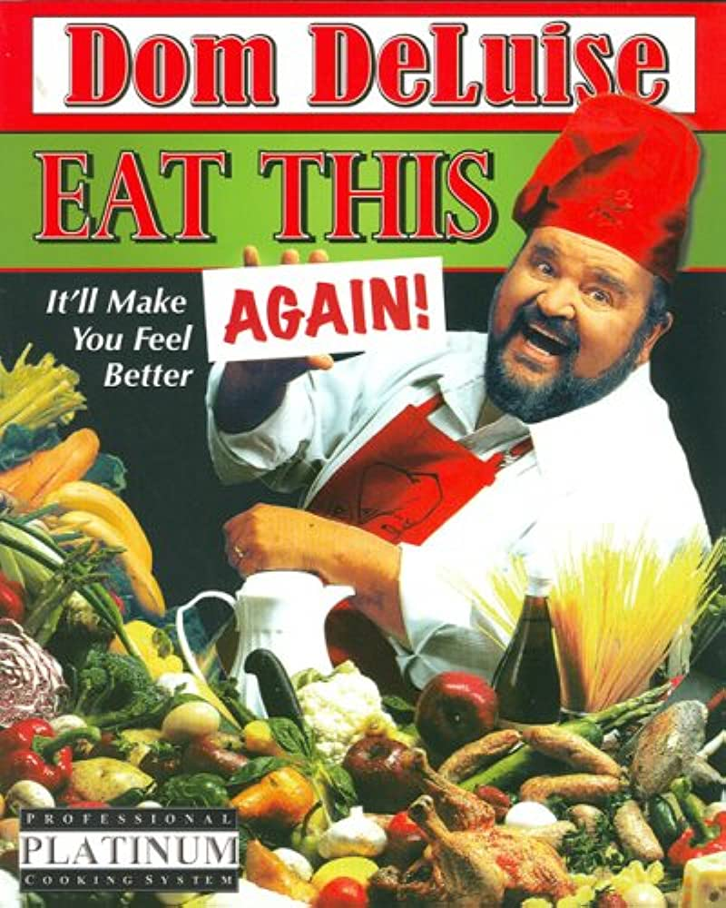
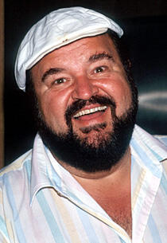
“who is and why are we manipulating him?”
Dom

Slide 3
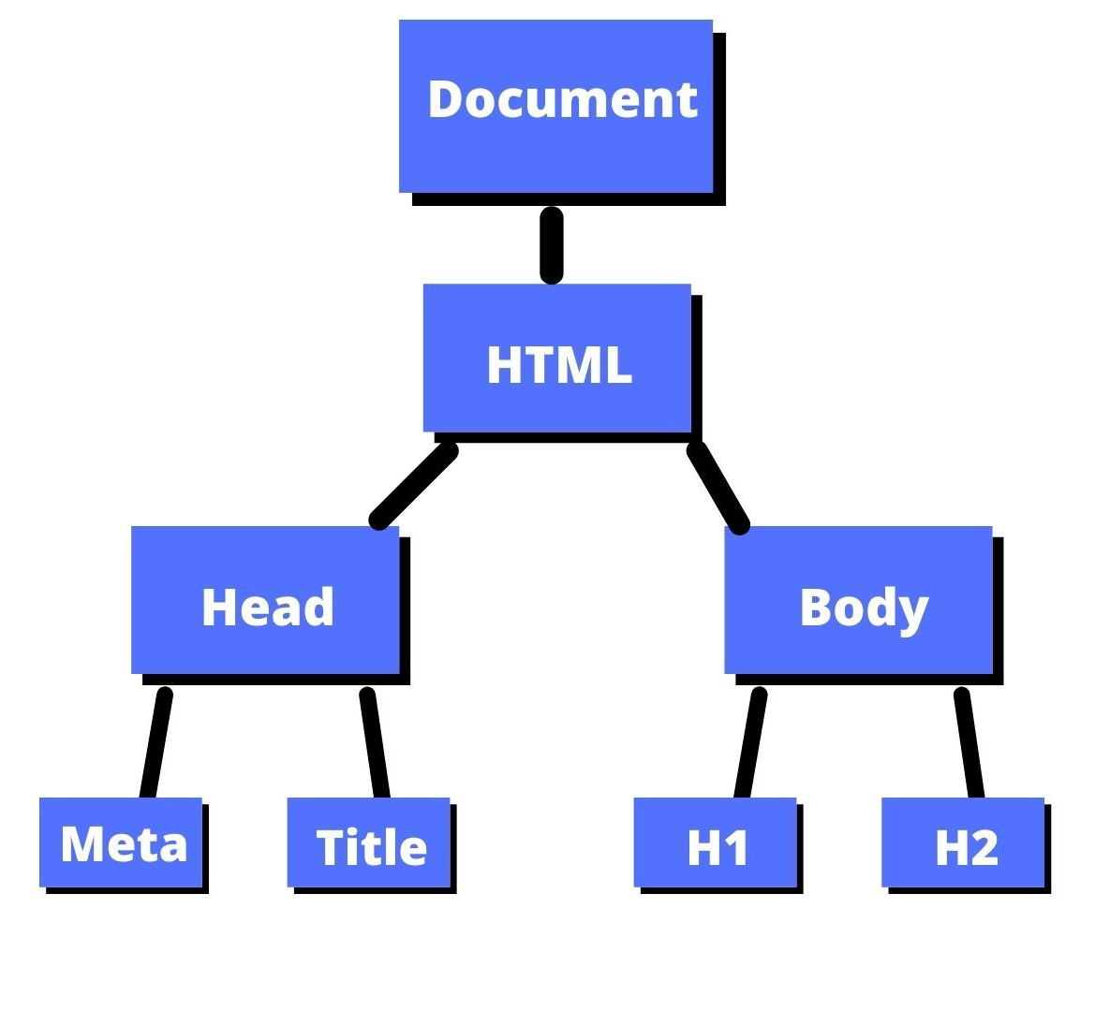
Dom
ocument
HTML Elements ->
bject
JavaScript Objects
odel

Slide 4
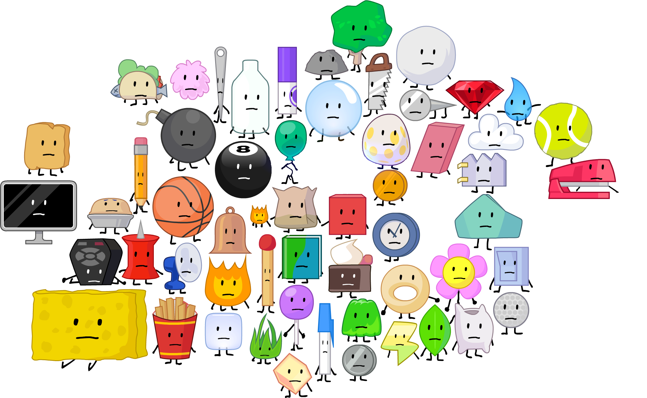
DATA TYPES
Number
String
Boolean
Object
Objects can store pretty much anything in JavaScript, including HTML elements.

Slide 5

Select
in
<input id="address">
CSS
#address

Slide 6
Select
in
<input id="address">
JS
#address

Slide 7
Select
in
<input id="address">
JS
#address

Slide 8
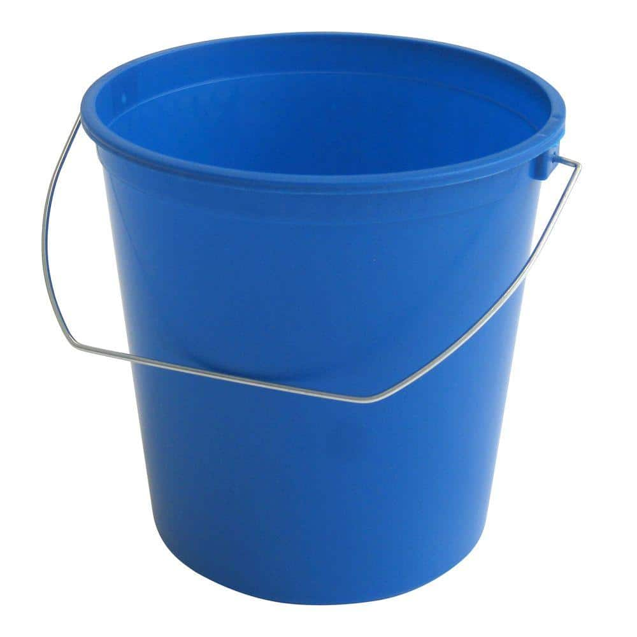
document.querySelector("
#address
");
returns the first child element that matches a specified CSS selector of an element
document.querySelector("#address");
let x
=
x

Slide 9
document.querySelector("
#address
");
returns the first child element that matches a specified CSS selector of an element
document.querySelector("#address");
let x
=
The full HTML <input> element is stored in the x variable
x

Slide 10
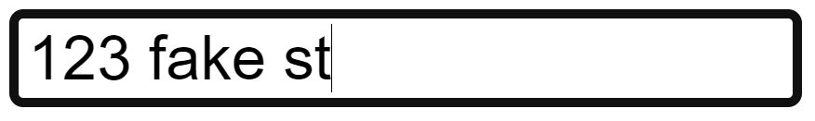
.value
let x = document.querySelector("#address");
let text = x.value;
123 fake st

Slide 11
.textContent
<p>Static</p>
let pEl = document.querySelector("p");
pEl.textContent = "Dynamic";
<p>Dynamic</p>
Static
Dynamic

Slide 12
document.createElement
let pEl = document.createElement("p")
pEl.textContent = "Totally new";
<p>Totally New</p>
Nothing appears on the page…

Slide 13
HTML
.appendChild
<div id="main"></div>
let mainEl = document.querySelector("#main");
let newEl = document.createElement("p");
newEl.textContent = "Hi, I'm new here."
mainEl.appendChild(newEl);
JavaScript
<div id="main">
<p>Hi, I'm new here.</p>
</div>
New HTML

Slide 14
THE END

