Slide 1
ARRAYS

Slide 2
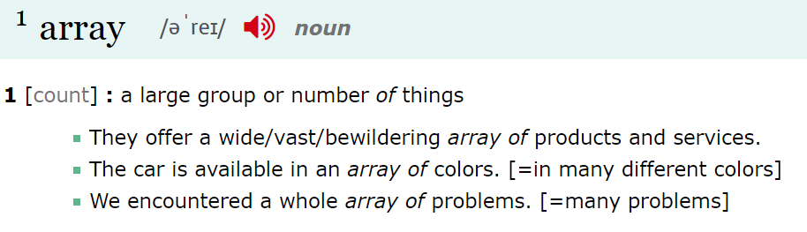
what is an array?
ENGLISH
JAVASCRIPT: an ordered list of values

Slide 3
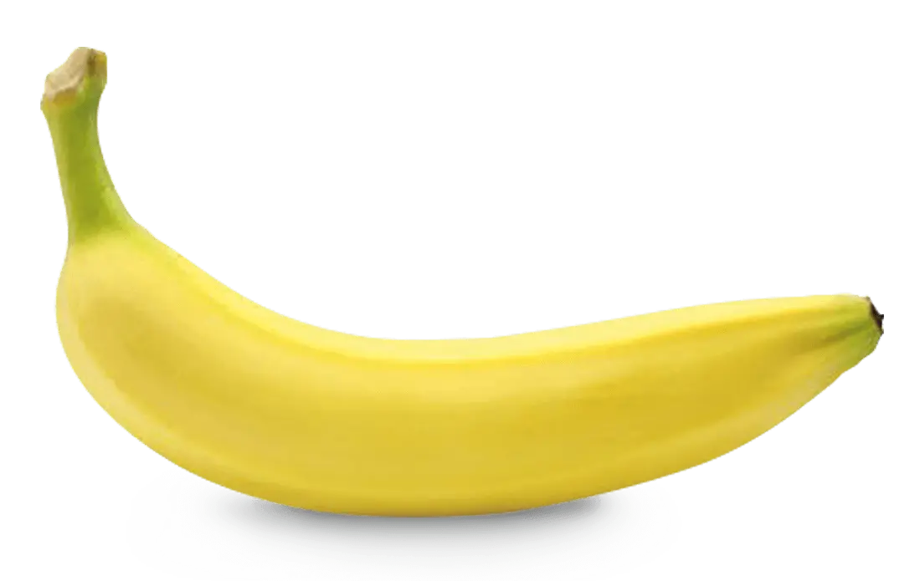
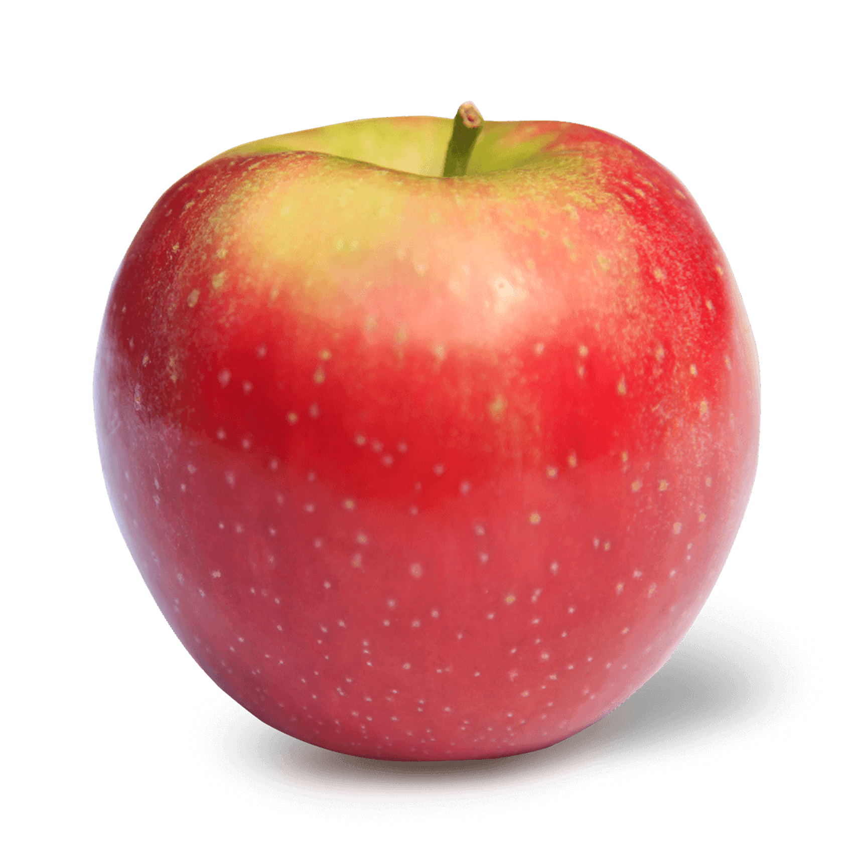
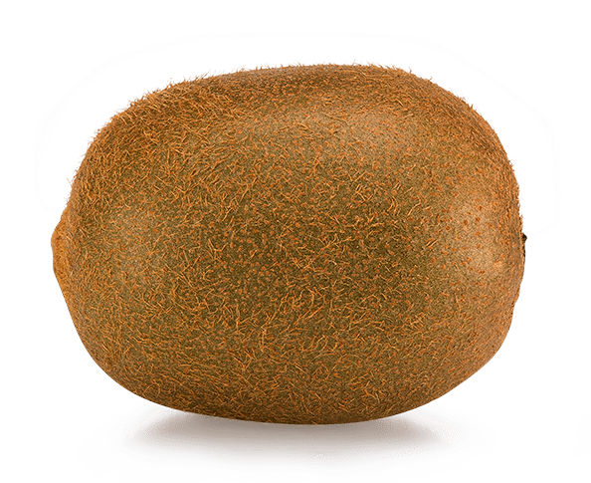
elements are zero-indexed
creating an array
let fruits = ["apple", "banana", "kiwi"]
let fruits = ["apple", "banana", "kiwi"]
0
2
1

Slide 4
accessing array values
let fruits = ["apple", "banana", "kiwi"]
let secondFruit = fruits[1];
alert(secondFruit); // banana

Slide 5
setting array values
let fruits = ["apple", "banana", "kiwi"]
fruits[1] = "pear";
"pear"

Slide 6
setting array values
"pear"
let fruits = ["apple", "banana", "kiwi"]
fruits[1] = "pear";
alert(fruits[1]); // pear

Slide 7
adding array values
let fruits = ["apple", "pear"]
"grape"
fruits.push("grape");

Slide 8
adding array values
"grape"
, "grape"];
let fruits = ["apple", "pear"]
fruits.push("grape");
alert(fruits[2]); // grape

Slide 9
let scores = [99, 80, 77, 65];
let count = scores.length;
alert(count); // 4
getting the length of an array

Slide 10
let scores = [99, 80, 77, 65];
for (let i = 0; i < scores.length; i++) {
let currentItem = scores[i];
alert(scores[i]);
}
looping through an array

Slide 11
arrays of the DOM
<div>
<p>DJ Khaled!! </p>
<p>Another one </p>
<p>Another one </p>
</div>
!
HTML
!
!
let paras = document.querySelectorAll("p");
for (let i = 0; i < paras.length; i++) {
let currentElement = paras[i];
currentElement.textContent += "!";
}
JS

Slide 12
THE END

