Slide 1
BOOLEANS

Slide 2
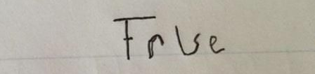
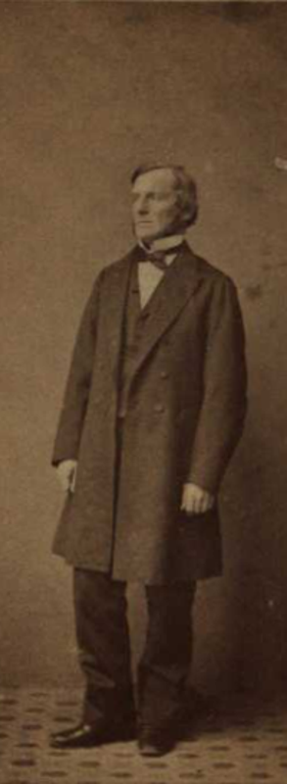
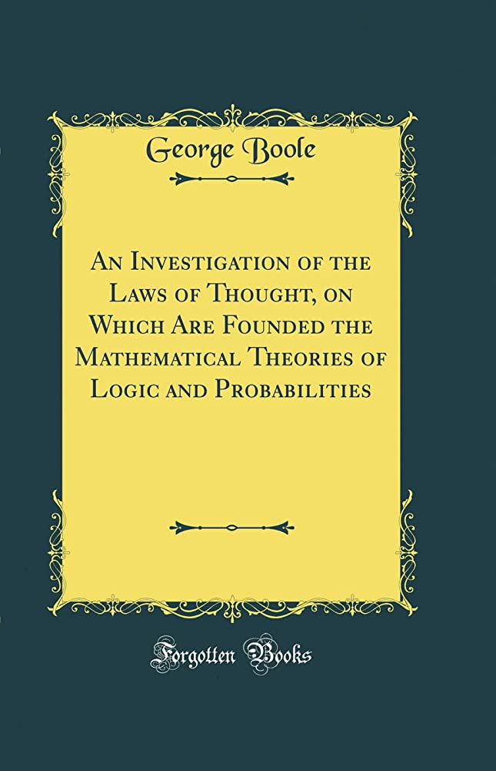
TRUE or FALSE
Examples
let darkModeOn = true;
let activeRecord = false;
let allowed = age > 16;
let answer = true;

Slide 3

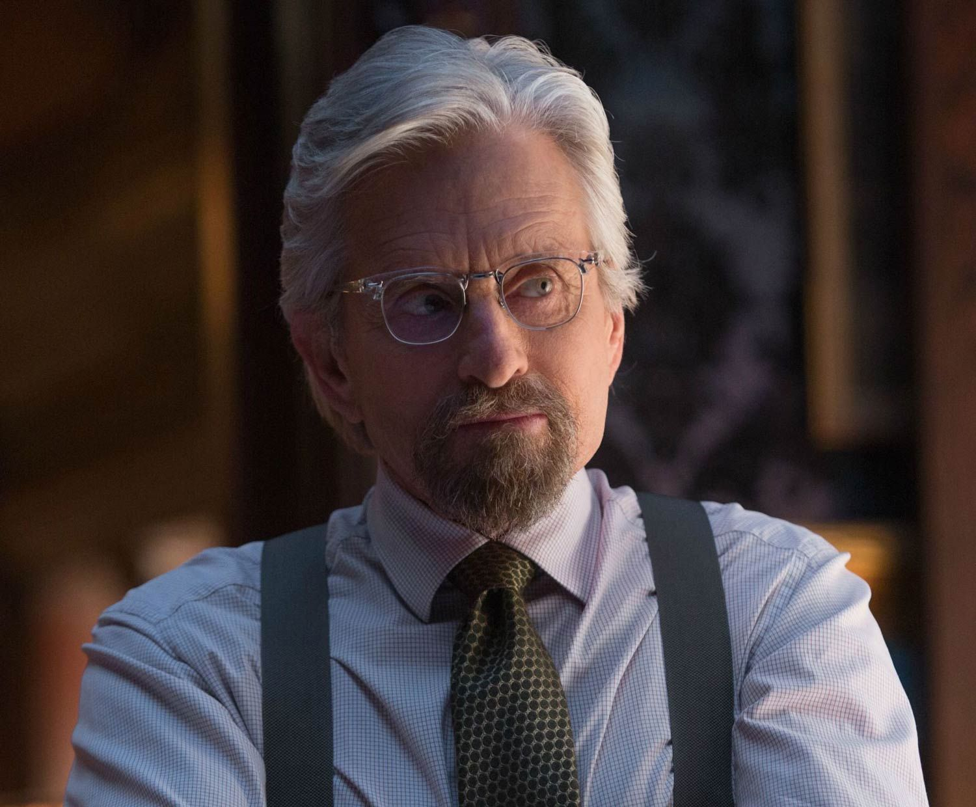
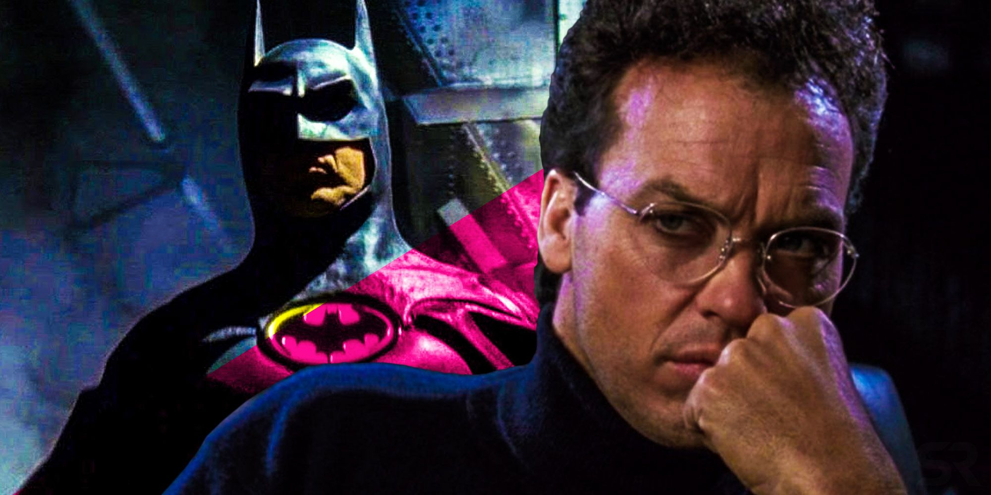

true/false trivia
Actor Michael Keaton’s real name is Michael Douglas
True
He changed it because no two actors can share a name in SAG
McDonald’s is the largest restaurant chain in the world
False
It’s Subway
Notes:
Have students vote on if they think these statements are true or false.
If students do not know who Michael Keaton is – he played Batman.
If students do not know who Michael Douglas is – he was in Ant-Man (and a lot of classic 80s movies)

Slide 4
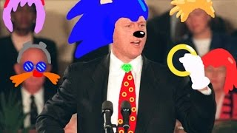
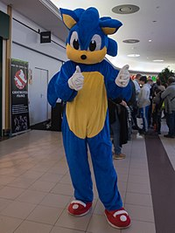
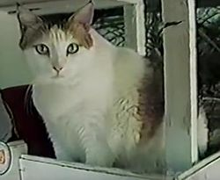
true/false trivia
The oldest domestic cat on record lived for 38 years
True – her name was Crème Puff and she lived in Austin, TX
Sonic the Hedgehog’s personality is inspired by Bill Clinton
True – the developers wanted him to be “cool”
Notes:
Have students vote on if they think these statements are true or false.

Slide 5
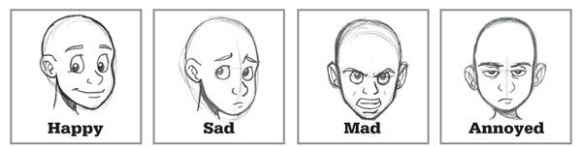
example expressions
5 > 4
2 <= 5
"Hi" === "Hey"
true && false
false || true
name !== "Mikle"
!false && true
1000 < 4000
"Ayy" === "Ayy"
height >= 58
10 === 5 + 5
1 === 1 && false
42 <= 42
"Just some text"
✅
✅
✅
✅
❌
❔
❌
✅
✅
❌
❔
✅
✅
✅

Slide 6
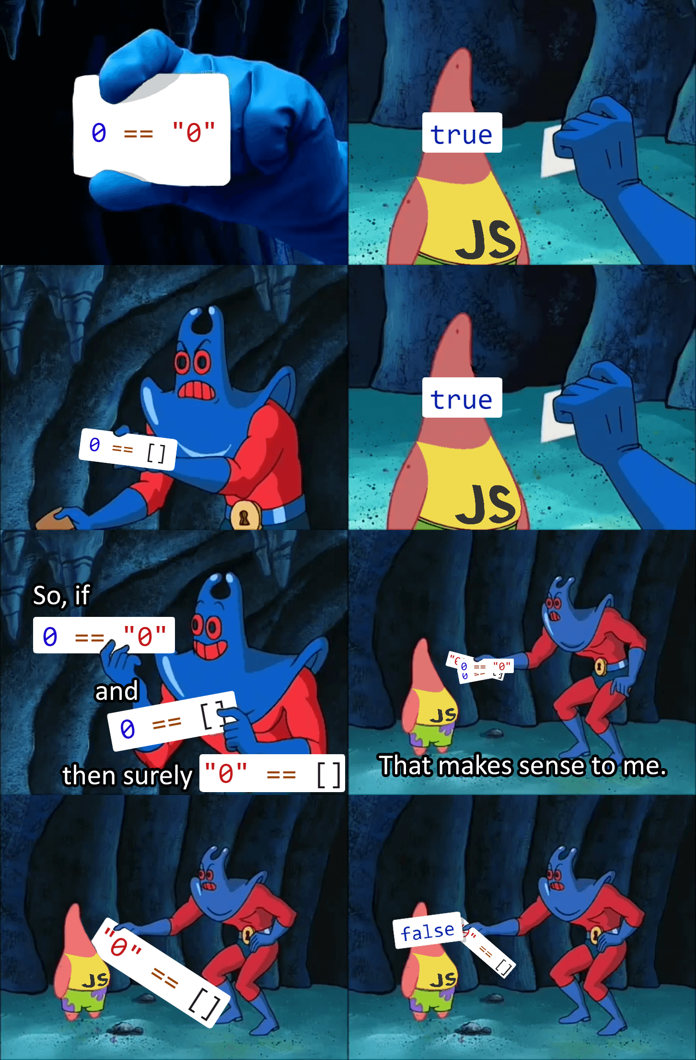

truthy and falsy
if (true)
if ({})
if ([])
if (42)
if ("0")
if ("false")
if (new Date())
if (-42)
if (12n)
if (3.14)
if (-3.14)
if (Infinity)
if (-Infinity)
if (false)
if (null)
if (undefined)
if (0)
if (-0)
if (0n)
if (NaN)
if ("")
if (1 && false)
alert(0 || "hi")
Notes:
Everything in JavaScript can be coalesced into a boolean.

Slide 7
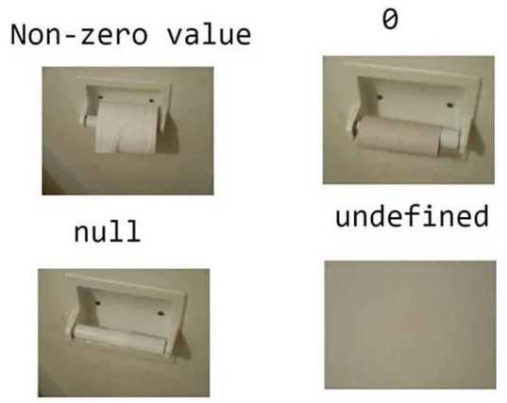
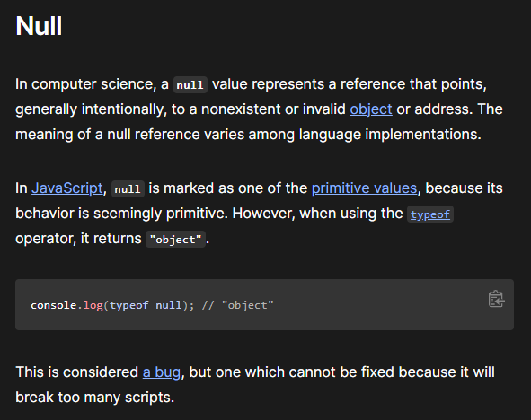
the null literal expresses a lack of identification, indicating that a variable points to no object.
the undefined property indicates that a variable has not been assigned a value, or not declared at all.
null and undefined
Notes:
Null and undefined are weird. You don’t need to know much about them, but they can be interesting to explore.

Slide 8
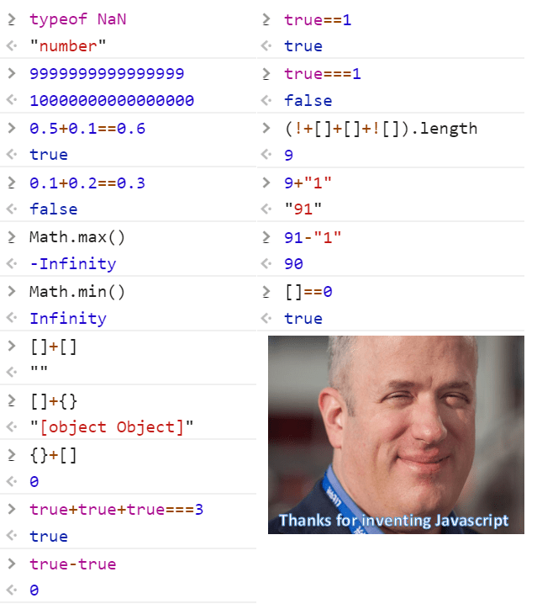
weird stuff

Slide 9
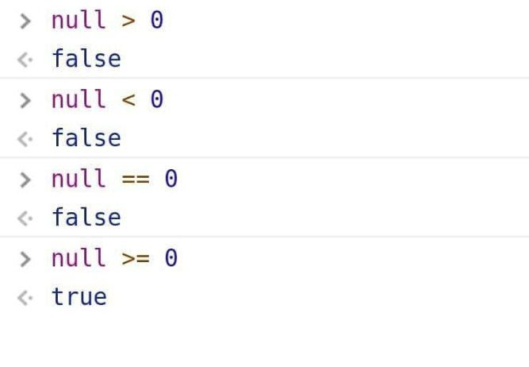
continued

Slide 10
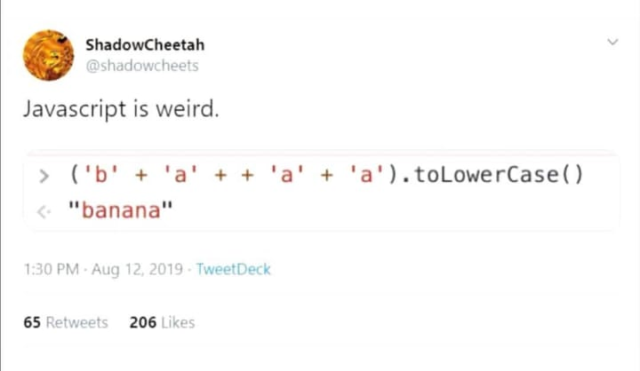
one more

Slide 11
THE END

