Slide 1
adding style to websites with css

Slide 2

ANALOGY
if html is the body, css is the clothing

Slide 3
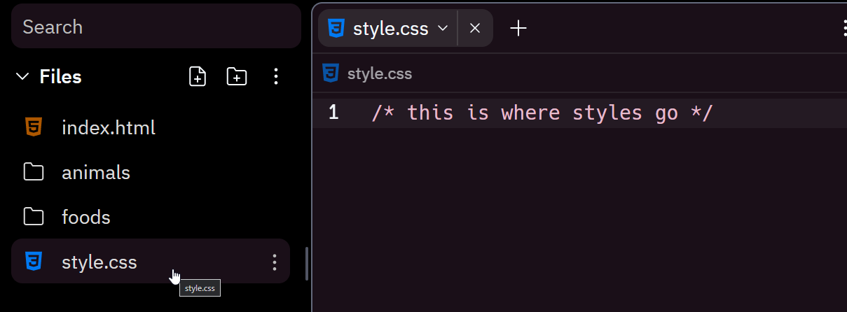
NOTE
css stands for cascading stylesheets
stylesheets
h1 {
color: pink;
}
css
<link rel="stylesheet" href="style.css">
html

Slide 4
vocabulary
ruleset
h1 {
font-size: 60px;
background-color: purple;
}
declaration
selector
property
value

Slide 5
THE END

