Slide 1
Buttons &&& Functions

Slide 2
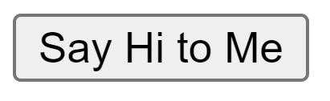
buttons in html
<button onclick="sayHi()">
Say Hi to Me
</button>

Slide 3
defining functions
function sayHi() {
alert("hi");
}
function sayHi() {
alert("hi");
}
function keyword
function name
parentheses
curly brackets (body)

Slide 4
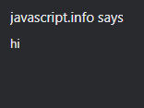
sayHi()
function name
parentheses
calling functions

Slide 5

parameters
function sayHi(name) {
alert("hi " + name);
}
sayHi("Anthony");
↑argument↑

Slide 6
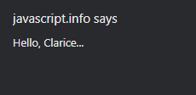
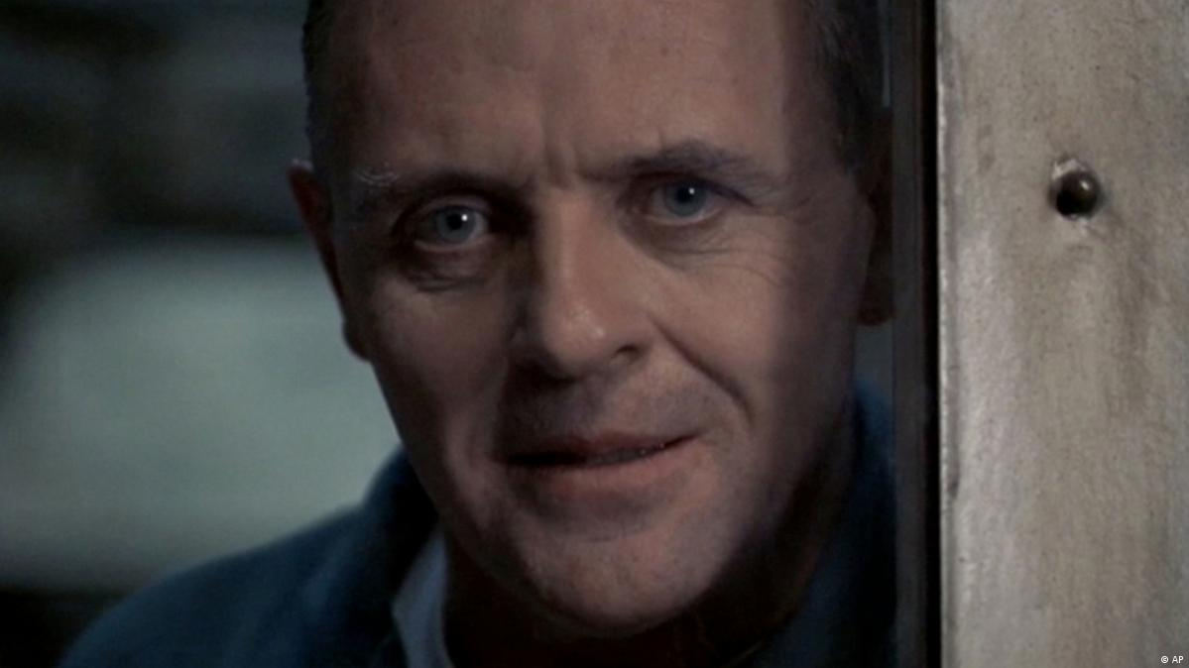
returns
function getMsg(name, greeting) {
return greeting + ", " + name + "...";
}
let response = getMsg("Clarice", "Hello");
alert(response);

Slide 7
THE END

