Slide 1
WEB SKILLUP
june 5-6, 2023
presented by the hyland tech outreach team
Notes:
Welcome slide – do introductions before jumping into the presentation.

Slide 2
thank you for being here.
Notes:
Thank you! We appreciate you taking the time to participate in this program.

Slide 3
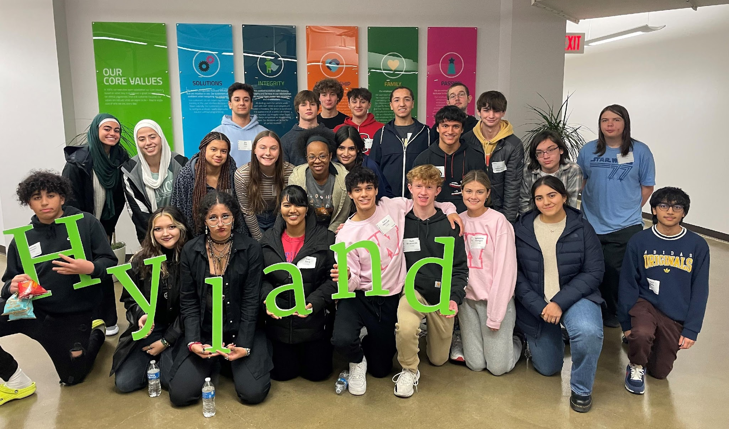
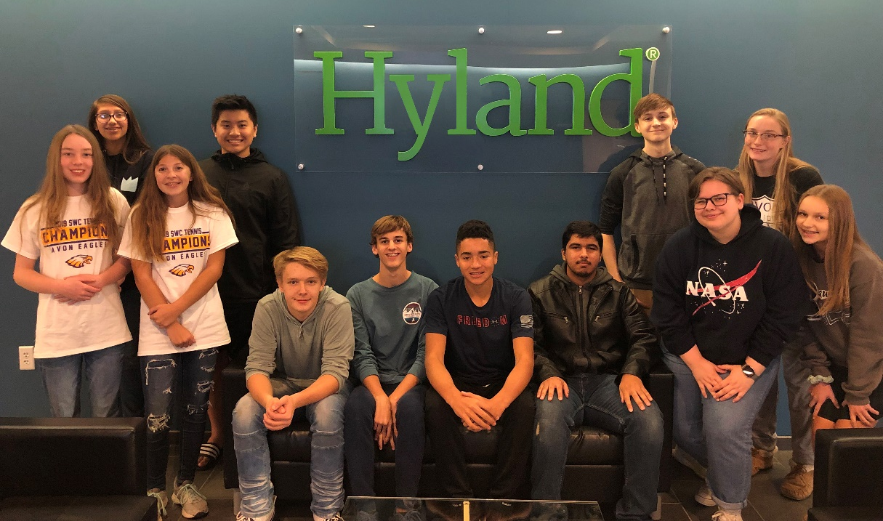
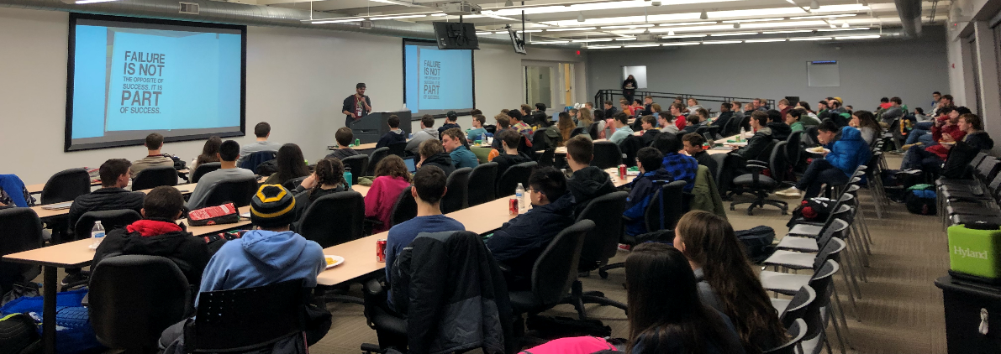
...provides a variety of programs that teach students computer science to support a future where technology skills are essential, while giving employees the opportunity to give back to the community
field trips
hy-tech club
hackathon
the tech outreach team
Notes:
We are here on behalf of the tech outreach team. Here’s a bit of background. Basically, we teach kids (and sometimes adults) how to code. And we’re going to do that for you!

Slide 4
what will we cover?
⏩
HTML/CSS
Conditionals
DOM Manipulation
JavaScript
Arrays
Variables & Data
For Loops
Functions
Objects
Notes:
What are we going to cover? All of these topics! We’ll start briefly with HTML & CSS, then move right into JavaScript. You may recognize some of these words, or maybe none of them, but by the end of this, you should be able to understand how all of them work.
This will be a crash course, so the pace will be quite quick; but the curriculum is designed to accommodate people with no experience whatsoever.

Slide 5
two approaches for each lesson
basic 🟢
designed to introduce the topic to a complete beginner, and work to ensure fundamental understanding
advanced 🔷
designed to enhance understanding of the topic, and provide further opportunities to explore
experience to value
Notes:
We know you all have different experience levels – but we believe that everybody here, regardless of experience, will be able to find some value in each lesson. There is a purposeful mix of experience in this group – so if you have more experience, this is a great opportunity to help your fellow participants who might have less experience! Strengthening your fundamental knowledge of programming can be quite valuable, and helping others learn is a great way to do that.
All that said, we have two approaches…
First, the basic approach. This is for folks who have never seen this before, and are just starting out. We’re going to make sure you walk away with a fundamental knowledge of these topics.
Next, the advanced approach. This will be for people who have already learned these concepts, but may want to dive a little deeper into more advanced concepts. So even if you aced the pre-program assessment, and you know everything there is to know about HTML, CSS, and JavaScript, we’ll try to show you some things you’ve never seen before.
We have quite a few topics to cover, so we will be moving fast. That said, please don’t hesitate to stop us if we need to review something. Speaking of things you should do…

Slide 6
our expectations for you
Participate
Ask Questions
Communicate Your Needs
Be Understanding
Learn
Notes:
We have some basic expectations for you.
Please, please, please participate. It will make the experience better for you, for us, for everybody.
Please ask questions. We don’t know what you don’t know, so don’t be afraid to speak up!
And make sure to communicate your needs. If you’re feeling bored, or feeling overwhelmed, or need a break, let us know!
We are going to try our best, but this is the first time we’ve ever done anything like this. Please bear with us as we go, and be flexible if we have to change things around!
Finally, we expect you to learn. That’s why you’re here! So how will that learning take place?

Slide 7
some pedagogical philosophy
training vs. teaching
children vs. adults
Notes:
Let’s get into a tiny bit of pedagogy – don’t worry if you don’t know what that is; it just means philosophy about teaching. Teaching!
We often refer to programs like this as “training,” but I like to think of them as “teaching.” those might be synonymous to most of you, but I think there is a key difference; training is all about showing you how to follow discrete steps to complete processes. Training shows you how to do something. To me, teaching is all about helping you learn how to think about these concepts, and discover solutions on your own. Web development requires creativity; you may have to do something no one has ever done before. To me, that is something that should be taught, not trained.
One other key point – the tech outreach team usually works with kids. This is quite a bit different… but is it really? Do you all like candy? Do you like having fun? I hope so, because there’s some “childlike” material in this program. Hopefully it’s all “childlike” and not “childish.” It has been a little bit adult-ified, but there may still be some remnants of kid-teaching throughout. Just wanted to give everybody a heads up ☺

Slide 8
WHY?
you have to be here
understanding these concepts will allow you to work with more hyland products
these skills will translate to many other arenas
the web may be quite important for the future
making websites is fun
Notes:
Now you might be wondering why you are here. Well…
You have to be here. But that’s not all.
These concepts will help you work with products like Nuxeo and Alfresco.
These skills will also translate to several different areas – and even if you already know them, it never hurts to practice and expand your knowledge.
The web is going to enable the future – technologies like cloud, ai, and vr may be surfaced through the web.
And finally, making websites is fun. I really believe that, and I hope that you have a lot of fun with this program!

Slide 9
THE END
questions?
Notes:
That’s it, anyone have any questions?

