Slide 1
JSON

Slide 2

JSON
{
"name": "Nuggets",
"city": "Denver",
"players": [
"Nikola",
"Jamal",
"Michael"
]
}
ava
cript
bject
otation

Slide 3
quick facts
JSON is a lightweight data-interchange format. JSON data is stored in .json files. Object property names (keys) must be strings. JavaScript can easily convert JSON text into JavaScript objects, and convert JavaScript objects into JSON text as well. Many databases and APIs use the JSON format to send and receive data through the web.

Slide 4
quick facts
JSON is a lightweight data-interchange format. JSON data is stored in .json files. Object property names (keys) must be strings. JavaScript can easily convert JSON text into JavaScript objects, and convert JavaScript objects into JSON text as well. Many databases and APIs use the JSON format to send and receive data through the web.

Slide 5
quick facts
JSON is a lightweight data-interchange format. JSON data is stored in .json files. Object property names (keys) must be strings. JavaScript can easily convert JSON text into JavaScript objects, and convert JavaScript objects into JSON text as well. Many databases and APIs use the JSON format to send and receive data through the web.

Slide 6
quick facts
JSON is a lightweight data-interchange format. JSON data is stored in .json files. Object property names (keys) must be strings. JavaScript can easily convert JSON text into JavaScript objects, and convert JavaScript objects into JSON text as well. Many databases and APIs use the JSON format to send and receive data through the web.

Slide 7
quick facts
JSON is a lightweight data-interchange format. JSON data is stored in .json files. Object property names (keys) must be strings. JavaScript can easily convert JSON text into JavaScript objects, and convert JavaScript objects into JSON text as well. Many databases and APIs use the JSON format to send and receive data through the web.

Slide 8
working with json
let merch = ["shirt", "hat", "socks"];
JSON.stringify(merch);
text in JSON format
let txt = `["shirt", "socks", "hat"]`;
let arr = JSON.parse(txt);
a JavaScript array

Slide 9
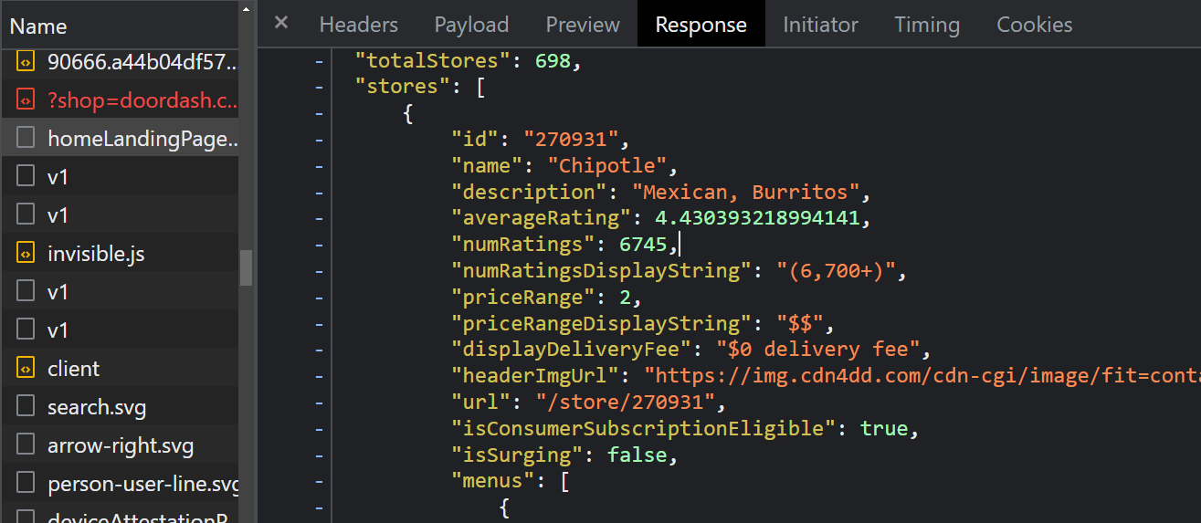
a real example

Slide 10
THE END

