Slide 1
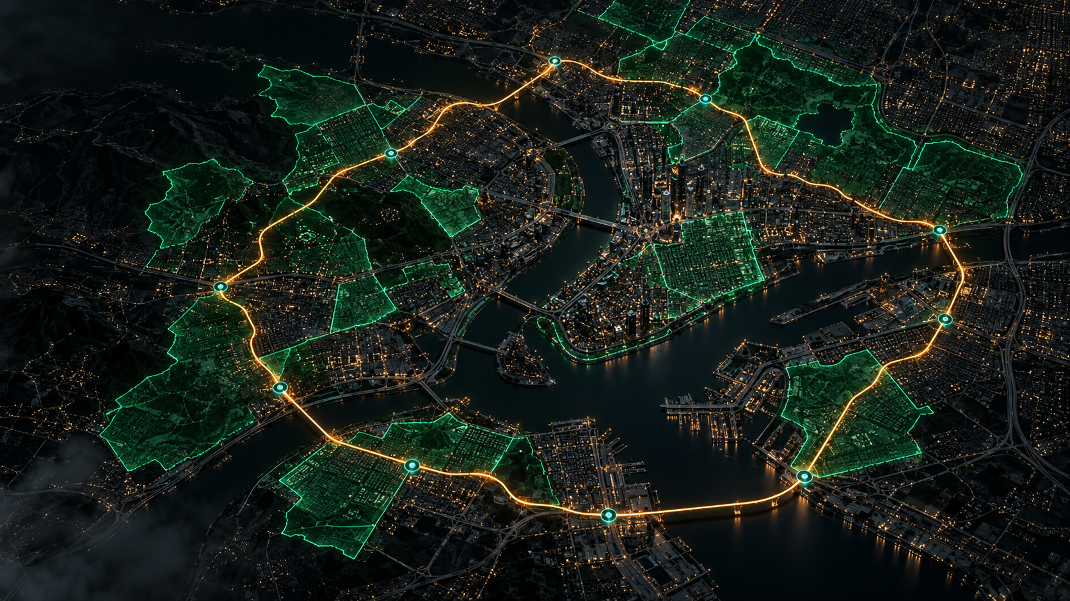
INVESTOR PITCH / 2026
DON'T STOP
A territory capture fitness platform that turns the city into a live game board
PRE-SEED • $50,000 • WORKING WEB ENGINE

Slide 2
DON'T STOP / INVESTOR DECK
02
The problem and the opening
PROBLEM
OPPORTUNITY
01
Fitness trackers measure activity, but they do not turn daily movement into a team game.
CAPTURE
A closed walking or running route captures the enclosed territory on the live map.
02
Most users exercise alone. Local rivalry and a shared objective are missing.
GUILDS
Guilds of up to 10 players compete through rankings and weekly territory events.
03
Mobile players want real-world progress, while deep guild mechanics remain uncommon.
PLATFORM
One platform connects fitness, social play and local brand activations.

Slide 3
DON'T STOP / INVESTOR DECK
03
How the product works
1 ROUTE
2 TERRITORY
3 GUILD
GPS validates the closed loop and calculates the remaining connection gap.
The area inside a verified route becomes captured ground on the map.
Teams defend territory and earn points in a weekly leaderboard.
+1
GPS • POSTGIS • MAPLIBRE GL

Slide 4
DON'T STOP / INVESTOR DECK
04
Why users come back
WEEKLY LOOP
TEAM MOTIVATION
Territory competition creates a fresh objective
Guild performance depends on member activity
PERSONAL IDENTITY
SAFETY
Emblems, avatars and map effects signal status
200 m privacy radius and teleport detection

Slide 5
DON'T STOP / INVESTOR DECK
05
Revenue model
01
02
03
04
BATTLE PASS
MICROTRANSACTIONS
BRAND PARTNERSHIPS
B2B ANALYTICS
Trail effects, emblems and map themes
$4.99 / month
Avatars, guild tokens and name changes
$0.99–$9.99
Sponsored zones and tournaments
$2K–$10K / event
Anonymized urban activity insights
Post-pilot opportunity

Slide 6
DON'T STOP / INVESTOR DECK
06
Three-year growth plan
3 MONTHS
6 MONTHS
1 YEAR
2 YEARS
3 YEARS
Pilot
Regional test
Multi-country
Expansion
Ecosystem
Nukus and Tashkent
Samarkand, Almaty, Shymkent
Istanbul, Astana, Baku
MENA and Eastern Europe
Global B2B sponsors
15K users*
75K users*
300K users*
1.2M users*
$4M+ annual revenue*
* Targets, not actual results. Updated after pilot evidence.

Slide 7
DON'T STOP / INVESTOR DECK
07
Use of $50,000 investment
BACKEND AND SPATIAL API
$12K
24%
$50,000 PRE-SEED
FRONTEND AND MOBILE
$10K
20%
✓ 12-month runway
✓ Android APK/AAB release
✓ Five core roles
✓ Server and map infrastructure
✓ Campus and influencer pilots
GAME / SPATIAL ENGINEERING
$10K
20%
BRAND AND DESIGN
$6K
12%
MARKETING AND COMMUNITY
$7K
14%
SERVERS, LEGAL, CONTINGENCY
$5K
10%

Slide 8
DON'T STOP / INVESTOR DECK
08
A working technology foundation
WORKING WEB ENGINE
105 AUTOMATED TESTS
MOBILE PIPELINE
FastAPI + PostGIS + MapLibre GL
Unit and integration coverage
React + Vite + Capacitor
ANTI-CHEAT AND PRIVACY
FIVE LANGUAGES
Teleport detection, 200 m radius
QQ, UZ, KK, TR, EN

Slide 9
The city becomes the game
We turn walking and running into a city-scale team game.
$50,000 PRE-SEED
WEB ENGINE READY • MOBILE PILOT IS NEXT

