Slide 1

Chapter Eleven:
Taxes and Tax Policy

Slide 2
Economic Theory and Taxes

Slide 3
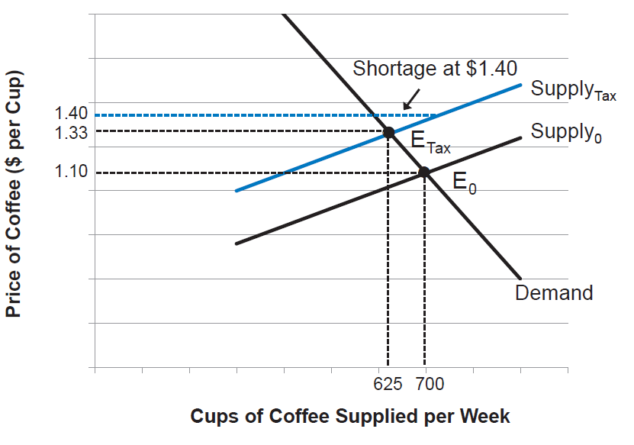
Figure 11.1: The Impact of a Tax on the Market for Cups of Coffee
Notes:
An excise tax on a product results in a higher price and a lower quantity sold.

Slide 4
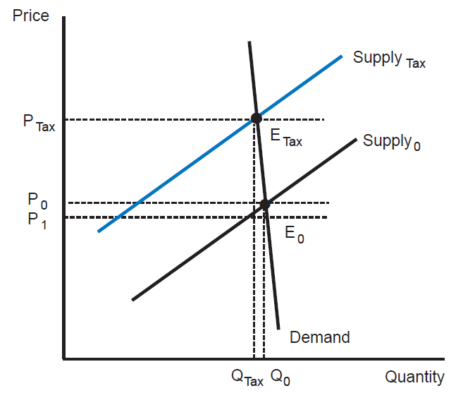
Figure 11.2: The Impact of an Excise Tax with an Inelastic Demand Curve
Notes:
When demand is highly inelastic, most of the burden of an excise tax will fall on consumers. In other words, producers will be able to pass on most of the cost of the tax by raising price.

Slide 5
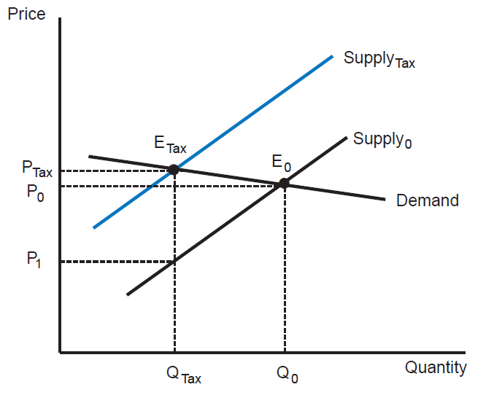
Figure 11.3: The Impact of an Excise Tax with an Elastic Demand Curve
Notes:
When demand is highly elastic, most of the burden of an excise tax will fall on producers. Price will rise slightly, but the quantity sold will decline significantly.

Slide 6
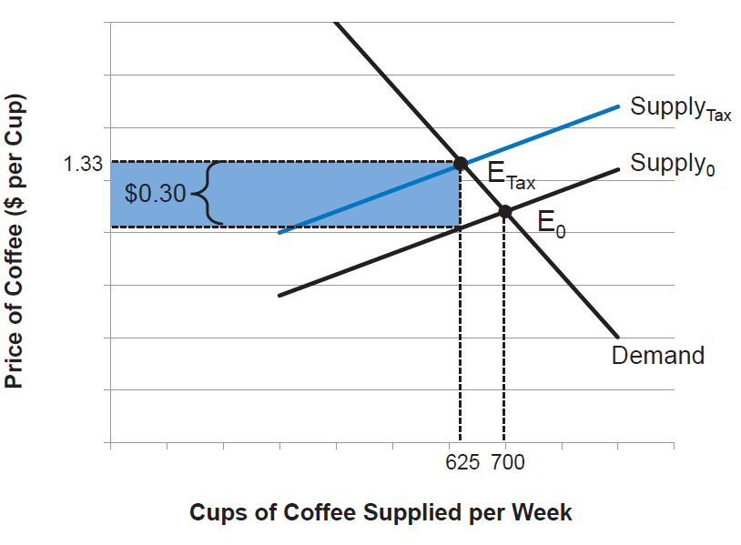
Figure 11.4: Tax Revenues from a Tax on Cups of Coffee
Notes:
We can represent the revenue from an excise tax as the shaded area in the graph.

Slide 7
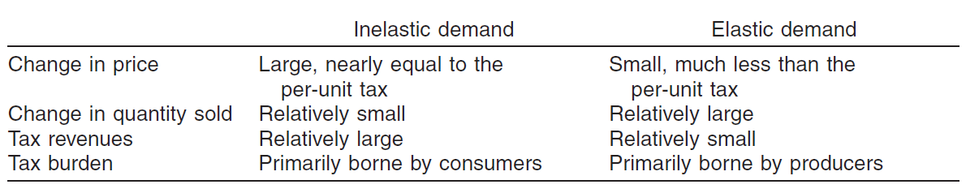
Table 11.1: Summary of Excise Tax Impacts for Products with Elastic and Inelastic Demand Curves

Slide 8
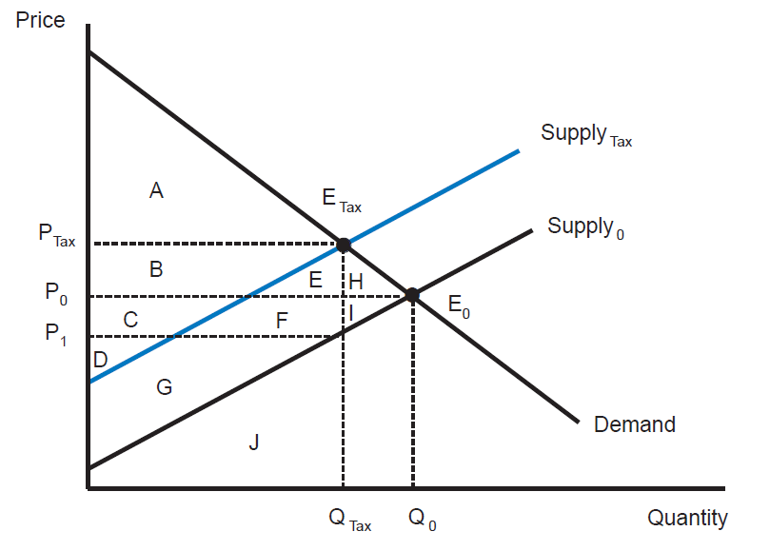
Figure 11.5: Welfare Analysis of an Excise Tax
Notes:
An excise tax in a market results in a deadweight loss equal to areas H and I.

Slide 9
The Structure of Taxation in the United States

Slide 10
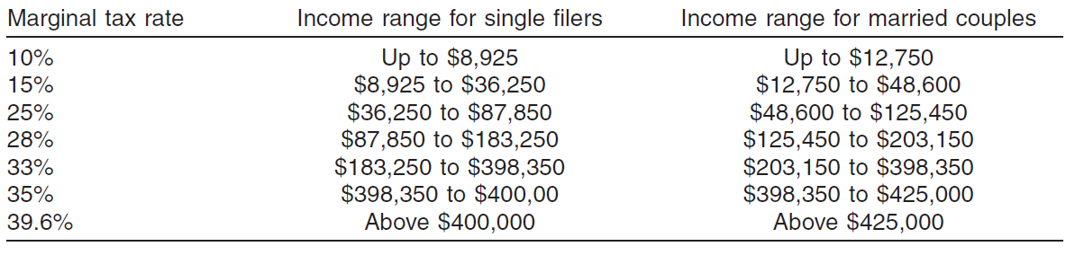
Table 11.2: U.S. Federal Marginal Tax Rates, 2013

Slide 11
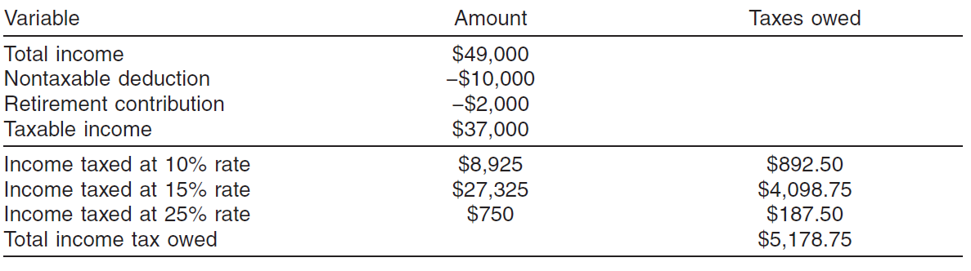
Table 11.3: Susan’s Federal Income Tax Calculations

Slide 12
Tax Analysis and Policy Issues

Slide 13
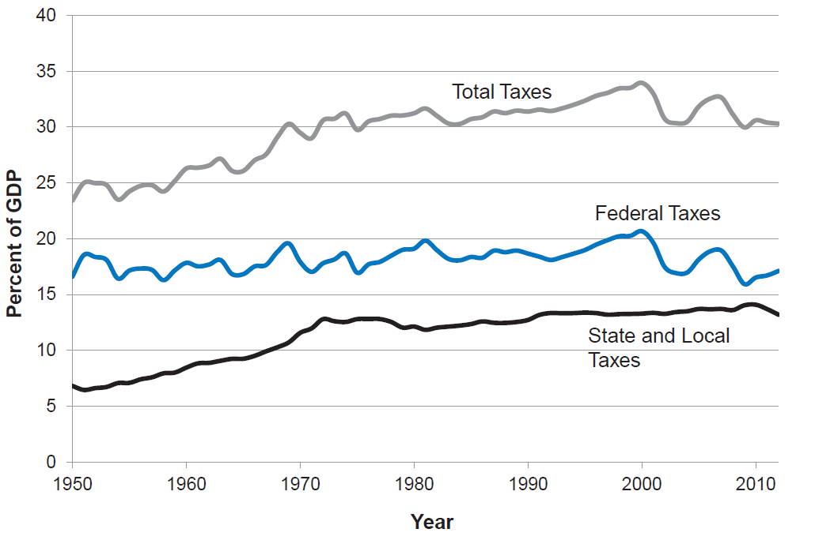
Figure 11.6: Tax Receipts in the United States, as a Percent of GDP, 1950-2012
Source: U.S. Bureau of Economic Analysis, online database.
Notes:
Total tax receipts in the U.S. as a share of GDP have generally increased since the 1950s, but have declined in recent years.

Slide 14
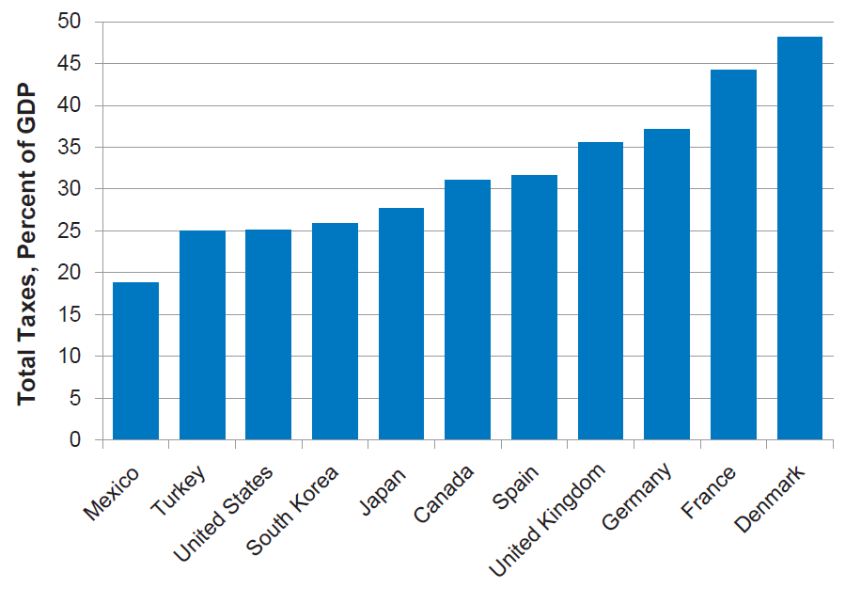
Figure 11.7: International Comparisons of Overall Tax Receipts, 2011
Source: Organisation for Economic Co-operation and Development, online tax statistics database.
Notes:
The United States has a relatively low overall rate of taxation compared to other industrialized countries.

Slide 15
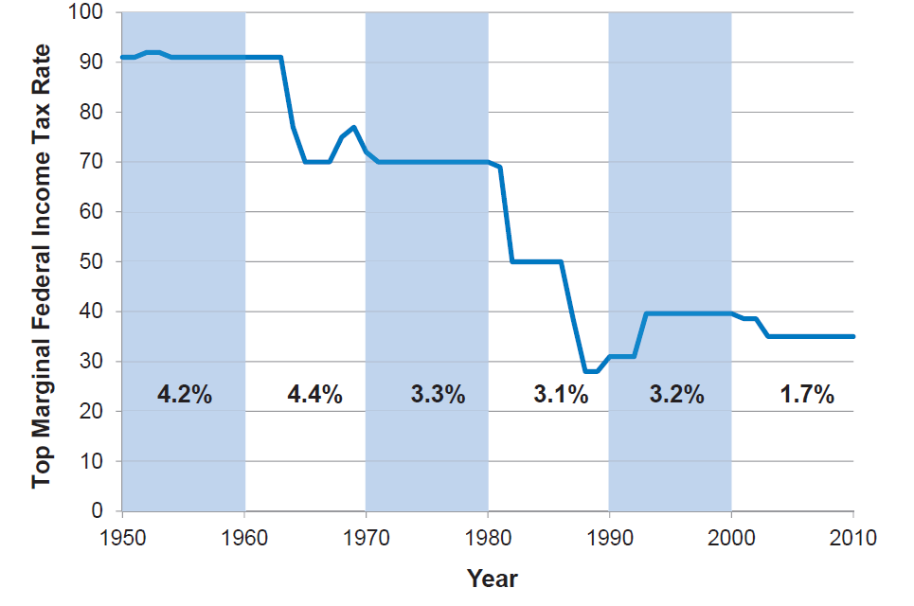
Figure 11.8: The Top Marginal Federal Tax Rate and Average Economic Growth, 1950-2010
(Average Economic Growth Shown by Decade as a Percentage)
Source: Sarah Anderson, “Full Testimony to the Senate Budget Committee on Inequality, Mobility, and Opportunity,” Institute for Policy Studies, February 8, 2012.
Notes:
The graph indicates that lowering the top marginal federal income tax rate does not seem to be correlated with higher economic growth.

Slide 16
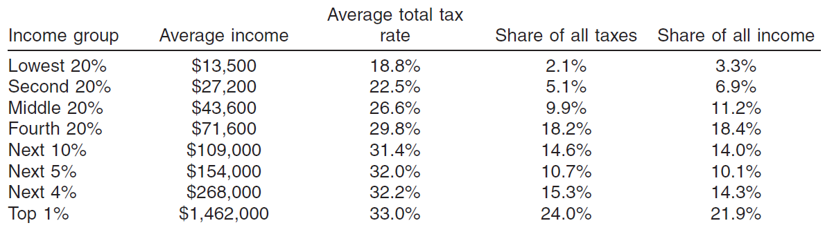
Table 11.4: The Distribution of Taxes in the United States, 2013
Source: Citizens for Tax Justice, “New Tax Laws in Effect in 2013 Have Modest Progressive Impact,” April 2, 2013.

