Slide 1
Fracture spacing optimization with an analytic heat-extraction surrogate
The Gringarten multiple-parallel-fracture model as a 100-microsecond objective inside a dfnWorks workflow
pydfnworks.thermal · branch feature/thermal-mpf-surrogate
Jeffrey Hyman, EES-16, Los Alamos National Laboratory · November 2026

Slide 2
One interface, two backends
The question. How far apart should hydraulic fractures be spaced to maximize heat extracted from a FORGE-type enhanced geothermal reservoir?
The design. An optimizer calls heat_extraction(spacing, ṁ, T_res, T_inj, rock, fluid, n, H, t) → Q̇(t). Two backends implement it:
Phase 1 Gringarten et al. (1975) multiple parallel fractures, inverted from the Laplace domain. Done, verified, ~100 μs per call.
Phase 2 dfnWorks graph transport with thermal TDRW parameters. Interface and parameter mapping in place; kernel deferred.
Why a surrogate first. The optimizer needs thousands of evaluations; a particle run costs seconds to minutes. The surrogate sets the interface and the baseline the DFN backend must beat.
n parallel fractures, spacing D, in an infinite rock mass
T_out
H
T_inj in
← D →
Each fracture draws on a slab of half-thickness D/2 by conduction normal to its plane; the slab mid-plane is insulated by symmetry. Equal flow in every fracture.
pydfnworks.thermal · dfnWorks, Los Alamos National Laboratory

Slide 3
The surrogate: Laplace solution and dimensionless groups
Outlet drawdown, Laplace domain (Gringarten et al. 1975, Eq. A17)
T̄_wD(s) = (1/s) · exp[ −√s · tanh(β√s) ] T_wD = (T_res − T_out) / (T_res − T_inj), t_D = t / t_s
Spacing parameter
β = (ρc)_f Q_f D / (4 k w H)
Time scale
t_s = 4 k (ρc)_r (wH)² / [ (ρc)_f Q_f ]²
Heat rate
Q̇(t) = ṁ c_f (T_res − T_inj) [ 1 − T_wD(t/t_s; β) ]
Q_f = ṁ / (ρ_f n) is the flow per fracture; H, w the fracture height (flow direction) and width; k, (ρc)_r rock conductivity and heat capacity.
Two limits anchor the model
β → ∞ (wide spacing) semi-infinite single fracture,
T_wD = erfc( 1 / 2√t_D ) (Lauwerier 1955; Bödvarsson & Tsang 1982)
β → 0 (close spacing) a step at t_D = β: piston displacement of the slab,
t_piston = β t_s = (ρc)_r n D w H / [ (ρc)_f ṁ/ρ_f ]
the heat stored in the n slabs divided by the heat-capacity flow of the water. Both limits are closed-form checks on the numerical inversion.
pydfnworks.thermal · dfnWorks, Los Alamos National Laboratory

Slide 4
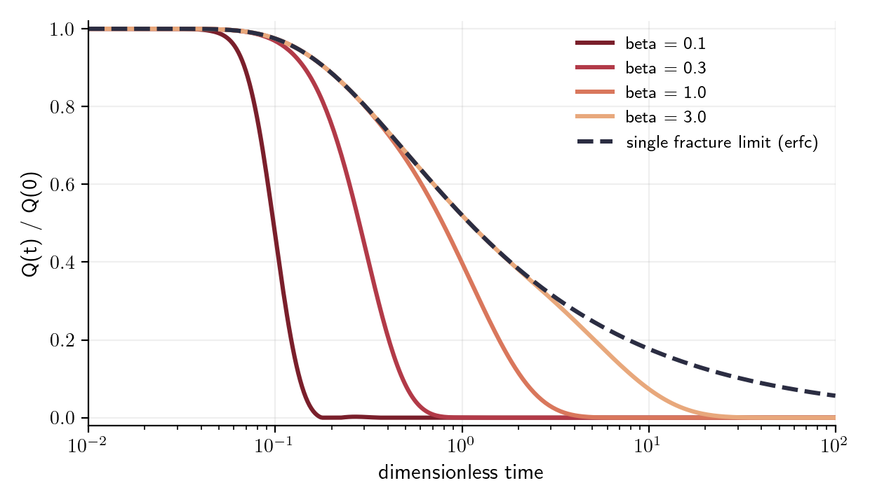
Inverted in double precision, verified four independent ways
Check | Reference | Result
Wide spacing, β = 3·10⁵ | erfc closed form | max error 6·10⁻⁶
Close spacing, β = 0.6 and 1.4 | energy balance, heat in slabs | 1.0001 and 0.9988
β = 0.5, 1.5, 6 | GEOPHIRES-X mpmath Stehfest | ≤ 1·10⁻⁴
Finite spacing, β = 1 | finite-difference solution of the PDEs | 9·10⁻³ → 5·10⁻³ on refinement
Close vs wide, same flow | physics | never more heat; 75 % drawdown at 51 vs 123 d
Gaver-Stehfest inversion, 18 terms, vectorized over time:
T_wD(t_D) ≈ (ln2/t_D) Σ_i V_i · T̄_wD(i ln2 / t_D). Shares the routine already used by the dfnWorks TDRW slab models. 361-point curve in ~100 μs; GEOPHIRES-X's mpmath route takes ~1 s.
No closed form exists at finite β, so the general case is checked against a finite-difference solution of the slab conduction and fracture advection equations that never sees the Laplace transform. The erfc limit, the energy balance and the finite-difference run together cover the whole β range.
pydfnworks.thermal · dfnWorks, Los Alamos National Laboratory

Slide 5
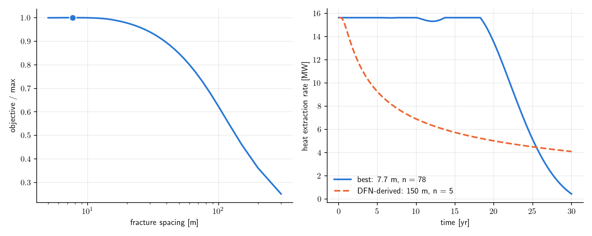
Workflow: DFN geometry in, surrogate objective out
1
Generate
FORGE-representative DFN: 600 m granitoid block, a set parallel to the hydraulic fractures and a natural set
2
Wells
Injection and production laterals placed with the well package; fractures each cuts are listed
3
Geometry
n = fractures cut by the injector, H = their mean diameter, L = lateral length. Here n = 5, H = 219 m, L = 600 m
Read the result. Left: 30-year heat vs spacing for stages filling the lateral, best at the closest allowed spacing (7.7 m, 78 stages, 11.6 PJ). Right: the heat rate at that spacing holds 15.6 MW for 18 years and then collapses as the slabs deplete, while the DFN-implied 150 m spacing (5 fractures, 6.4 PJ) declines from day one.
Same optimizer, other backend. Pointing heat_extraction at the DFN backend changes one argument; it raises NotImplementedError until the kernel lands.
4
Optimize
optimize_spacing() over candidates L/n, objective = 30-year cumulative heat, 20 kg/s, 226 °C reservoir, 40 °C injection
pydfnworks.thermal · dfnWorks, Los Alamos National Laboratory

Slide 6
What the surrogate says, and what Phase 2 has to add
Objectives are monotone in spacing
Heat is a solute with new coefficients
The slab sampler cannot be reused as is
At fixed flow and fixed rock volume the piston time t_p = (ρc)_r L w H / [(ρc)_f ṁ/ρ_f] does not depend on D, so the closest spacing always wins; at fixed fracture count the widest does. An interior optimum needs a cost per stage or the DFN flow partition.
φ_m → (ρc)_r/(ρc)_f = 0.52 and D_m → k/(ρc)_r = 1.4·10⁻⁶ m²/s turn run_graph_transport() into a thermal run. The infinite-matrix model handles 10⁴ particles in 2 s.
Event-by-event trapping at rate 2φ_m D_m/(b ε B) is 10⁷ times faster for heat than for a solute: minutes per particle. Phase 2 draws the whole slab retention time per edge from the finite-slab kernel instead.
Next: per-edge finite-slab kernel and the arrival-time → Q̇(t) conversion (Shook 2001), then the same optimizer with the DFN backend.
pydfnworks.thermal · dfnWorks, Los Alamos National Laboratory

