Slide 1

Basic details of the Team And Problem Statement :
Problem Statement ID - 1631
Problem Statement Title - AI-Powered Student Assistance Chatbot for Department of Technical Education, Government of Rajasthan.
Theme - Smart Education
PS Category - Software
Team Name - Tech Divas

Slide 2
IDEA / APPROACH DETAILS :
Chat Campus is AI-Powered Student Assistance Chatbot for Department of Technical Education
Chat Campus Provides :
Admission process and eligibility criteria
Information about engineering and polytechnic colleges
Fee structure
Curriculum and available courses
Scholarship details
Hostel facilities
Previous year's allotment and cutoff data
Placement opportunities
Voice-based assistance
User-friendly, intuitive interface
24/7 availability
Automated responses to FAQs
Data collection for insights and service optimization

Slide 3
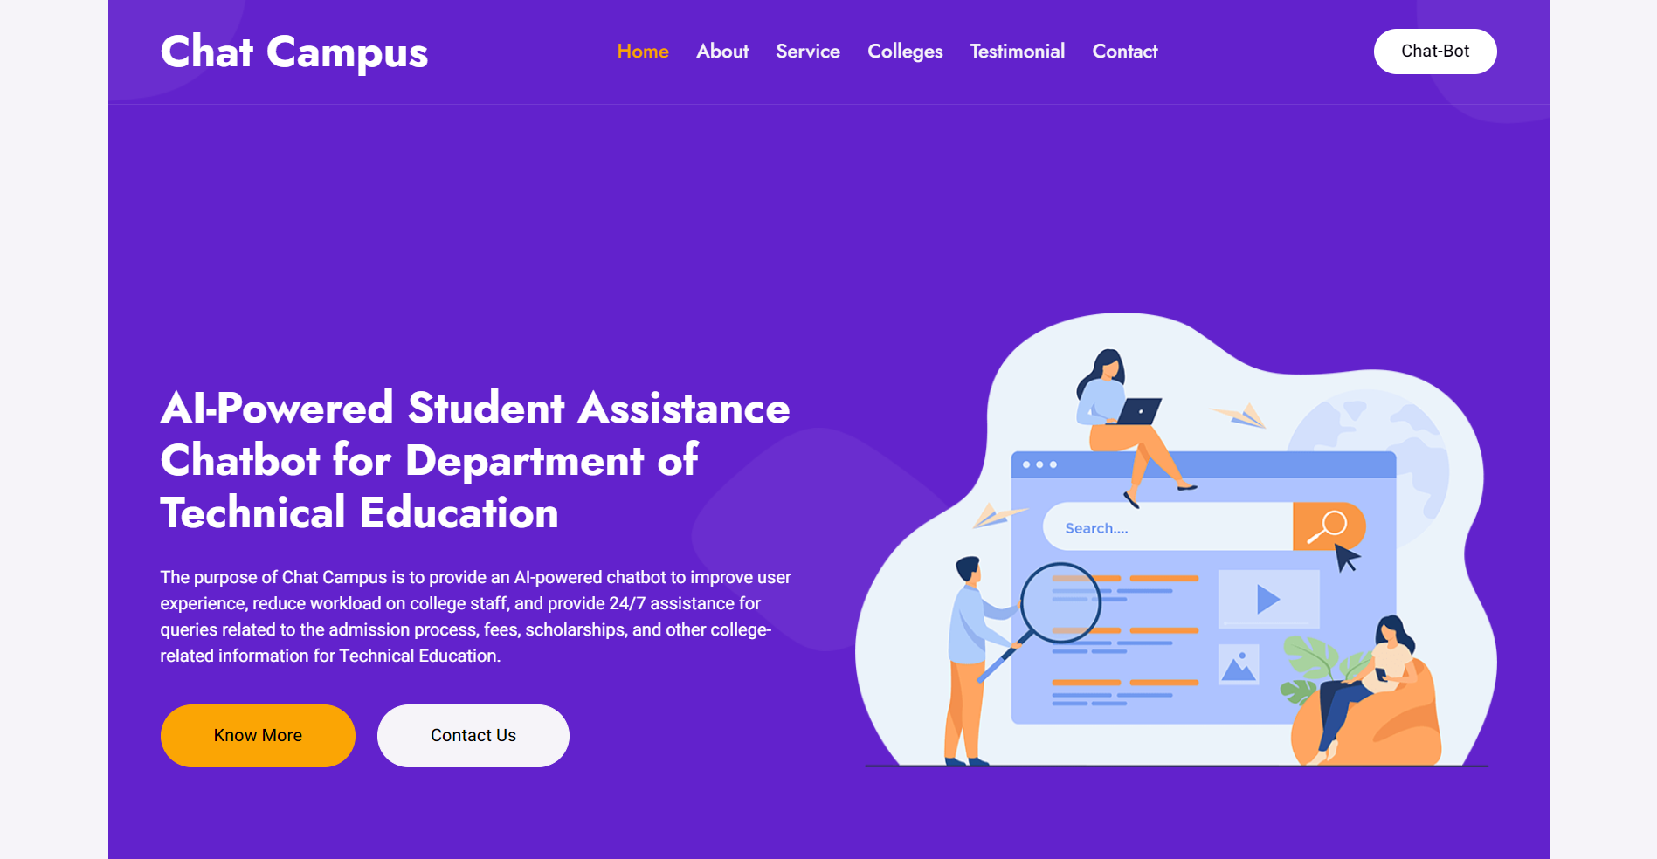
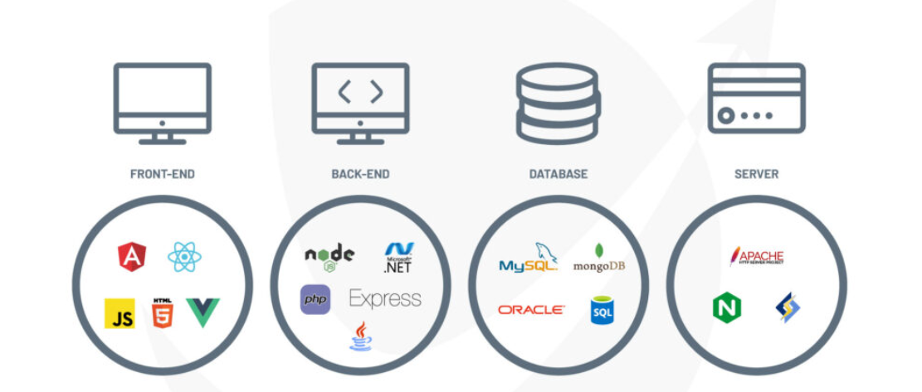
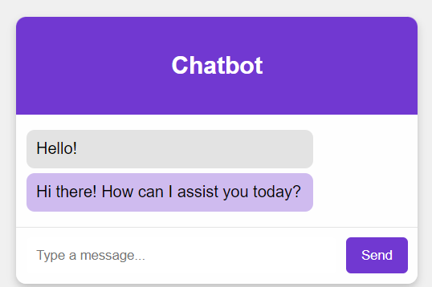
TECHNICAL APPROACH :
Chat Campus is Developed By Using this Technology Stack

Slide 4
FEASIBILITY AND VIABILITY :
Feasibility Key Points: | Viability Key Points:
Availability of AI and NLP technologies for chatbot development. | High demand for timely information during peak admission periods.
Reduction in human resource needs through automation. | Scalable to handle increasing inquiries 24/7.
Centralized integration of college information databases. | Wide user adoption due to intuitive interface and multilingual support.
Cost-effective with long-term savings on staffing. | Reduces workload for staff, improving operational efficiency.
Accessible across platforms with future support for regional languages. | Sustainable through data-driven insights for continuous improvement.

Slide 5
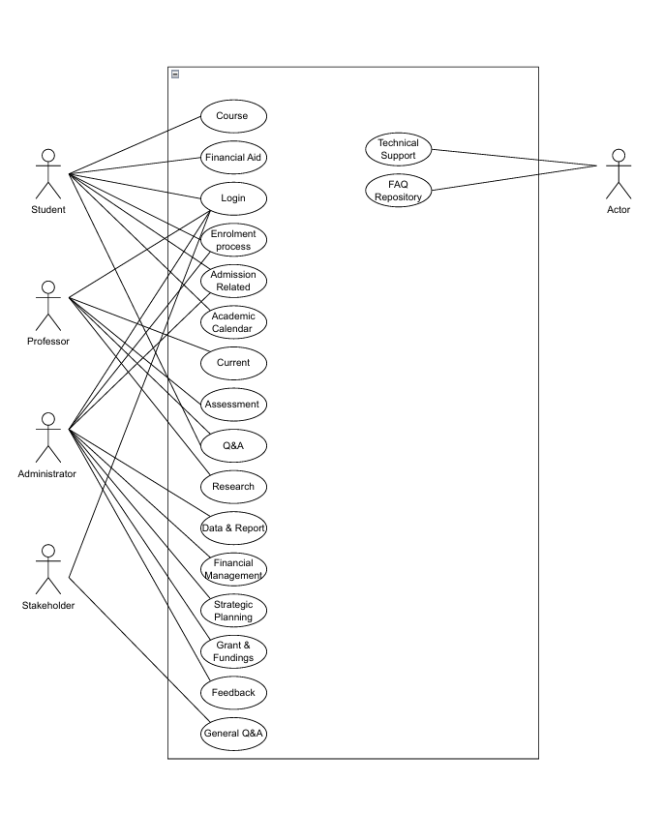
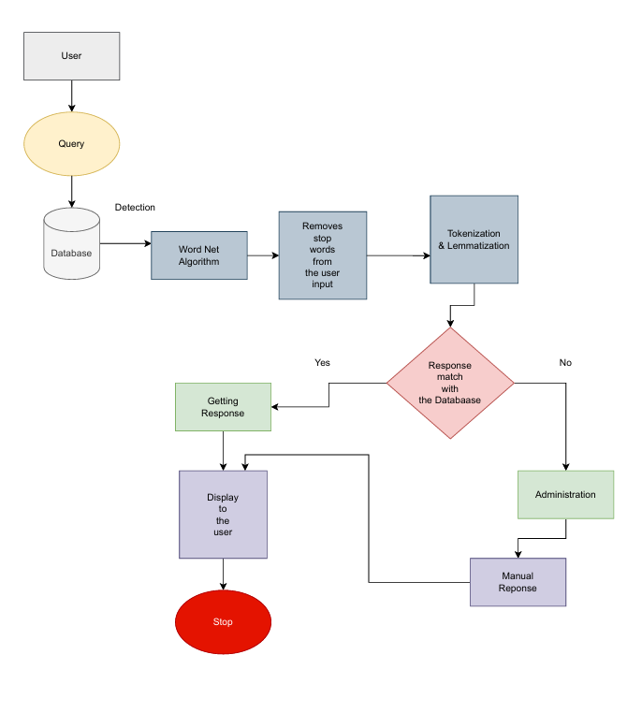
IMPACT AND BENEFITS :
Use Case Diagram :
Er Diagram :
Benefits :
Automation.
Efficiency.
Support.
Engagement.
Insight.
Guidance.
Navigation.
Interaction.
Convenience.
Accessibility.

Slide 6
Team Members and Links :
P Hymavathi ( Team Leader )
V Sai Saranya
K Devi
G Nikhila
P Mounika
V Sravanthi
Project Video Link : Click Here
Website : Click here
(Complete Front-end)
Git Repo : Click Here

