Slide 1
Heart Attack Prediction
CAPSTONE PROJECT
Presented By:
1. Hymavathi Peddimudi - Vsm College Of Engineering - CSM

Slide 2

OUTLINE
Problem Statement
Proposed System/Solution
System Development Approach
Algorithm & Deployment
Result
Conclusion
Future Scope
References

Slide 3
Problem Statement
Predicting heart attacks accurately is essential to reducing mortality and enhancing patient care. Predictive techniques used today frequently lack early detection and accuracy. Artificial Intelligence (AI) presents a promising means of improving forecast accuracy through multidimensional, complicated data analysis. To improve overall cardiovascular health management, lower death rates, and provide timely therapies, it is imperative to develop strong AI models for heart attack prediction.

Slide 4
Proposed Solution
The proposed system aims to address the challenge of predicting heart attack risks by utilizing data analytics and machine learning techniques to forecast potential occurrences. The solution will consist of the following components:
The proposed system aims to address the challenge of predicting heart attack risks by utilizing data analytics and machine learning techniques to forecast potential occurrences. The solution will consist of the following components:
1. Data Collection
Historical Data: Gather data related to patient health, including age, cholesterol levels, blood pressure, ECG results, heart rate, and other relevant factors.
Real-Time Data: Incorporate real-time health metrics, such as physical activity, heart rate variability, and monitoring of critical health markers, to enhance prediction accuracy.
2. Data Preprocessing
Data Cleaning: Handle missing values, outliers, and inconsistencies in the collected health data.
Feature Engineering: Extract relevant features from the data that may impact heart attack risks, such as lifestyle habits, genetic factors, and clinical history.
3. Machine Learning Algorithm
Implement a classification algorithm (e.g., Logistic Regression, Random Forest, XGBoost, or Neural Networks) to predict heart attack risk based on historical and real-time data.
Incorporate additional factors like family history, lifestyle choices, and comorbidities for enhanced accuracy in prediction.
4. Deployment
Develop a user-friendly interface or mobile application that provides real-time predictions and alerts for users about their heart attack risks.
Deploy the solution on a scalable and reliable platform, ensuring fast response times, high availability, and security of sensitive health data.
5. Evaluation
Evaluate model performance using appropriate metrics such as Accuracy, Precision, Recall, F1-Score, and Area Under the ROC Curve (AUC).
Continuously monitor and fine-tune the model based on prediction performance, patient feedback, and updated health data.

Slide 5
System Approach
System Approach for Heart Attack Prediction Model :
System requirements :
1. Hardware:
CPU with multiple cores (for model training)
GPU (optional, for deep learning models)
8 GB+ RAM (preferably 16 GB or more for larger datasets)
Sufficient storage for datasets and model outputs (SSD preferred)
2. Software:
Operating System: Linux/Windows/macOS
Library required to build the model :
Data Processing: pandas, numpy, scikit-learn
Data Visualization: matplotlib, seaborn
Machine Learning Models: scikit-learn, XGBoost, TensorFlow/Keras
Model Tuning: hyperopt, Optuna
Deployment: IBM Cloud

Slide 6
Algorithm & Deployment
Algorithm Selection:
For predicting heart attack risk, we have chosen a Logistic Regression model due to the binary nature of the prediction (whether a person will have a heart attack or not). This supervised machine learning algorithm is ideal for binary classification problems and provides interpretable results in the context of health risk prediction. It was chosen for its simplicity, performance, and ability to handle imbalanced datasets with appropriate adjustments.
Data Input:
The algorithm uses the following input features:
Demographic Information: Age, gender, and ethnicity.
Medical History: Pre-existing conditions like hypertension, diabetes, smoking habits, and family history of heart diseases.
Lifestyle Factors: Physical activity, diet, alcohol consumption, and stress levels.
Clinical Features: Blood pressure, cholesterol levels, heart rate, and ECG results.
Lab Results: Blood glucose, C-reactive protein levels, and other relevant biomarkers.
Training Process:
The logistic regression model is trained on a labeled dataset consisting of patient data, with each sample marked as either "heart attack" or "no heart attack." We apply cross-validation to ensure that the model generalizes well and avoid overfitting. Additionally, hyperparameter tuning is performed using grid search to identify the best parameters (e.g., regularization strength). To address any class imbalance in the dataset, we employ techniques like oversampling the minority class or adjusting class weights during training.
Prediction Process:
Once trained, the model predicts heart attack risk based on a patient's current clinical, demographic, and lifestyle data. It provides a probability score for each patient, indicating the likelihood of experiencing a heart attack. The higher the probability score, the greater the risk. Real-time patient data can also be incorporated (e.g., daily heart rate and ECG readings from wearables) to make continuous predictions and issue timely alerts.
Deployment Section :
A user-friendly mobile or web application is developed, allowing users to input their health and lifestyle data. The app provides real-time heart attack risk predictions and health alerts, including recommended preventive measures. The solution is deployed on a scalable cloud platform, ensuring fast response times, high availability, and the security of sensitive health data using end-to-end encryption and HIPAA compliance measures.

Slide 7
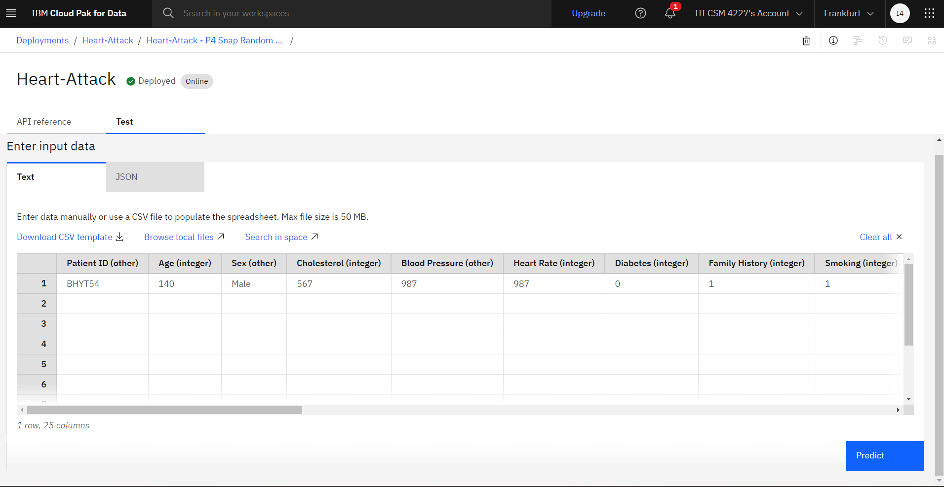
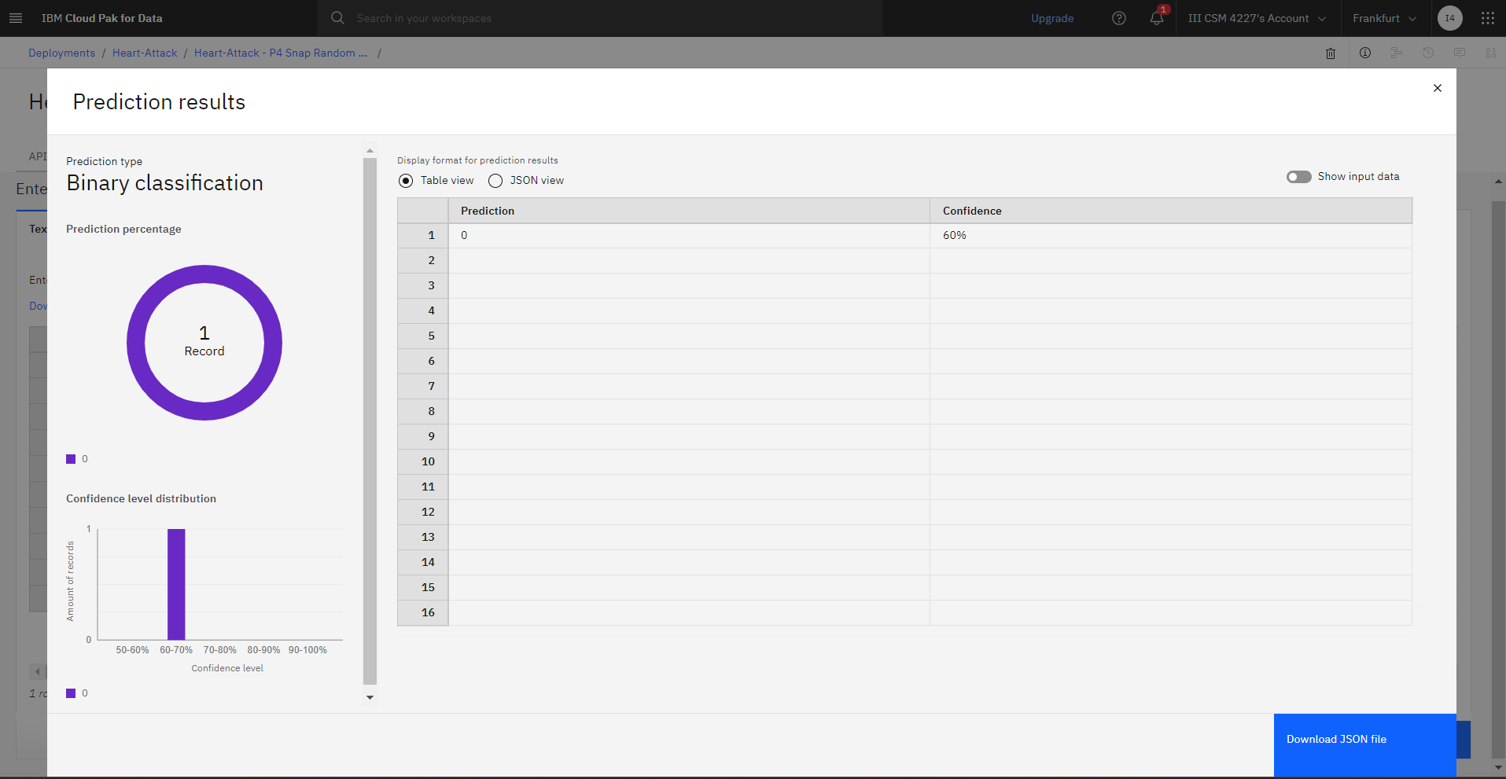
Result
Giving New Values :
Prediction :

Slide 8
Conclusion
The heart attack prediction model, powered by a Logistic Regression algorithm, offers a reliable and interpretable approach to assessing an individual's risk of experiencing a heart attack. By leveraging demographic, clinical, lifestyle, and medical history data, the model provides a probability-based prediction, empowering users and healthcare providers to make informed decisions regarding preventive care.
Ultimately, this approach has the potential to improve early detection, encourage lifestyle adjustments, and facilitate more proactive healthcare management, significantly reducing the overall burden of heart diseases on individuals and the healthcare system. With its scalable, secure deployment, the heart attack prediction solution represents an important step towards personalized, data-driven healthcare.

Slide 9
Future scope
The future scope of heart attack prediction lies in enhancing the model's accuracy and applicability through the integration of advanced machine learning techniques, diverse data sources, and real-time health monitoring from wearable devices. By expanding the predictive capabilities to encompass a wider range of cardiovascular conditions and incorporating personalized health recommendations, the model can provide more tailored care. Additionally, its integration into clinical decision support systems will assist healthcare professionals in diagnosing and managing at-risk patients more effectively. Longitudinal studies will further refine the model's effectiveness, ensuring it remains relevant in promoting cardiovascular health and reducing the incidence of heart diseases in various populations.

Slide 10
References
Krittanawong, C., et al. (2017). "Artificial Intelligence in Cardiology: A Review." The Journal of the American College of Cardiology, 69(21), 2578-2580.
Chung, K. J., et al. (2019). "Prediction of Cardiovascular Events Using Machine Learning and Traditional Risk Factors." Journal of the American Heart Association, 8(14), e012878.
Mahmood, M., et al. (2022). "Heart Disease Prediction Using Hybrid Machine Learning Models: A Review." Health Informatics Journal, 28(2), 14604582221082616.

Slide 11
THANK YOU

